Slide 1
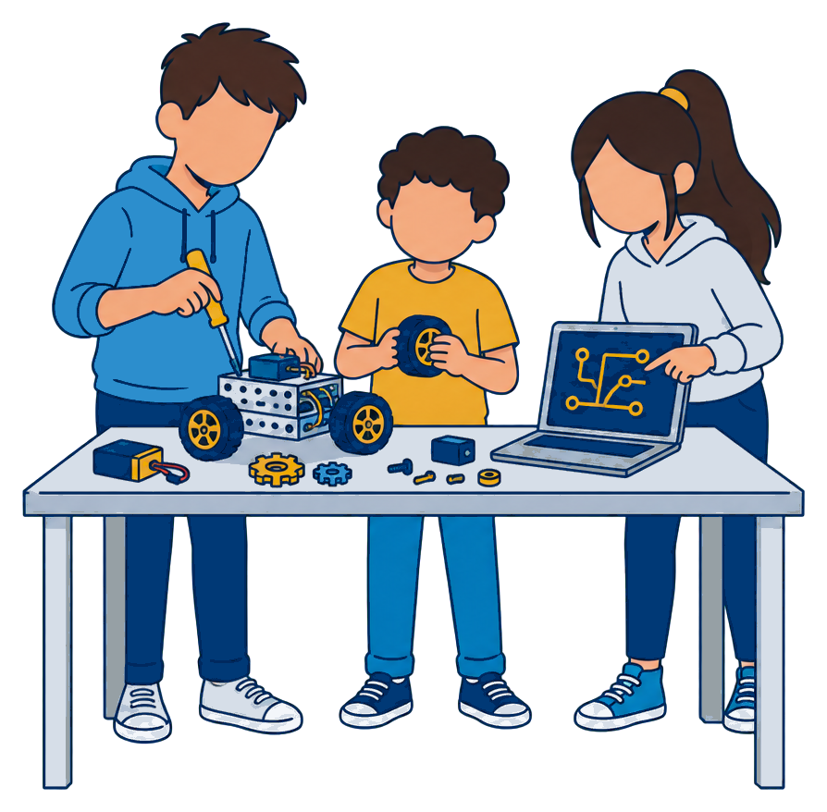
Hands-on Physical AI and Robotics
[DEMO DAY] · [SATURDAY, SEPT. 23, 2026] · [9 A.M.-NOON]
Build, program and drive a robot with Kent State researchers. [One sentence on who this is for and why to come.]
[Saturday, Sept. 23, 2026]
[9 a.m.-noon]
[Check-in from 8:30 a.m.]
[Mathematical Sciences Building], [Room ###]
Kent State University, Kent, Ohio
[Students in grades 6-8] with a parent or guardian
[Free] · [24 places]
FIG. 01 // Illustration, not a lab photo. Replace with a consented event photo.
What you will do
REGISTER
[QR code]
navy on white,
4-module quiet zone
Build a small wheeled robot
Program it in [Python]
Drive a telepresence robot in VR
Sign up by [Sept. 1]
[atr.cs.kent.edu/k12]
Supervised stations; parents and guardians are welcome to stay. Photos only with a signed parent or guardian release.
Questions: [name]@kent.edu
330-672-[xxxx]
Notes:
EVENT FLYER (demo day, open house, K-12 workshop). Replace every [bracketed] placeholder. Character budgets (Source Sans 3; Arial is 8-9% wider): headline two lines of about 18 characters each (about 36 in total, which also holds in Arial) at 48 pt Black; a longer headline shrinks in PowerPoint (44 pt at about 42 characters), so cut words before that. Subhead two lines at 18 pt (about 120 characters). WHEN / WHERE / WHO values: three lines at 13 pt each (about 40 characters per line); keep every value at two or three lines so the three rows share one rhythm. Three activity bullets of one line. Safety line two lines at 9 pt (about 110 characters).
WHERE: the building name is verified (Mathematical Sciences Building); the room number is a placeholder until confirmed.
K-12 pieces speak to parents: grades, dates, cost, location, three bullets of what students do, a safety line, and consented photos only (never name minors). The illustration is a concept image and is captioned as such; a real, consented photo replaces it whenever available (delete the illustration, insert the photo, crop to the mist panel on the layout).
QR code: navy or black on white, 4-module quiet zone, at least 0.8 in, printed with the clean URL. Scan the printed proof with two phones.
Bands, color fields, panels, plates, logos and the footer live on the slide layout (View > Slide Master), so they cannot be dragged by accident. The text boxes are layout placeholders: New Slide > this layout (layouts are named for people: Event flyer, Recruiting flyer, Certificate, One-pager front and so on) gives you every panel and every box with its prompt, and Reset restores a box you moved. Only swappable content (illustrations, icons, the QR box) sits on the slide itself.
Boxes that hold names, titles and headlines have "Shrink text on overflow" turned on: a value longer than the character budget in these notes shrinks instead of running over the next element. Keep inside the budgets so the type stays at or near the design size; Keynote and Google Slides ignore the setting, so shorten the text there.
The hazard band is a bookend on one edge (two on a sign). Never place text or logos over it; keep 0.30 in clear.
Editorial style: "Advanced Telerobotics Research Lab" on first reference, then "the lab"; "Kent State University" first, then "Kent State". No Oxford comma, "and" not "&", dates like "Sept. 23", times like "9 a.m.-noon". Never invent facts: keep the [bracketed] placeholders until you have real values.
Printed pieces that carry Kent State marks add the trademark line in small type (8 pt, the print floor; preferably on the back).
PRINT SPECS. This file is built at trim size. Text, logos and QR codes sit at least 0.25 in inside the trim (0.5 in on most edges).
Bleed: color fields and hazard bands run to the page edge. A contracted Kent State printer that trims from oversized stock needs 0.125 in of bleed on every side: ask the printer to add the bleed from the trim-size PDF (every edge element is flat color or a repeating stripe, so the extension is mechanical). If you have the generator (build/templates-src/print), BLEED=1 builds a version whose fields already extend 0.125 in past the trim.
Export: File > Export > PDF at "Best for printing" (PowerPoint cannot write PDF/X; the printer preflights it). Colour: navy = PMS 281 C / C100 M72 Y0 K38, gold = PMS 124 C / C7 M35 Y100 K0. Never let a default RGB-to-CMYK profile convert the gold.
Logos: the Kent State wordmark in this file (assets/logos/ksu) is a working copy of the old Stacked raster (colors corrected); replace with the official UCM file before public use: swap it on the slide layout (View > Slide Master) with the file from https://www.kent.edu/brand/logos at the same size. Keep it at least 1.05 in wide (so UNIVERSITY is at least 1 in) with K-height clear space and the (R).
Fonts: Source Sans 3, Roboto Slab and Source Code Pro (assets/fonts). Embed fonts before sending the file, or send the PDF. Fallbacks are Arial / Georgia / Courier New and every text box carries about 10% width slack.

Slide 2



Build robots that put people somewhere else
JOIN THE LAB · [FALL 2026] RESEARCH POSITIONS
Undergraduate and graduate research positions in telepresence robotics, tele-embodiment, autonomy and Physical AI at the Advanced Telerobotics Research Lab, Kent State University.
Telepresence robotics
Tele-embodiment
Autonomy and Physical AI
Robots that carry your presence into a distant space.
Interfaces that make a remote body feel like your own.
Shared autonomy that keeps people in the loop.
What we look for
How to apply
Curiosity about robots, VR and AI; no robotics experience needed for undergraduates
Comfort with programming ([Python, C++ or ROS] is a plus)
[8-10] hours a week during the semester
Graduate applicants: a background in [robotics, HRI, vision or machine learning]
Email [name]@kent.edu with your resume and a short note on what you want to build
Open lab hours: [Wednesdays, 3-5 p.m.], [Room ###]
[QR code]
navy on
white,
quiet zone
Or scan to apply online: [atr.cs.kent.edu/join]
[Equal opportunity statement: get the current wording from University Communications and Marketing or the Office of General Counsel before printing.]
Notes:
RECRUITING FLYER ("Join the lab"). Gold top field with the gold/white band carries only the eyebrow and the headline, in navy (white on gold fails contrast). The two signatures share one white row above the footer at equal height (1.01 in, which puts the Kent State wordmark at 1.06 in wide, above its 1.05 in minimum), ATR left and Kent State right, each with its own clear space, like the event flyer's top row; the Kent State wordmark never sits on gold.
Character budgets: headline two lines of about 18 characters each (about 36 in total, which also holds in Arial) at 48 pt Black (longer shrinks to 44 pt in PowerPoint, never a third line on the gold field); subhead three lines at 15 pt across the full width (about 210 characters); card titles two lines at 13 pt (about 40 characters); card bodies two lines at 10.5 pt (about 60 characters); four requirement bullets, at most two of them two lines; each step two lines at 10.5 pt (step 1 about 90 characters, steps 2 and 3 about 55 characters beside the QR code).
The three cards name the lab's research threads. The station plates (01-03) are the only numbering device on the page.
Recruiting pieces: the legacy Kent State equal-opportunity sentence may be out of date. Keep the placeholder until UCM or the Office of General Counsel supplies the current wording; the line holds two lines of 8 pt (about 230 characters), the print floor for fine print.
Bands, color fields, panels, plates, logos and the footer live on the slide layout (View > Slide Master), so they cannot be dragged by accident. The text boxes are layout placeholders: New Slide > this layout (layouts are named for people: Event flyer, Recruiting flyer, Certificate, One-pager front and so on) gives you every panel and every box with its prompt, and Reset restores a box you moved. Only swappable content (illustrations, icons, the QR box) sits on the slide itself.
Boxes that hold names, titles and headlines have "Shrink text on overflow" turned on: a value longer than the character budget in these notes shrinks instead of running over the next element. Keep inside the budgets so the type stays at or near the design size; Keynote and Google Slides ignore the setting, so shorten the text there.
The hazard band is a bookend on one edge (two on a sign). Never place text or logos over it; keep 0.30 in clear.
Editorial style: "Advanced Telerobotics Research Lab" on first reference, then "the lab"; "Kent State University" first, then "Kent State". No Oxford comma, "and" not "&", dates like "Sept. 23", times like "9 a.m.-noon". Never invent facts: keep the [bracketed] placeholders until you have real values.
Printed pieces that carry Kent State marks add the trademark line in small type (8 pt, the print floor; preferably on the back).
PRINT SPECS. This file is built at trim size. Text, logos and QR codes sit at least 0.25 in inside the trim (0.5 in on most edges).
Bleed: color fields and hazard bands run to the page edge. A contracted Kent State printer that trims from oversized stock needs 0.125 in of bleed on every side: ask the printer to add the bleed from the trim-size PDF (every edge element is flat color or a repeating stripe, so the extension is mechanical). If you have the generator (build/templates-src/print), BLEED=1 builds a version whose fields already extend 0.125 in past the trim.
Export: File > Export > PDF at "Best for printing" (PowerPoint cannot write PDF/X; the printer preflights it). Colour: navy = PMS 281 C / C100 M72 Y0 K38, gold = PMS 124 C / C7 M35 Y100 K0. Never let a default RGB-to-CMYK profile convert the gold.
Logos: the Kent State wordmark in this file (assets/logos/ksu) is a working copy of the old Stacked raster (colors corrected); replace with the official UCM file before public use: swap it on the slide layout (View > Slide Master) with the file from https://www.kent.edu/brand/logos at the same size. Keep it at least 1.05 in wide (so UNIVERSITY is at least 1 in) with K-height clear space and the (R).
Fonts: Source Sans 3, Roboto Slab and Source Code Pro (assets/fonts). Embed fonts before sending the file, or send the PDF. Fallbacks are Arial / Georgia / Courier New and every text box carries about 10% width slack.

