Slide 1
Immersive Teleoperation for Physical AI
[EVENT OR VENUE] · [SEPT. 23, 2026]
[Subtitle: one line on the contribution of this talk]
[Presenter Name], [Title or degree program]
Notes:
ATR - Title. Use once, as the first slide. Replace the four bracketed placeholders; the affiliation lines, the two signatures (ATR lockup and the Kent State academic wordmark, equal height, 0.30 in above the band) and the hazard band are fixed on the layout, and every text box ends at least 0.32 in (the lockup clear space) above the logos. Title budget: two lines of about 22 characters at 44 pt (44 in all); 40 pt holds 48, 36 pt holds 52; shorten anything longer. Subtitle: one line of about 50 characters. Dates in AP style (Sept. 23, 2026). Never put text over the band or inside the logo clear space. The constellation at right is brand geometry, not decoration to move. The Kent State wordmark on this layout is a working copy of the old Stacked raster (colors corrected to 003976 and EFAB00, 1.06 in wide); the official file from University Communications and Marketing (kent.edu/brand/logos) must replace it on the layout before public use.

Slide 2
Gesture-Enabled Telepresence Robot
[COURSE OR REPORT] · [SPRING 2027]
[Project report, lecture handout or poster talk]
[Author Names]
Notes:
ATR - Title (Light). The print-friendly cover: white field, navy type, gold/white band on the bottom edge, navy ATR lockup and the color Kent State wordmark. Use it for handouts, lecture decks and anything that will be printed; keep the navy Title for projected talks. Same text rules as the navy title. The color Kent State wordmark is a working copy of the old Stacked raster (colors corrected); replace it on the layout with the official file from University Communications and Marketing (kent.edu/brand/logos) before public use.

Slide 3
Agenda
TALK OUTLINE
Where the lab is going
T+00
ABOUT THE LAB
Exploring the frontiers of telepresence robotics, tele-embodiment, autonomy and artificial intelligence.
  atr.cs.kent.edu
Immersive teleoperation
T+05
Tele-embodiment
T+15
Results
T+25
What is next
T+35
Notes:
ATR - Agenda. Five numbered station plates at a 0.74 in pitch; the plate numbers are the section numbers reused on every divider and eyebrow. Each row is its own placeholder (Item 1 to Item 5, one line of about 24 characters, centred on its plate): a long title wraps on its own row and shrinks in PowerPoint instead of pushing the other rows off their plates. The Timing placeholders (T+MM, mono bronze) are optional: delete them for untimed talks. The navy panel is a placeholder with 0.26 in insets: keep the lab description (its own words, shortened) with the website as a level-2 (Tab) mono gold line, or type a session card as label (Tab) / value pairs (SESSION, DATE, DURATION, SPEAKER), or delete the panel for a plain agenda.

Slide 4
Immersive teleoperation
02
Immersed Pilot Training Simulator and the telepresence robot
Notes:
ATR - Section Divider. Gold field, gold/white hazard band on the top edge, navy station plate with the numeral centred in it. The plate number is the one thing to edit on the plate; it must match the agenda and the eyebrows that follow. Title 44 pt navy (two lines of about 18 characters), subtitle 20 pt ink (two lines) at a fixed 3.32 in (drag it up to about 2.65 in under a one-line title). Text boxes end at 7.05 in; the navy constellation starts at 7.6 in and nothing is clipped by the slide edge. Never white text on gold (2.0:1). No Kent State wordmark on gold: Kent State is named in the footer of every content slide.

Slide 5
Tele-embodiment
03
01 Where the lab is going
02 Immersive teleoperation
03 Tele-embodiment
04 Results
05 What is next
Gesture-Enabled Telepresence Robot
Notes:
ATR - Section Divider (Outline). The alternative divider for talks with four or more sections: the mini table of contents at right replaces the art, so the audience sees where they are. Title 40 pt (two lines of about 16 characters in the 4.4 in box; a longer single word drops to 36 pt). One paragraph per section, typed as the number, a Tab and the title; bold the current section. Navy only on gold. Same plate rule as the primary divider.

Slide 6
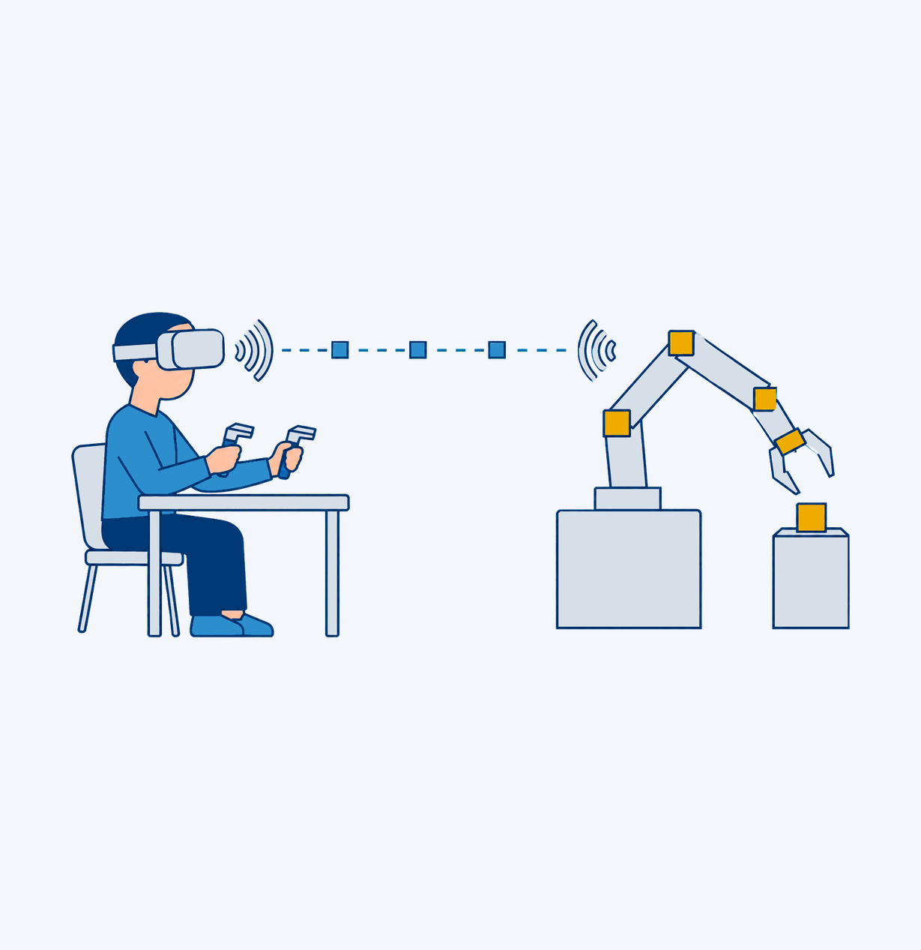
Keep titles to one line, sentence case
SECTION 01 · HOW TO USE THIS TEMPLATE
Six one-line bullets fit; more than that, split
Body is 18 pt Source Sans 3 ink, left aligned
Press Tab for a 16 pt slate sub-point
  Sub-points carry detail, not a new argument
One gold accent per white slide: the plate
AP dates (Sept. 23, 2026), no Oxford comma
Notes:
ATR - Title + Content. The everyday slide: one-line title (about 38 characters at 32 pt; 39 to 44 characters at 28 pt; longer titles use the Two-line title layout), a 5.5 in bulleted body and a 3.2 in figure slot on mist at right. Body: 18 pt with triangle bullets, 24 pt line spacing, 8 pt after each bullet; six one-line (about 46 characters) or four two-line bullets fill the 3.30 in content zone with 0.30 in clear above the footer rule. Tab makes a 16 pt slate sub-point. Put a figure, plot, photo or icon in the slot (illustrations and icons composed on a mist panel, as here); delete the slot on a text-only slide, which is forgettable anyway.

Slide 7
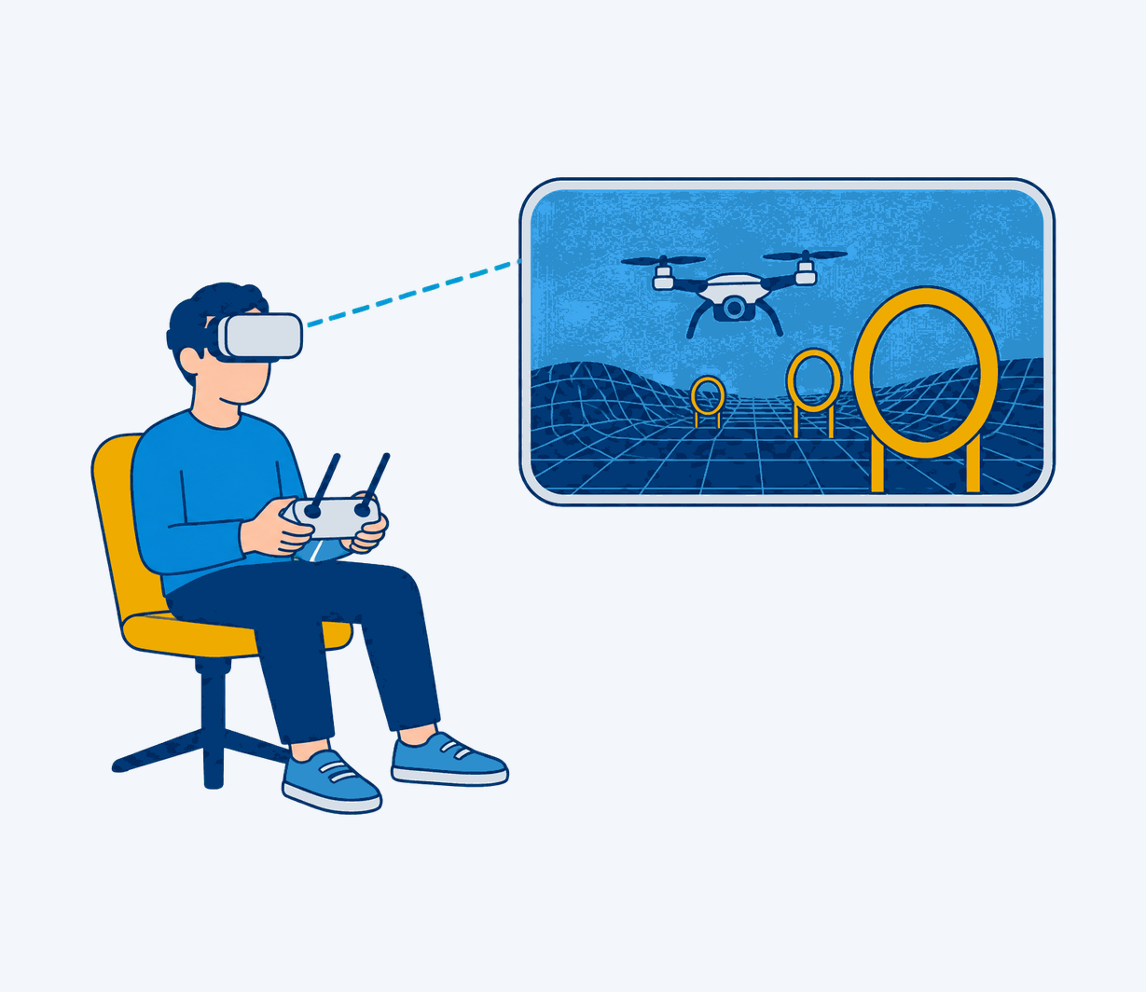
Results: task completion time by interface
SECTION 04 · RESULTS
Gestures cut mean task time by 44 percent
VR controllers: second fastest, most workload
Latency above 120 ms cancelled the gain
  Example findings, n = [N]
Notes:
ATR - Title + Content (Two-line title). The same slide with a two-line title box (1.05 in) and the content top at 1.95 in, for research titles of 39 to 76 characters ("Results: task completion time by interface" is 42 characters and 8.3 in wide at 32 pt, so it wraps). The body loses 0.53 in: five one-line or three two-line bullets. Everything else follows Title + Content.

Slide 8
Compare two things side by side
SECTION 04 · RESULTS
Baseline: keyboard and mouse
Proposed: gesture control
Operator watches a monitor
Camera view is fixed
Mean task time [84 s], example data
Two hands, six degrees of freedom
Operator wears a VR headset
Head motion steers the camera
Mean task time [47 s], example data
Gestures map directly to the gripper
Notes:
ATR - Two Content. Two 4.35 in columns for a comparison (baseline vs proposed, before vs after, pros vs cons) or two parallel lists. Each column has a 22 pt navy heading (one line, about 30 characters) and an 18 pt bulleted body: five one-line or three two-line bullets per column. Keep the columns parallel: same number of bullets, same order of ideas. Bracketed numbers are placeholders; replace them with measured values and state n.

Slide 9
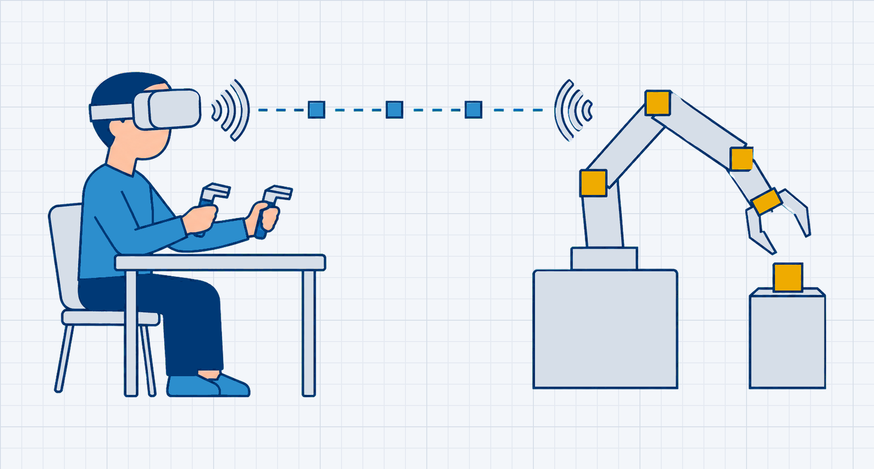
Operator, network, robot
SECTION 02 · IMMERSIVE TELEOPERATION
One control loop across two places
The operator sees through the robot’s cameras in VR
Controllers and gestures map to robot motion
Feedback closes the loop over the network
FIG. 01 // Operator, network and robot arm. Concept illustration, not lab hardware
Notes:
ATR - Content + Image. Text column (22 pt lead statement, up to three two-line bullets) beside a 5.125 x 2.75 in figure frame. Illustrations and plots sit on the mist graph paper; photos fill the frame edge to edge (the placeholder crops to fill, so export figures at that aspect). Caption in mono: "FIG. NN // ..." in two lines at most. Integrity rule: an AI-generated image is captioned "Concept illustration, not lab hardware" and is replaced by a real lab photo whenever one exists. The bullets end 0.30 in above the footer rule; if the lead statement wraps to two lines, keep three bullets.

Slide 10
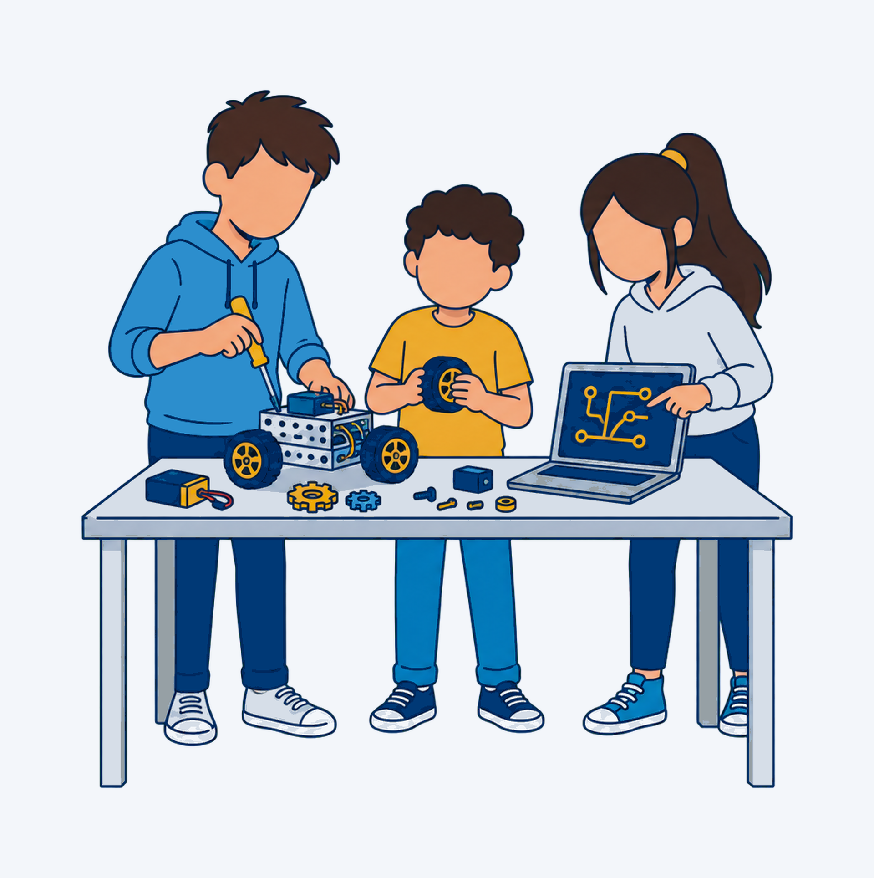
K-12 programs in the lab
OUTREACH
Summer internship for high school students
Summer workshop for middle school students
Hands-on Physical AI and robotics
FIG. 02 // Concept illustration, not a lab photo.
Notes:
ATR - Full-Bleed Image. The photo fills the right half from the top edge to the footer rule (5.0 x 5.02 in, cropped to fill). The left column keeps the plate, a two-line 32 pt title (about 16 characters per line), three bullets and a mono FIG. caption with the credit and date. The eyebrow here is the section NAME only (OUTREACH, IMMERSIVE TELEOPERATION): the 3.4 in column cannot hold the usual "SECTION NN · NAME" form. Use a real lab photo whenever one exists; the concept illustration shown here is a stand-in and is captioned as such. If text must sit on the photo, add a navy scrim at 60 percent behind it.

Slide 11



Three research threads
SECTION 01 · THE LAB
Telepresence robotics
Tele-embodiment
Autonomy and Physical AI
Robots that carry your presence into a distant space.
Interfaces that make a distant body your own.
Shared autonomy that keeps people in the loop.
Notes:
ATR - Three Icon Columns. Three mist cards on the 12-column grid (2.80 in each, 0.30 in gutters). Each card: a navy icon from assets/icons/png (never gold on mist, never the ATR mark in an icon row), a 20 pt navy heading (two lines maximum) and up to three lines of 18 pt body without bullets. One icon color per surface. The cards are not numbered: the agenda plates already number the talk, and one numbering device per deck is enough.

Slide 12
Carry your presence into a distant space, with a person always in the loop.
KEY TAKEAWAY
[Speaker or source], [year]
Notes:
ATR - Statement. A navy pause between white slides: one sentence at 40 pt white (three lines of about 30 characters), a gold eyebrow (KEY TAKEAWAY, QUOTE, IN ONE SENTENCE) and an attribution line. Type quotation marks as part of the text when quoting. Use at most one or two per talk; the hazard band on the bottom edge is the same bookend device as the title slide.

Slide 13
Results at a glance
SECTION 04 · RESULTS
TASK TIME
PARTICIPANTS
LATENCY
[44%]
[24]
[38]
less task time with gestures than keyboard and mouse
within-subjects study, four tasks per interface
ms median round trip, controller to gripper
Notes:
ATR - Key Numbers. Three mist panels: a tracked bronze label, a Roboto Slab 52 pt navy numeral (up to seven characters with the unit) and an 18 pt description that says what was measured, against what, and n. The slate brackets around each numeral mark placeholder data: remove them only when the value is real and sourced. No gold here; the header plate is the slide’s one gold accent.

Slide 14
Task completion time by interface
SECTION 04 · RESULTS
44%
less time per task with gestures than keyboard and mouse
EXAMPLE FIGURE
SOURCE // Example data, n = [N], lower is better
Notes:
ATR - Chart + Takeaway. One result per slide. The chart is native (editable in PowerPoint): navy bars, one gold bar for the bar the story is about, direct value labels with units, no gridlines, no legend for a single series, categories top to bottom. Every gold bar carries a label because gold on white is only 2.0:1. The mono SOURCE line states the study, n, units and direction. The navy callout holds the headline number in Roboto Slab gold; the mono flag says EXAMPLE FIGURE until the data are real. Multi-series charts: legend at top, value gridlines E6EBF1, categorical order navy, gold, sky, brick, teal, orange, plum, green.

Slide 15
Milestones and status
SECTION 05 · PLAN
Milestone | Owner | Due | Status
Requirements and study protocol | [Name] | 2026-10-15 | Complete
Prototype: gesture mapping | [Name] | 2026-12-01 | On track
User study, n = [N] | [Name] | 2027-02-15 | At risk
Analysis and paper draft | [Name] | 2027-04-01 | Late
Submission to [Venue] | [Name] | 2027-05-15 | Not started
!
x
Notes:
ATR - Table. Native table (editable): navy header row with white bold 16 pt, ink 16 pt body, 0.75 pt D6DEE8 rules under each row and no vertical lines. Never apply the gold Accent-2 table style (white on gold fails contrast). Dates in mono. Milestone status uses shape + label + color so nothing depends on color alone: filled navy triangle = complete, green circle = on track, amber diamond with ! = at risk, red square with x = late, hollow gray triangle = not started. The markers are 0.28 in shapes in the Status column (token fills and outlines from assets/tokens/colors.json), one per 0.48 in row, and the label is typed in the cell with a 0.5 in left inset: to add a row, copy a marker and move it 0.48 in down. If you type the glyph instead, use the dark status text colours (navy, 137738, 915109, A21921, 616F7E), because the marker fills are too light for 16 pt text on white. Six body rows maximum; more rows, more slides.

Slide 16
Project timeline
SECTION 05 · PLAN
2026-01
2026-04
2026-07
2026-10
2027-01
Kickoff
  Protocol and hardware
Prototype
  Gesture mapping v1
User study
  n = [N], four tasks
Analysis
  Task time, workload
Publication
  [Venue] submission
Notes:
ATR - Timeline. Five navy station plates on a hairline at y 2.60 in. Above each plate a mono date (ISO 2026-04 or AP Sept. 23, 2026), below it a bold 18 pt navy label and, after a Tab, a 16 pt slate detail line. Fill the stations left to right and leave unused ones empty. For more than five steps, use two slides or the Table layout.

Slide 17

Team
SECTION 01 · THE LAB
Dr. Jong-Hoon Kim
  Lab director
[Name Surname]
  [Ph.D. student]
[Name Surname]
  [Ph.D. student]
[Name Surname]
  [M.S. student]
[Name Surname]
  [M.S. student]
[Name Surname]
  [Undergrad researcher]
[Name Surname]
  [Undergrad researcher]
[Name Surname]
  [Visiting scholar]
Notes:
ATR - Team. Four by two grid: 0.95 in square photo placeholders (cropped to fill), a bold 16 pt navy name (paragraph 1) and the role as a LEVEL-2 paragraph (Tab in PowerPoint, paragraph.level = 1 in python-pptx): regular 14 pt slate, about 22 characters. A role left at level 1 is bold 16 pt and "Undergraduate researcher" then wraps into the footer. Real photos and real names only; the mist stand-ins mark empty cells. Leave unused cells empty rather than shrinking the grid. The director is listed as verified on the lab website; confirm titles before presenting.

Slide 18
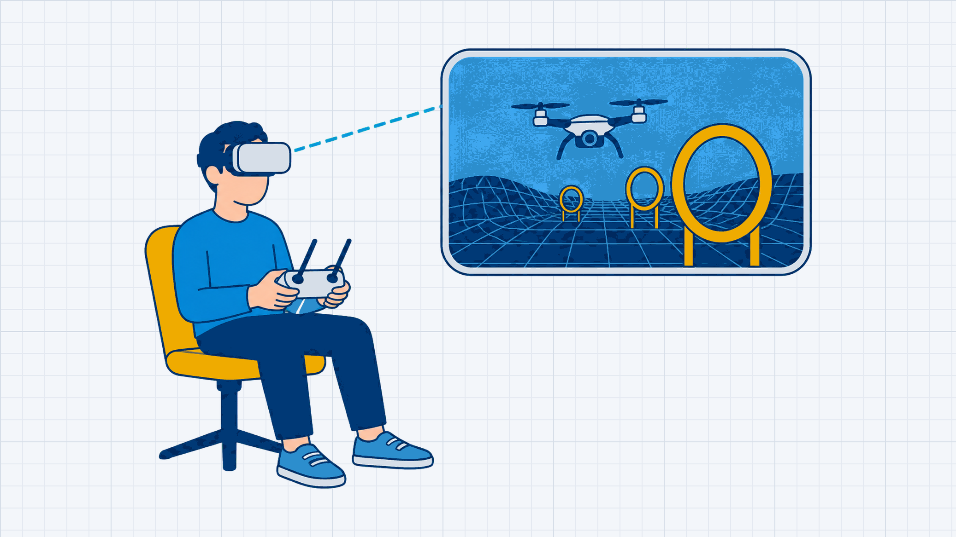
Demo: immersive pilot training
SECTION 03 · TELE-EMBODIMENT
Head motion steers the camera view
Gates show the training course
Watch the latency readout at 0:42
Concept illustration as poster frame
DEMO // [Title], [mm:ss], [Mon. D, YYYY]
Notes:
ATR - Video. Insert the video into the media placeholder (Insert > Video > This Device, or paste a link) at 16:9; the placeholder is 5.4 x 3.04 in. Set it to start on click and test the audio path before the talk. The mono caption states the title, duration and recording date. The right column lists what to watch for so the audience knows where to look. The poster frame shown here is a concept illustration, not a lab recording; replace it with the real video or its first frame.

Slide 19
References
REFERENCES
[1] [Author, A. and Author, B.] [Title of the paper]. In [Proceedings or journal], [year]. [DOI or URL]
[2] [Author, A. and Author, B.] [Title of the paper]. In [Proceedings or journal], [year]. [DOI or URL]
[3] [Author, A. and Author, B.] [Title of the paper]. In [Proceedings or journal], [year]. [DOI or URL]
[4] [Author, A. and Author, B.] [Title of the paper]. In [Proceedings or journal], [year]. [DOI or URL]
[5] [Author, A. and Author, B.] [Title of the paper]. In [Proceedings or journal], [year]. [DOI or URL]
Notes:
ATR - References. One paragraph per reference: "[n]", Tab, then the reference in the venue’s style; 16 pt ink with a hanging indent. Eight entries of two lines fit; more than that, use a second References slide rather than smaller type. Only real, checked citations: the lab’s own publications are listed at atr.cs.kent.edu.

Slide 20

Acknowledgements and funding
ACKNOWLEDGEMENTS
This work was supported by [Sponsor] under [Grant No.]. We thank [collaborators] for [contribution] and the students of [program].
[Sponsor]
[Grant No.]
[Sponsor]
[Grant No.]
[Sponsor]
[Grant No.]
[Sponsor]
[Grant No.]
Notes:
ATR - Acknowledgements. The funding statement (18 pt, two lines of about 70 characters) names each sponsor and grant number exactly as the award letter does. Four logo frames sit on mist panels with a 0.2 in inset; drop the sponsor-supplied logo file into each frame (it is fitted, not stretched) and put the sponsor name (paragraph 1) and grant number (paragraph 2) in the 14 pt caption below: three lines in all, about 22 characters per line ("National Science Foundation" takes two, plus the grant line). Never invent sponsors, grant numbers or collaborators; with fewer sponsors leave the spare panels and captions empty.

Slide 21
Thank you
[Presenter Name]
[presenter@kent.edu]
Questions and collaboration welcome.
Notes:
ATR - Thank You. Closing bookend: hazard band on the top edge, "Thank you" in Source Sans 3 Black 60, presenter and email, one closing line. The address, the FIND THE LAB grid (atr.cs.kent.edu, atrlab.kent@gmail.com, @atrlab_kent on X, github.com/ATR-Lab) and the signature row are fixed on the layout and verified; the handle printed in the old template footer does not exist and must not come back. Edit the grid on the layout only if the lab’s contacts change. The white Kent State wordmark is a working copy of the old Stacked raster (colors corrected); the official file from University Communications and Marketing (kent.edu/brand/logos) must replace it on the layout before public use.

Slide 22

Blank branded canvas
Plate, footer rule, footer text and slide number only. Draw diagrams, embed content or place one large figure inside x 0.5 to 9.5 in and y 1.42 to 4.72 in, with at most one gold accent.
Notes:
ATR - Blank Branded. A white canvas with only the header plate, footer rule, footer text and slide number. Use it for custom diagrams, embedded content or one very large figure. Keep everything inside the live area (x 0.5 to 9.5 in, y 1.42 to 4.72 in), use navy for line work, mist for panels and at most one gold accent. This example text box is ordinary content, not a placeholder.

