Slide 1
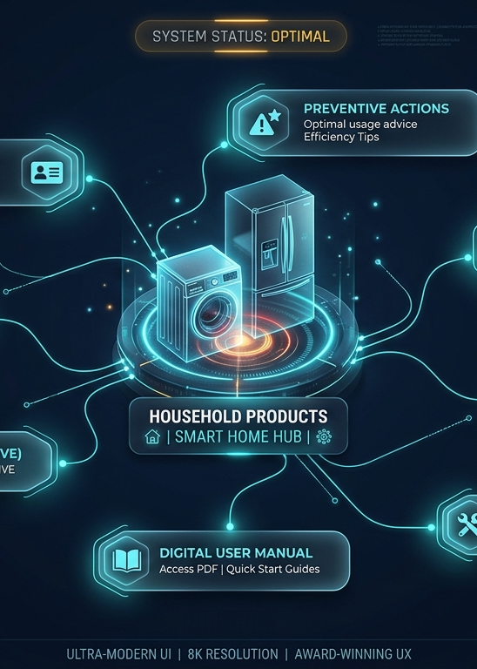
IQOO HACKATHON 2026 / AI TRACK
Your home has memory.
It just needs a system.
Verid connects products, invoices, manuals, and maintenance into a private household intelligence layer.
Verified ownership
Actionable care
Private AI
A working product for the moment homeowners need it most: when something breaks, expires, or gets forgotten.
VERID / HOUSEHOLD INTELLIGENCE OS
01
Notes:
Source: PROJECT_DOCUMENTATION.md, Team Verid, iQOO Hackathon 2026. Project screenshots are supplied by the team.

Slide 2
THE HOUSEHOLD OWNERSHIP GAP
A product’s history disappears the moment it enters the home
Documents, hardware evidence, and service events live apart. That makes a simple warranty claim or maintenance decision unnecessarily hard.
01
02
03
Proof is scattered
Care arrives too late
Files cannot answer
Invoices sit in chat threads, folders, and drawers while model and serial details fade from view.
Warranty deadlines, filters, cleaning, and service history surface only after a failure.
A storage folder cannot connect a real appliance to evidence, a manual, and the next action.
The missed opportunity: turn ownership records into a reliable, usable household memory.
VERID / HOUSEHOLD INTELLIGENCE OS
02
Notes:
Source: PROJECT_DOCUMENTATION.md, Team Verid, iQOO Hackathon 2026. Project screenshots are supplied by the team.

Slide 3
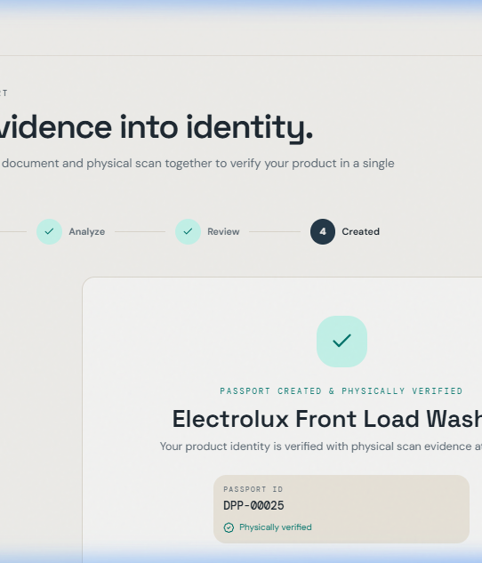
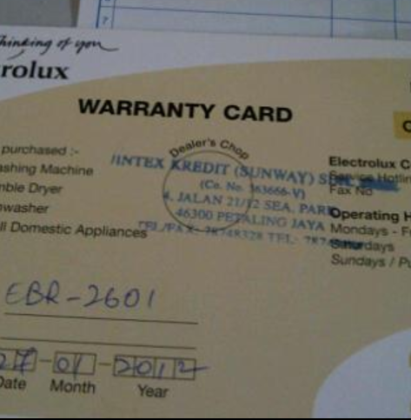
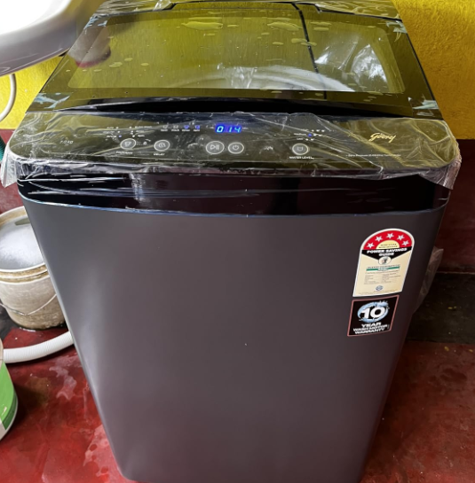
THE CORE PRODUCT
One verified passport for every important product
Verid pairs commercial evidence with a real product photo before it creates a household record.
RapidOCR
+ YOLO
+
Extracts facts
Checks the physical object
DOCUMENT
EVIDENCE
HARDWARE
EVIDENCE
A durable record with evidence, identity, warranty, manual, service history, and next actions.
VERID / HOUSEHOLD INTELLIGENCE OS
03
Notes:
Source: PROJECT_DOCUMENTATION.md, Team Verid, iQOO Hackathon 2026. Project screenshots are supplied by the team.

Slide 4
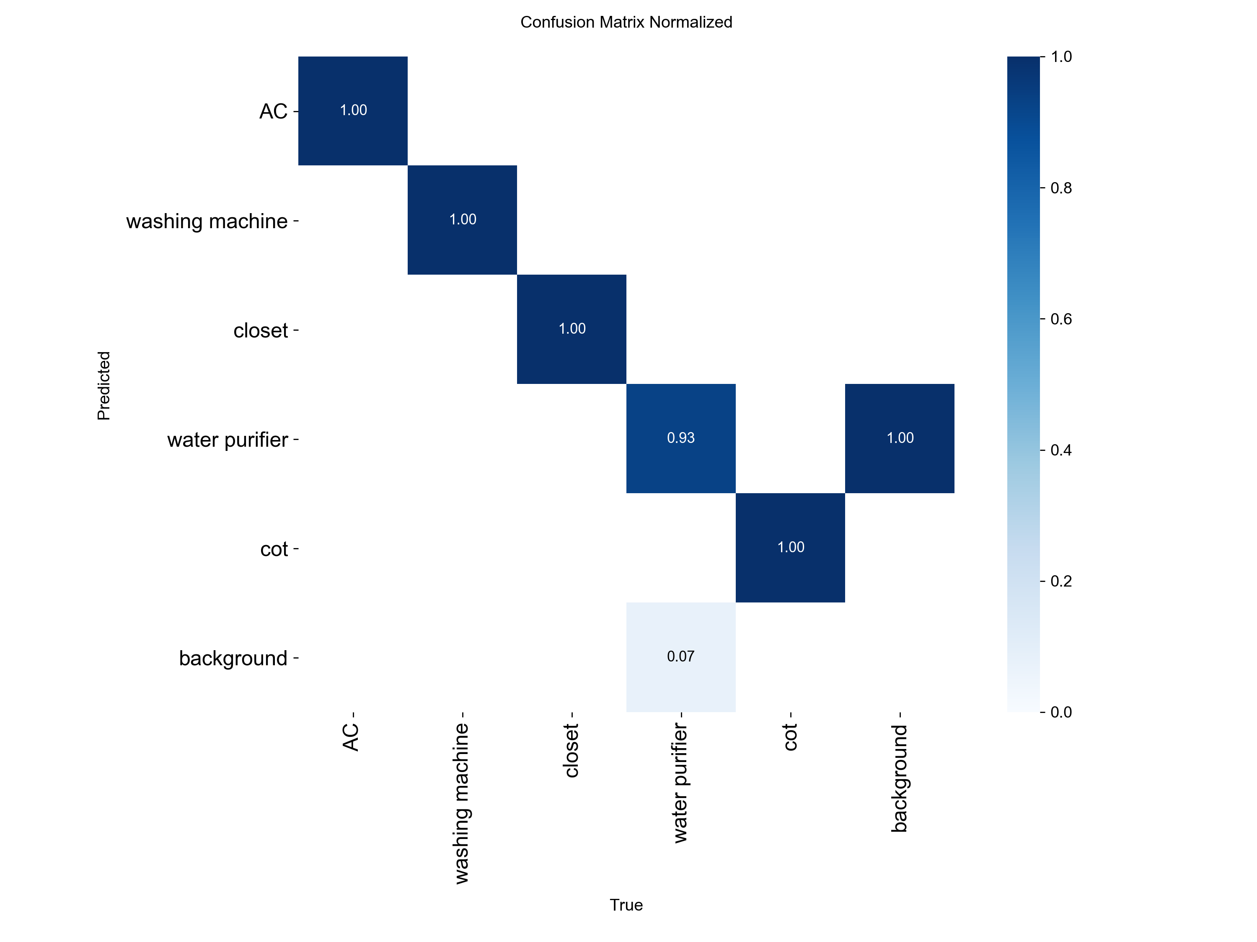
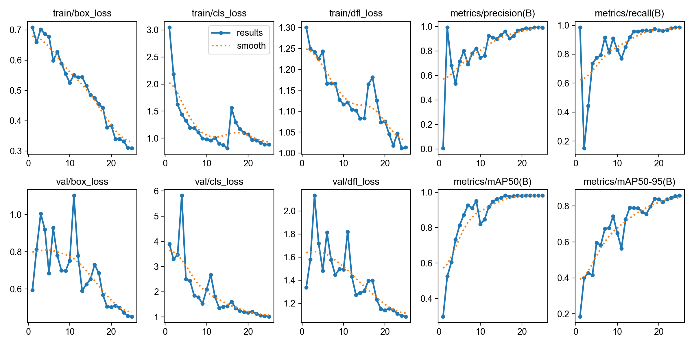
COMPUTER VISION PROOF
The vision model recognizes the physical side of ownership
A custom YOLOv8n detector identifies five household classes from real images, then connects the result to the relevant passport.
99.29%
98.10%
69-97 ms
Precision on the validation split
mAP@50 across five target classes
Per-image CPU inference latency
Target classes
AC
Washing machine
Closet
Water purifier
Cot
VERID / HOUSEHOLD INTELLIGENCE OS
04
Notes:
Source: PROJECT_DOCUMENTATION.md, Team Verid, iQOO Hackathon 2026. Project screenshots are supplied by the team.

Slide 5
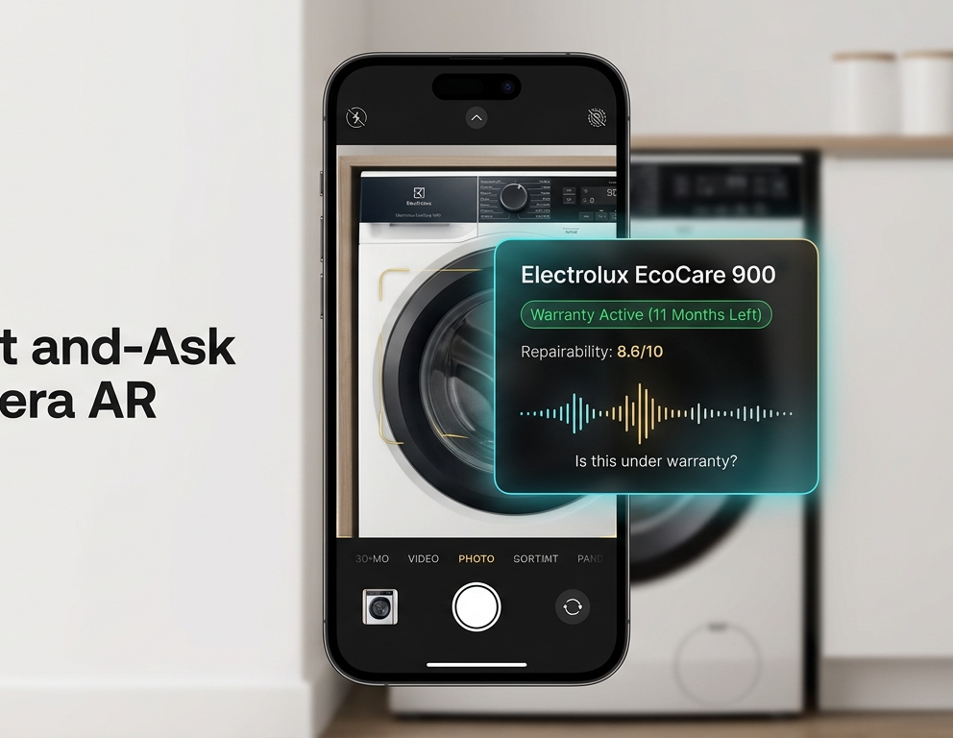
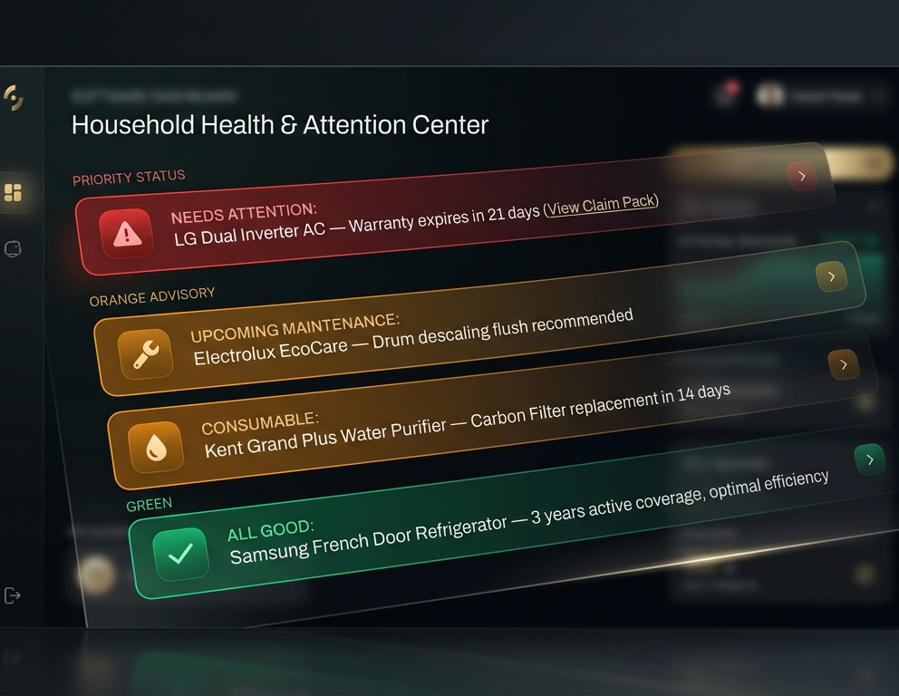
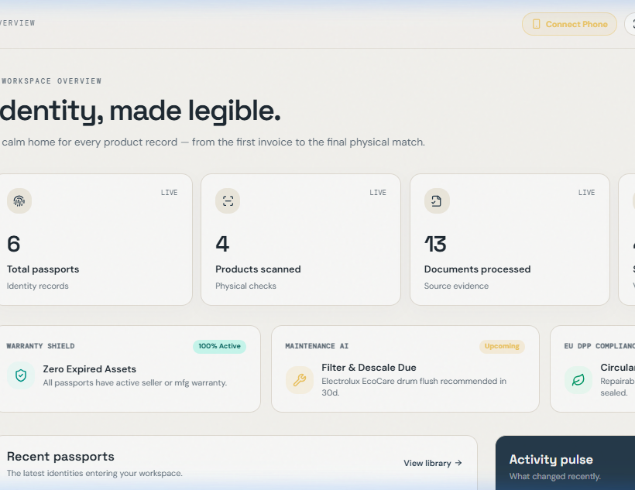
THE DAILY EXPERIENCE
Point. Ask. Act.
A household record is only useful when it answers a question in the moment.
See the appliance
Find what needs attention
Ask the whole house
“When does my washing machine warranty expire?”
VERID / HOUSEHOLD INTELLIGENCE OS
05
Notes:
Source: PROJECT_DOCUMENTATION.md, Team Verid, iQOO Hackathon 2026. Project screenshots are supplied by the team.

Slide 6
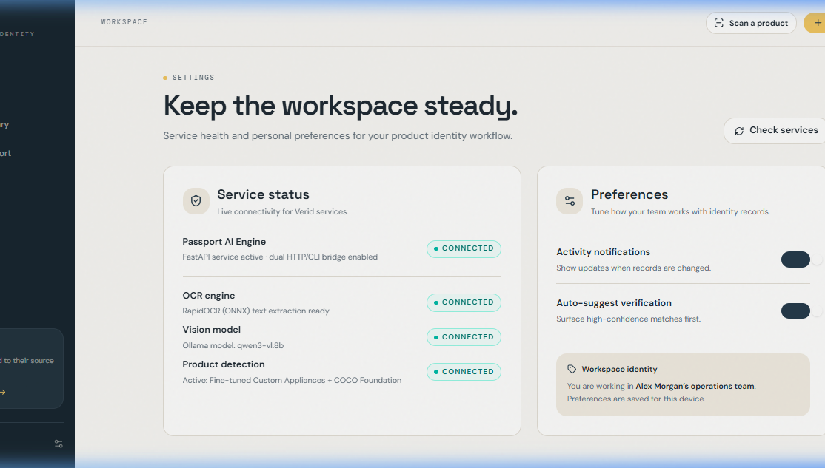
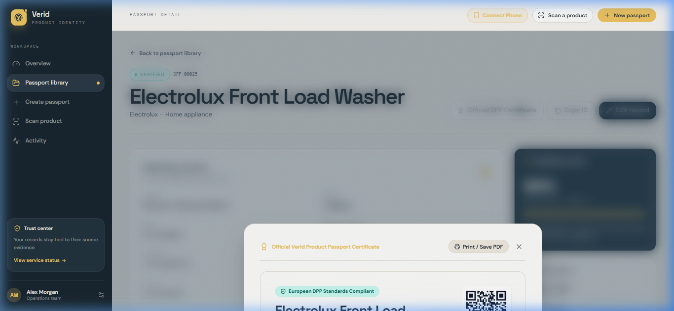
TRUST IS A PRODUCT FEATURE
Every answer carries its evidence
Verid shows the answer, why it reached it, and the source record. When the system cannot verify a detail, it says so.
Evidence
Invoice, product photo, manual, service log
Reasoning
A plain-language explanation for each result
Provenance
Traceable source record and confidence check
Offline mode keeps household data local while the system processes documents and answers questions.
VERID / HOUSEHOLD INTELLIGENCE OS
06
Notes:
Source: PROJECT_DOCUMENTATION.md, Team Verid, iQOO Hackathon 2026. Project screenshots are supplied by the team.

Slide 7
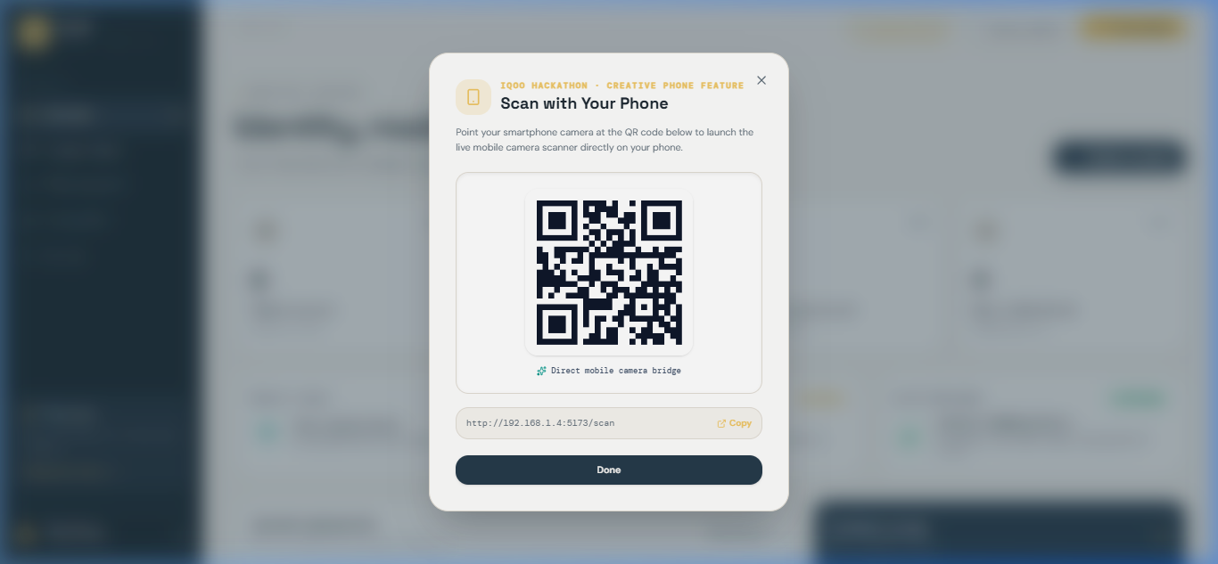
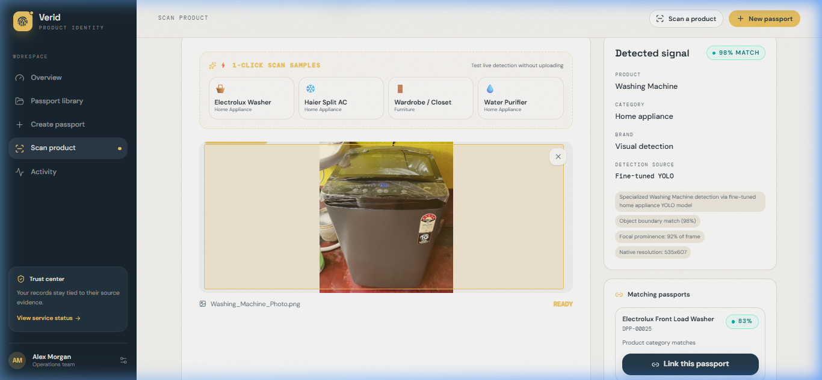
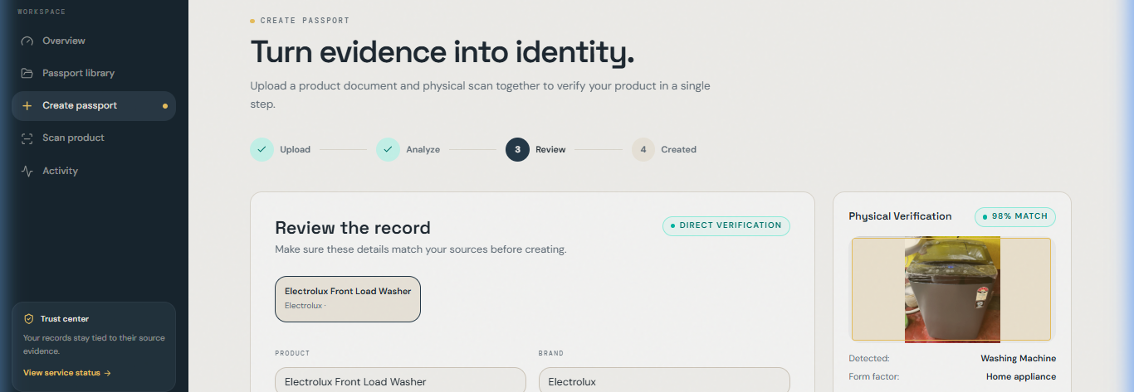
LIVE DEMO
Three minutes to show the complete loop
The demo makes the product tangible: capture evidence, recognize the appliance, prove the passport, then trigger an action.
01
02
03
04
Connect a phone
Point at a product
Inspect the proof
Take the next action
Scan the local QR bridge and open the live camera, with no app installation.
The detector recognizes the appliance and retrieves its linked household passport.
Show the evidence-backed record, warranty status, and source documents.
Surface a maintenance alert or prepare a complete warranty claim pack.
VERID / HOUSEHOLD INTELLIGENCE OS
07
Notes:
Source: PROJECT_DOCUMENTATION.md, Team Verid, iQOO Hackathon 2026. Project screenshots are supplied by the team.

Slide 8
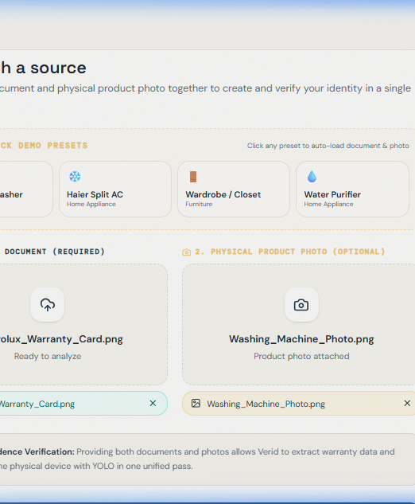
WHY VERID
A real household system,
not another document folder.
Verid combines working vision, document intelligence, grounded assistance, and on-device privacy into one connected experience.
Working demo
Verified ML
Phone-first scanner, product passport, attention center
98.10% mAP@50 on the supplied validation split
Team Verid / Ready to show the household intelligence loop live
VERID / HOUSEHOLD INTELLIGENCE OS
08
Notes:
Source: PROJECT_DOCUMENTATION.md, Team Verid, iQOO Hackathon 2026. Project screenshots are supplied by the team.

