Slide 1
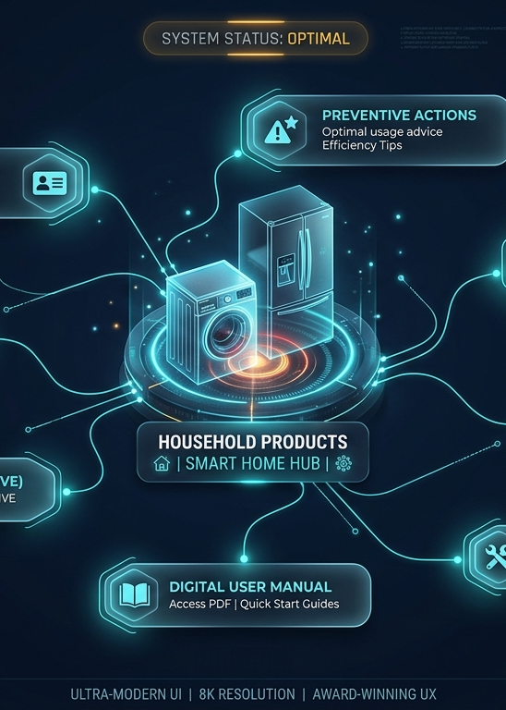
IQOO HACKATHON 2026 / AI TRACK
A household assistant
that knows your home.
Verid brings live camera understanding, product records, and household context together on a mobile-first experience.
Live video conversation
Household graph awareness
Built for mobile
A working product for the moment homeowners need context: when something breaks, expires, or gets forgotten.
VERID / HOUSEHOLD INTELLIGENCE OS
01
Notes:
Source: PROJECT_DOCUMENTATION.md, Team Verid, iQOO Hackathon 2026. Project screenshots are supplied by the team.

Slide 2
THE HOUSEHOLD OWNERSHIP GAP
A product’s history disappears the moment it enters the home
Documents, hardware evidence, and service events live apart. That makes a simple warranty claim or maintenance decision unnecessarily hard.
01
02
03
Proof is scattered
Care arrives too late
Files cannot answer
Invoices sit in chat threads, folders, and drawers while model and serial details fade from view.
Warranty deadlines, filters, cleaning, and service history surface only after a failure.
A storage folder cannot connect a real appliance to evidence, a manual, and the next action.
The missed opportunity: turn ownership records into a reliable, usable household memory.
VERID / HOUSEHOLD INTELLIGENCE OS
02
Notes:
Source: PROJECT_DOCUMENTATION.md, Team Verid, iQOO Hackathon 2026. Project screenshots are supplied by the team.

Slide 3
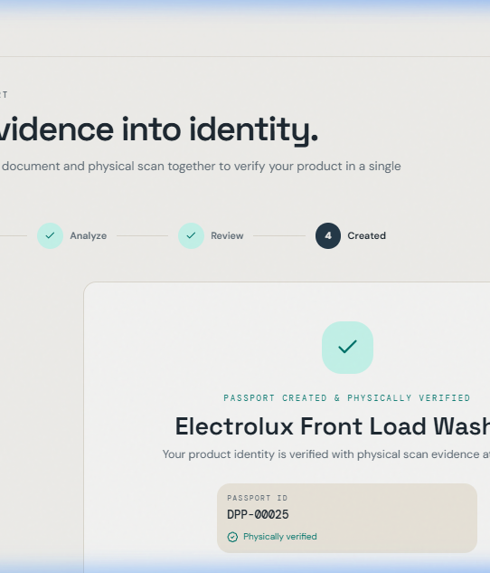
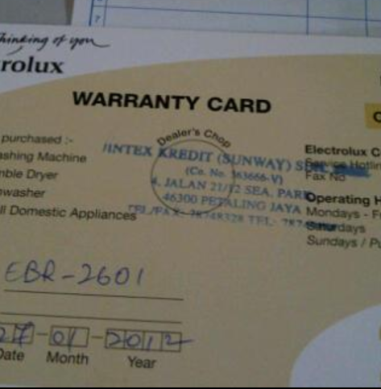
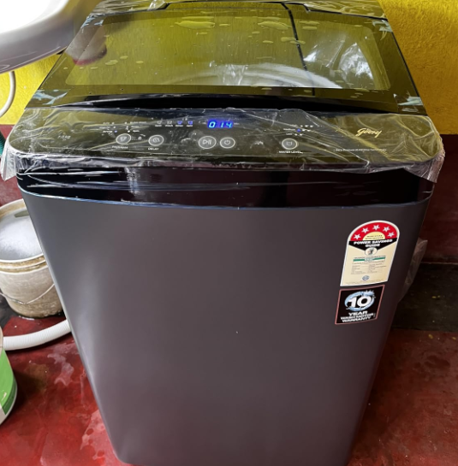
THE CORE PRODUCT
One verified passport for every important product
Verid pairs commercial evidence with a real product photo before it creates a household record.
RapidOCR
+ YOLO
+
Extracts facts
Checks the physical object
DOCUMENT
EVIDENCE
HARDWARE
EVIDENCE
A durable record with evidence, identity, warranty, manual, service history, and next actions.
VERID / HOUSEHOLD INTELLIGENCE OS
03
Notes:
Source: PROJECT_DOCUMENTATION.md, Team Verid, iQOO Hackathon 2026. Project screenshots are supplied by the team.

Slide 4
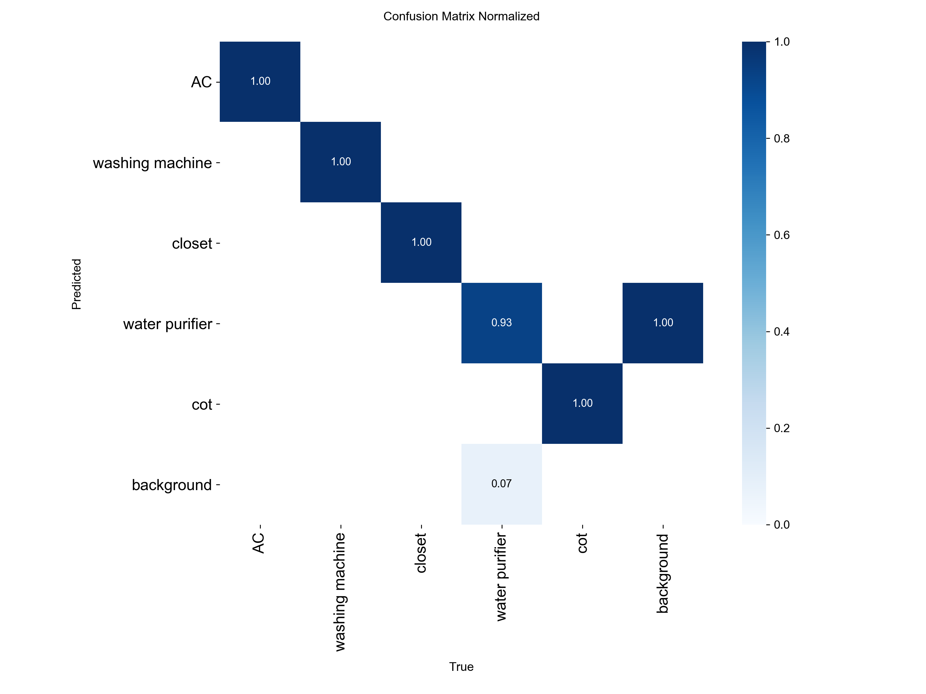
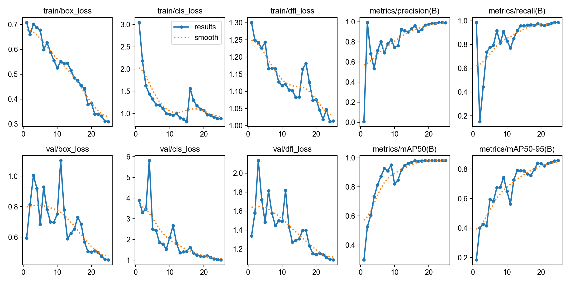
MOBILE MULTIMODAL UNDERSTANDING
Live vision understands the room and the household behind it
The primary experience combines a live camera conversation with the household graph. A compact detector adds fast support for common appliance categories.
Live context
99.29%
69-97 ms
Camera view plus the household graph
Supporting detector precision
Supporting detector latency on CPU
Supporting detector
AC
Washing machine
Closet
Water purifier
Cot
VERID / HOUSEHOLD INTELLIGENCE OS
04
Notes:
Source: PROJECT_DOCUMENTATION.md, Team Verid, iQOO Hackathon 2026. Project screenshots are supplied by the team.

Slide 5
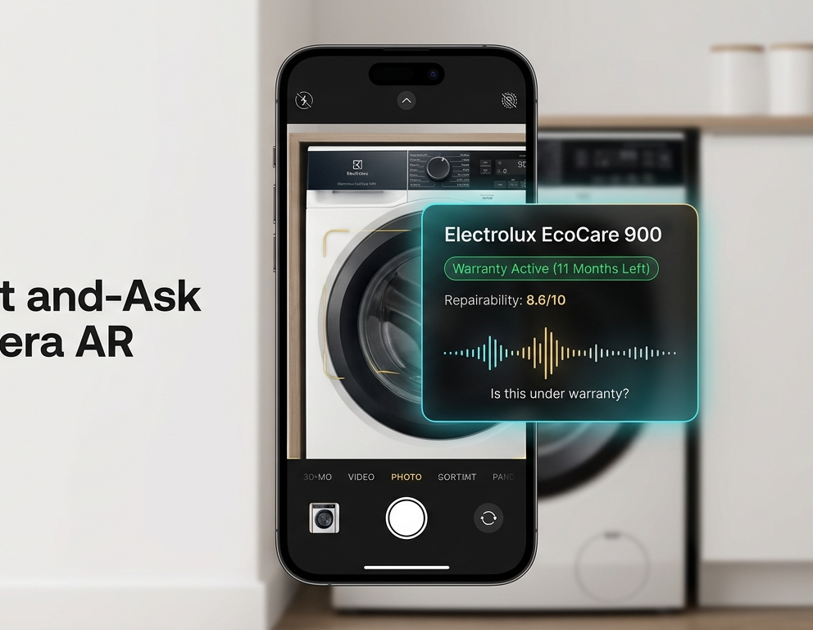
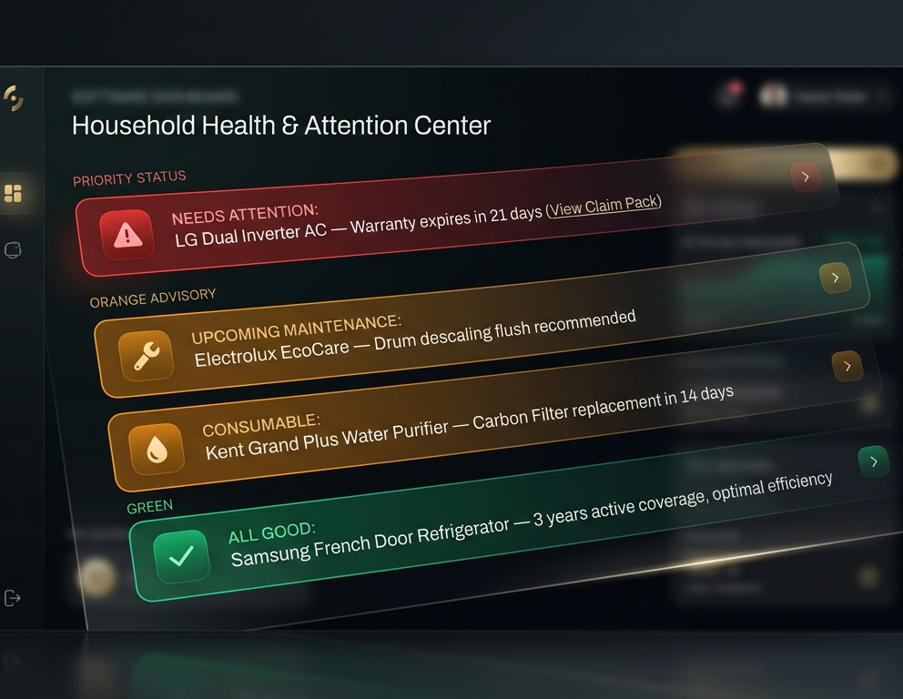
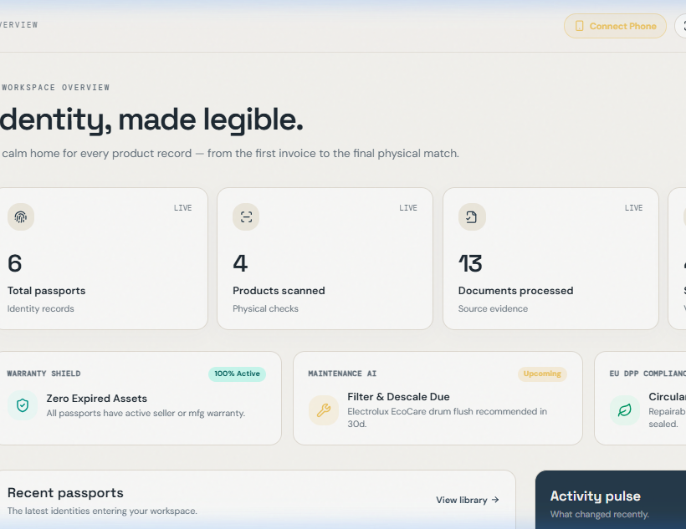
THE DAILY EXPERIENCE
Live camera conversation with your home
The assistant sees the current view while using the household graph to answer in context and suggest the right next step.
Share the live view
Understand priority and health
Ask with household context
“When does my washing machine warranty expire?”
VERID / HOUSEHOLD INTELLIGENCE OS
05
Notes:
Source: PROJECT_DOCUMENTATION.md, Team Verid, iQOO Hackathon 2026. Project screenshots are supplied by the team.

Slide 6
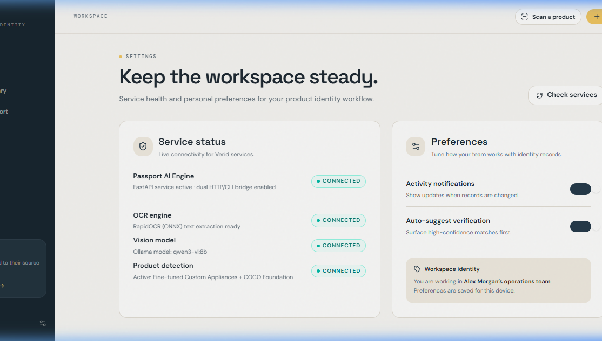
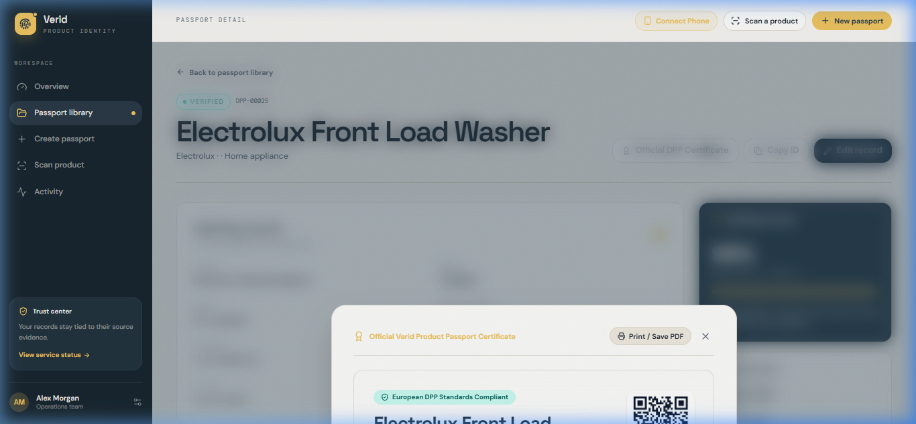
TRUST IS A PRODUCT FEATURE
Every answer carries its evidence
Verid shows the answer, why it reached it, and the source record. When the system cannot verify a detail, it says so.
Evidence
Invoice, product photo, manual, service log
Reasoning
A plain-language explanation for each result
Provenance
Traceable source record and confidence check
Offline mode keeps household data local while the system processes documents and answers questions.
VERID / HOUSEHOLD INTELLIGENCE OS
06
Notes:
Source: PROJECT_DOCUMENTATION.md, Team Verid, iQOO Hackathon 2026. Project screenshots are supplied by the team.

Slide 7
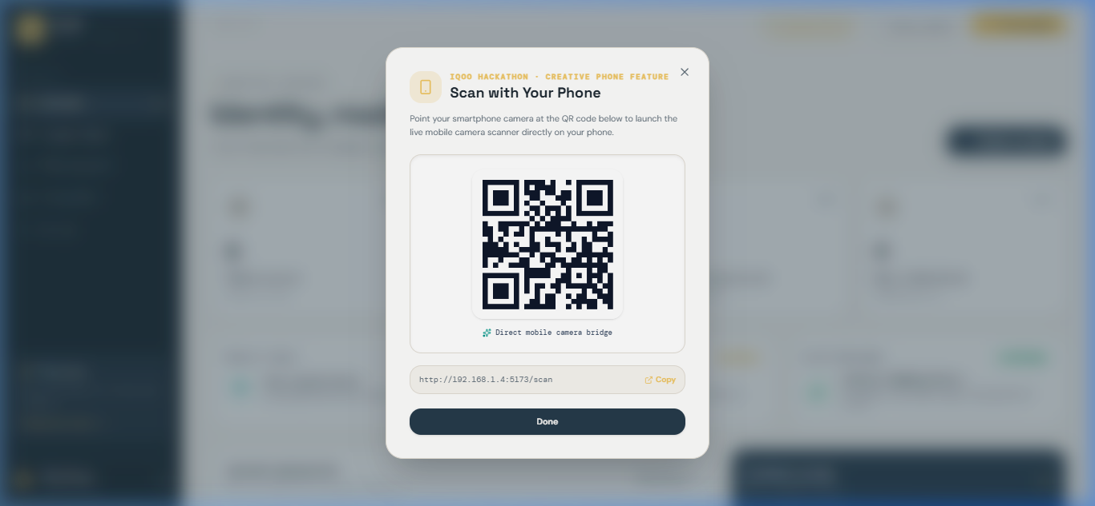
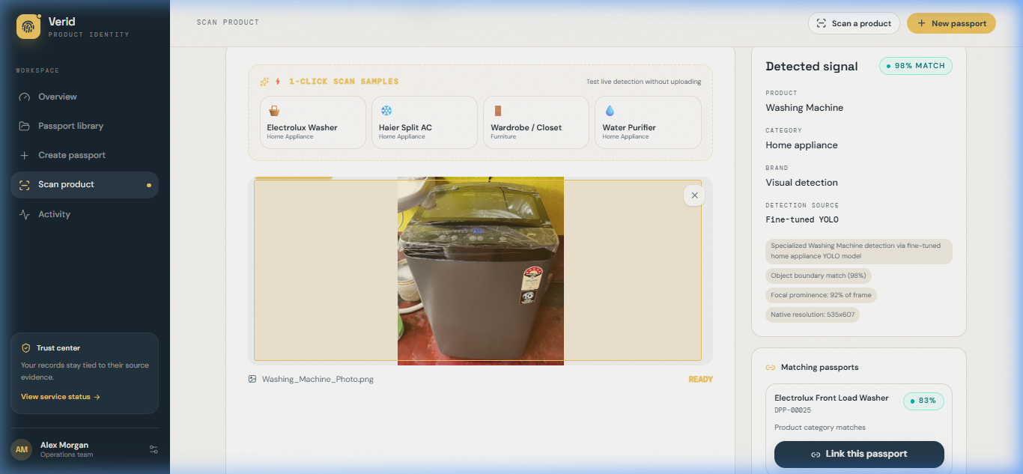
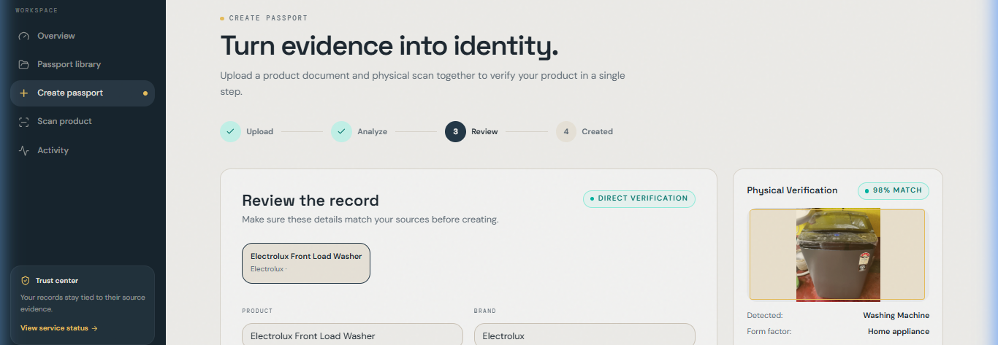
LIVE DEMO
Three minutes to show the complete loop
The demo makes the product tangible: capture evidence, recognize the appliance, prove the passport, then trigger an action.
01
02
03
04
Connect a phone
Start a live conversation
Inspect the proof
Take the next action
Scan the local QR bridge and open the live camera, with no app installation.
The vision assistant reads the scene and uses the home graph to understand what it sees.
Show the evidence-backed product record, warranty status, and source documents.
Surface a maintenance alert or prepare a complete warranty claim pack.
VERID / HOUSEHOLD INTELLIGENCE OS
07
Notes:
Source: PROJECT_DOCUMENTATION.md, Team Verid, iQOO Hackathon 2026. Project screenshots are supplied by the team.

Slide 8
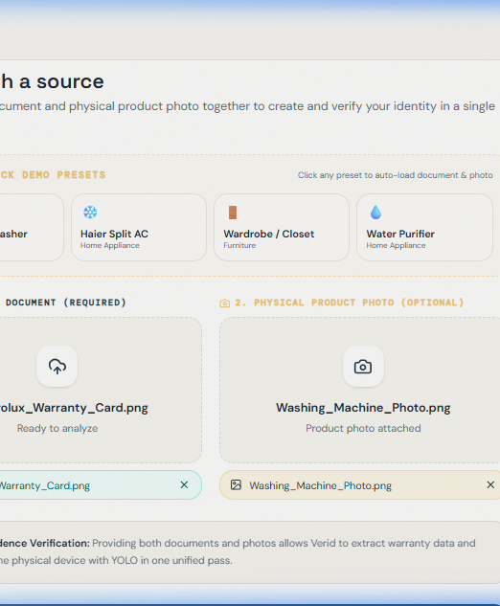
WHY VERID
A professional household companion
for the mobile era.
Verid combines live vision, a household graph, product proof, and private mobile optimization in one working experience.
Working demo
Mobile first
Live camera conversation, product proof, attention center
Optimized experience for an everyday phone workflow
Team Verid / Ready to demonstrate a complete household conversation live
VERID / HOUSEHOLD INTELLIGENCE OS
08
Notes:
Source: PROJECT_DOCUMENTATION.md, Team Verid, iQOO Hackathon 2026. Project screenshots are supplied by the team.

