Slide 1

Good Morning
Campus Maintenance & Complaint Management System
Database Systems Lab Project · Oracle SQL/PL/SQL · Node.js · Web Portals
Name: Ahnaf Tajwar Sadi Roll: 2207104 · KUET CSE
https://github.com/ATSadi/dB-proj/

Slide 2
Project Overview
A database-driven campus system for complaints, worker assignments, SLA tracking, chronic-issue detection, and monthly reporting.
• Students report location-based maintenance issues with priority
• Supervisors assign workers and monitor overdue / chronic cases
• Workers execute jobs and update availability
• Students rate completed work; Admins generate monthly reports
• Oracle triggers/procedures enforce SLA, audit, scoring, and escalation

Slide 3
Key Features
Authentication
Student Portal
Worker Portal
Ops + Admin
• Email + password login
• Forgot-password reset
• Role-based session guards
• Submit complaints
• Filter / search / SLA
• Rate resolved jobs
• Active & done queues
• Start / resolve jobs
• Availability toggle
• Assign / overdue / chronic
• Monthly reports
• Directory + CSV import

Slide 4
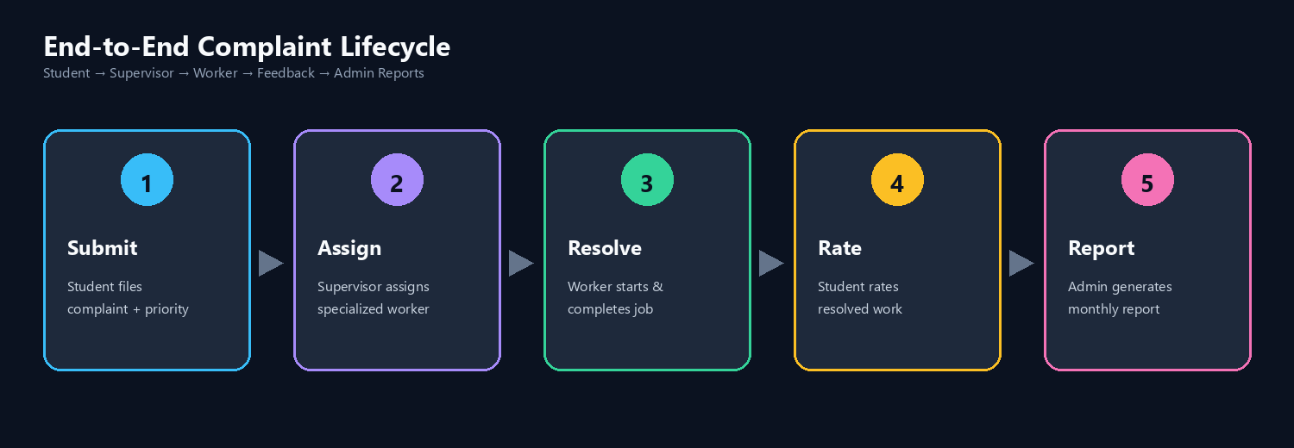
End-to-End Complaint Lifecycle

Slide 5
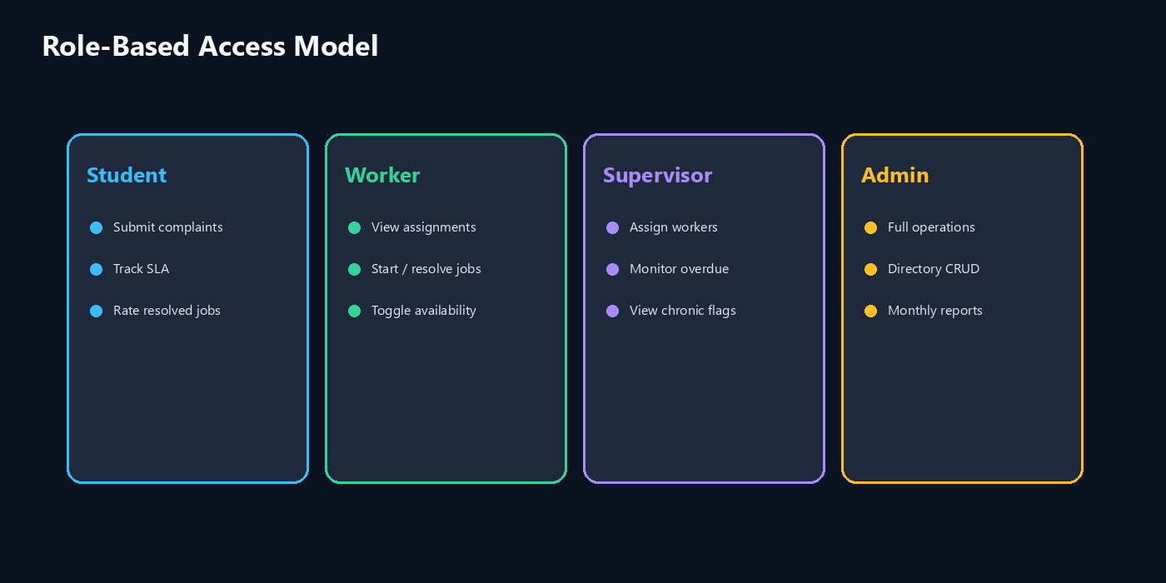
Role-Based Access Model

Slide 6
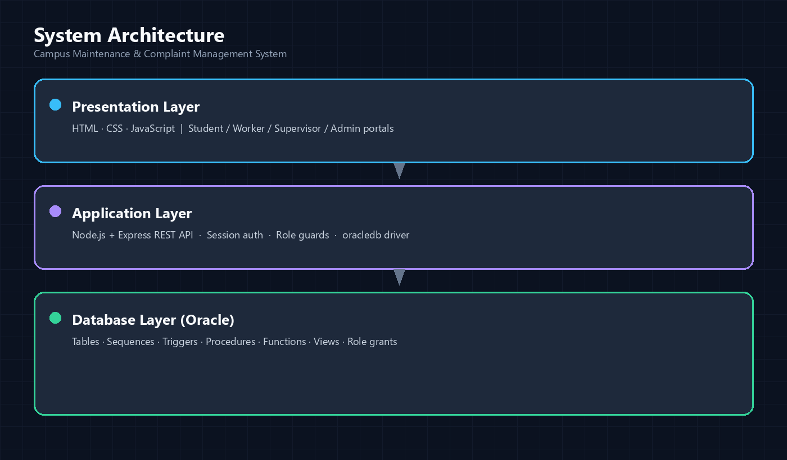
System Architecture

Slide 7
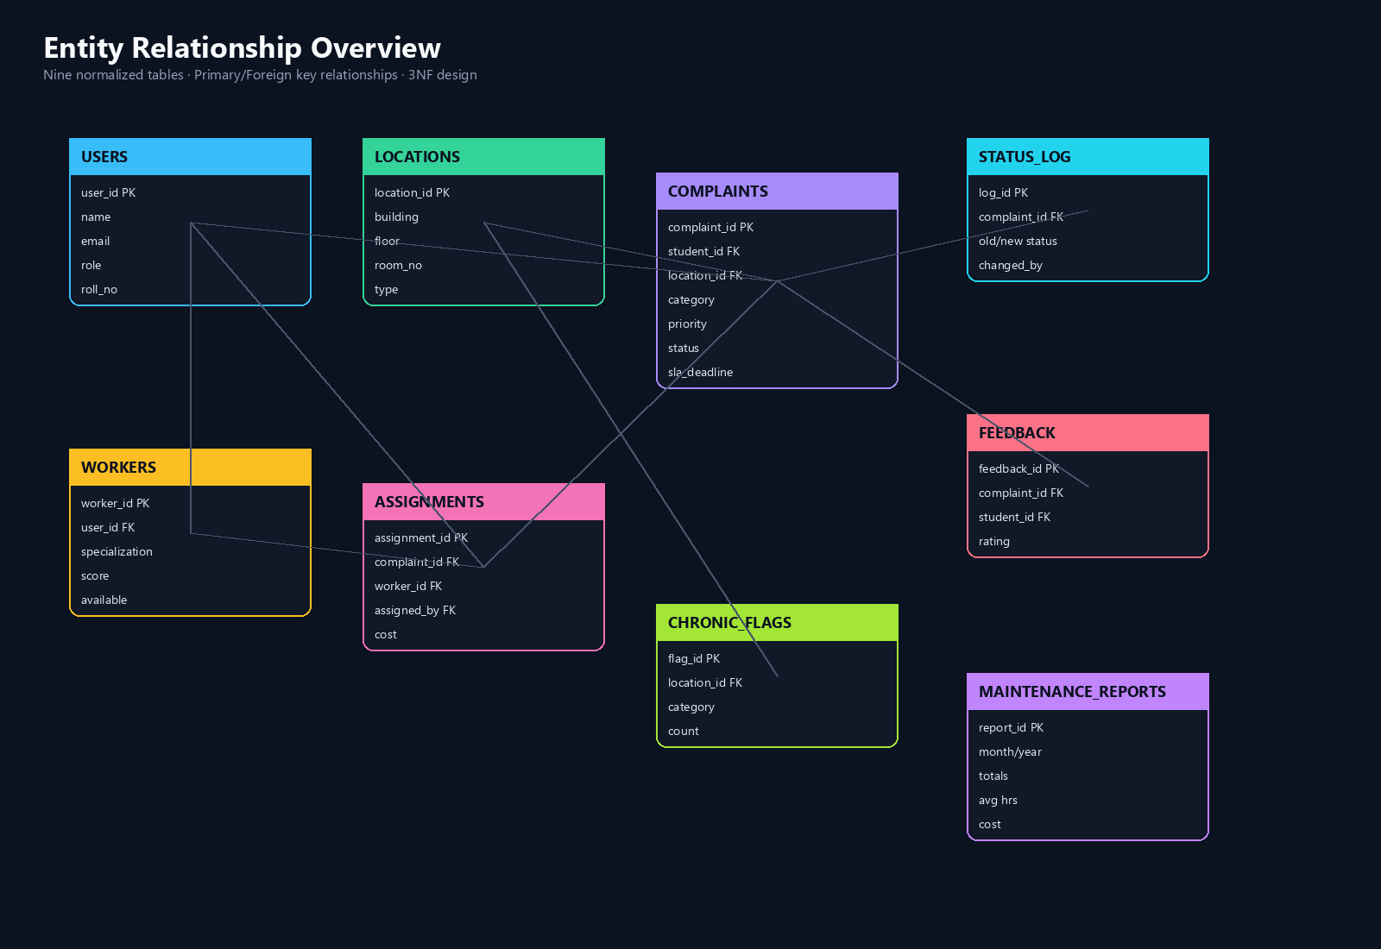
Entity Relationship Overview

Slide 8
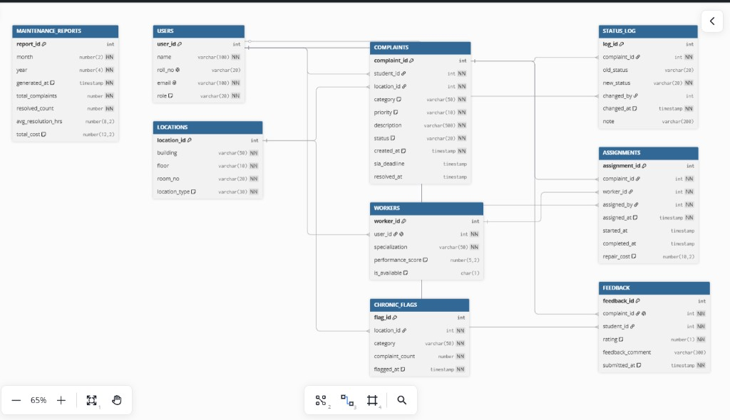
Database Schema Diagram
USERS · LOCATIONS · COMPLAINTS · WORKERS · ASSIGNMENTS · STATUS_LOG · FEEDBACK · CHRONIC_FLAGS · MAINTENANCE_REPORTS

Slide 9
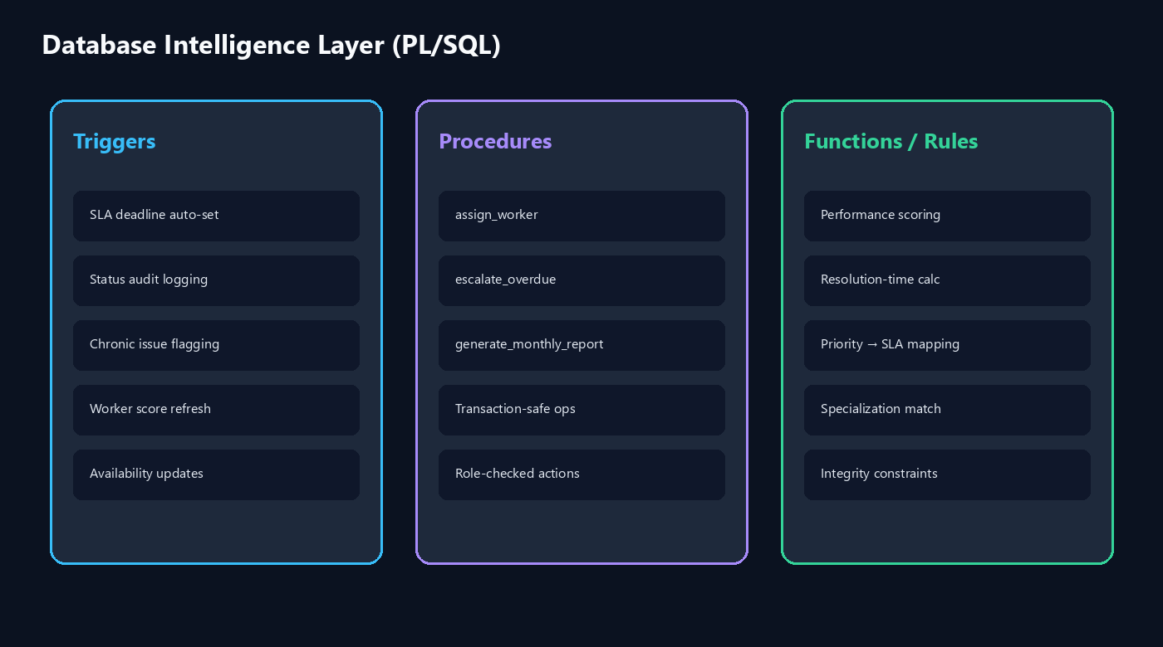
PL/SQL Business Logic

Slide 10
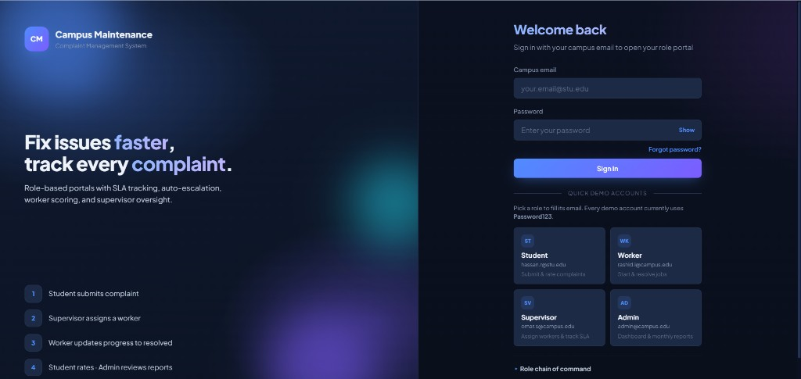
Secure Login & Demo Access
Email + password authentication · Default demo password: Password123 · Forgot-password reset codes

Slide 11
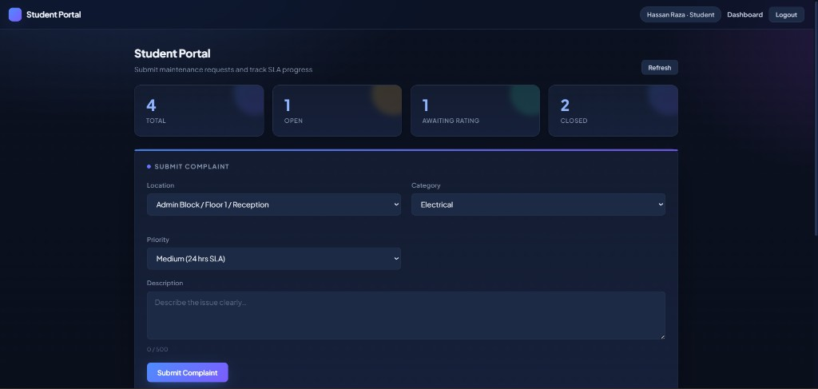
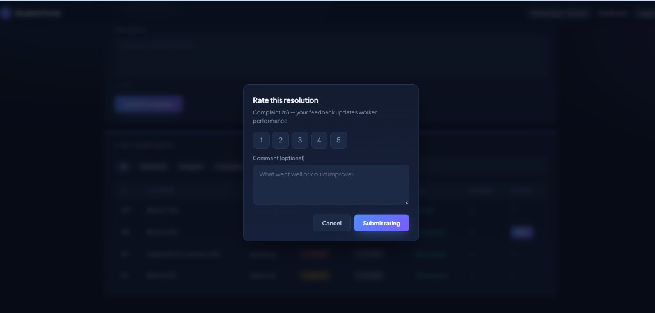
Student Portal
• Submit complaints tied to campus locations with category and priority
• Filter, search, and track SLA remaining time on open tickets
• Rate resolved work to feed worker performance scoring

Slide 12
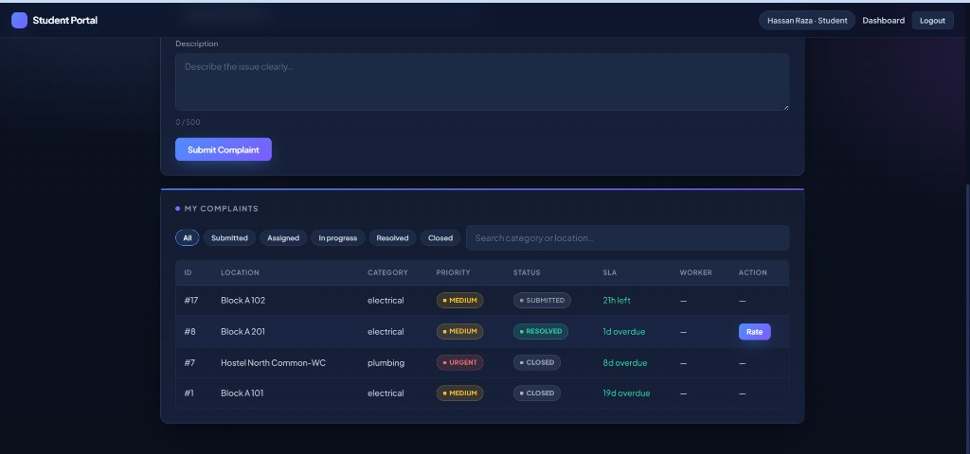
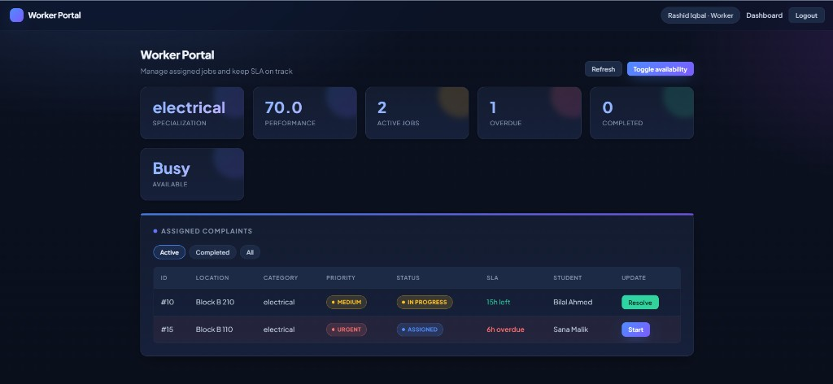
Worker Portal
• Active vs completed job filters with SLA urgency cues
• Start and resolve assignments with optional repair cost
• Toggle availability so supervisors assign only ready workers

Slide 13
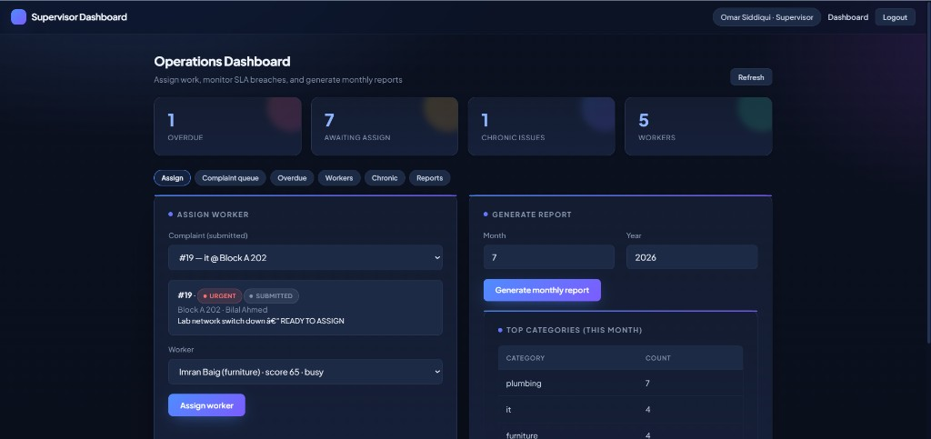
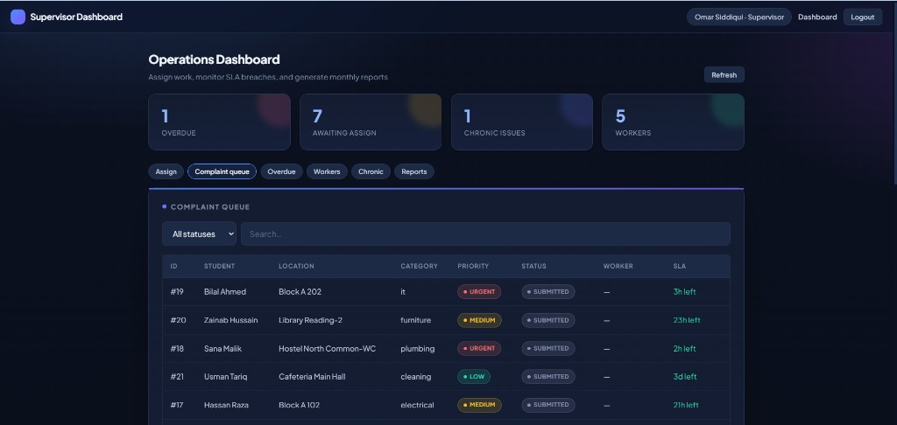
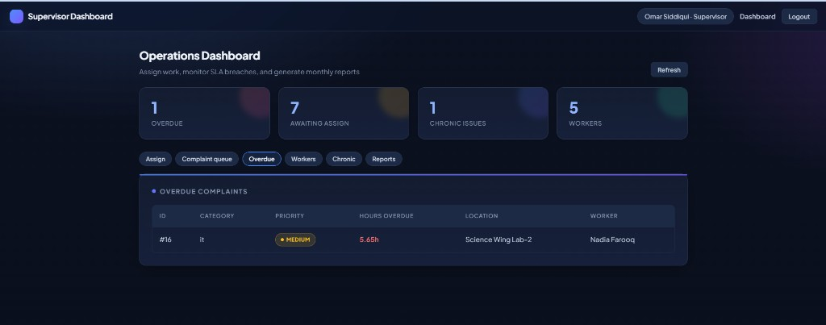
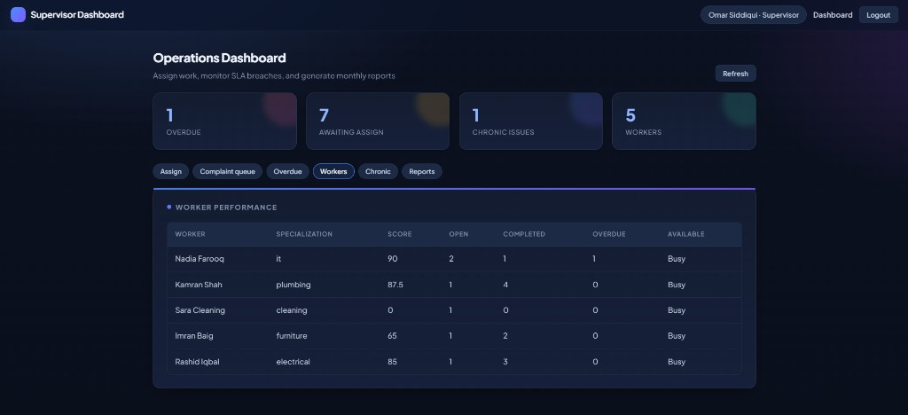
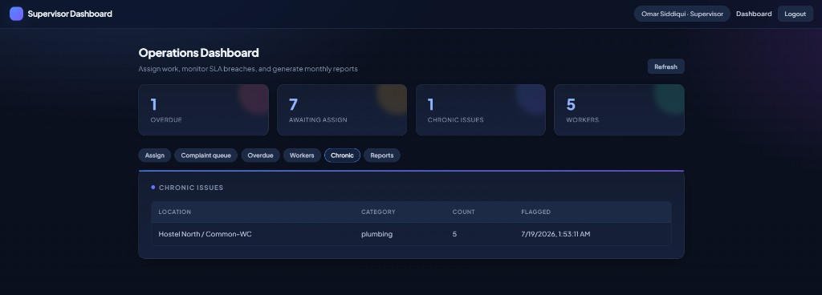
Supervisor Dashboard

Slide 14
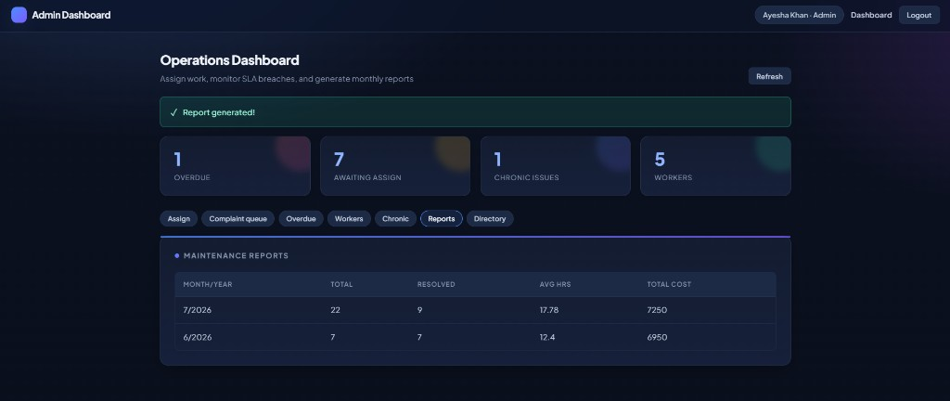
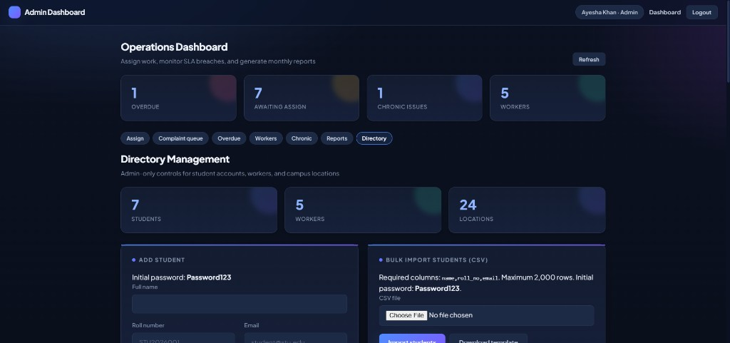
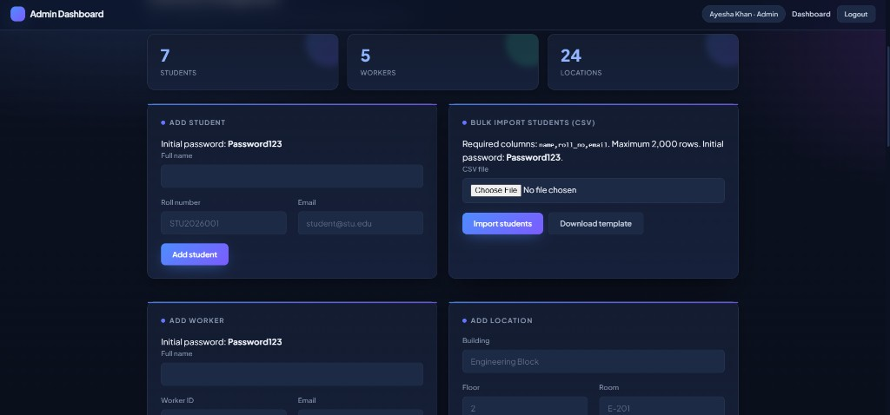
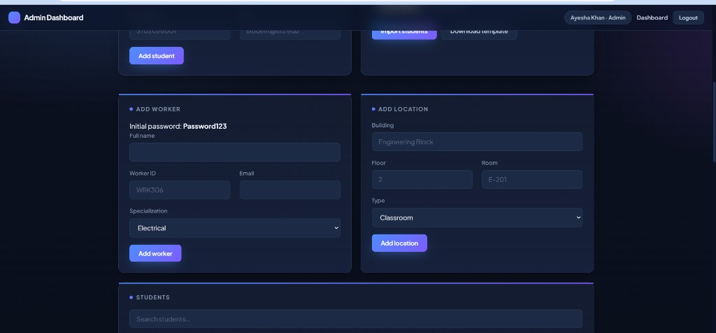
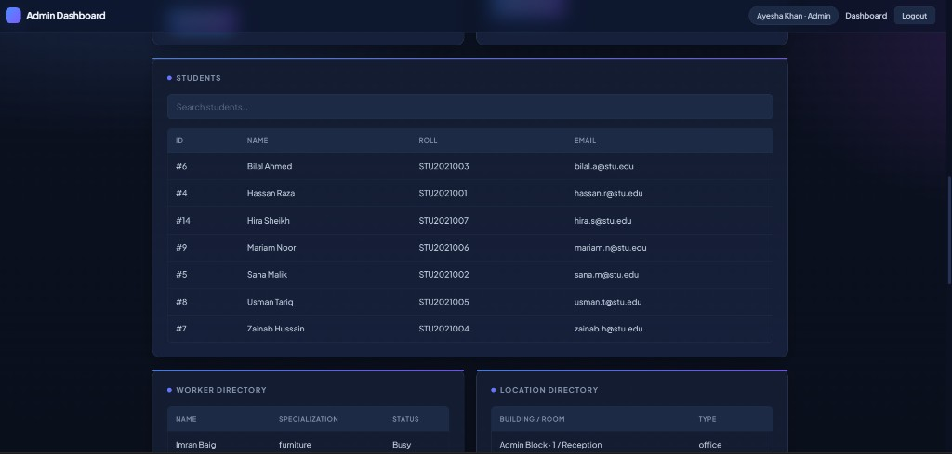
Admin Dashboard & Directory

Slide 15
Tech Stack & Demo Accounts
Technology
Demo Login (Password123)
• Oracle Database (SQL + PL/SQL)
• Node.js + Express + oracledb
• HTML / CSS / JavaScript portals
• DBeaver / SQL Developer tooling
• GitHub version control
• Student — hassan.r@stu.edu
• Worker — rashid.i@campus.edu
• Supervisor — omar.s@campus.edu
• Admin — admin@campus.edu
• Local URL — http://localhost:3000

Slide 16
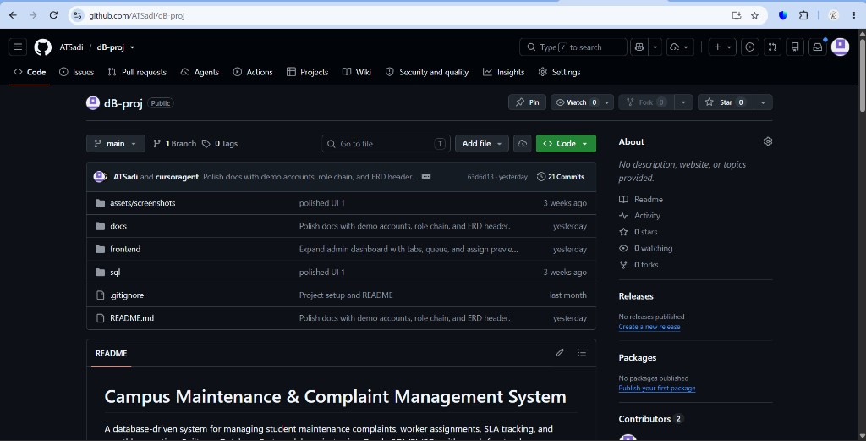
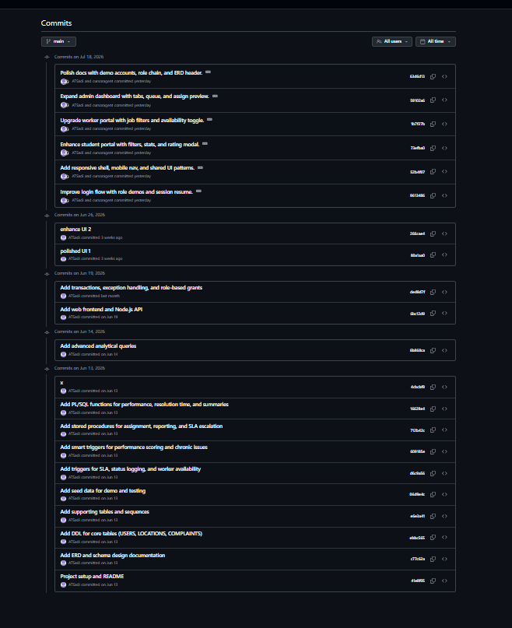
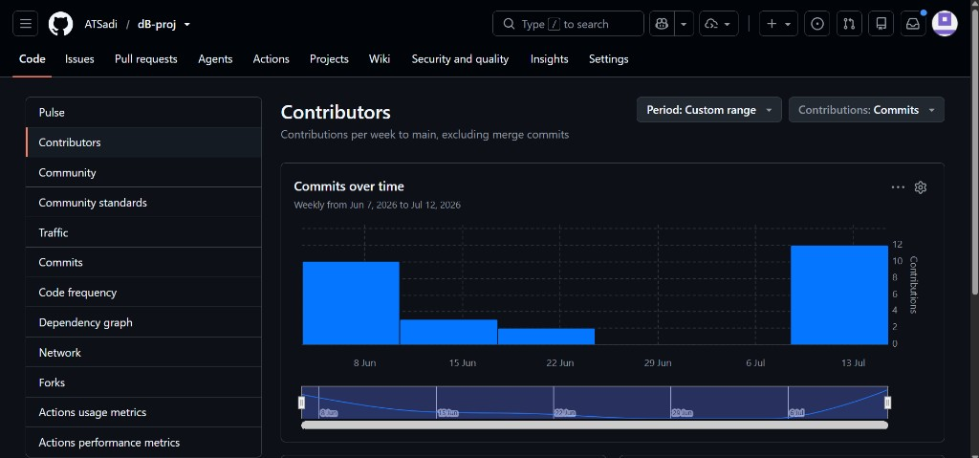
GitHub Repository & Development History
https://github.com/ATSadi/dB-proj/

Slide 17
Thank You
Questions & Discussion Welcome
Ahnaf Tajwar Sadi · 2207104 Campus Maintenance & Complaint Management System

