Slide 1


PORTFOLIO
Presentation
HYEONSE JO
PORTFOLIO

Slide 2
PORTFOLIO
Presentation
Java BlackJack
Python
TradingBot
01
02
UML, Socket Programming
Pytham anaconda,binance api,uml
Flutter Dart
medicine app
Android Kotlin
Memo app
03
04
Local Format Medicine Alarm Application
DB : Firebase Date Specified Memo Application
Android Kotlin
Dice app
05
Just Throwing two dice Application
PORTFOLIO JHS

Slide 3
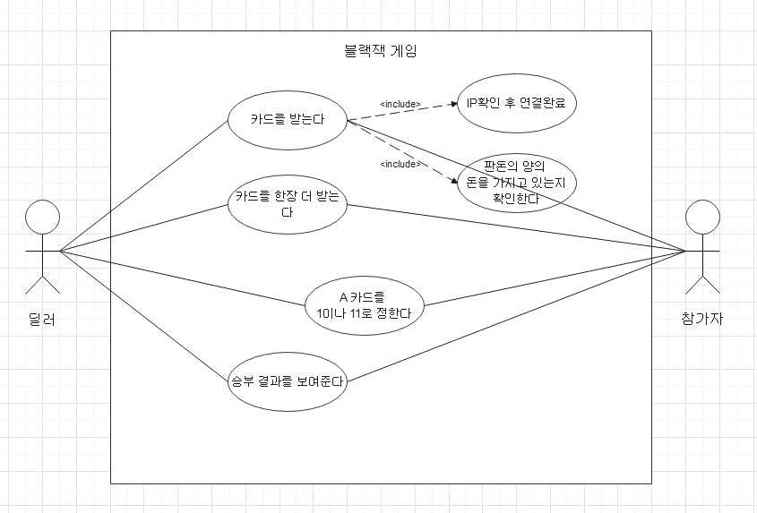
01 Java BlackJack UML
Use Case Diagram

Slide 4
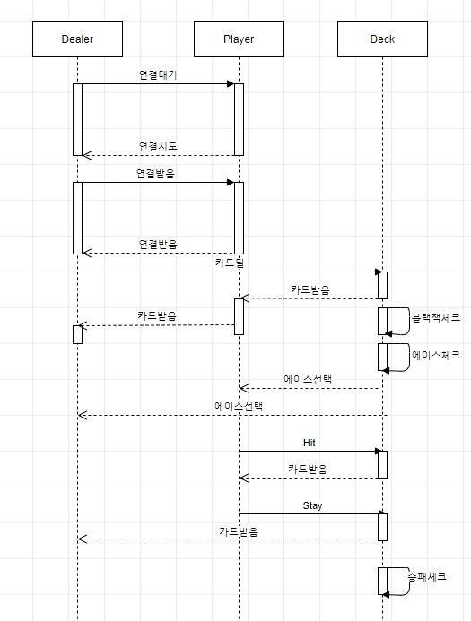
01 Java BlackJack UML
Sequence Diagram

Slide 5
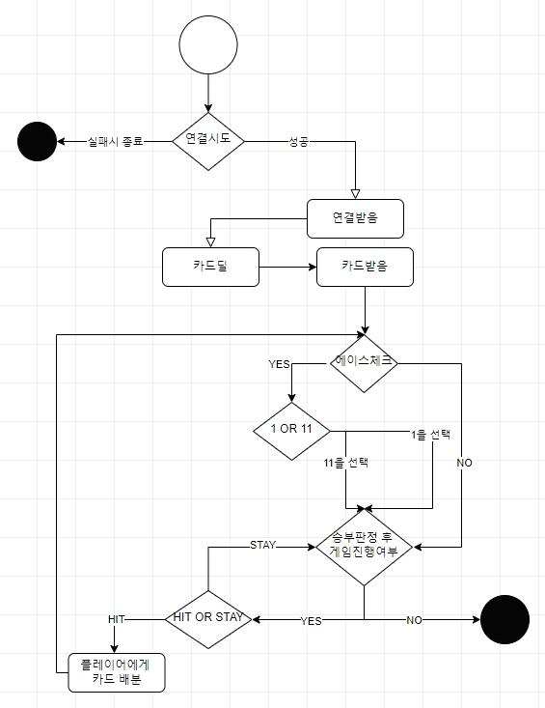
01 Java BlackJack UML
Activity Diagram

Slide 6
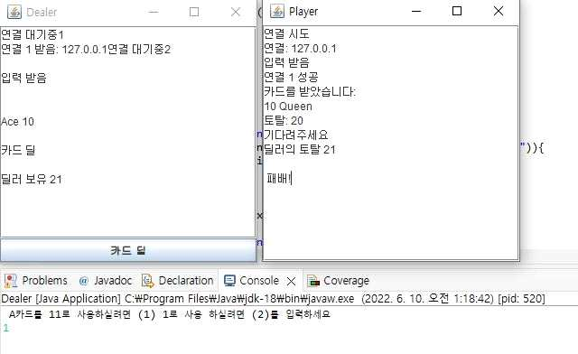
01 Java BlackJack result
Dealer have A

Slide 7
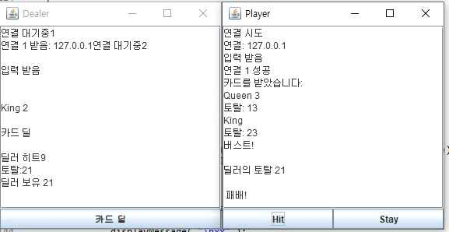
01 Java BlackJack result
if Player Lose

Slide 8
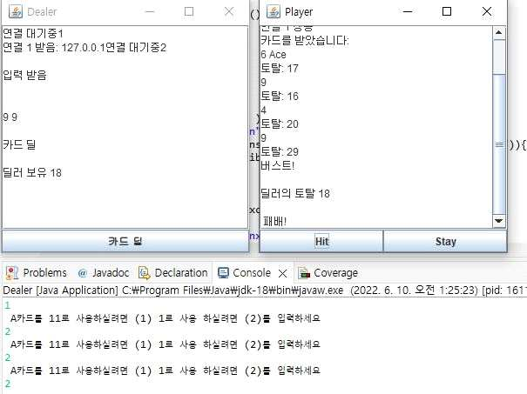
01 Java BlackJack result
When the player gets an A card and keeps hitting
If you use card A as 11 and change it to 1

Slide 9
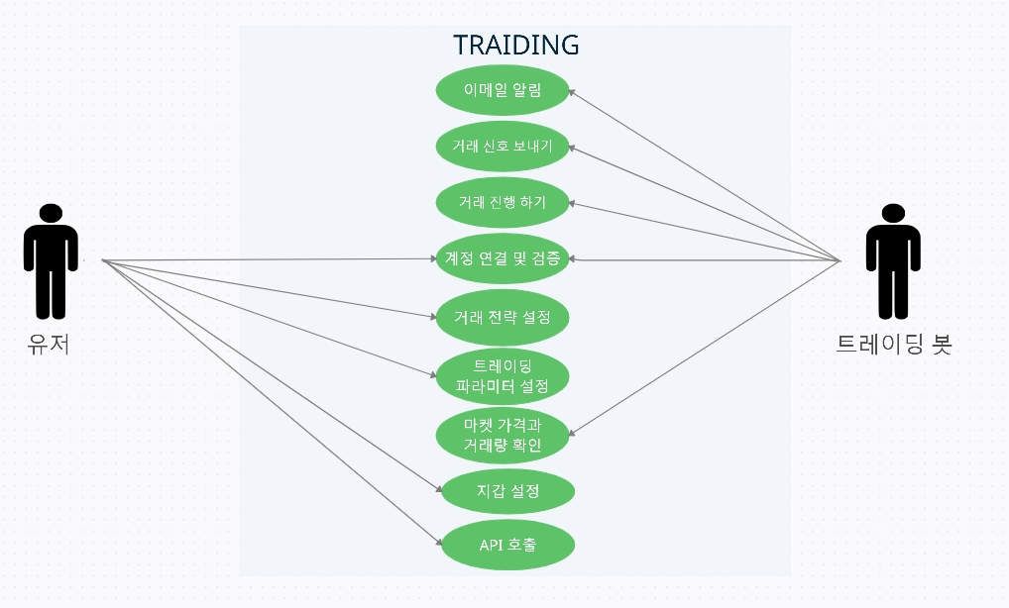
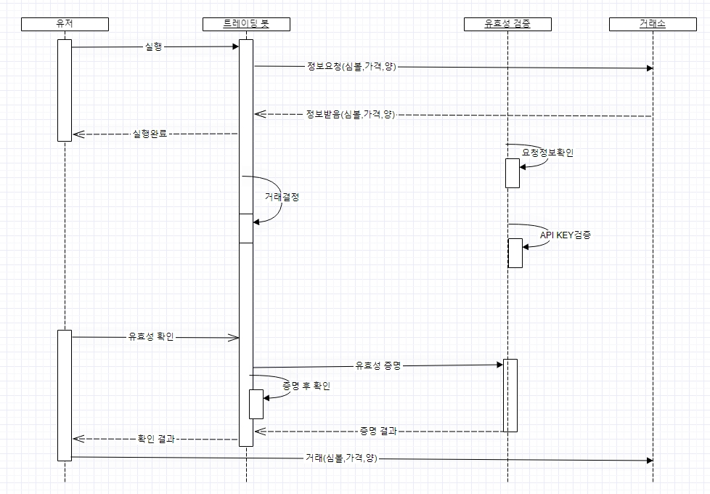
02 Python Trading Bot
(Usecase) (Sequnecs Diagram)

Slide 10
02 Python Trading Bot
Move average
To briefly explain the moving average line again, the average value of the closing price over a certain period of time is connected by a line.
It is an indicator that is useful as a reference for rough movement, current trend analysis, and trading timing, and the moving average line is classified into three patterns: short, medium, and long. Depending on the chart displayed, the period used also varies as follows. The basic design was applied to actual transactions after automatic training at the sandbox using a cross technique using two mobile parallels. The moving average used an algorithm that buys when a short-term golden cross occurs using the short-term 5 days and the medium-term 15 days, and sells when a dead cross occurs
*Frequently used moving average (SMA) timeline
 | 단기 | 중기 | 장기
일간 | 5일 | 25일 | 75일
주간 | 13주 | 26주 | 52주
월간 | 12개월 | 24개월 | 60개월

Slide 11
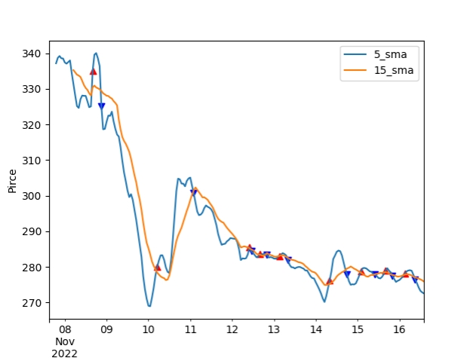
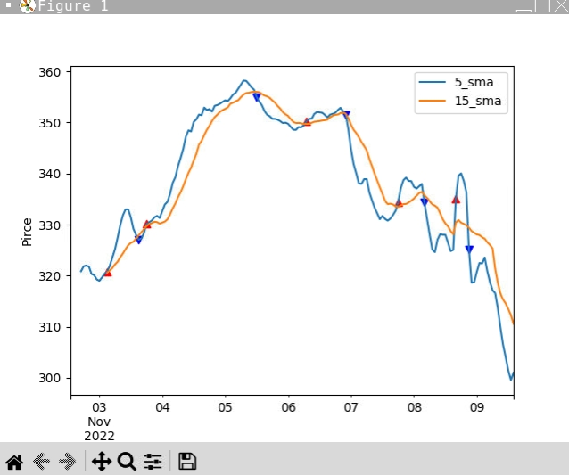
02 Python Trading Bot result
a red buying point
Blue selling point
This can be applied to change the viewpoint and number of lines

Slide 12
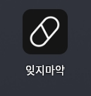
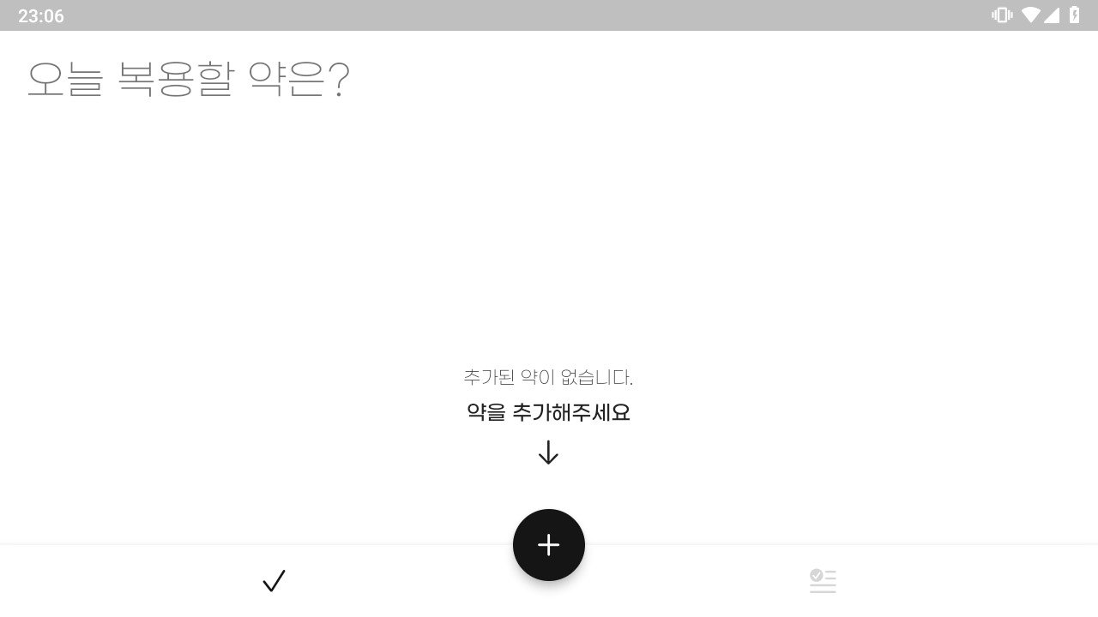
03 Flutter Dart medicine app

Slide 13
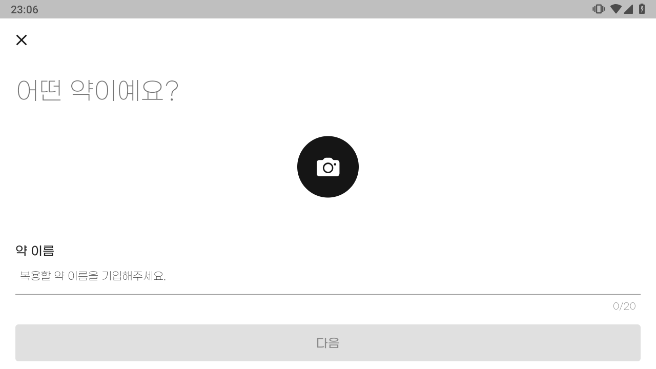
03 Flutter Dart medicine app

Slide 14
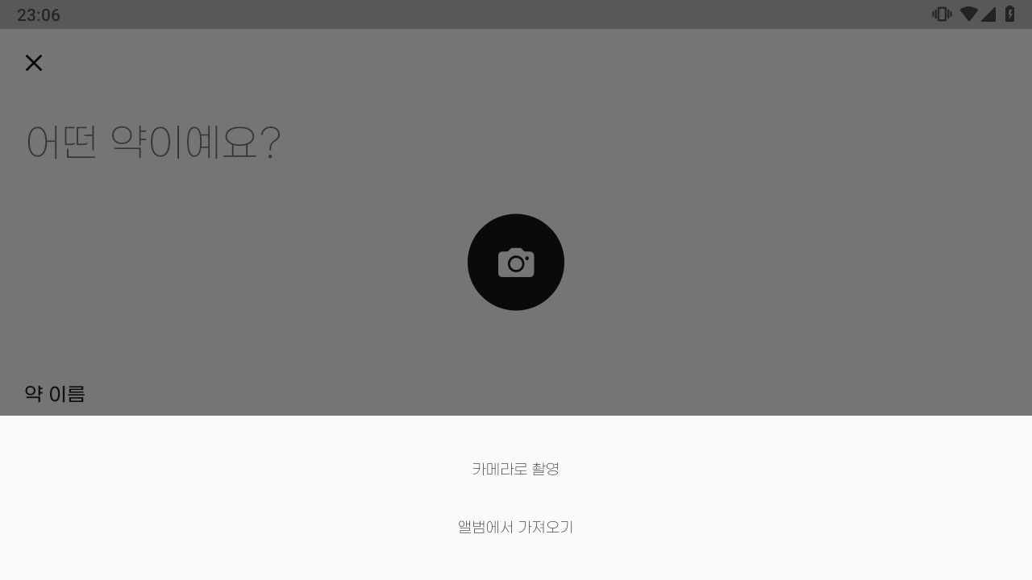
03 Flutter Dart medicine app

Slide 15
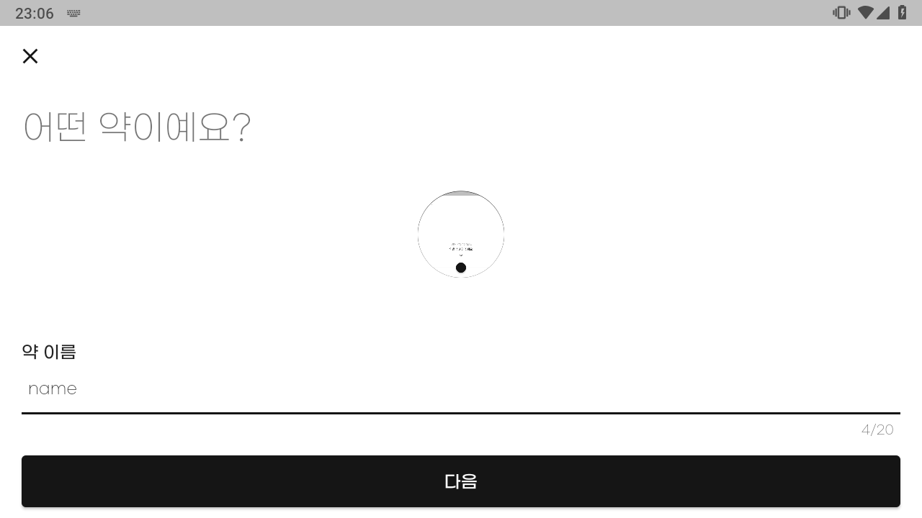
03 Flutter Dart medicine app

Slide 16
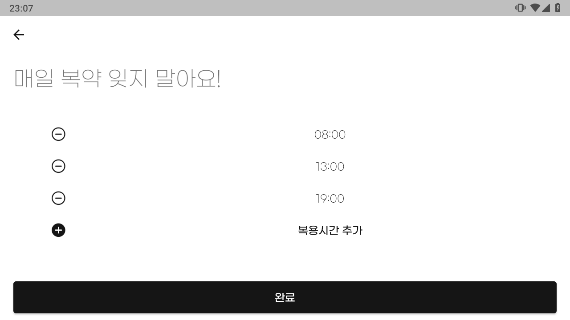
03 Flutter Dart medicine app

Slide 17
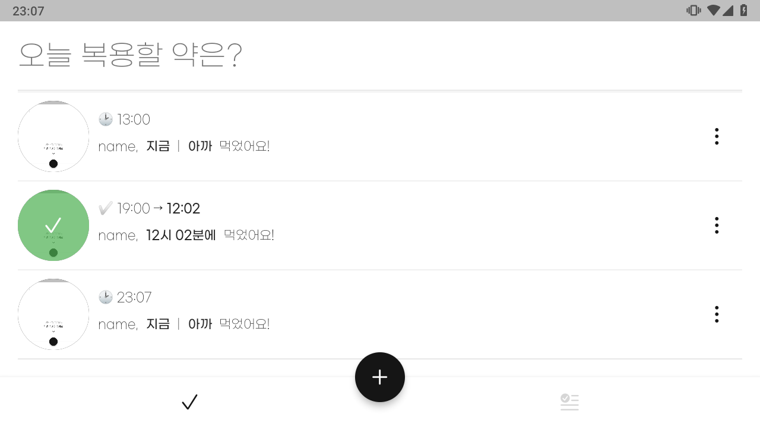
03 Flutter Dart medicine app

Slide 18
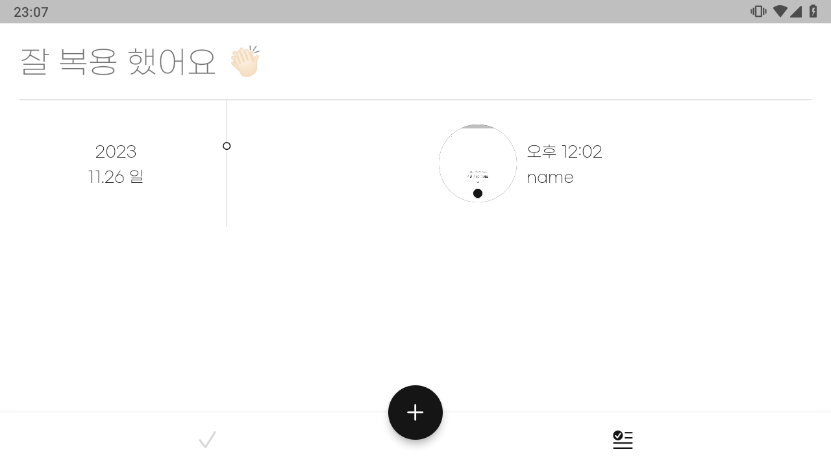
03 Flutter Dart medicine app

Slide 19
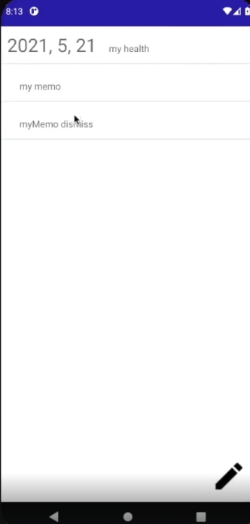
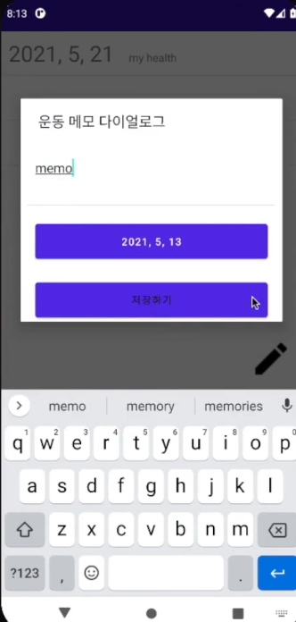
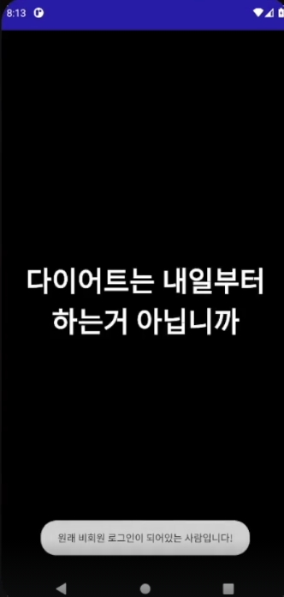
04 Android Kotlin Memo app

Slide 20
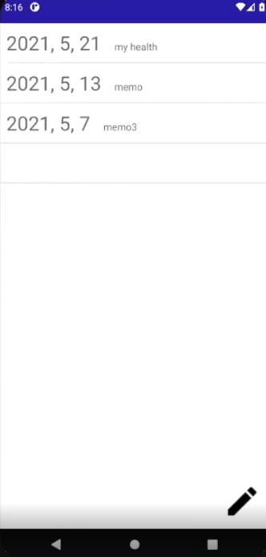
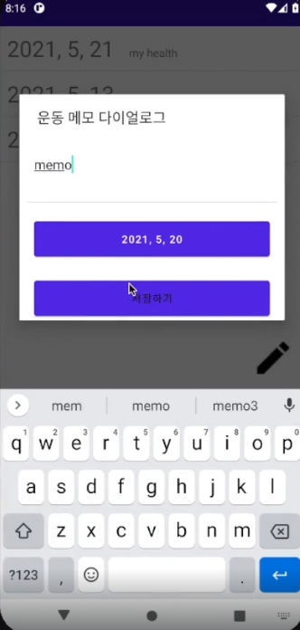
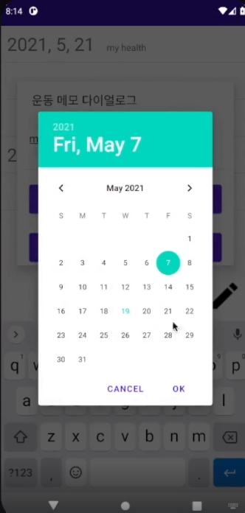
04 Android Kotlin Memo app

Slide 21
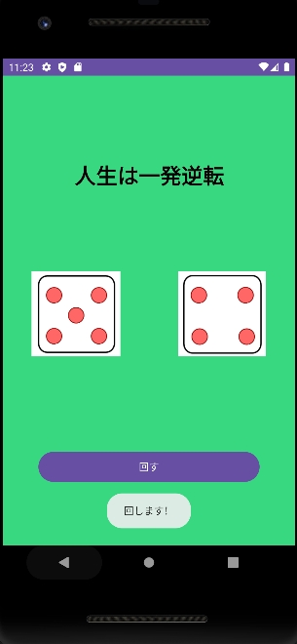
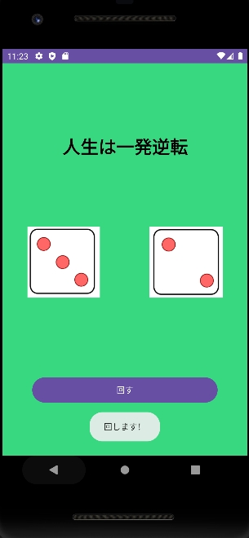
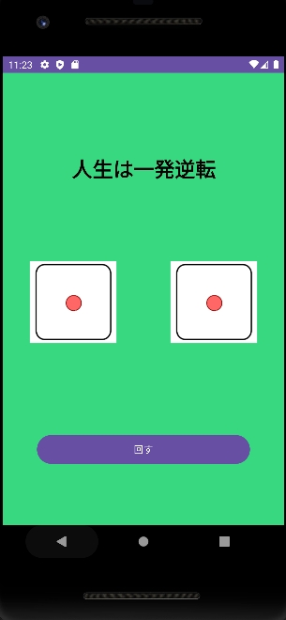
05 Android Kotlin Dice app

Slide 22
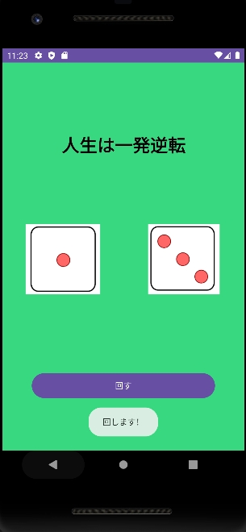
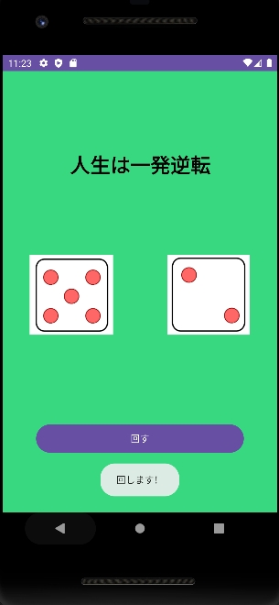
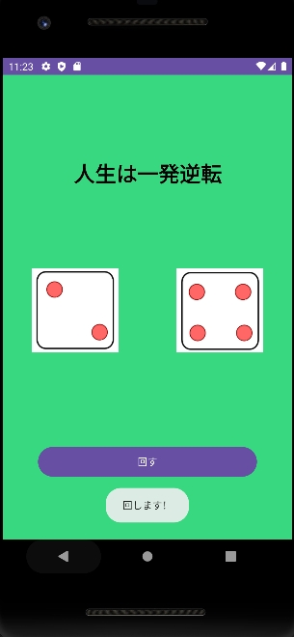
05 Android Kotlin Dice app

Slide 23
Thank you

