Slide 1
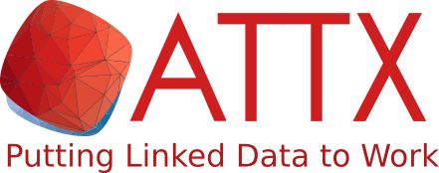
Practical Data Provenance in Distributed Environment or: implementing Linked Data Broker using Microservices Architecture
Joonas Kesäniemi, Stefan Negru, João da Silva
SWIB 2017
Hamburg

Slide 2
ATTX project
8/2016-4/2018
Developing software component for building semantic data brokers
Main features
”Easy” & scalable deployment
Flexible & linked data
Full & usable provenance
Funded by the Ministry of Education and Culture
Executed by the Helsinki University Library
http://attx-project.github.io
https://www.helsinki.fi/en/projects/attx-2016

Slide 3
Data brokering and ATTX
Owners and maintainers of published (open) data
Data sources
ATTX components
Internal data
Redistributed data
Users of redistributed data

Slide 4
ATTX deliverables
COMPONENTS
WORKFLOW
GRAPH MANAGER
PROVENANCE
PROCESSING
DISTRIBUTION
MESSAGE BROKER
DEPLOYMENT ENVIRONMENTS
SINGLE HOST
DOCKER COMPOSE
DOCKER SWARM
OPEN STACK CLOUD
DOCKER SWARM
KONTENA
KONTENA CLOUD
PROTOTYPES
OPEN ACCESS DASHBOARD
UNIVERSITY OF JYVÄSKYLÄ
HANKEN
METADATA MAPPING AND VALIDATION
CSC / METAX
RESEARCH DATASET METADATA BROKER
UNIVERSITY OF HELSINKI

Slide 5
ATTX core components
WorkflowManagent – UnifiedViews & custom provenance API
GraphManager
Manages the state of the internal graph store
MessageBroker – RabbitMQ
Indexing
Distribution
In JSON format using ElasticSearch
Transformation to RDF
RML processor to transform from CSV, JSON and XML
Transformation from RDF to JSON
JSON-LD Framing
Provenance

Slide 6
Provenance
“Provenance is a record that describes the people, institutions, entities, and activities involved in producing, influencing, or delivering a piece of data or a thing. In particular, the provenance of information is crucial in deciding whether information is to be trusted, how it should be integrated with other diverse information sources, and how to give credit to its originators when reusing it. In an open and inclusive environment such as the Web, where users find information that is often contradictory or questionable, provenance can help those users to make trust judgements.”
Emphasis mine
K. Belhajjame, R. B’Far, J. Cheney, S. Coppens, S. Cresswell, Y. Gil, P. Groth, G. Klyne, T. Lebo, J. McCusker, S. Miles, J. Myers, S. Sahoo, C. Tilmes, L. Moreau, and P. Missier (Eds.), PROV-DM: The PROV Data Model, W3C Recommendation REC-prov-dm-20130430, World Wide Web Consortium (Oct. 2013). URL http://www.w3.org/TR/2013/REC-prov-dm-20130430/.

Slide 7
Prov-O - You know, for Provenance
prov:Agent
prov:Plan
prov:Agent
wasAttributedTo
wasAssociatedWith
prov:Entity
prov:Activity
used / generated
hadPlan
Adapted from https://www.w3.org/TR/prov-o/

Slide 8
ATTX provenance model
https://attx-project.github.io/attx-onto/
attx:Ingestion
Workflow
attx:Processing
Workflow
attx:Publishing
Workflow
rdfs:subClassOf
attx:Component
prov:Agent
attx:Workflow
prov:Plan
prov:Entity
prov:Activity
attx:DataSet
attx:Graph
attx:File
attx:Service
Execution
attx:Step
Execution
attx:Workflow
Execution
prov:used / prov:generated

Slide 9
ATTX pipelines
PIPELINES
Ingest (Extract)
Process (Transform)
Publish (Load)
Extract
Download external data
Select source datasets
Select source datasets
Transform
Transform to RDF
Create new dataset
Transform to published format
Data API
Load
Store dataset
Store new dataset
Publish dataset
STEPS
Internal graph store

Slide 10
Example case Connecting publications to files
CRIS system is the source for publication metadata
ID = pub1
DOI = doi1
Title = “Simple example”
Digital repository is the source for file metadata
ID = file1
DOI = doi1
Download link = link1
File type = “Publisher’s PDF”
Data broker’s internal data
cris:pub1
hasExternalID
extpub:doi1
hasFile
hasFile
repo:file1
Missing from the input data.
Needs to be generated.

Slide 11
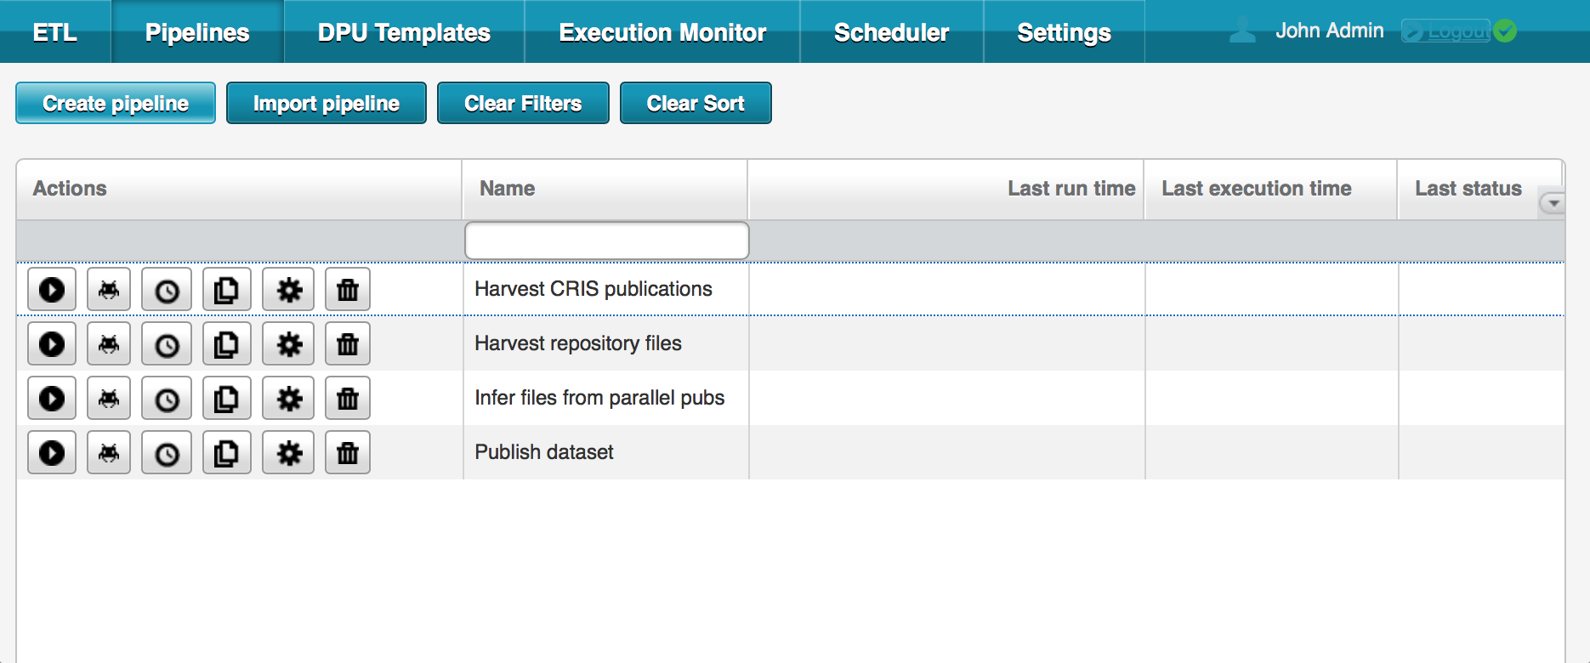
Example case – Pipelines in UnifiedViews (UV)

Slide 12
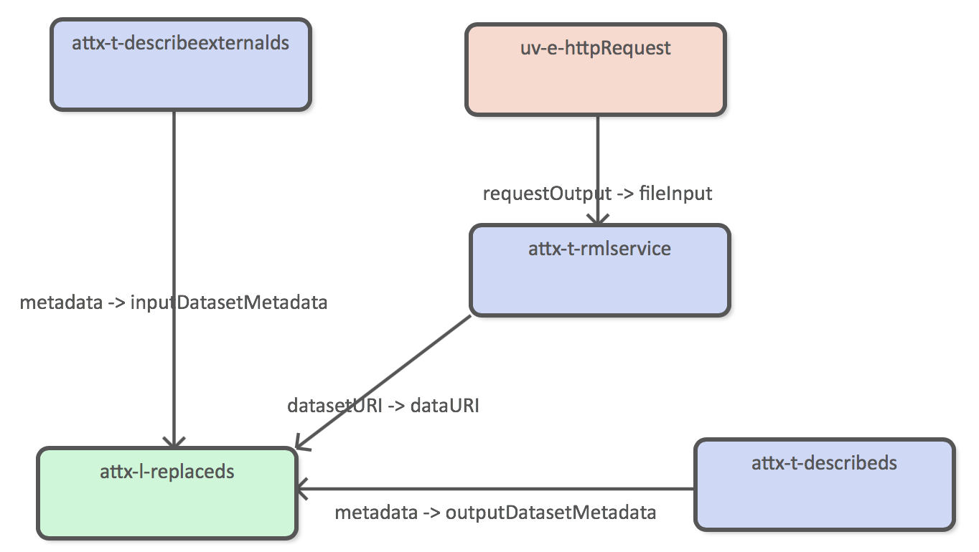
Example case – Ingestion pipeline (UV)
Transformation from JSON to RDF
Graph
management

Slide 13
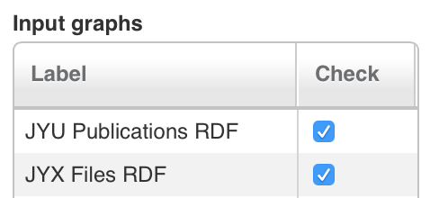
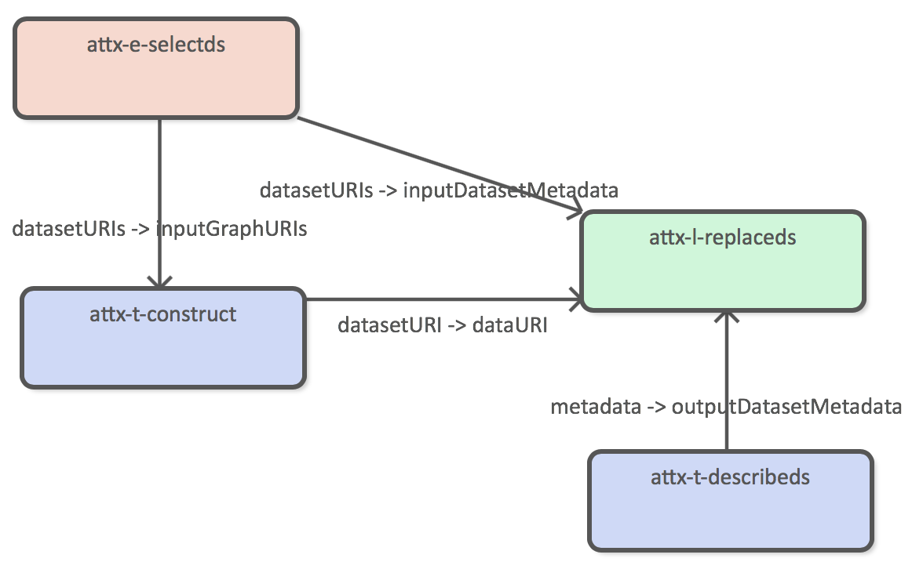
Example case – Processing pipeline (UV)
Graph selection
using GraphManager
Graph
management
Creating new RDF
data

Slide 14
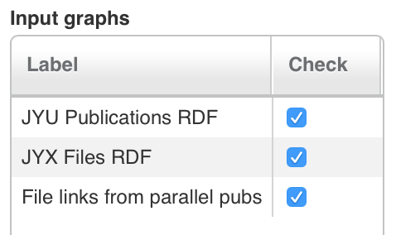
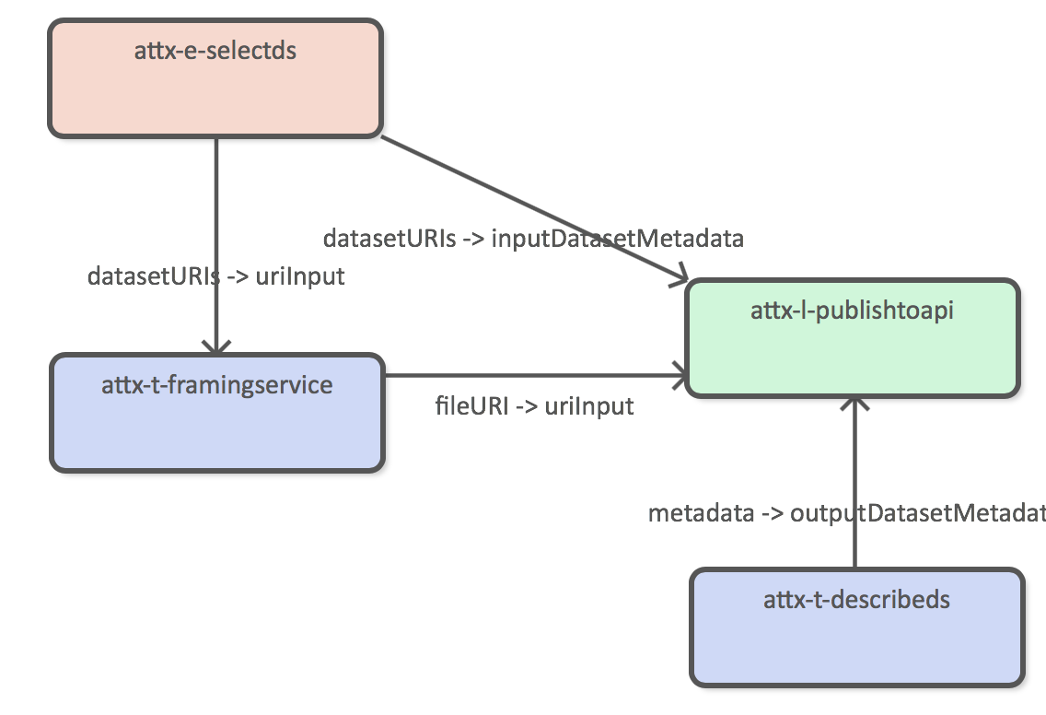
Example case – Publishing pipeline (UV)
Graph selection
using GraphManager
Indexing service
Transformation
from RDF to JSON

Slide 15
Collecting provenance data
Explicit messages
“I did this”
“Fire-and-forget” type of operation
Message broker is responsible for getting message to the provenance service using message persistency and automatic retries
Activities are connected through shared input/output entities
Resulting provenance graph is generated from bits and pieces sent in by multiple components running in different containers and possibly on different nodes

Slide 16
Provenance messages
Workflow
Management
executedStep
replacedGraph
Graph
Management
executedWorkflow
Provenance
Service
retrievedGraph
generatedRDF
generatedJson
RML
Framing
replacedIndex
Indexing

Slide 17
Publishing provenance
Provenance service is updating the ElasticSearch index with the up-to-date information automatically
Provenance graphs are converted to JSON using JSON-LD framing
Documents related a single provenance graph, i.e. provenance related to single workflow execution, is indexed under common document type
GET /prov/workflow1_activity1

Slide 18
Using provenance
Provenance use case scenarios
How are the inputs and outputs of the pipelines related to one another?
Document was downloaded from an endpoint X, what are the data sources and transformations related to that endpoint?
Provenance browser (PoC)
Workflow, step and service level information
Connections between pipelines
WF B used the data generated by WF A as a data source

Slide 19
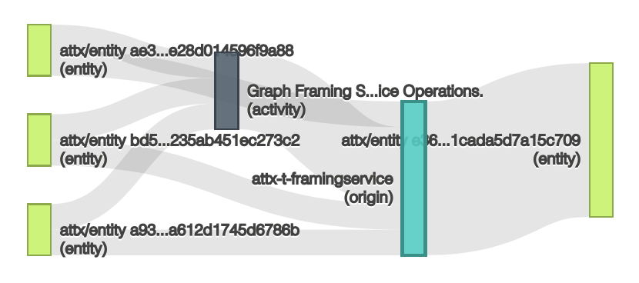
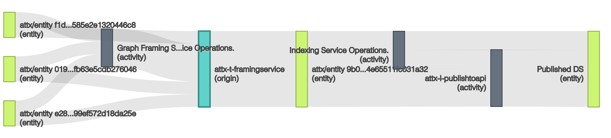
Publish pipeline execution
Failed run – indexing part is missing
Plan
attx-e-selectDS
attx-t-framing
service
attx-l-publish
toapi
Successful run

Slide 20
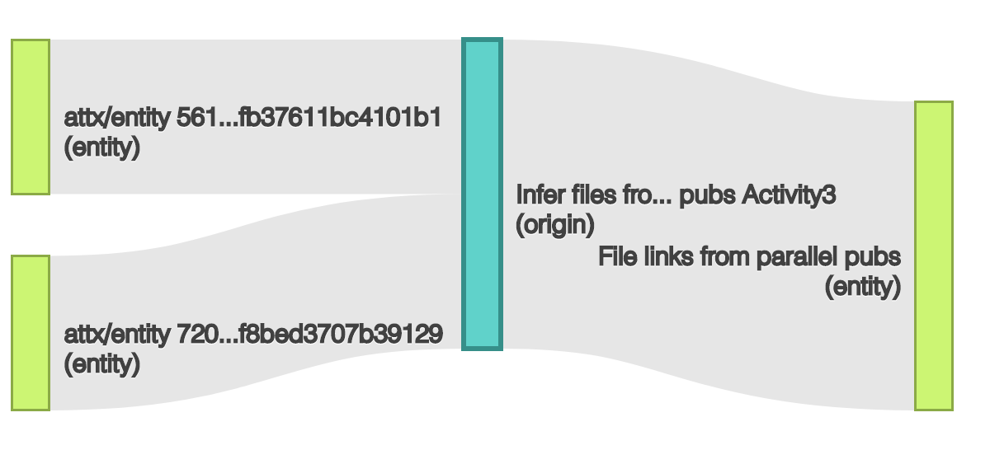
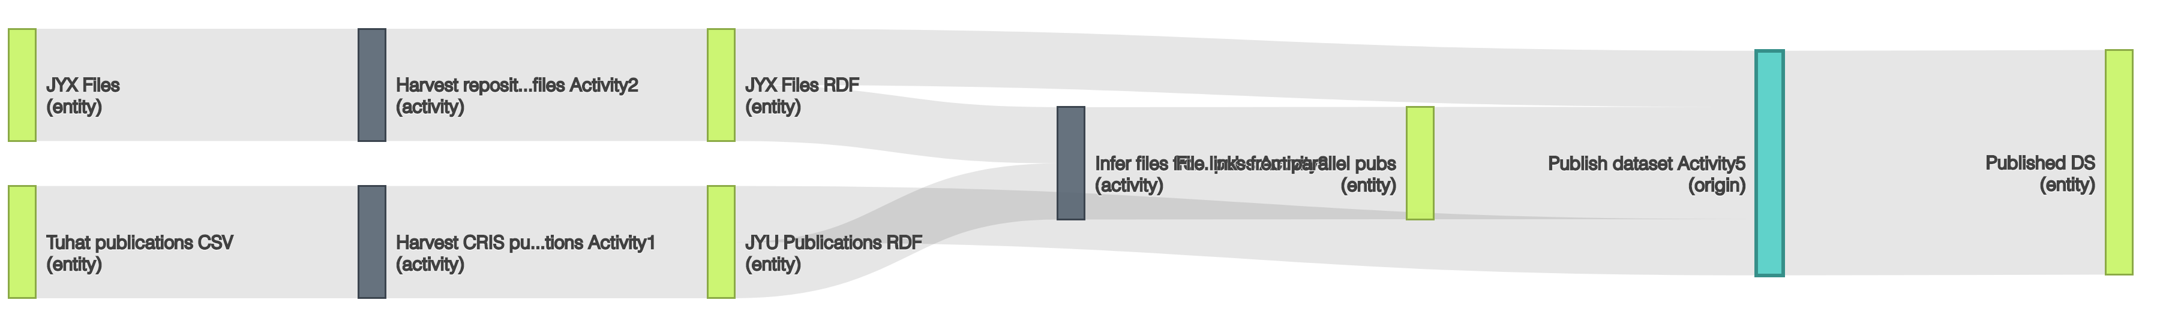
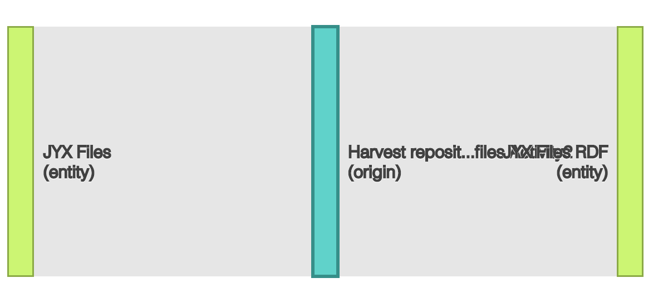
Connected datasets
Created using Prov-O-Viz
http://provoviz.org/

Slide 21
The TODO
Provenance for incrementally harvested datasets
Datasets that have subsets
Integrating Service Registry to the provenance data
More information about the component in a common manner
Implicit provenance
Routing all the messages to the provenance service
Creating the request-response patterns based on provenance contexts

Slide 22


Thank you
https://creativecommons.org/licenses/by-nc-sa/2.0/

