Slide 1
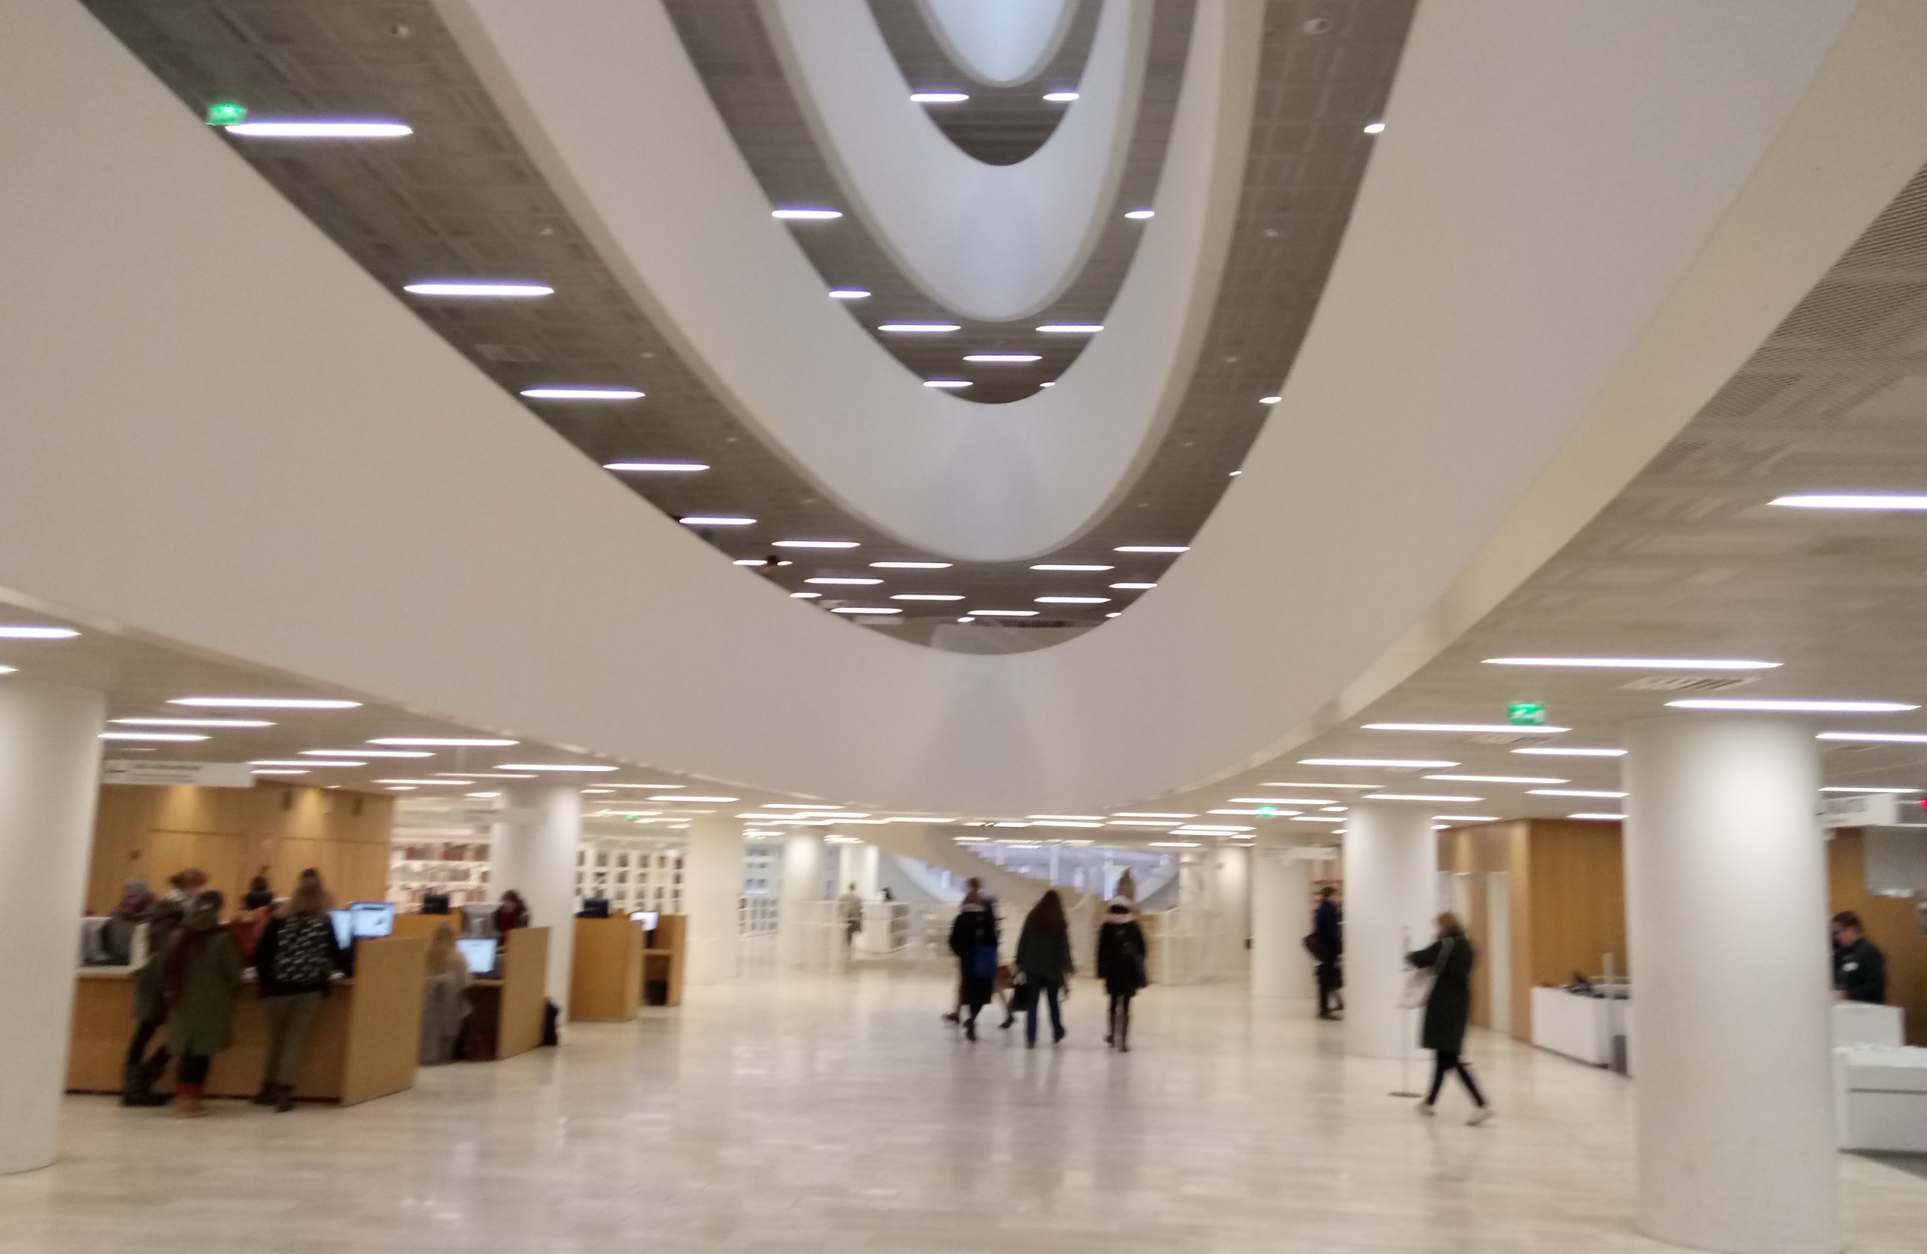
Putting Linked Data to Work:
Semantic Data "Brokering" in Practice

Slide 2
Outline
ATTX Project Overview
ATTX Semantic Broker on the ETL Landscape
  Provenance tracking
  Use cases
Demo
ATTX Technology Stack
  CI/CD Automation
  Deployment

Slide 3


Slide 4
Semantic Broker
Just Another ETL Tool?

Slide 5
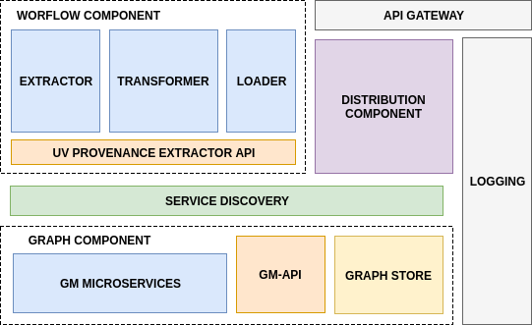
Semantic Broker
ATTX Semantic Broker Architecture
Provenance tracking
Advance capabilities of generating new data
Flexible graph based internal data model
Use case oriented
Containerised components: aiming for Micro-services Architecture

Slide 6
DEMO
Deployment & usage
Docker Swarm as platform for ATTX components: containerise everything (and run it everywhere);
Infrastructure-as-Code approach (yml file with service stack definition);
Automatic deployment via YML in own PC or Cloud (OpenStack)
Notes:
Docker benefits: “ship” the software with your own configurations and environment. You run it just like the developer did. Docker Swarm as software-defined PaaS
IaaC: don’t hard-depend sw architecture on servers or vms, but “programmatically” define how it should run and be configured in broad PaaS sense (in our case, Docker Swarm)
In practice: we aim that all SW researchers/IT librarians are able to run the ATTX stack in their standalone PC or Cloud with minimum constraints possible (Docker).

Slide 7
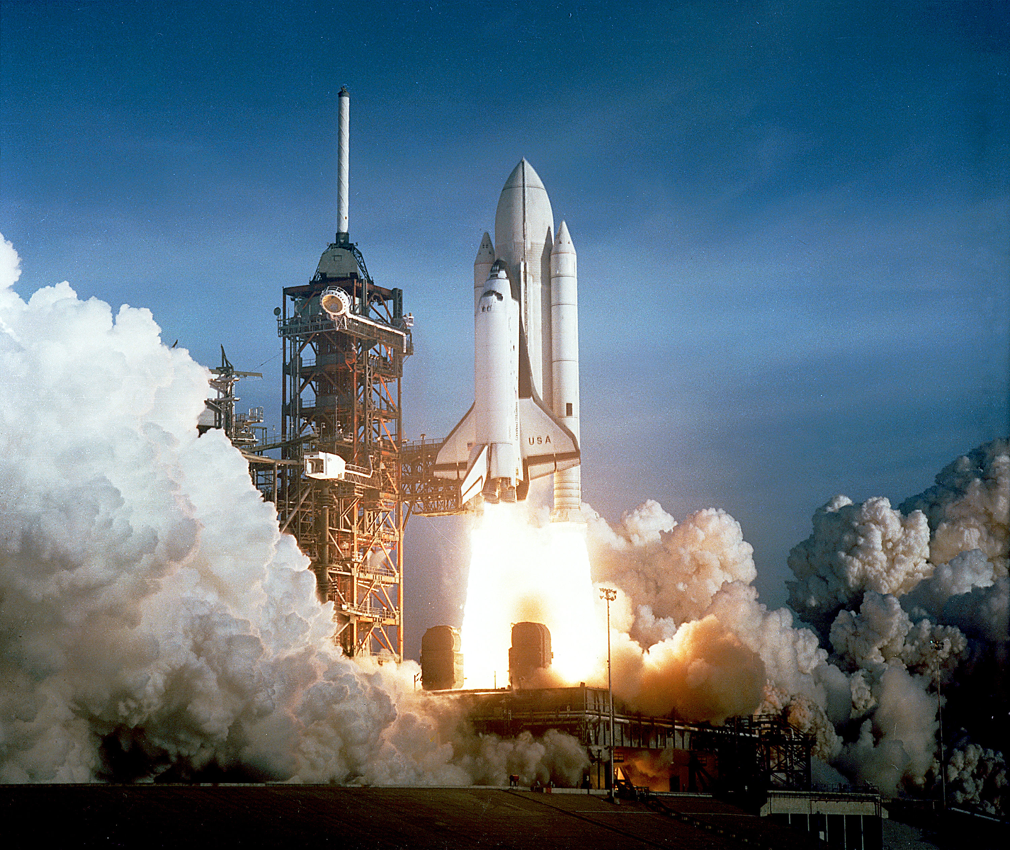
AUTOMATION FTW …
RIGHT?

Slide 8
Technology Stack
CI/CD workflow
Community tool

Slide 9
Technology Stack
CI/CD Environment
Gradle build tool - https://gradle.org/ with {py}Gradle
Github - https://github.com/
Jenkins - https://jenkins.io/
Docker - https://www.docker.com/
Archiva - https://archiva.apache.org/

Slide 10
Technology Stack
ATTX Semantic Broker
ElasticSearch - https://www.elastic.co/
UnifiedViews - https://unifiedviews.eu/
Consul - https://www.consul.io/
Jena + Fuseki - https://jena.apache.org
RML - http://rml.io/
SHACL - https://www.w3.org/TR/shacl/
ShEx -

Slide 11
Thank you
"They say it could not be done,
but we did it anyway, and it (kinda) worked"
Joonas Kesäniemi - @lunch 2017
https://www.helsinki.fi/en/projects/attx-2016
https://attx-project.github.io/
https://github.com/ATTX-project/elag2017-demo

