Slide 1
MACHINE LEARNING & SMART SYSTEMS · TOPIC 12.4
Explainable Sports Category
Classification
CNN transfer learning with Grad-CAM & SHAP — 100-class image recognition
Arda Tekin Tezel
Machine Learning & Smart Systems
University of Europe for Applied Sciences, Potsdam
Final Project — Phase III
100-class image classification
Custom CNN · EfficientNetV2-B0 · ConvNeXt-Tiny
Notes:
Title slide. Introduce yourself, the topic (12.4), and the three models. ~20s.

Slide 2
PROBLEM & MOTIVATION
Why classify sports images — and why explain it?
Accuracy alone is not enough for a trustworthy system
Scale
Sports media platforms and archives hold millions of images that must be tagged by sport for search, indexing, and broadcast analytics.
Manual tagging fails
Hand-labelling across 100+ categories is slow, costly, and inconsistent — it simply does not scale.
Explainability is essential
A model can be right for the wrong reasons. We must verify it looks at the athlete and equipment, not the background.
🎯 Goal
An accurate AND interpretable 100-class sports classifier, deployed as a live web demo whose every decision can be inspected with Grad-CAM and SHAP.
Notes:
Motivate the task and stress why explainability matters for trust. ~40s.

Slide 3
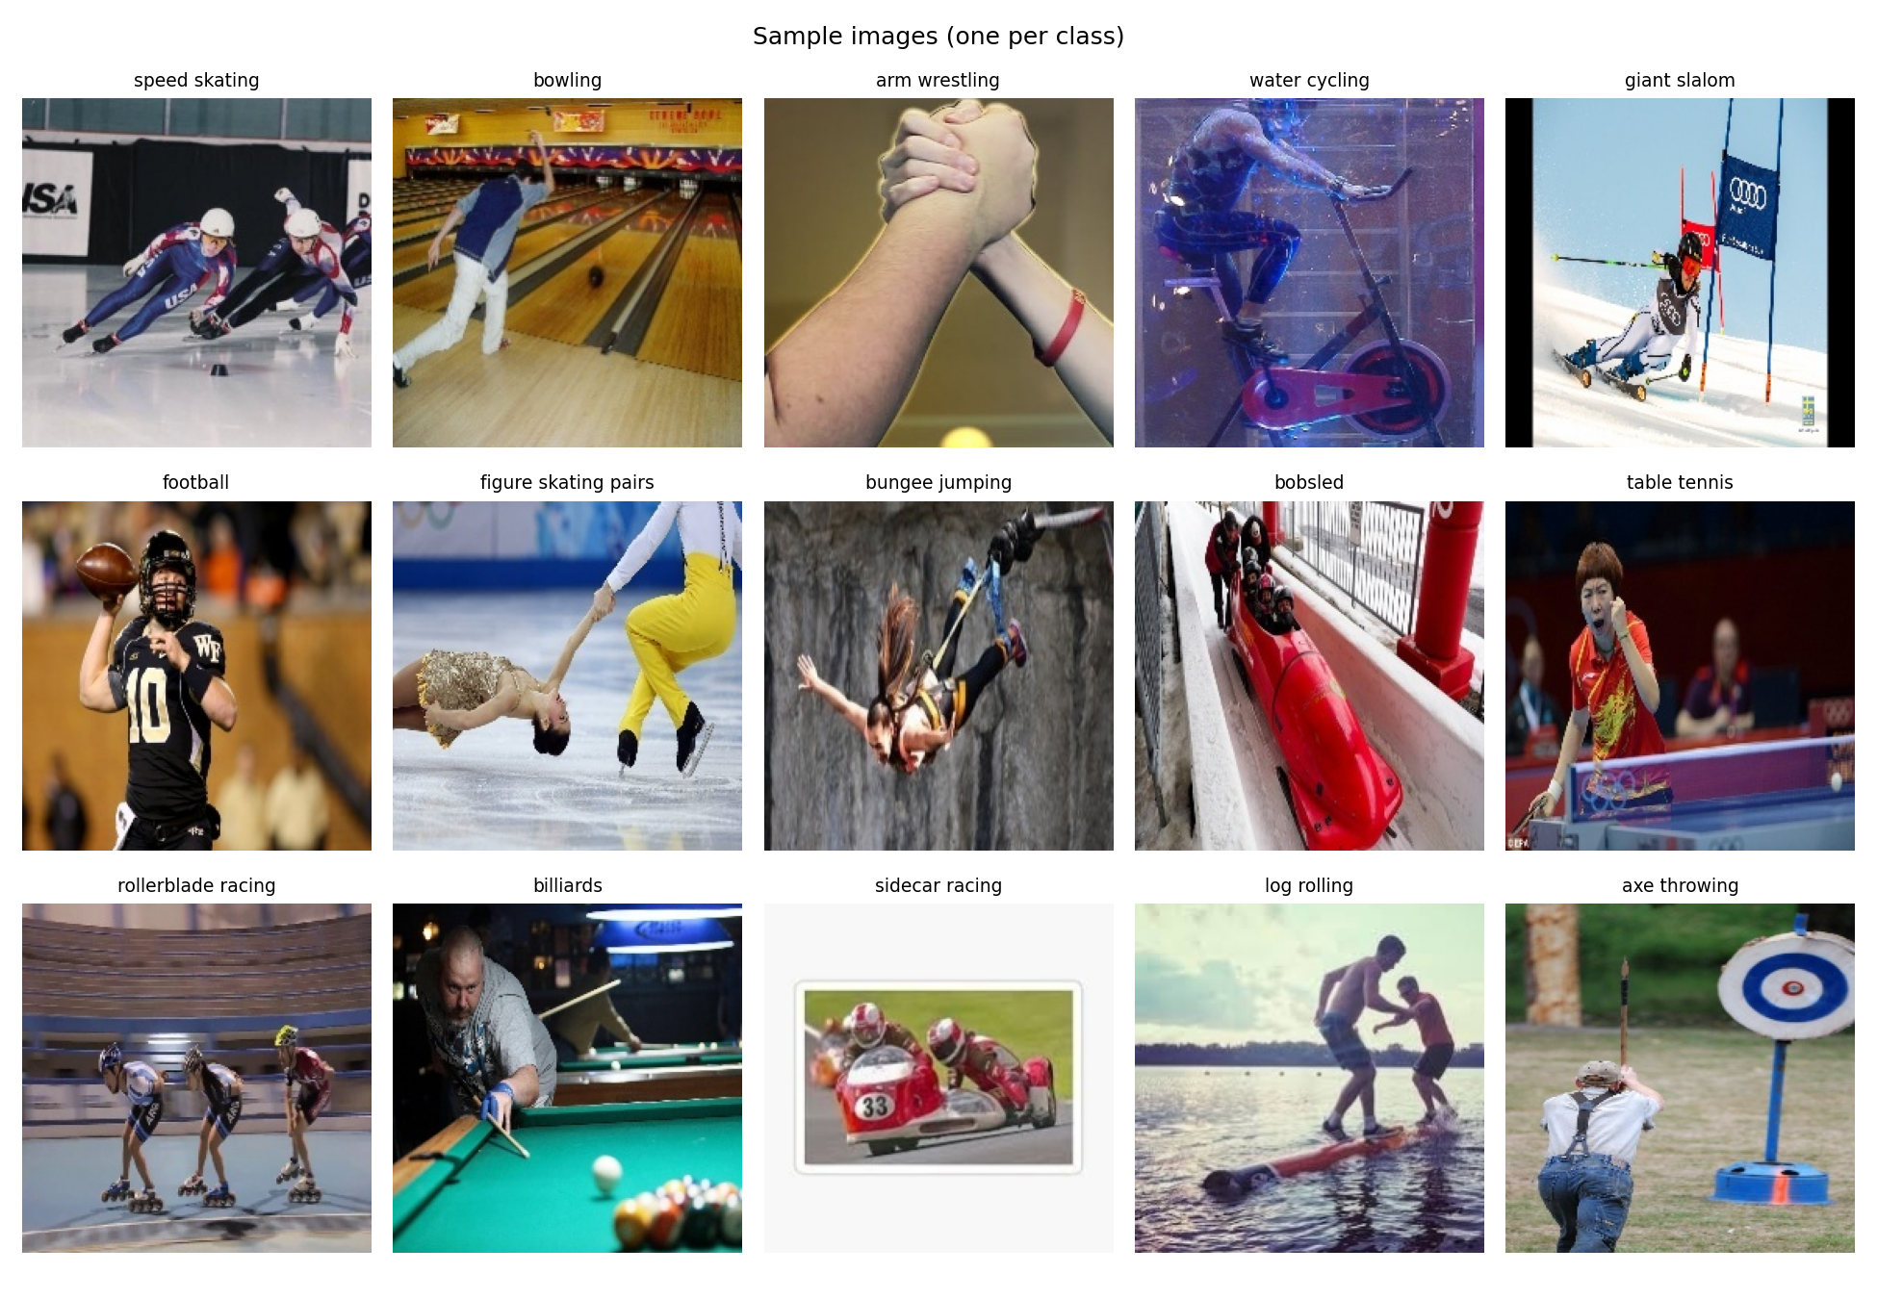
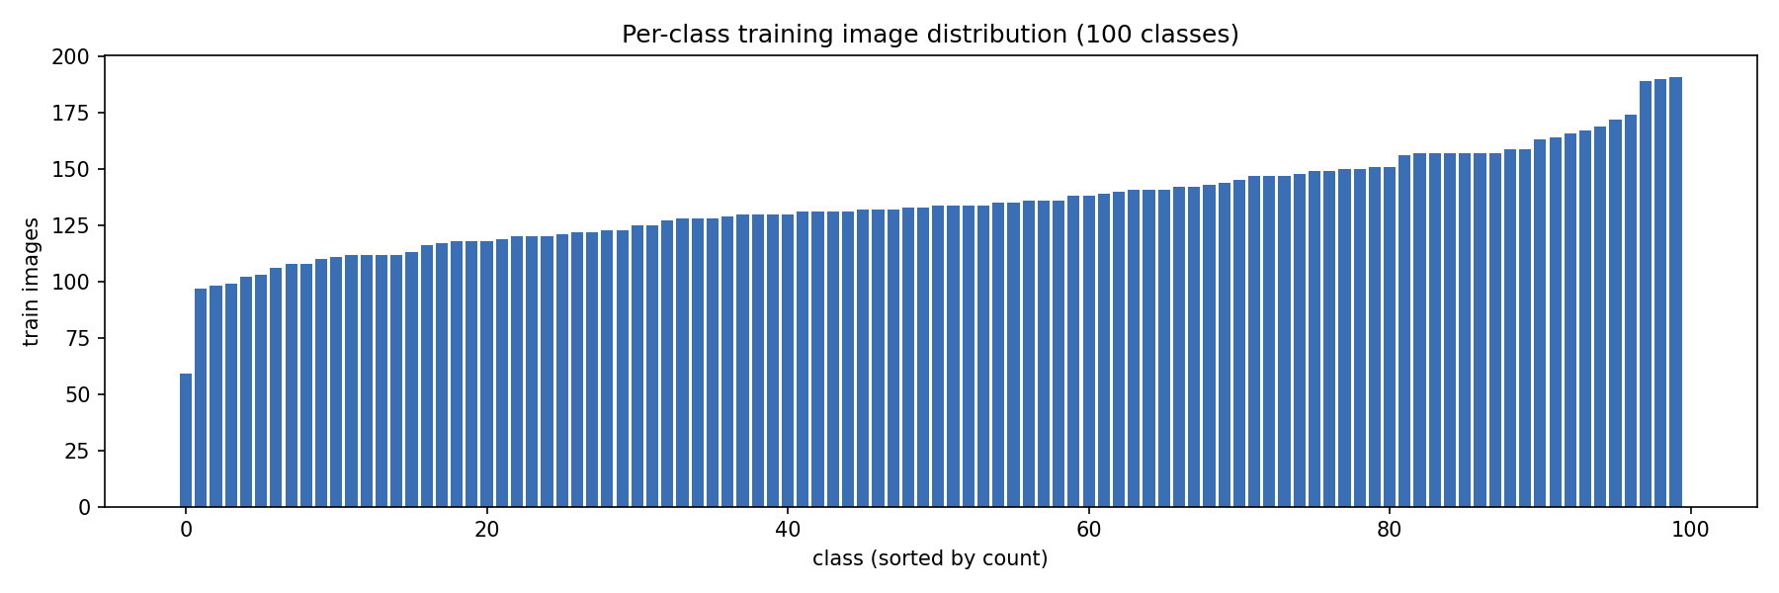
DATA & PREPROCESSING
100 Sports Image Classification (Kaggle, gpiosenka)
From raw images to a model-ready pipeline
100 classes
~14,500 RGB images spanning 100 sports, from air hockey to wingsuit flying.
Fixed splits
13,493 train / 500 validation / 500 test, all standardised to 224 x 224 x 3.
Augmentation
Horizontal flip, small rotation, zoom and contrast — applied to the training set only.
Sample images (one per class)
Class distribution — near-balanced
Notes:
Describe the dataset and preprocessing. Point to the sample grid and the near-balanced distribution (59–191 images/class, mean ~135). ~40s.

Slide 4
RESEARCH QUESTIONS
Five questions guide the study
From model choice to a deployable, explainable prototype
RQ1
Which architecture classifies 100 sports most accurately?
RQ2
Does ImageNet transfer learning beat a custom CNN trained from scratch?
RQ3
Do Grad-CAM and SHAP show the model attends to athletes and equipment, not the background?
RQ4
Which model gives the best accuracy / speed / size trade-off?
RQ5
Can the best model be deployed as a working, explainable web demo?
Notes:
Read the five research questions; they structure the whole talk. ~35s.

Slide 5
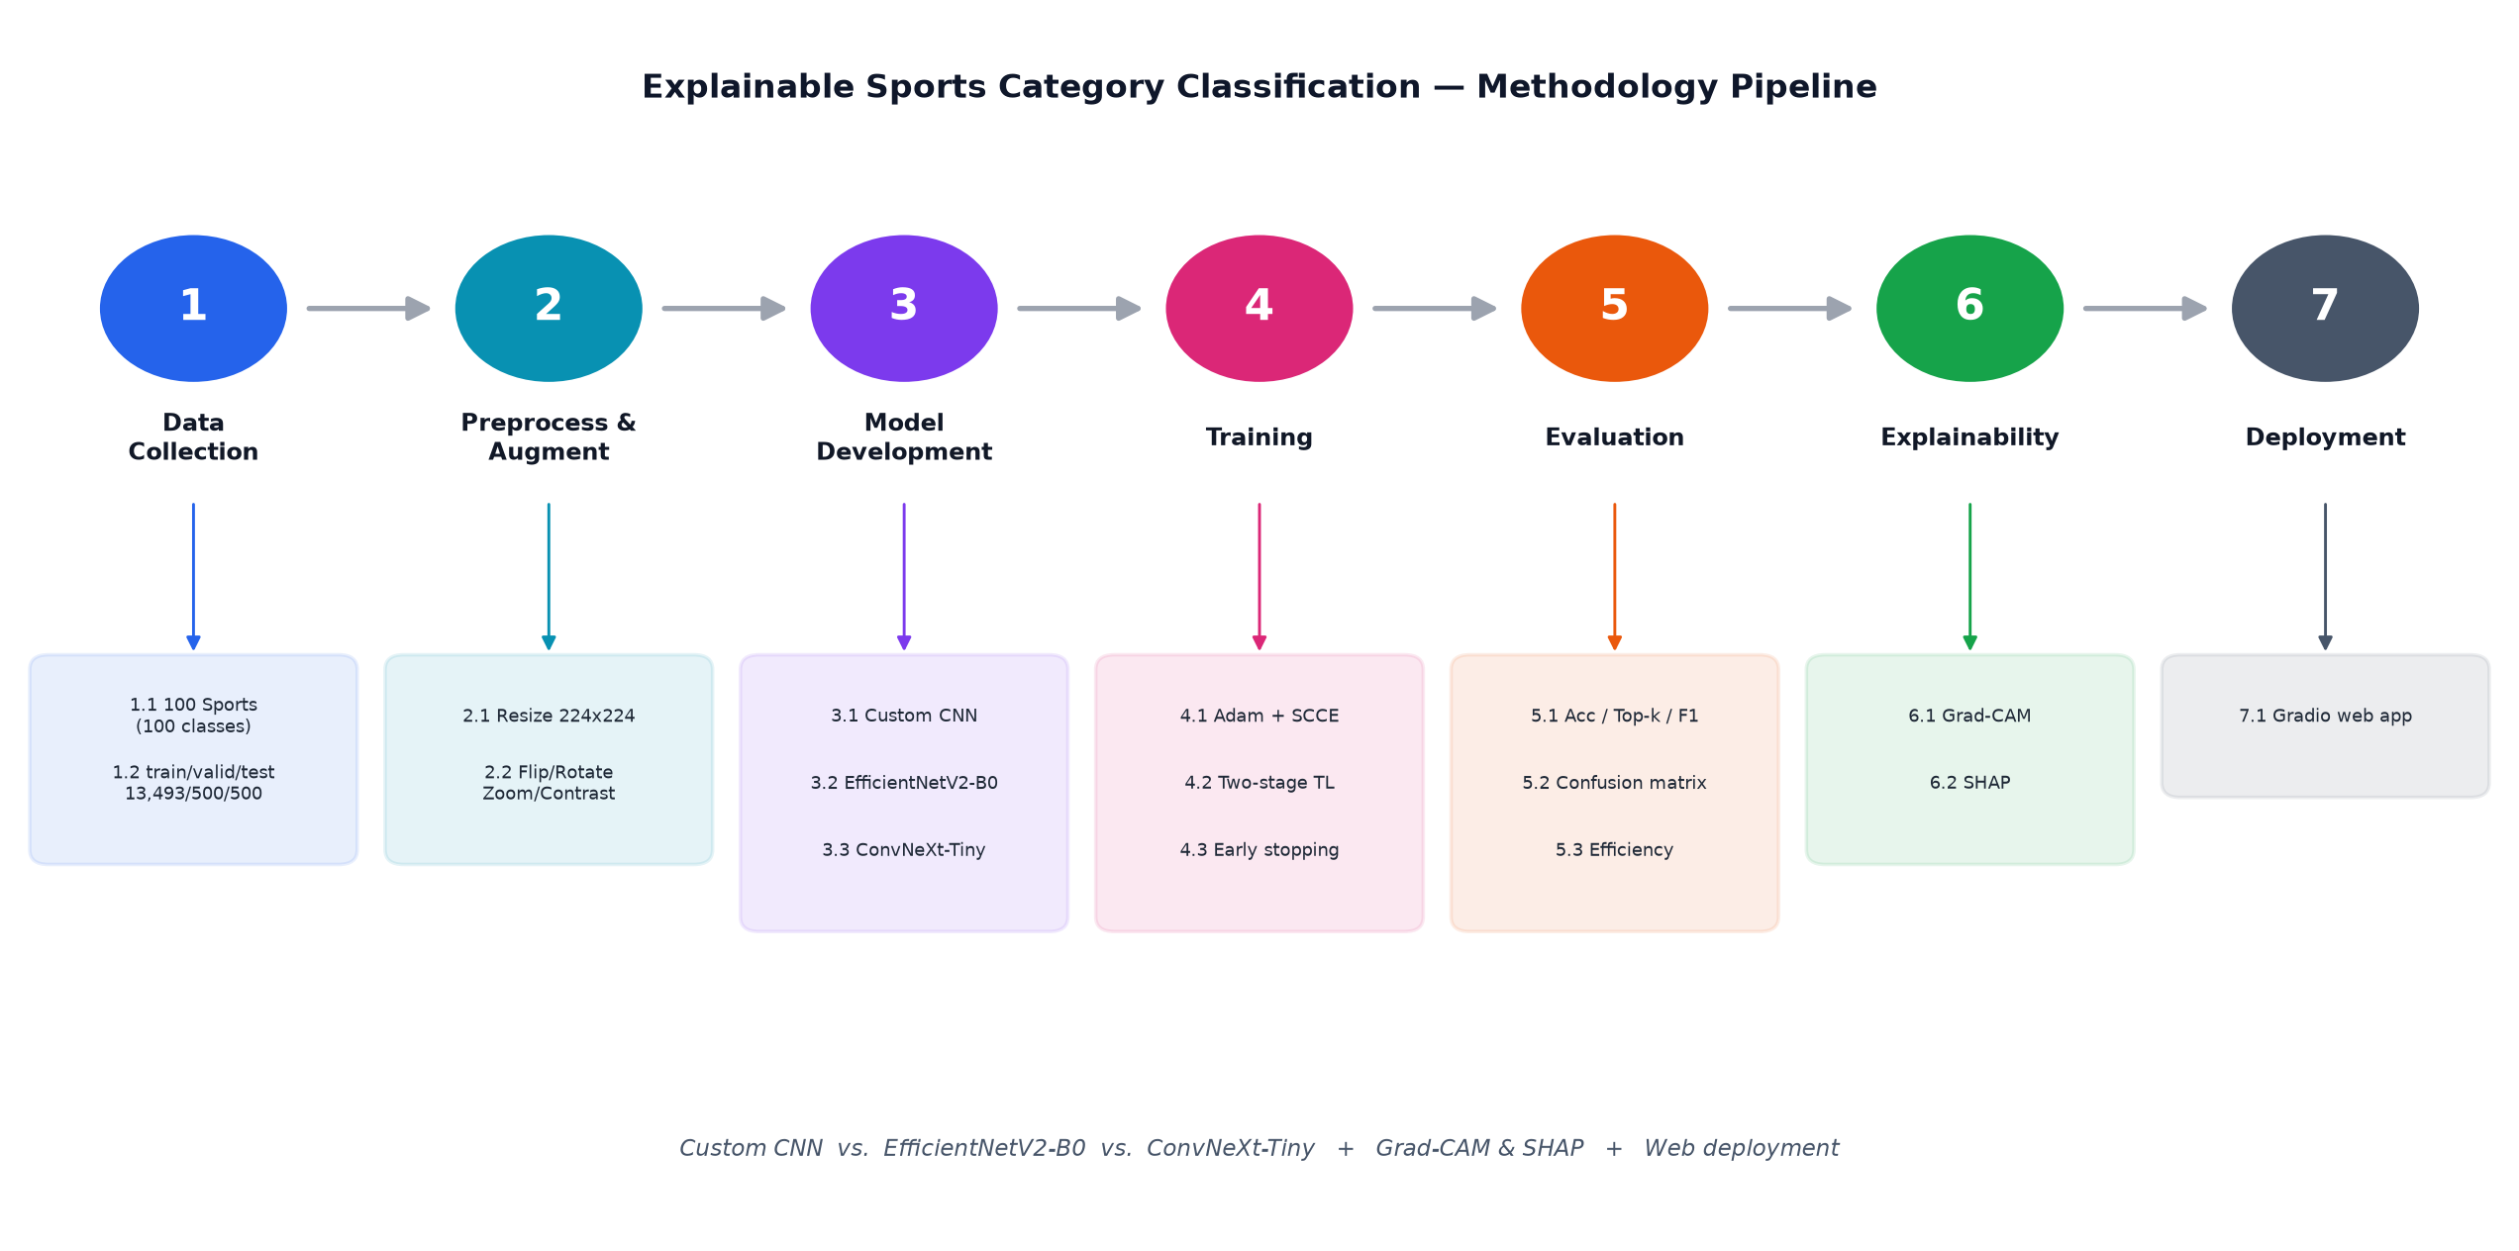
METHODOLOGY
From raw images to an explainable web app
A single, reproducible pipeline (seed 42)
Notes:
Walk left to right through the pipeline: data -> preprocess/augment -> 3 models -> evaluate -> Grad-CAM/SHAP -> deploy. Everything is seeded for reproducibility. ~45s.

Slide 6
MODELS
Three architectures, one classification task
A lightweight baseline versus two pretrained backbones
1
Custom CNN
From scratch; 4 convolutional blocks (32 -> 256).
BatchNorm + MaxPool; global average pooling.
~0.48M parameters; lightweight baseline.
2
EfficientNetV2-B0
ImageNet pretrained; transfer learning.
Two-phase fine-tuning; ~6.0M parameters.
Efficiency-focused; best trade-off.
3
ConvNeXt-Tiny
ImageNet pretrained; modern ConvNet.
Two-phase fine-tuning; ~27.9M parameters.
Highest capacity and accuracy.
All trained with Adam, sparse categorical cross-entropy, early stopping and LR-reduction on plateau. Two-stage transfer: freeze the backbone to train the head, then fine-tune the top ~30%.
Notes:
Contrast the from-scratch baseline with the two transfer-learning models and the two-stage protocol. ~40s.

Slide 7
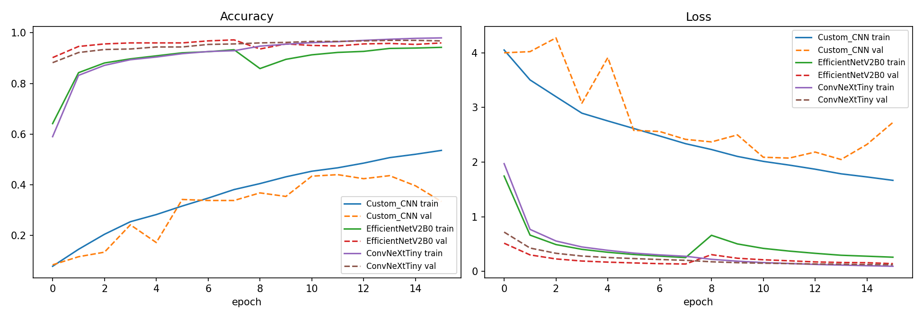
TRAINING BEHAVIOUR
Convergence and overfitting control
Accuracy and loss, training versus validation
What the curves show
• All models converge within the epoch budget.
• Early stopping restores the best validation weights.
• The small train–validation gap shows augmentation kept overfitting under control.
• Transfer-learning models start higher and plateau sooner than the from-scratch baseline.
Notes:
Read the training curves: convergence, early stopping, and the train-val gap as an overfitting check. ~35s.

Slide 8
RESULTS — TEST SET
Accuracy, and the cost of chasing it
Headline metrics on the 500-image held-out test set
Model | Accuracy | Macro-F1 | Top-3 | Params | Size | Inference
Custom CNN | 0.472 | 0.429 | 0.676 | 0.48 M | 1.9 MB | 0.6 ms
EfficientNetV2-B0 | 0.962 | 0.960 | 0.992 | 6.05 M | 24 MB | 9.6 ms
ConvNeXt-Tiny ✓ | 0.964 | 0.963 | 0.994 | 27.9 M | 112 MB | 113 ms
✓ Transfer learning wins
Both pretrained backbones beat the from-scratch baseline by roughly 49 accuracy points (96% vs 47%), answering RQ1 and RQ2.
⚡ Efficiency matters
ConvNeXt-Tiny is the most accurate; EfficientNetV2-B0 matches it within 0.2 points at about one-fifth the size and one-twelfth the latency — the best efficiency trade-off (RQ4).
Notes:
Walk through the table: ConvNeXt-Tiny is most accurate (marked ✓), EfficientNetV2-B0 is nearly tied but far cheaper, and the custom CNN trails badly. Stress the ~49-point transfer-learning gain. ~50s.

Slide 9
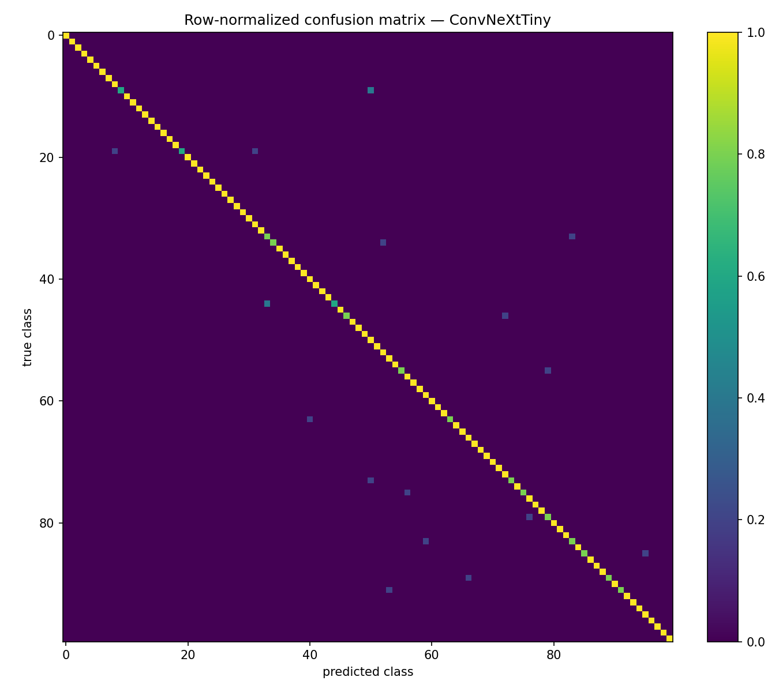
CLASS-LEVEL ANALYSIS
Where the mistakes land
A 100 x 100 confusion matrix
Reading the errors
• A strong diagonal: most classes are recognised reliably.
• Errors concentrate between visually similar sports — e.g. horseshoe pitching vs frisbee, baton twirling vs javelin.
• Distinctive-scene sports (e.g. wingsuit flying, wheelchair racing, weightlifting) score a perfect F1 of 1.0.
• This pattern is exactly what explainability then probes (RQ3).
Notes:
Use the confusion matrix to name the hardest, most-confused sports (frisbee, baton twirling, horseshoe pitching) and the perfect ones. ~35s.

Slide 10
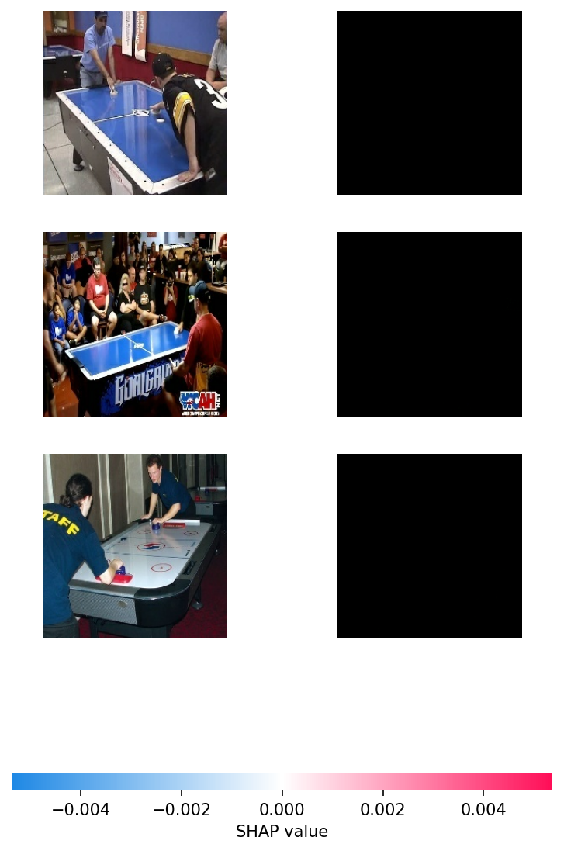
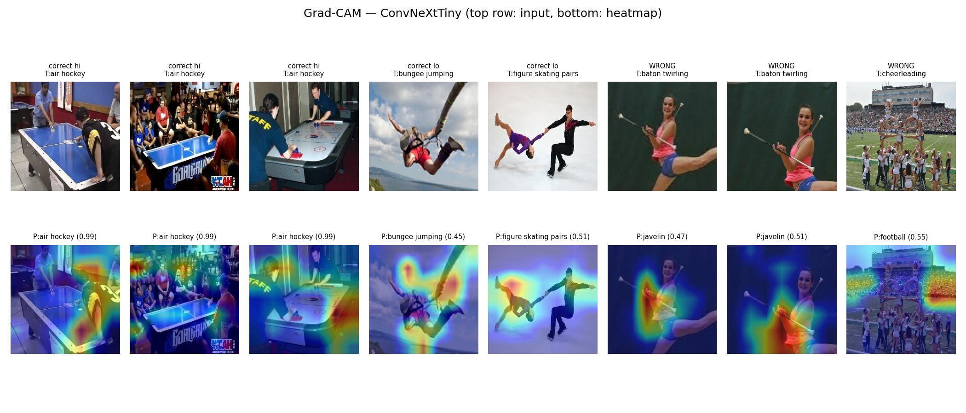
EXPLAINABILITY
Does the model look at the right thing?
Two independent methods: Grad-CAM and SHAP
Grad-CAM — class activation heatmaps
SHAP — pixel-level attributions
✓ Methods agree
Both methods are computed independently yet highlight the athlete, ball and playing area — strengthening trust that predictions use meaningful features (RQ3).
✕ But not always
On some errors the attention drifts to the background — a reliability warning that explainability surfaces and accuracy alone hides.
Notes:
Show Grad-CAM and SHAP agree on correct cases and expose background reliance on wrong ones. ~45s.

Slide 11
TRADE-OFF & DEPLOYMENT
Choosing for balance, not for the leaderboard
Accuracy is only one axis
Custom CNN
1.9 MB · 0.6 ms.
Smallest and fastest by far — but only 47% accuracy, so not usable in practice.
EfficientNetV2-B0
24 MB · 9.6 ms.
Within 0.2 pts of the best accuracy at ~1/5 the size and ~1/12 the latency.
Best efficiency trade-off (recommended).
ConvNeXt-Tiny
112 MB · 113 ms.
Highest accuracy (96.4%) but largest and slowest — deployed as the top-accuracy model.
🚀 Live, explainable web demo
Deployed on Hugging Face Spaces with Gradio: upload an image and get the top-5 sports, confidence scores, and a live Grad-CAM heatmap — directly in the browser (RQ4 & RQ5).
Notes:
Argue for balance over raw accuracy: EfficientNetV2-B0 is the efficiency pick, ConvNeXt-Tiny the accuracy pick (and what is deployed). Introduce the live demo. ~40s.

Slide 12
CONCLUSION
Accuracy is necessary. Explanation makes it trustworthy.
What the study established
Strong results
The pretrained CNNs classify 100 sports well; the best (ConvNeXt-Tiny) reaches 96.4% test accuracy.
Transfer learning wins
ImageNet pretraining beats the from-scratch baseline by ~49 points — 96% vs 47% (RQ1, RQ2).
Explanations validated
Grad-CAM and SHAP confirm focus on athletes and equipment — and expose occasional background reliance (RQ3).
Deployed prototype
ConvNeXt-Tiny deployed as an explainable web demo; EfficientNetV2-B0 recommended for efficient deployment (RQ4, RQ5).
🔭 Limitations & future work
Single public dataset, no external validation, and heatmaps are not proof of correct reasoning. Future work: add diverse external data and reduce background-shortcut behaviour.
Notes:
Summarise the four takeaways, state limitations honestly, and thank the audience. ~40s.

