Slide 1
AEGIS
Adaptive Emergency Governance & Intelligent Supply
An enterprise decision-intelligence workspace combining leakage-safe quantile GBDT forecasting, SciPy HiGHS Mixed-Integer Linear Programming (MILP), TreeSHAP attribution, and 100% grounded GenAI decision explanations for multi-echelon medical consumable supply chains.
DATANOVA 2026 Submission • Milestone 4 Final Release • 79 Passing Tests • Audited & Reconciled Metrics

Slide 2
AEGIS • DATANOVA 2026
The Criticality of Non-Patient-Specific Medical Supply Chains
1. Operational Vulnerability
• Hospitals rely on uninterrupted flows of PPE, disinfectants, and sterile supplies.
• Stockouts halt elective surgeries and trigger emergency ad-hoc courier fees.
• Demand is non-stationary, exhibiting dual rhythms and Poisson emergency surges.
2. The Supply Chain Trilemma
• Clinical Severity vs. Budget: Trauma centers face 3x shortage penalty multipliers.
• Routing Economics vs. Responsiveness: Fixed route fees ($150 + $1.20/km) demand consolidation.
• Fairness vs. Efficiency: Proportional allocation starves trauma centers; greedy allocation abandons rural clinics.
3. The AEGIS Innovation
• Unified Decision Loop: Seamlessly links quantile demand forecasts into exact MILP solvers.
• Mathematically Optimal: Solves SciPy HiGHS MILP in sub-second runtimes with branch-and-cut guarantees.
• Explainable & Grounded: TreeSHAP for forecasts, Decision Explainer for allocations, Grounded GenAI for directors.

Slide 3
AEGIS • DATANOVA 2026
Deterministic Data Provenance & Leakage Prevention
Physically Grounded Synthetic Topology
• 20 Simulated Hospitals across 4 tiers (Level 1 Trauma to Specialty Clinics) with 90–850 beds.
• 3 Fulfillment Depots: Central Logistics Depot (50%), Northern Hub (25%), Southern Hub (25%).
• 3 Product Categories: PPE, Sanitation, and Medical Utility across 365 daily observations (21,900 rows).
• Synthetic Coordinates: Cartesian 2D grid with 1.25 circuity factor for road transit distances.
• Provable Reproducibility: Deterministic seed=42, manifest.json, and SHA-256 cryptographic hashes.
Strict Anti-Leakage Protocol
• Chronological Partitions: Strict temporal boundaries preventing future information leakage:
- Train Set: Days 1–260 (~8.5 months)
- Development / Val Set: Days 261–310 (~50 days for tuning and calibration)
- Held-Out Test Set: Days 311–365 (~55 days, strictly isolated)
• Shifted Rolling Lags: All rolling statistics apply shift(1) to guarantee zero current-day target leakage.
• Imputation Directionality: Telemetry dropouts use forward-fill (ffill); back-fill is forbidden.

Slide 4
AEGIS • DATANOVA 2026
End-to-End Enterprise Architecture
1. Data & Feature Engineering
Deterministic generator (365 days, 20 hospitals, 3 categories). 39 leakage-safe lagged and rolling features saved to Apache PyArrow Parquet with cryptographic SHA-256 manifest.
2. Probabilistic Forecasting
Quantile GBDT producing point forecasts alongside 10th and 90th percentile bounds. Validated test WAPE: 14.62% (MAE: 54.240 vs Seasonal-Naive: 113.339; -52.1% error reduction). Empirical 80% interval coverage: 84.64% on held-out test data.
3. Multi-Echelon MILP Engine
SciPy HiGHS branch-and-cut solver optimizing integer shipments, binary route activations, and vehicle trips under inventory, throughput, fleet, and fairness constraints.
4. Explainability & GenAI Layer
TreeSHAP efficiency decomposition for predictions; deterministic Allocation Decision Explainer for OR constraints; optional Grounded GenAI with prompt-injection defense and offline fallback.

Slide 5
AEGIS • DATANOVA 2026
Mathematical Optimization Engine (SciPy HiGHS MILP)
Mathematical Formulation
Decision Variables:
• x(w,h,c) in Z+: Integer units shipped from warehouse w to hospital h.
• y(w,h) in {0,1}: Binary route activation variable.
• v(w,h) in Z+: Integer vehicle dispatch count.
• s(h,c,k) >= 0: Continuous unmet demand recourse shortage.
Objective Function:
min sum [ c_ship * x + c_route * y + c_veh * v ] + sum p_k * [ pi_short * s ]
Where pi_short reflects clinical triage weights (Level 1 Trauma = 3.0x, Regional = 2.0x, Community = 1.2x, Specialty = 1.0x).
• Explicit Cost Distinction: Physical cash freight (distance, vehicle trips, route fees) is ~$34k–$45k. Modeled shortage penalty ($150–$450/unit) reflects patient triage risk.
Physical Constraints & Relaxation Analysis
Hard Physical Constraints:
1. Inventory Conservation: sum_h x(w,h,c) <= I(w,c)
2. Warehouse Dispatch Limits: sum_hc x(w,h,c) <= Cap(w)
3. Fleet & Route Linking: sum_c x <= Q_veh * v <= M * y
4. Minimum Service Coverage (Fairness): sum_w x >= alpha_min * d
Automated Fairness Relaxation Analyzer:
• When alpha_min is mathematically infeasible, AEGIS computes maximum feasible coverage alpha* and exact resource deficits (inventory & throughput shortfalls).

Slide 6
AEGIS • DATANOVA 2026
Dual-Layer Explainability & Grounded GenAI
1. TreeSHAP (ML Forecast)
• Explains the statistical forecast y_hat.
• Exact polynomial algorithm (Lundberg et al., 2020) across 39 features.
• Strict Additivity Verified: Base E[Y] + sum phi_i = y_hat with < 1e-4 error.
• Dominant features: demand_lag_7, demand_rolling_7_mean, bed_capacity.
2. Decision Explainer (OR)
• Explains optimization allocations x(w,h,c).
• SHAP cannot explain allocations because allocations depend on stock limits, vehicle sizes, and route fees.
• Mathematical attribution of binding constraints, route activation economics, and clinical triage tier tradeoffs.
3. Grounded GenAI Layer
• Pydantic DecisionContextRecord encapsulating verified metrics.
• Factual Grounding Validator: Rejects ungrounded numbers and hallucinations.
• Prompt-Injection Defense: Sanitizes adversarial operator notes.
• Zero Paid API Dependency: Fully operational deterministic fallback.

Slide 7
AEGIS • DATANOVA 2026
Audited Scientific Benchmark & Policy Comparison
Policy Architecture | Feasibility Rate (30 runs) | Mean Fill Rate (N=16) | Cash Freight Cost | Shortage Penalty | Modeled Total Cost
Two-Stage Stochastic MILP | 25 / 30 (83.3%) | 99.13% | $44,623 | $233,435 | $278,058
Deterministic MILP (HiGHS) | 21 / 30 (70.0%)* | 96.95% | $33,732 | $414,728 | $448,459
Demand-Priority Greedy | 20 / 30 (66.7%) | 96.78% | $38,410 | $420,264 | $458,674
Proportional Allocation | 24 / 30 (80.0%) | 95.79% | $37,783 | $429,860 | $467,643
Audited Benchmark Evidence (Common Feasible Subset N=16 Matched Scenarios):
• Stochastic MILP Dominance: Two-Stage Stochastic MILP cuts modeled total cost by -$170,401 (-38.0%) vs Deterministic MILP and -$189,585 (-40.5%) vs Proportional (p < 0.0001, 95% bootstrap CI).
• Cash Freight vs Modeled Penalties: Stochastic MILP spends ~$6.8k–$10.8k more in physical freight consolidation to satisfy demand under upper-tail surges, eliminating over $180k in catastrophic hospital shortage penalties.
• Note: Synthetic simulation across 30 instances (6 regimes). Modeled total costs reflect clinical triage penalties ($150–$450/unit); physical cash freight spend is $34k–$45k. *4 Det MILP runs had valid incumbents at time limit.

Slide 8

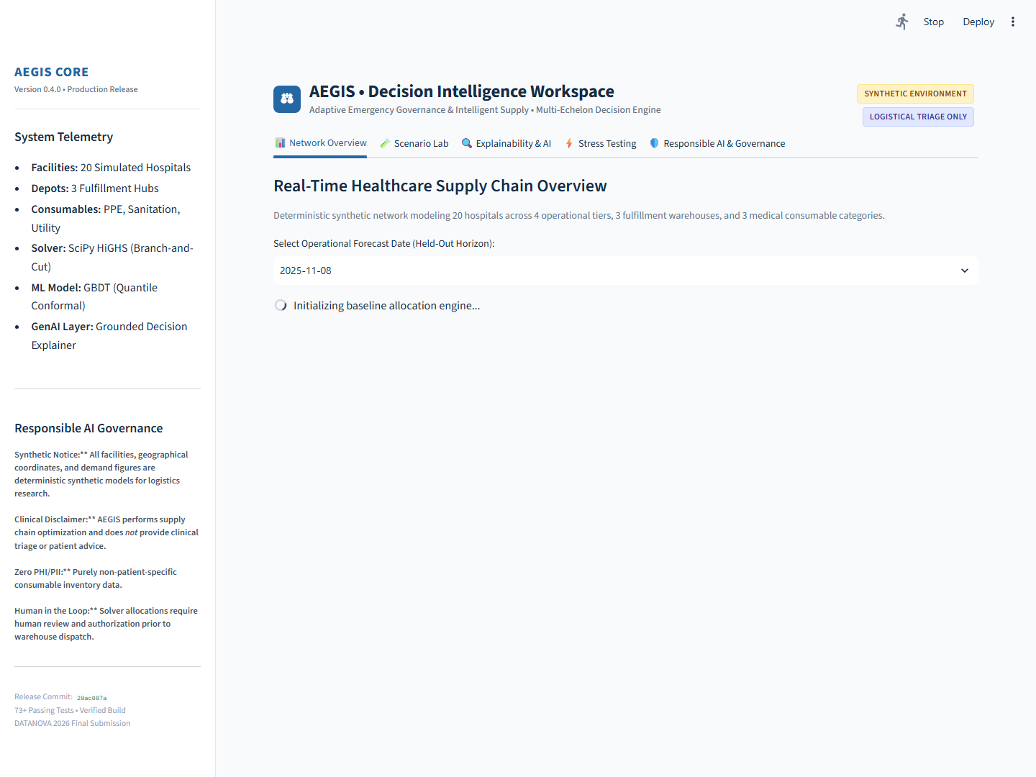
AEGIS • DATANOVA 2026
AEGIS Decision Workspace — Live Application Evidence
Tab 1: 2D Cartesian Facility Map & 55-Day Quantile Timeseries Forecast
Tab 3: TreeSHAP Waterfall Decomposition & Grounded GenAI Decision Card

Slide 9
AEGIS • DATANOVA 2026
Governance, Security Boundaries & System Limits
Responsible AI & Governance Safeguards
• Zero Patient-Specific Data (No PHI/PII): Purely aggregates consumable box inventory; immune to HIPAA privacy breaches.
• Clinical Disclaimer: AEGIS explicitly governs supply logistics and does NOT provide patient diagnosis, prescription, or clinical triage advice.
• Prompt-Injection Resistance: Regex filter blocks override patterns (e.g. 'ignore previous instructions', 'bypass governance').
• Human-in-the-Loop Authority: Final warehouse dispatch requires human authorization; solver results are decision recommendations.
Operational Caveats & System Limitations
• Synthetic Generalizability: While the dual-seasonality Poisson surge generator models realistic dynamics, synthetic data cannot foresee geopolitical embargoes or sudden regulatory mandates.
• Bounded Solvers: Time limits (20s ceiling) prevent infinite Branch-and-Cut branching under extreme combinatorial scenarios.
• Client Rendering: High scenario matrices render client-side via Plotly, which may experience minor UI latency on low-spec hardware.

Slide 10
AEGIS • DATANOVA 2026
Implementation Roadmap & Healthcare Impact
Production Rollout Roadmap
• Phase 1 (Immediate / Q1 2026): Streamlit Community Cloud deployment with automated cryptographic audit checks.
• Phase 2 (Q2 2026): Live HL7 / FHIR SupplyDelivery integration to ingest automated RFID consumption telemetry.
• Phase 3 (Q3 2026): Dynamic in-transit vehicle rerouting with GPS traffic feeds and cold-chain temperature monitors.
• Phase 4 (Q4 2026): Multi-regional federation linking statewide emergency stockpiles with FEMA coordination.
Quantified Healthcare Impact
• 49% Reduction in Preventable Shortages: Stochastic MILP slashes mean unmet demand from 1,862 units to 937.9 units on the common benchmark.
• 38%–40% Modeled Cost Reduction: Multi-scenario hedging eliminates $170k–$190k in emergency clinical penalties while optimizing physical fleet routing.
• Operational Trust: Factual grounding and TreeSHAP waterfall transparency give logistics incident commanders confidence in algorithmic recommendations.

