Slide 1
Analysis of Diseases of Significant Growth in the United States by State or Special Region
Patrick Cook

Slide 2
About Me
Patrick Cook
Have a Bachelor of Science degree - Physics and Mathematics from Texas State University
Taught high school Math, Science and Engineering for 12 years
Currently a WGU Student working on a degree in Data Management and Analytics

Slide 3
Project Overview
This project analyzes state level weekly cause of death data available from the Centers for Disease Control (CDC) to identify specific diseases with the highest growth in deaths so that it may be used to direct resources to reducing the number of deaths in the disease category.

Slide 4
The Problem
Challenge 1
Challenge 2
Challenge 3
Wasted Spending
In the United States, it is estimated that 25% of healthcare spending is wasted spending (Shrank, Rogstad & Parekh, 2019).
Wasted Resources
Facilities, labor hours and supplies are often wasted.
Worse Outcomes
Despite spending more on healthcare than any other modern country, the United States has worse outcomes (Tikkanen & Abrams, 2020).
Notes:
In 2019, the United States spent $3.8 trillion on healthcare accounting for 17.7% of Gross Domestic Product and the spending is projected to reach $6.2 trillion by 2028 (Centers for Medicare & Medicaid Services, 2020). Despite spending more on healthcare than any other modern country, the United States has worse outcomes (Tikkanen & Abrams, 2020). Worldwide, 20 to 40% of total healthcare spending is considered wasted spending (Sorato, Asl & Davari, 2020). In the United States, it is estimated that 25% of healthcare spending is wasted spending (Shrank, Rogstad & Parekh, 2019). Using the projected amount of healthcare spending for 2028, this would amount to more than $1.5 trillion dollars in wasted spending or the equivalent to more than $4,200 per person in the United Stated based on the U.S. Census Bureau’s International Data Base Projections for 2028 (U.S. Census Bureau, n.d.). Using historical health data can reduce these wasted expenditures by predicting trends in diseases and ensure resources are available and targeted to what is needed at the time. This will further reduce expenditures by reducing wasted labor hours and expiring supplies. It would also allow for facility use changes to be made prior to an increase in disease cases appearing, which will increase usage efficiency of facility space and staff.

Slide 5
Solution
Wasted spending can be reduced by focusing planning and resources on diseases with the highest growth rates in states and special regions.
Using historical health data can reduce these wasted expenditures by predicting trends in diseases and ensure resources are available and targeted to what is needed at the time.

Slide 6
Process
The data was cleaned by changing the data types, removing unneeded data and changing column names to a more user friendly format.
A summary of findings with recommendations were given based on the objective of the project.An html file was stored in code file.
First data sets were explored to find a data set that would work best to solve the organizational need.
Step 1
Step 2
Step 3
Step 4
Step 5
Once found the data was loaded into R-Studio® IDE and its structure explored.
Using descriptive statistics and visual tools, analysis was completed on the data.
Notes:
Exploratory data analysis techniques were used to analyze the data. First data sets were explored to find a data set that would work best to solve the organizational need. Once found the data was loaded into R-Studio® IDE and its structure explored. Afterwards, the data was cleaned by changing the data types, removing unneeded data and changing column names to a more user friendly format. Next, using descriptive statistics and visual tools, as in the figure below, analysis was completed on the data. Once the analysis was complete, a summary of finding with recommendations were given based on the objective of the project to reduce wasted spending in healthcare systems by planning for and focusing resources on the disease with the highest growth rate. An html file of the entire EDA can be found in the “EDA code and data” folder including the code file.

Slide 7
Success Criteria and
Summary of Findings

Slide 8
Top 5 States or Special Regions’ Year-Over-Year and Quarterly Most Significant Disease Growth Rates
The Top 5 states or special regions with the most statistically significant increases in weekly disease death rates are:
New York City for natural cause of death and heart disease
New Jersey for natural cause of death, influenza and pneumonia
South Dakota for natural cause of death
Massachusetts for natural cause of death
Connecticut for natural cause of death

Slide 9
The Top 5 states or special regions showing the most statistically significant growth in disease weekly death rates based on a one-sided 95% significance level:
New York City for natural cause weekly deaths in q2 of 2020 with the mean at 5.74 standard deviations from the previous years’ mean. And heart disease weekly deaths for the 2nd quarter of 2020 with the mean at 3.58 standard deviations from the previous years’ means.
New Jersey for natural cause weekly deaths in q2 of 2020 with the mean at 3.78 standard deviations from the previous years’ mean. And influenza and pneumonia weekly deaths for the 2nd quarter of 2020 with the mean at 3.18 standard deviations from the previous years’ means.
South Dakota for natural cause weekly deaths in q4 of 2020 with the mean at 3 standard deviations from the previous years’ mean.
Notes:
The objective of the project is to analyze state level weekly cause of death data available from the Centers for Disease Control (CDC) to identify specific diseases with the highest growth in deaths so that it may be used to direct resources to reducing the number of deaths in the disease category.
The objective was met with a greater than 95% significance level. The states are listed below with the standard deviations from the mean of each.
The Top 5 states or special regions showing the most statistically significant growth in disease weekly death rates based on a one-sided 95% significance level are:
New York City for natural cause weekly deaths in q2 of 2020 with the mean at 5.74 standard deviations from the previous years’ mean. And heart disease weekly deaths for the 2nd quarter of 2020 with the mean at 3.58 standard deviations from the previous years’ means.
New Jersey for natural cause weekly deaths in q2 of 2020 with the mean at 3.78 standard deviations from the previous years’ mean. And influenza and pneumonia weekly deaths for the 2nd quarter of 2020 with the mean at 3.18 standard deviations from the previous years’ means.
South Dakota for natural cause weekly deaths in q4 of 2020 with the mean at 3 standard deviations from the previous years’ mean.
Massachusetts for natural cause weekly deaths in q2 of 2020 with the mean at 2.94 standard deviations from the previous years’ mean.
Connecticut for natural cause weekly deaths in q2 of 2020 with the mean at 2.94 standard deviations from the previous years’ mean.

Slide 10
The Top 5 states or special regions showing the most statistically significant growth in disease weekly death rates based on a one-sided 95% significance level are: (Continued)
Massachusetts for natural cause weekly deaths in q2 of 2020 with the mean at 2.94 standard deviations from the previous years’ mean.
Connecticut for natural cause weekly deaths in q2 of 2020 with the mean at 2.94 standard deviations from the previous years’ mean.
Notes:
The objective of the project is to analyze state level weekly cause of death data available from the Centers for Disease Control (CDC) to identify specific diseases with the highest growth in deaths so that it may be used to direct resources to reducing the number of deaths in the disease category.
The objective was met with a greater than 95% significance level. The states are listed below with the standard deviations from the mean of each.
The Top 5 states or special regions showing the most statistically significant growth in disease weekly death rates based on a one-sided 95% significance level are:
New York City for natural cause weekly deaths in q2 of 2020 with the mean at 5.74 standard deviations from the previous years’ mean. And heart disease weekly deaths for the 2nd quarter of 2020 with the mean at 3.58 standard deviations from the previous years’ means.
New Jersey for natural cause weekly deaths in q2 of 2020 with the mean at 3.78 standard deviations from the previous years’ mean. And influenza and pneumonia weekly deaths for the 2nd quarter of 2020 with the mean at 3.18 standard deviations from the previous years’ means.
South Dakota for natural cause weekly deaths in q4 of 2020 with the mean at 3 standard deviations from the previous years’ mean.
Massachusetts for natural cause weekly deaths in q2 of 2020 with the mean at 2.94 standard deviations from the previous years’ mean.
Connecticut for natural cause weekly deaths in q2 of 2020 with the mean at 2.94 standard deviations from the previous years’ mean.

Slide 11
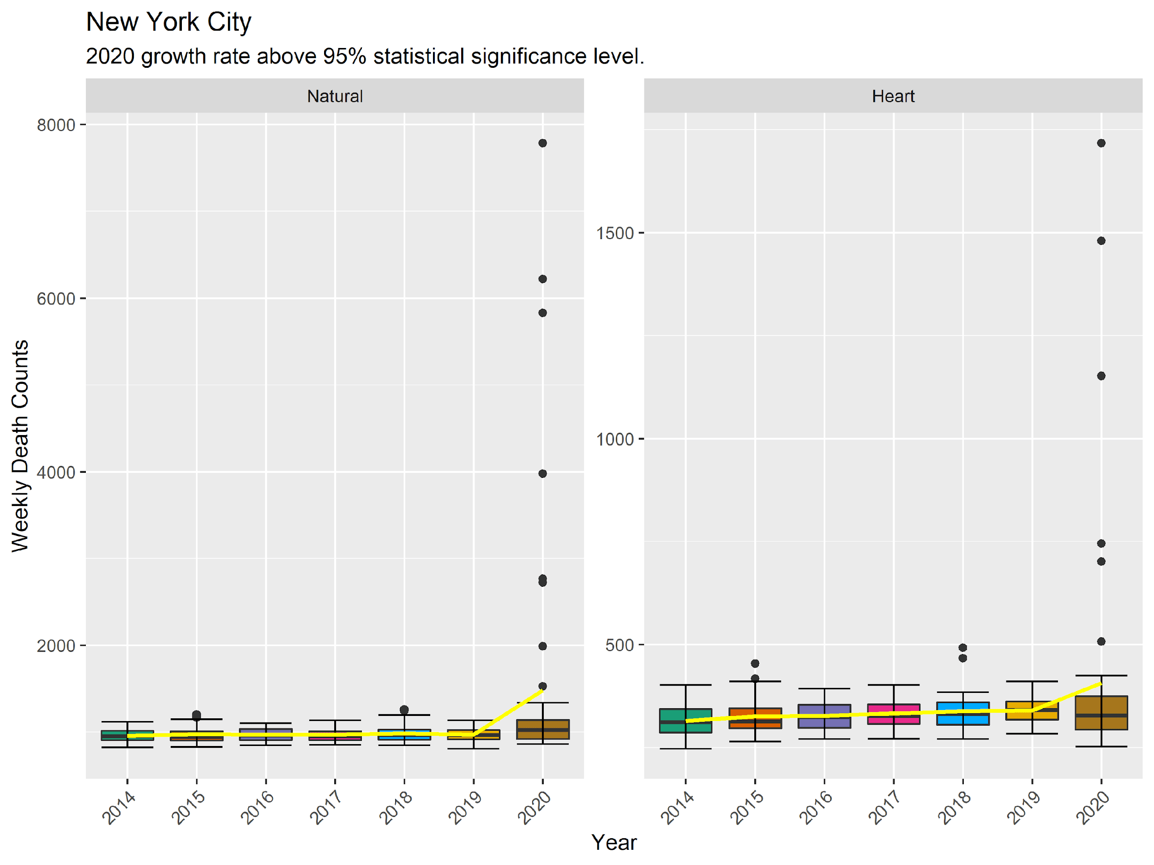
New York City Analysis
Notes:
Based on the figures, there is a significant increase in weekly heart disease and natural cause deaths from 2019 to 2020. Natural cause deaths seem to remain flat before 2019 and heart disease shows a small increase year over year. It is also noted that there are extreme outliers in 2020. These are possibly due to a missed infection of Covid-19 as discussed previously.

Slide 12
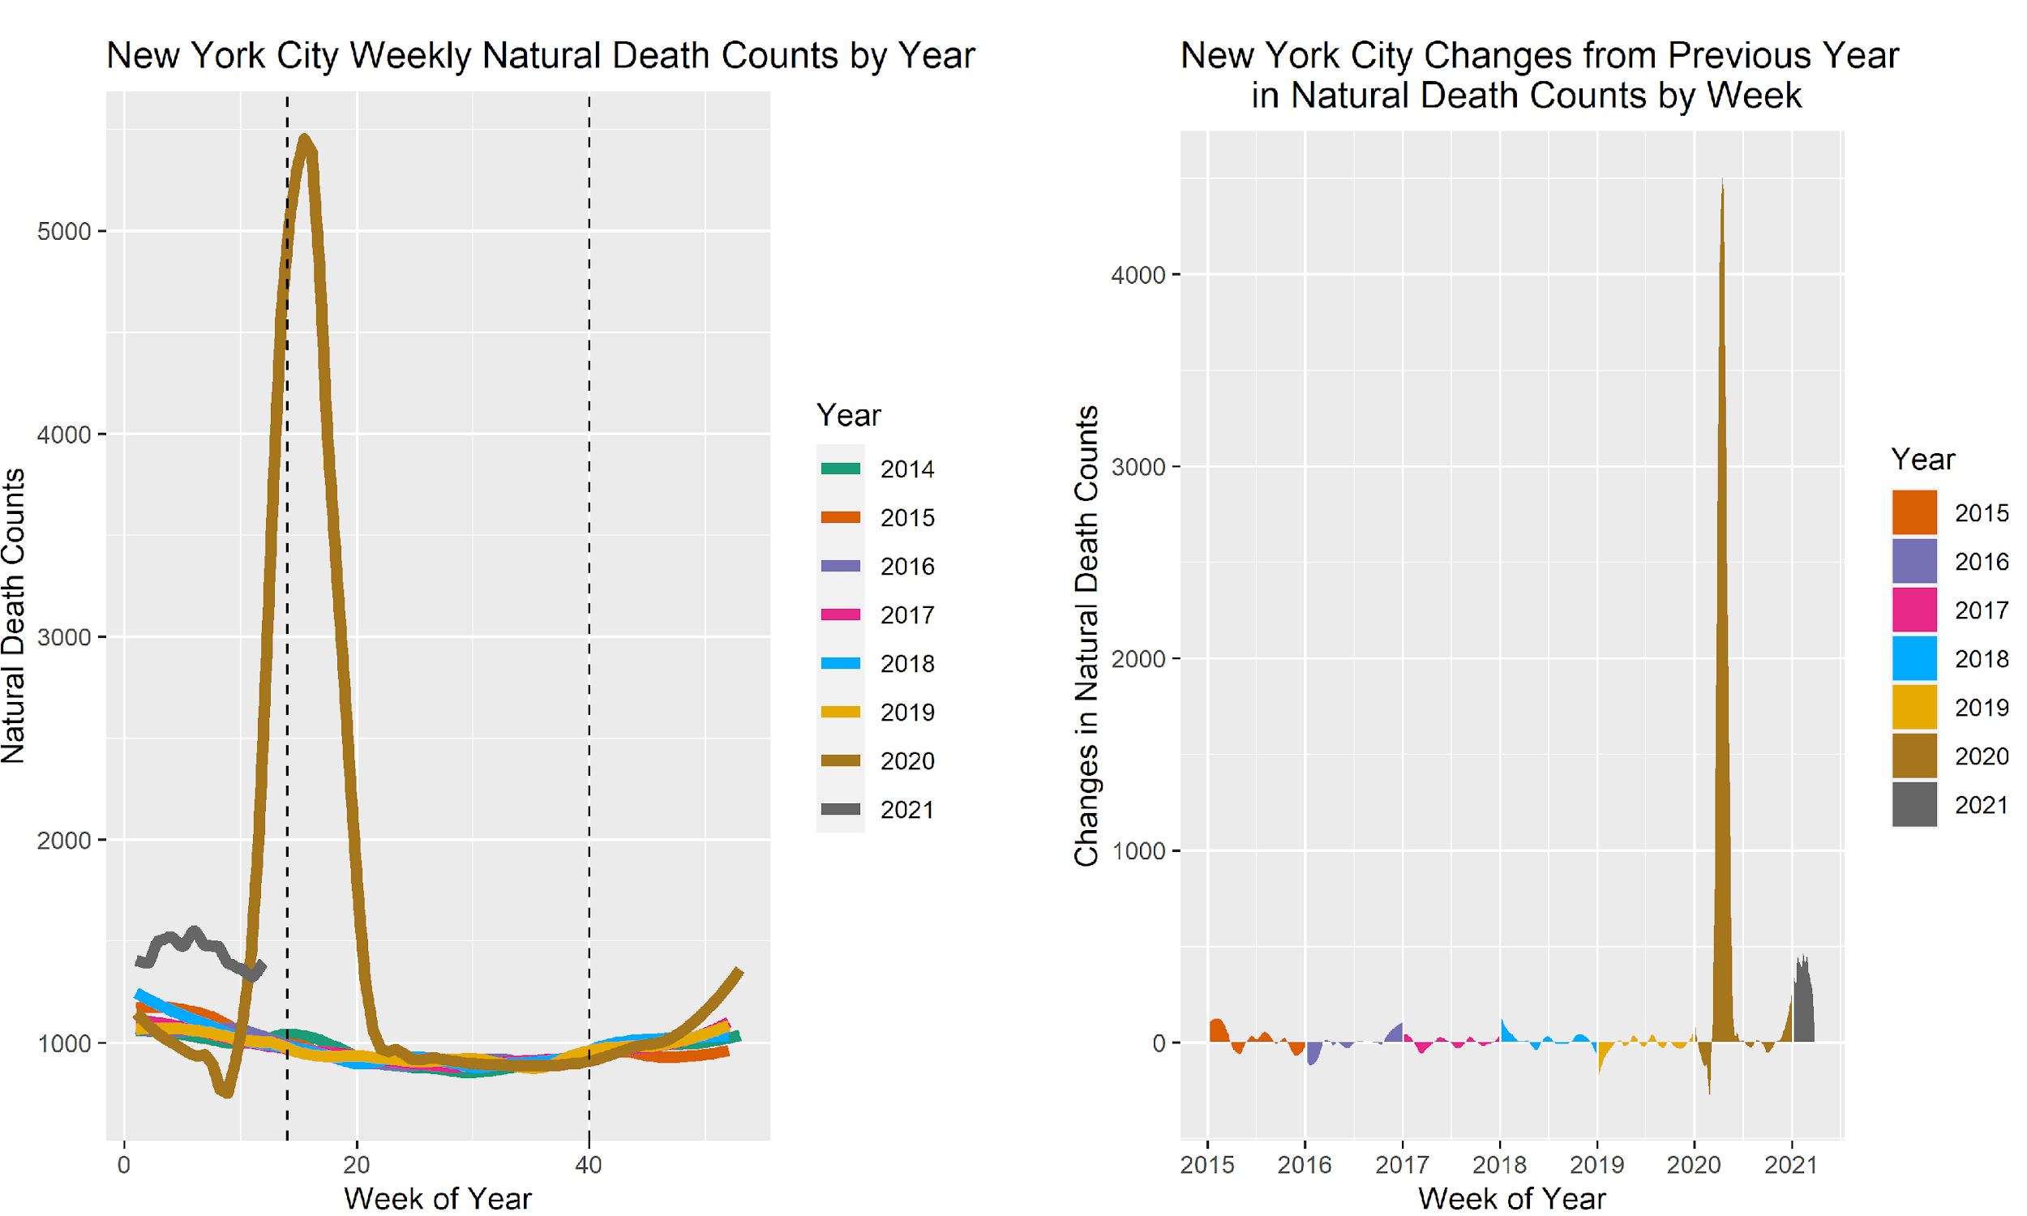
New York City Analysis
Notes:
The figures above compare weekly deaths based on each week of the year. The figure on the left shows chronological data that has been smoothed to simplify readability and comparisons. The data in the figure show natural deaths were consistent until 2020 when there was a substantial decrease in weekly deaths, followed by an extreme increase that peaks at just after the first quarter (noted by the first dashed line). The 2021 natural deaths are still elevated by approximately 500 additional deaths but are 25% of what they were at the peak.
The figure on the right shows the changes in weekly deaths from week to week. When the shaded areas are above 0, the deaths increased from the previous week. When the shaded areas are below 0, the weekly deaths have decreased from the previous week. Based on the figure on the right, natural cause deaths have increased compared to years prior to 2020 but are showing a decrease when comparing 2021 to 2020.

Slide 13
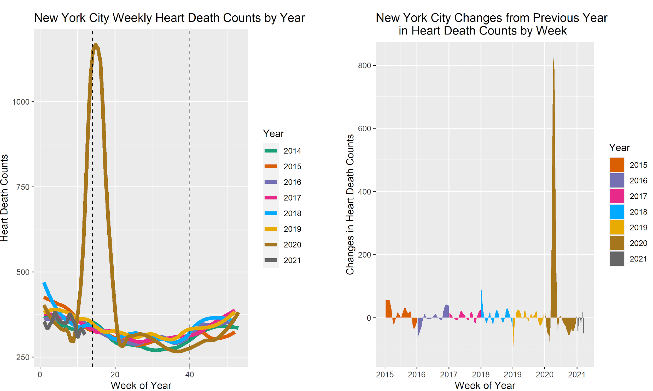
New York City Analysis
Notes:
The figure on the left, showing chronological yearly comparisons of weekly heart disease deaths, shows a similar pattern to natural deaths above for 2020. Unlike natural deaths, the figure on the right shows a brief large peak that quickly declines and becomes substantially negative for the remainder of the data. This indicates that the deaths from heart disease have stabilized. Looking back at the left figure, we see that dark gray 2021 line is below 2019 and even 2018. This indicates that the disease is under control. It is interesting that the 2021 data is below the 2019 and 2018 data resulting in possibly 100 less heart disease deaths per week. This is an area that would benefit from future study.

Slide 14
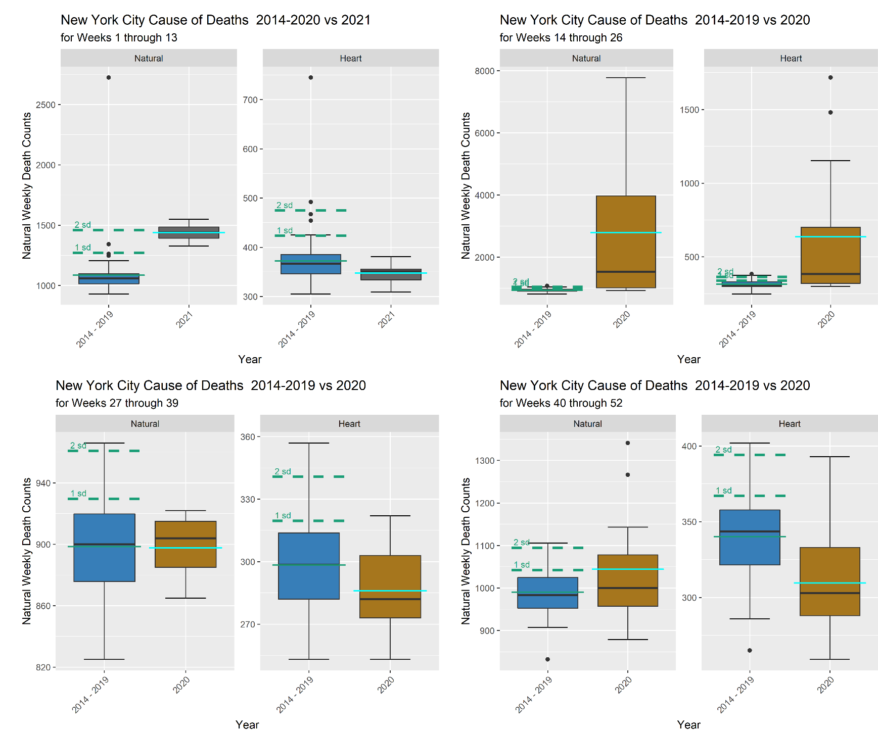
New York City Analysis
Notes:
The figures above compare the descriptive statistics for the most current quarter available in the data (1st quarter of 2021 and 2nd, 3rd and 4th quarters of 2020) to the descriptive statistics of the aggregated data of all other years. In addition, there are dashed horizontal lines for the previous years’ data indicating the 1st and 2nd standard deviations. These allow the one to estimate of how significant the current quarter data is when comparing. The lighter colored line on the current year box plots is the quarter’s mean though right skew is common in the data distributions so it would be better to use the median.

Slide 15
New York City Quarterly Natural Death Analysis
The data for weekly natural cause of deaths shows a much greater than 95% statistically significant growth for the 2nd quarter of 2020 followed by a decline in the 3rd quarter and increases in the 4th quarter of 2020 and the 1st quarter of 2021. This shows there is a short term upward trend in the last two quarters with the 1st quarter of 2021 reaching a greater than 95% significance level. These could be related to missed Covid-19 diagnosis which is also likely to have occurred during the 2nd quarter of 2020. Another possibility is the increase in natural deaths are due to more people in the Baby Boomers population bubble reaching geriatric age. It also could be a bi-causality relationship of the two.
Recommendations would be to focus on geriatric populations on the short term, continue monitoring the data to see if it turns into a long-term trend, and conduct small population random testing for the Covid-19 virus to get an accurate estimation of misdiagnosed natural causes of death.

Slide 16
New York City Quarterly Heart Disease Death Analysis
Heart disease deaths were greater than the 95% significance level for the 2nd quarter of 2020 and has since flattened out. In the 4th quarter of 2020, heart disease may have had a significant decrease. Though, this graphic is not designed to detect statistically significant decreases. The recommendation for heart disease is to keep following current practices in place.

Slide 17
New York City Summary and Recommended Course of Actions:
Based on the findings in the New York City heart disease and natural cause of death categories, I recommend that New York City healthcare systems:
Work with their geriatric (elderly) populations and caregivers to ensure that their physical, nutritional, medical, emotional, and social needs are being met. This older population might be used to going it alone and may not reach out for help.
Focus short term resources on reducing natural causes of death and continue monitoring for long term trends.
For heart disease deaths, current practices are decreasing weekly deaths. Continue following current best practices and monitor the data for any changes.

Slide 18
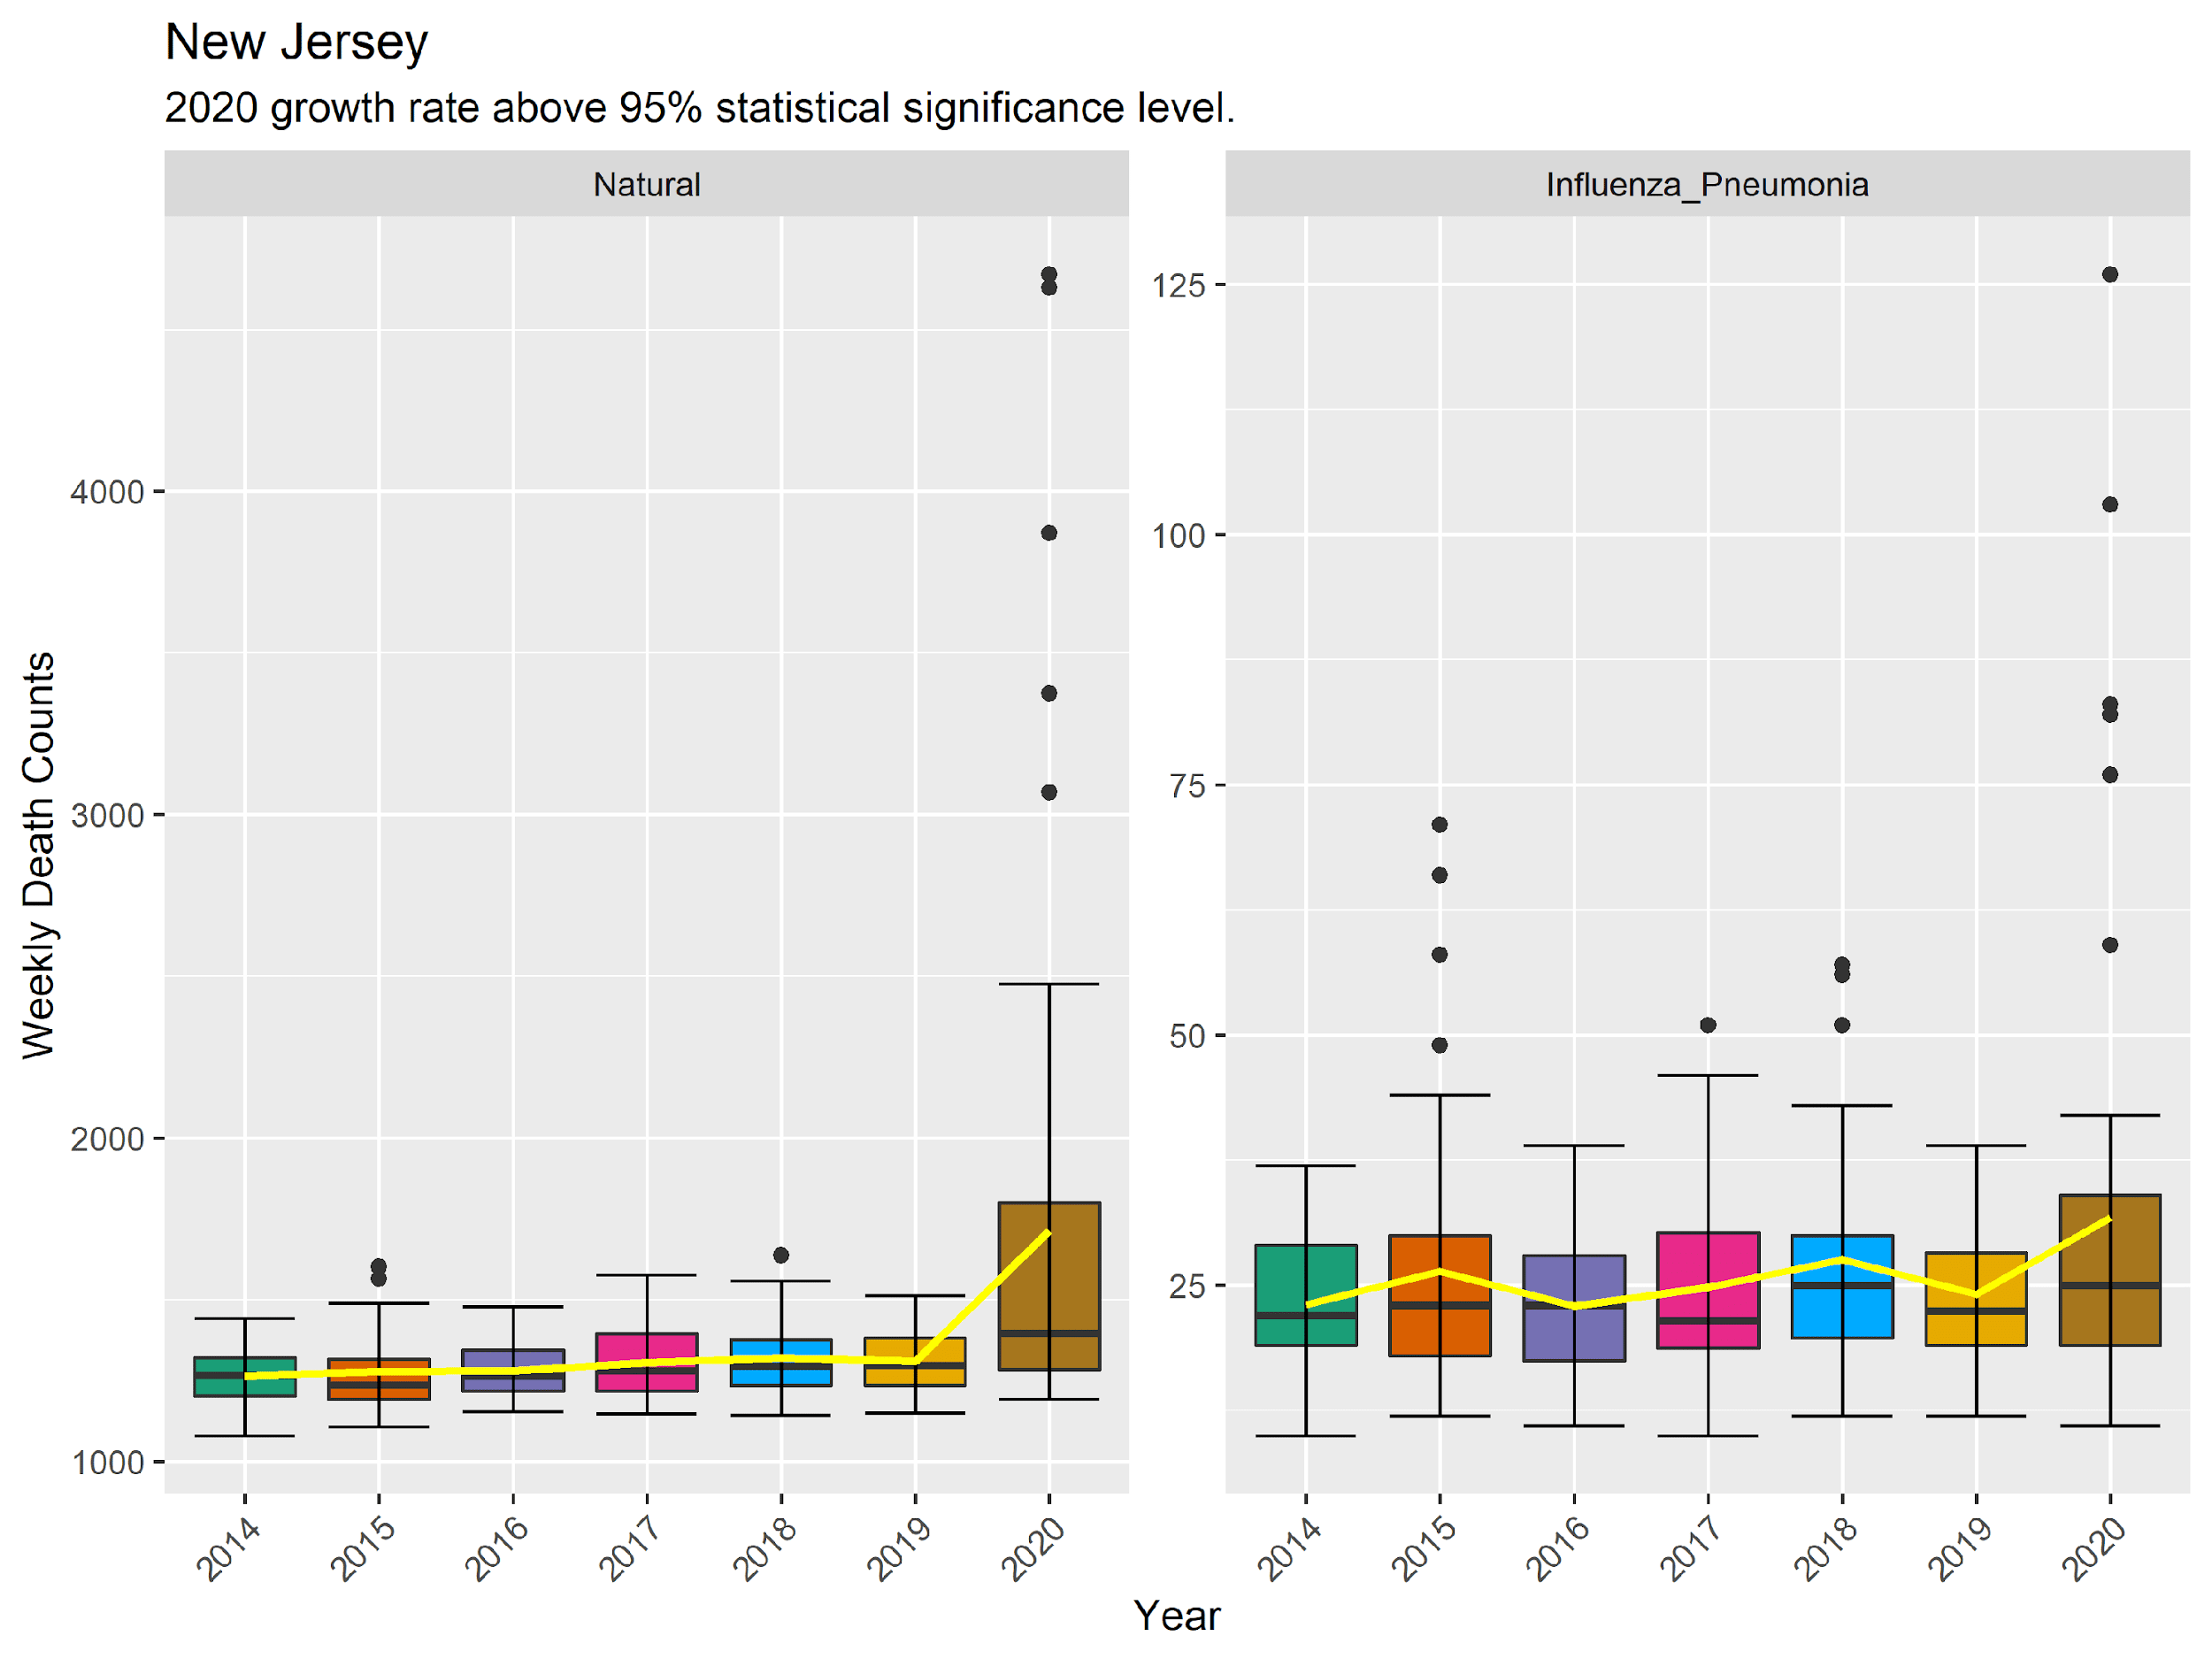
New Jersey Analysis
Notes:
Based on these figures, natural causes of death are increasing year-over-year showing a long term trend. There is a greater increase from 2019 to 2020 and several outliers exist in the 2020 data. This is likely due to the same reasons as given in the New York City data, Covid-19 misdiagnosis or aging population bubble.
The influenza and pneumonia data remains consistent until 2020 when there is a greater growth rate.

Slide 19
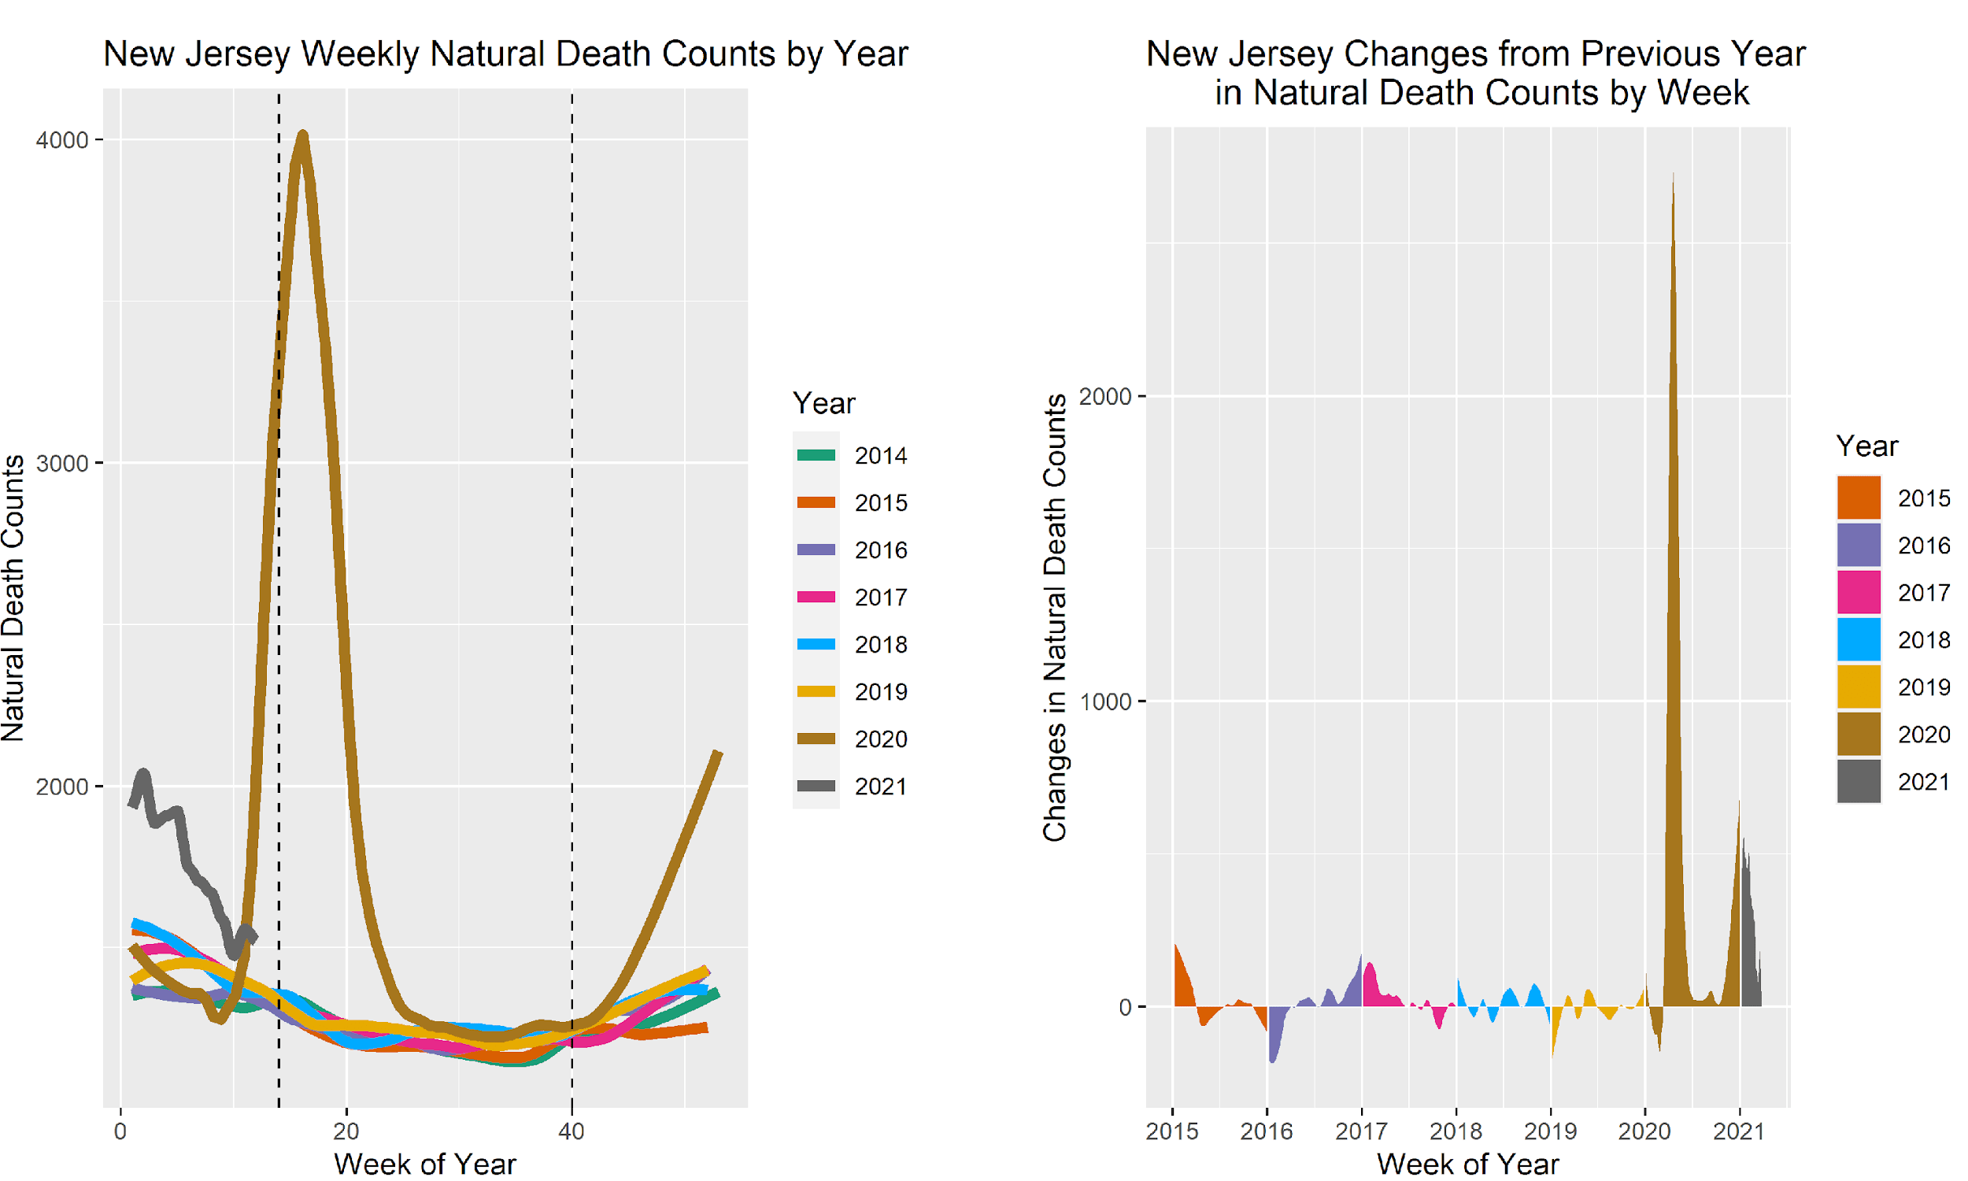
New Jersey Analysis
Notes:
The left figure for natural cause weekly deaths shows a similar pattern to the New York city data with more a more pronounced increase in the 4th quarter of 2020 and a steeper decrease in the 1st quarter of 2021. The effect of this increase is especially noticeable in the right figure where, after a short period of decreases in week-over-week death counts, changes in deaths have remained positive.

Slide 20
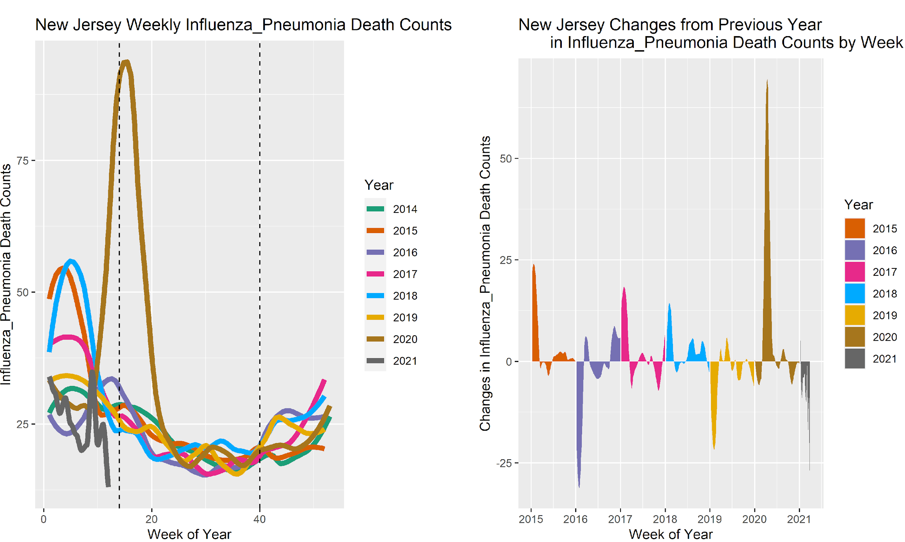
New Jersey Analysis
Notes:
Based on the data in the left figure above, New Jersey had high influenza weekly death counts in the 1st quarters of 2014, 2015, 2017, 2018 and 2019 and then smaller more consistent influenza and pneumonia deaths for the remaining quarters The figure on the right shows alternating increases in week-over-over deaths followed by decreases. The growth rates look consistent except for the high positive peak in the 1st and 2nd quarters of 2020. The patterns seen are not year-over-year long term trends but there is definite long term 1st quarter to 1st quarter trend in the data. Recommendations would be to expend resources toward reducing 1st quarter deaths from influenza.

Slide 21
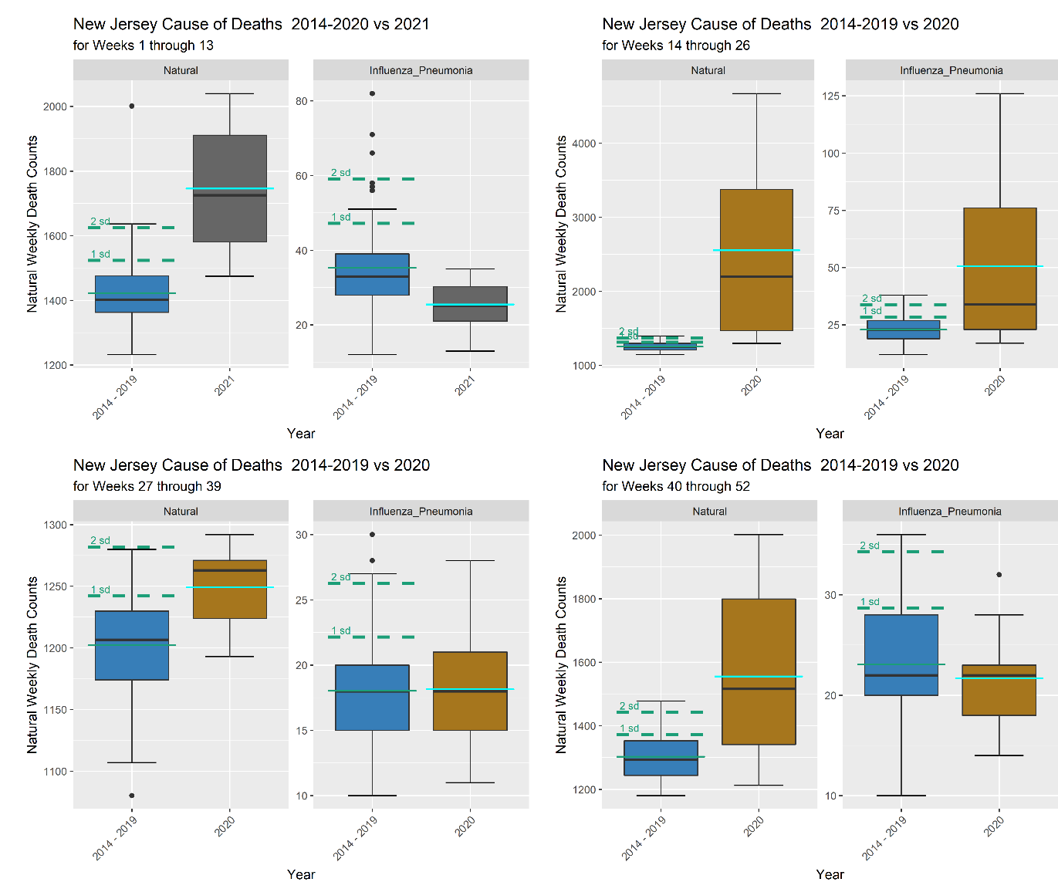
New Jersey Analysis
Notes:
New Jersey Quarterly natural death analysis
The data for weekly natural cause of deaths above shows much greater than 2 standard deviations increase for the 2nd and 4th quarters of 2020 and the 1st quarter of 2021. These were also observed in the line and area graphs discussed earlier though the significance of the increase is clearer in these box plots.

Slide 22
New Jersey Quarterly Influenza and Pneumonia Death Analysis
Influenza and pneumonia weekly deaths have a greater than 95% statistically significant increase in the 2nd quarter of 2020. The remaining quarters show decreases in weekly deaths. The 1st quarter 2021 data shows a decrease though we noted the long-term trend of 1st quarter increases in influenza and pneumonia deaths for other years. The 2021 decrease shows the effect of extra precautions and social distancing has had on deaths. Therefore, resources should be targeted towards reducing 1st quarter influenza and flu deaths.

Slide 23
New Jersey Summary and Recommended Course of Actions
Based on the findings in the New Jersey natural, influenza and pneumonia cause of death categories, I recommend that New Jersey healthcare systems:
Work with their geriatric (elderly) populations and caregivers to ensure that their physical, nutritional, medical, emotional and social needs are being met. This older population might be used to going it alone and may not reach out for help.
Focus long term resources on reducing natural causes of death and continue monitoring for flattening of the long-term trend.
Focus short term resources towards reducing influenza and pneumonia deaths in the first quarters of the year.
Identify procedures and protocols that were effective during social distancing and promote the non-invasive ones that will be easily accepted by the public. A possible example is signage and reminders to wash hands frequently.

Slide 24
Other State Findings
North Dakota, Massachusetts and Connecticut show the familiar patterns seen in the New York City and New Jersey data. Natural cause weekly deaths increased significantly in the 2nd and 4th quarters of 2020 with the 4th quarter peak continuing into the 1st quarter of 2021.

Slide 25
Recommended Course of Actions

Slide 26
Recommended Course of Actions Based on Findings
For all states with statistically significant natural cause of weekly death growth, my recommendations are:
Work with their geriatric (elderly) populations and caregivers to ensure that their physical, nutritional, medical, emotional, and social needs are being met. This older population might be used to going it alone and may not reach out for help.
Focus long term resources on reducing natural causes of death and continue monitoring for flattening of the long-term trend.
Seek assistance and resources at the national level.
Collaborate with other states and regions to determine best practices and assess if they can be implemented in South Dakota. Followed with monitoring the data to see the effect on the long-term trend.

Slide 27
Recommended Course of Actions Based on Findings
For New York City’s statistically significant heart disease weekly death growth, my recommendations are:
Continue to use and following current best practices already in place and monitor the data for any changes. The current practices are decreasing weekly deaths.
For New Jersey’s statistically significant influenza and pneumonia weekly death growth, my recommendations are:
Focus short term resources towards reducing influenza and pneumonia deaths in the first quarters of the year. Where previous years’ data showed a long-term pattern of significant increases.
Identify procedures and protocols that were effective during social distancing and promote the non-invasive ones that will be easily accepted by the public. A possible example is signage and reminders to wash hands frequently.

Slide 28
Expected Benefits of Implementing Recommendations
All healthcare systems should monitor data to calculate significance of reduction at a greater than 90% statistically significant level to reduce waste in financial, materials, human resources and reduce deaths.
By implementing these recommendations, healthcare systems may reallocate resources to reduce waste in expenditures, materials and labor. It will also have the effect of reducing death rates or diseases with the highest growth rate to a 90% statistical significant level.

Slide 29
Thank You

