Slide 1
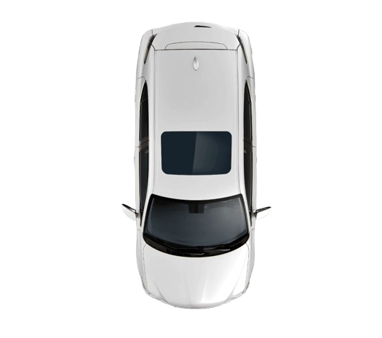
Cars Streaming Alerting
2025 DE

Slide 2
Contents
Idea and goals
Workflow
Tech stack
Problems on the way
App demo

Slide 3
Idea and goals
Build an app that
Implements the tasks
Include Iceberg tables
Include orchestration (Airflow)
Include a tool to query the data
Build a dashboard in Superset
Include Telegram bot to manipulate the process
AI integration in the bot

Slide 4
Idea and goals
Build an app that
Implements the tasks
Include Iceberg tables
Include orchestration (Airflow)
Include a tool to query the data
Build a dashboard in Superset
Include Telegram bot to manipulate the process
AI integration in the bot

Slide 5
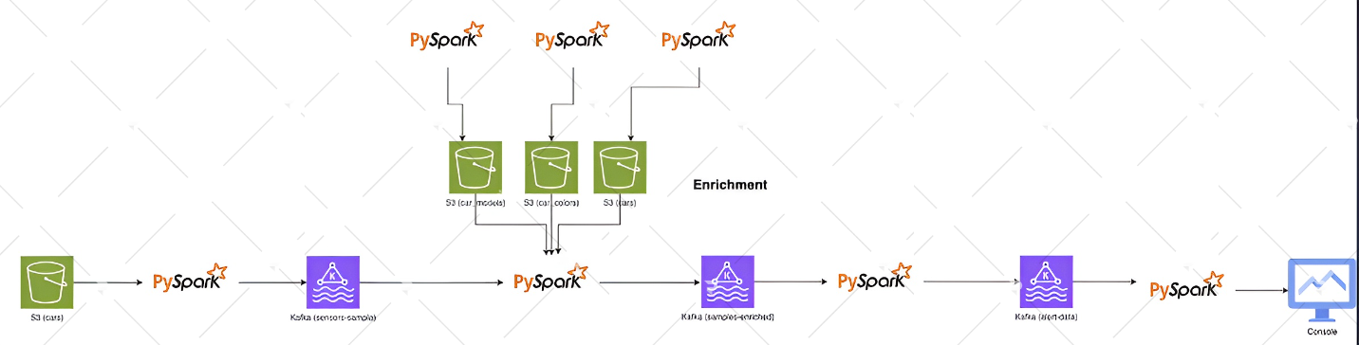
Workflow (task)

Slide 6











Workflow (implemented)
cars_raw.cars_raw
dims.car_colors
dims.car_models
dims.cars
dims.cars_enriched
dims.car_colors
dims.car_models
dims.cars
Create schemas.tables
cars_raw.cars_raw
dims.cars_enriched
Data generator
sensors-sample
DataEnrichment
samples-enriched
AlertDetection
alert-data
AlertCounter
alert

Slide 7
Problems on the way
Configuration of all the containers to talk to each other
Learn Iceberg
Learn how telegram bot works
Telegram control integration (menus, buttons, runs)
AI integration (chat that can run DAGs/queries, jobs)

Slide 8
App demo

Slide 9
Thank you for your attention!

