Slide 1

EDA DS Project Naya 2024
Aleksander Tanskii
Private and Business vehicles in Israel
Private and Business vehicles in Israel

Slide 2
A bit about the data
The files were downloaded from https://data.gov.il/dataset/private-and-commercial-vehicles, which is a governmental source of publicly available data
The datasets contain official information of license numbers of the private active vehicles from the year of manufacture 1996 and above and the license numbers of the commercial active vehicles weighing up to 3,500 kg from the year of manufacture 1998 and above.
The data gets updated daily at 9 am
There are 2 files with with 3.8 m (23 and 9 columns) rows each, one is an extension of the first one
Although 2 valuable columns lacked a lot of data (safety_upgrade_status – 2/3, emission_group – around 15%), they were not dropped, as it was still interesting to check the data that exists.
There was a big challenge of opening and cleaning the data, as the original columns contains much Hebrew words - An additional piece of software was downloaded in order to open and make the datasets readable for pandas - A substantial amount of time was put into cleaning data and splitting a column, that originally was in Hebrew, into a column country and vehicle brand

Slide 3
Results

Slide 4
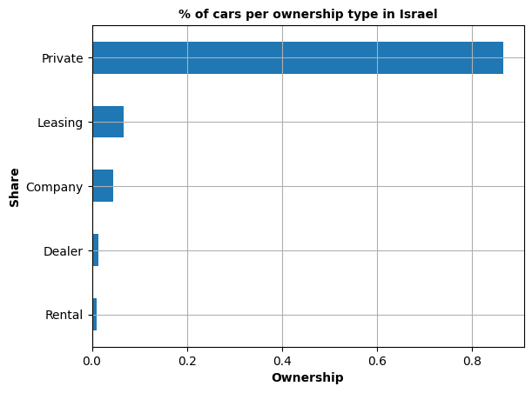
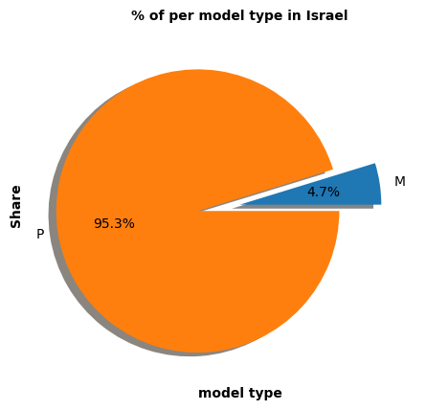
Number vehicles by car ownership and model type
fasdfasd
Conclusion:
1. Most of the cars (around 85%) are private ones. 4 other groups take up to 15% all together. 2. Most likely M stands for mechanical gear and P for Automotive one. No explanation for those was found

Slide 5
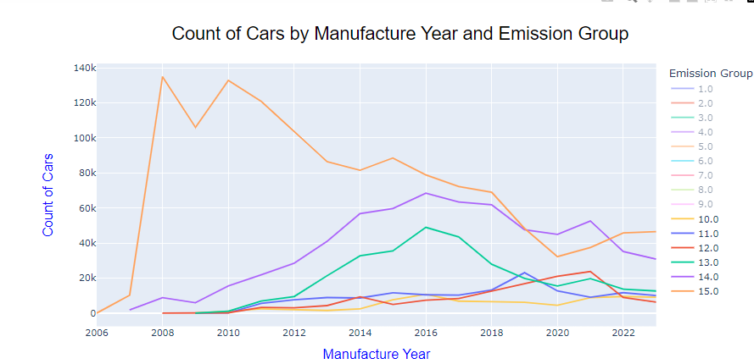
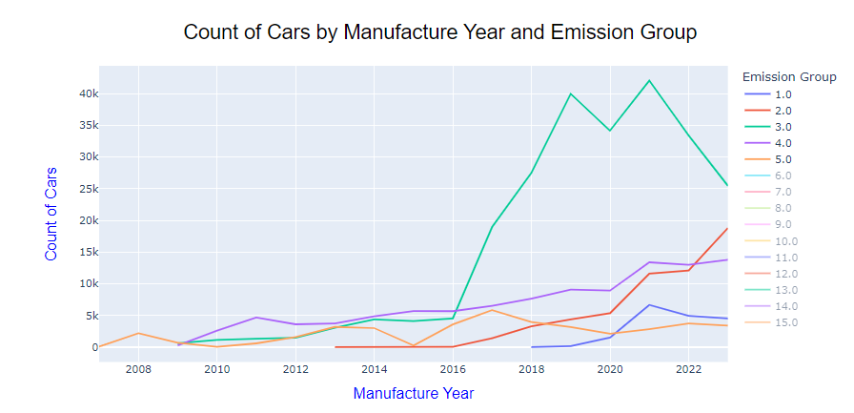
Count of Cars by Manufacture Year and Emission Group
Conclusion:
1. In general starting from 2016, number of vehicles with high emissions drops (apart from 15.0 from 2010) 2. In general it’s possible to say that the number of cars with a lower pollution indicator (which pollutes less) is slowly growing (1.0-5.0)

Slide 6
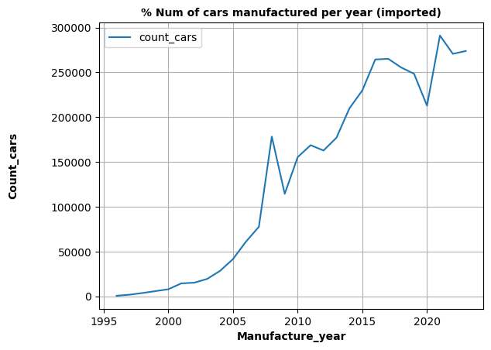
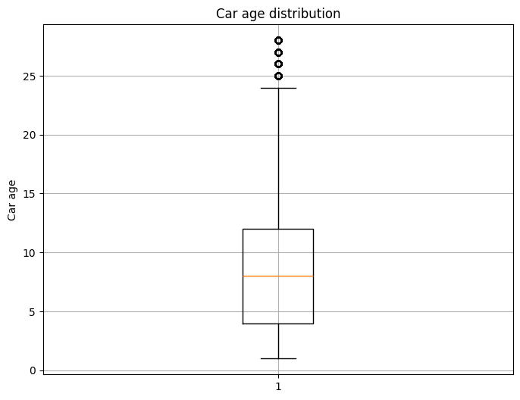
Num vehicles imported annually and car age
fasdfasd
(2024 was removed from the dataset in order to keep it consistent)
1. It can be seen the the number of cars imported grows continually
2. There is a peak in 2008 with some extra import (a little bit weird)
3. There is a drop in 2020, as it seams, due to beginning of the Corona, but then it went up sharply.
1. 25% of the vehicles are 1-4 years old
2. 50% of the vehicles are between 4 and 12 years old
3. 75% of the vehicles are 12 year old ones or newer

Slide 7
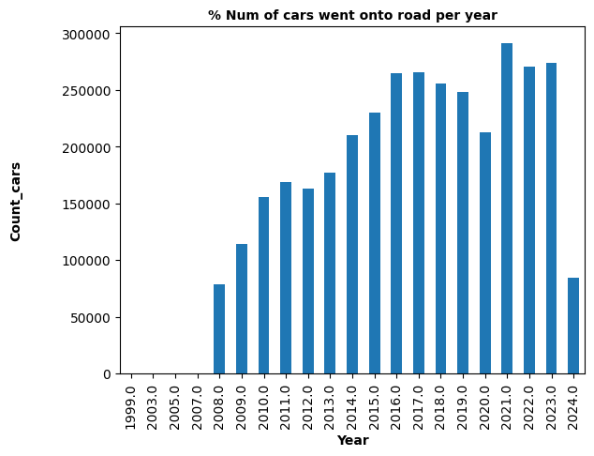
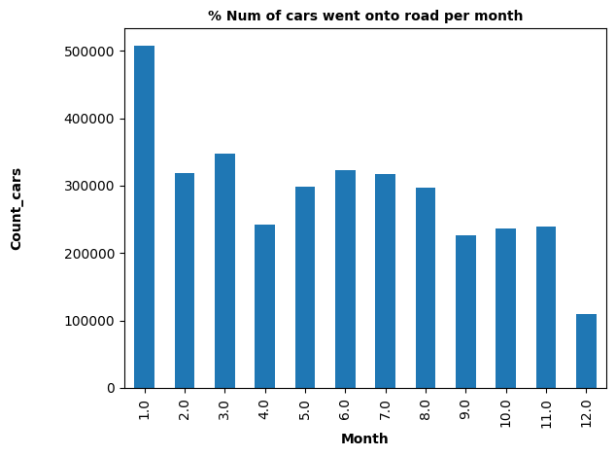
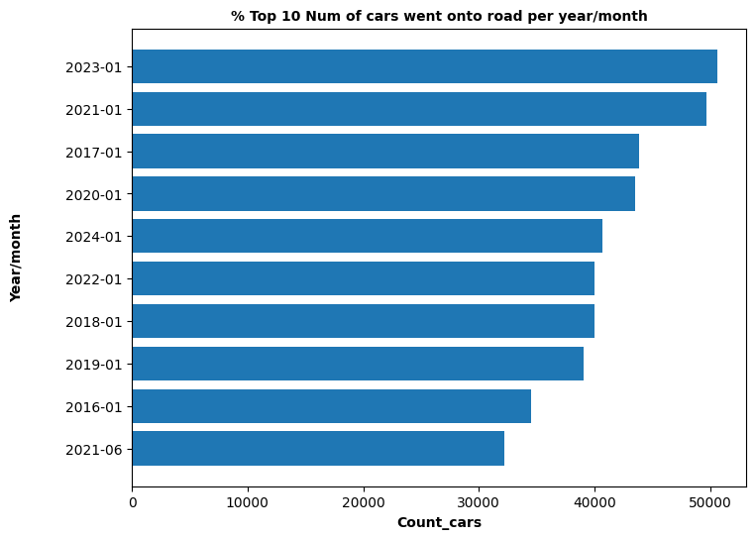
Num vehicles going onto road annually, monthly, year-month
fasdfasd
1. Year 2024 wasn't removed from the data and isn't representative here
2. A stron trend in growing the number of cars going onto roads from year to year
3. 7The year with most cars that went onto roads is 2021 (probably recovery after the Corona began)
1. Strangely enough, the month overall time perdiond with most cars that went onto road is January, the least - December
2. Some similarity can be see along summer and autumn months
It can be seen that not only is January the most popular month for getting cars on to road, but it happenes every
year starting from 2016 (for top 10 year-month periods) apart from year 2021

Slide 8
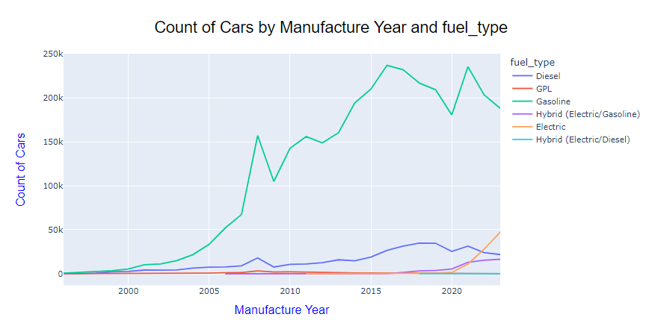
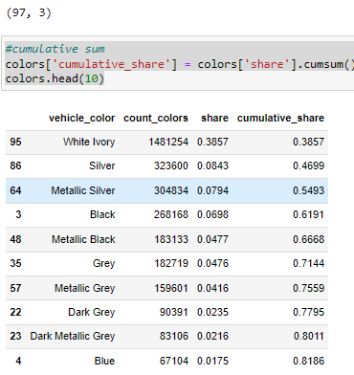
Information for vehicle colors and fuel type distribution
fasdfasd
1. It can be seen that White Ivory takes up 38.5% of all the colors (97)
2. Silver and Metallic Silver around 16.5% together
3. Black and Metallic Black almost 12%
4. Grey, Metallic Grey and Dark Grey take up around 10%
5. Lastly, Blue takes up 1.8%
6. Top 10 above-mentioned colors take up 82% of the data
1. At the moment there isn't a clear trend on the number of Gasoline cars going down
2. There is a slight trend in the number of Diesel vehicles going down
3. There is a clear trend in the number of Electric/Hybrid cars going up

Slide 9
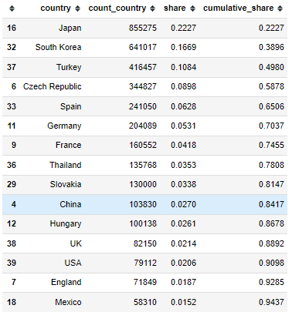
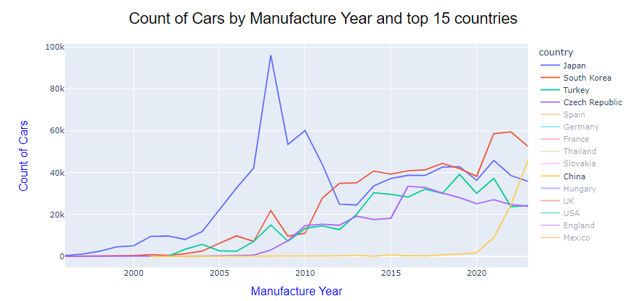
Countries
fasdfasd
Top 15 countries the cars were imported from.
top 10 countries represent 84.17% of data (out of 40)
1. Japan remains to be the most common supplier of vehicles to Israel with a peak in 2008 and 96K cars, but later on we see the number of cars coming from Japan going down
2. There is a sharp raise of cars coming from China from 2020
3. South Korea keeps growing starting from 2010
4. The number of vehicles coming from Turkey is dropping and apparently will drop even more

Slide 10
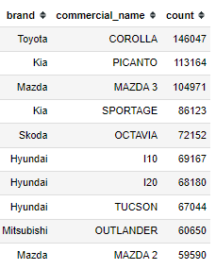
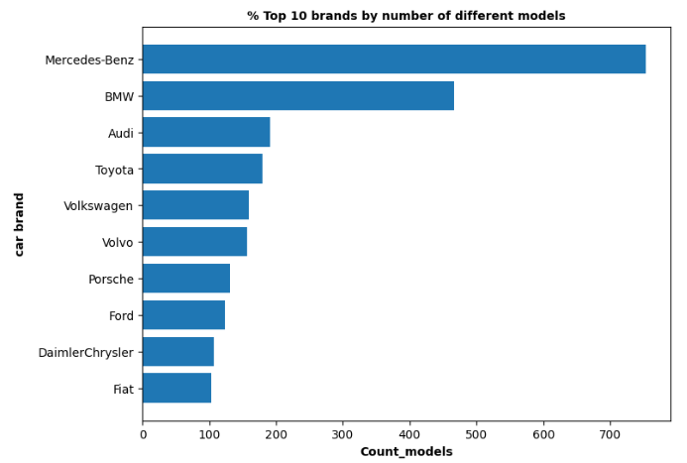
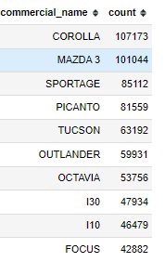
Top 10 brands + model; top 10 brands with most models
fasdfasd
Top 10 combinations brand + model
Top 10 brands with highest numbers of different models
Top 10 brands with most pollute models by number of vehicles in Israel

