Slide 1



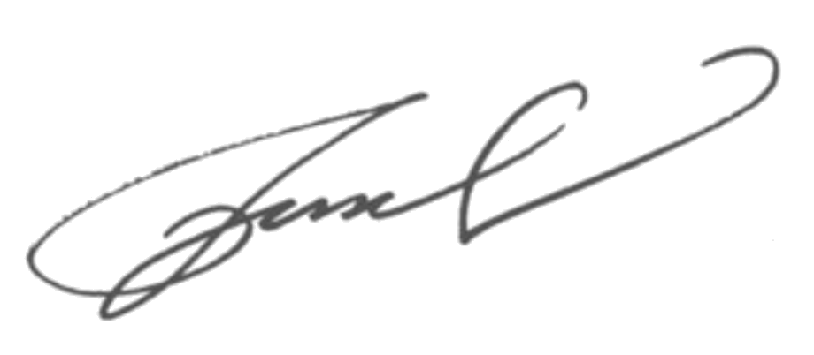
Emma Taylor
Cloud Architect
+1234 567 890
janedoe@email.com
Country, Zip, CityCode
Cover Letter
Dear Hiring Manager,
My name is Emma Taylor, and I am excited to apply for the Cloud Architect position at your company. With 5 years of experience in cloud computing, I have honed my skills in designing and implementing cloud solutions that drive efficiency and innovation.
During my tenure at various tech firms, I have successfully led cloud migration projects, optimized cloud infrastructure for cost-effectiveness, and ensured data security in cloud environments. My experience with leading cloud service providers and proficiency in cloud technologies make me a valuable asset for your team.
I am particularly drawn to this opportunity at your company because of your reputation for fostering a culture of innovation and excellence in cloud technology. I am eager to contribute my expertise to your team and collaborate on cutting-edge cloud solutions that drive business growth.
Thank you for considering my application. I am enthusiastic about the possibility of bringing my skills and experiences to your esteemed organization and contributing to your continued success.
Sincerely,
Emma Taylor

