Slide 1




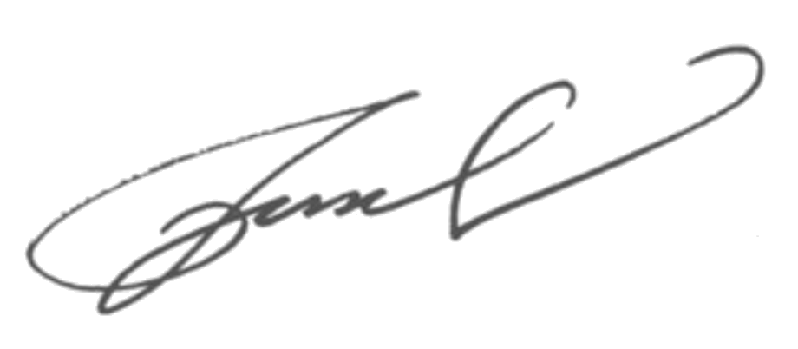
JANE DOE
MARKETING MANAGER
Contacts
Cover Letter
+1234 567 890
Dear Hiring Manager,
janedoe@email.com
I am writing to express my interest in the position at your esteemed company. With a strong background in [industry or skill], I bring both professional expertise and a dedication to achieving excellence. My experience spans across [X years/months], during which I have consistently delivered on targets and exceeded expectations.
www.janedoe.com
Country, Zip, CityCode
In my previous role, I successfully led initiatives in [relevant achievement or skill], ensuring efficiency and positive outcomes for the team and the company. I am confident that my abilities in [mention a key skill or project] align well with the goals of your organization.
I have always admired [Company Name]’s reputation for innovation and growth in the industry, and I am excited about the opportunity to contribute my skills and experience to your team. I would love the chance to further discuss how my expertise can benefit your organization.
Thank you for considering my application. I look forward to the opportunity to contribute to your continued success.
Yours sincerely,
JANE DOE

