Slide 1




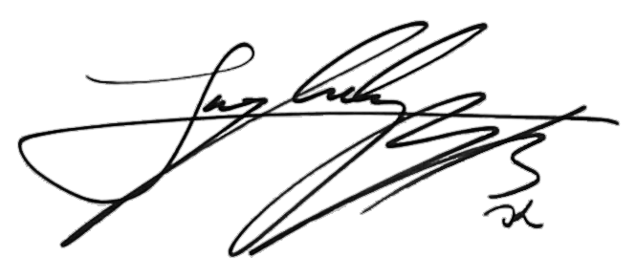
Jessica Wright
+0857 632 645
yourmail@mail.com
www.website.com
Senior UX/UI Designer
123 street, City, 1983647
Company name
September 30th
134 Street Name, CA 743839, USA
2024
Cover letter
Experience
Dear Hiring Manager
My name is Jessica Wright, and I am excited to apply for the UI Designer position at your company. As a Senior UX/UI Designer with a wealth of experience in creating user-centered designs, I am confident in my ability to contribute effectively to your team.
Throughout my career, I have honed my skills in wireframing, prototyping, and visual design, delivering intuitive interfaces that enhance user experience. My previous roles have allowed me to collaborate with cross-functional teams to bring innovative design solutions to life, resulting in measurable improvements in user engagement and satisfaction.
I am particularly attracted to this opportunity at your company due to your reputation for fostering creativity and innovation in the digital space. Your commitment to pushing boundaries and delivering exceptional user experiences aligns perfectly with my professional ethos. I am eager to bring my expertise to your team and contribute to the success of your projects.
Thank you for considering my application. I am enthusiastic about the possibility of contributing to your team and am looking forward to the opportunity to discuss how my skills and experiences align with your needs.
Sincerely,
Jessica Wright
Work experience
Yours sincerely,
Jessica Wright

