Slide 1
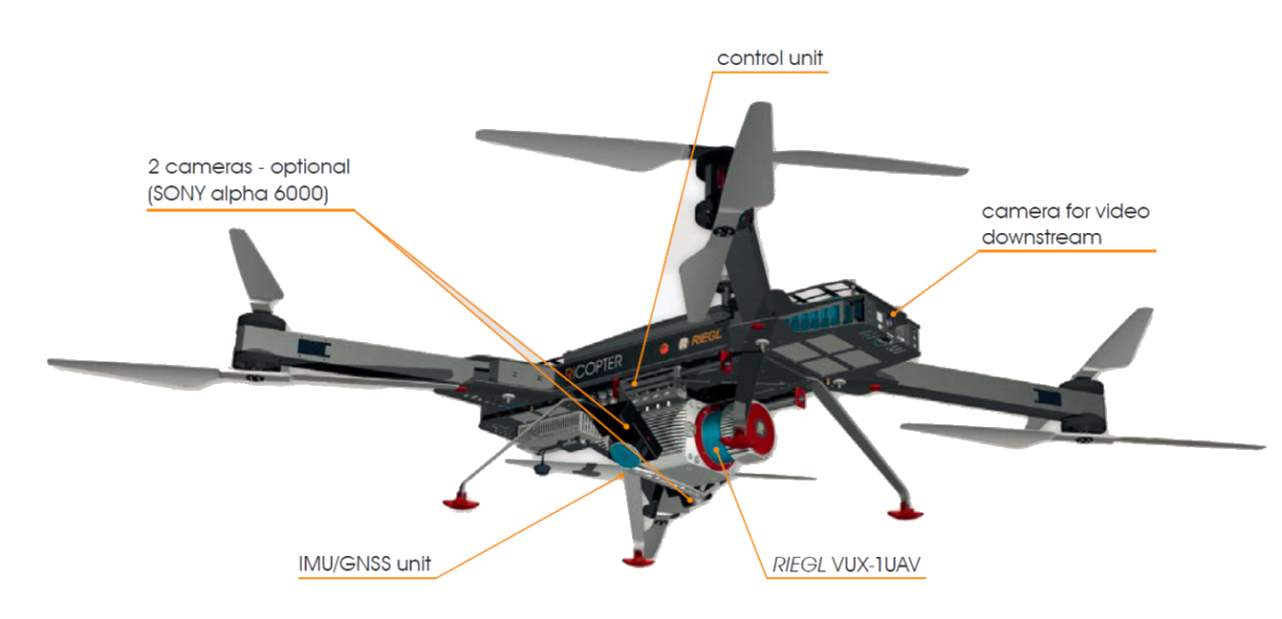
Real Time UAV
Synchronization
UAVsynch
A simple app to control your UAV (Unmanned Aerial Vehicle) programmatically for general recurring purposes
Notes:
Hello! I am here to present our new project, introducing UAVsynch, a Real Time UAV Path Synchronization app. Our objective is to build a sweet algorithm or app you can say to programmatically maneuver UAVs, extending their applications to more general purpose tasks.

Slide 2
Background
UAVsynch
With the world constantly advancing in technology, there is now a higher requirement of unmanned vehicles.
UAVs are controlled remotely or via a program. However, they are not yet truly autonomous.
In order to achieve this, we require smart programs to control the paths of these UAVs, in a synchronized manner.
Notes:
There are a ton of fields whose operations are yet to be optimized and UAVs are the key. With truly autonomous UAVs still unexplored to the depths, we aim to provide a complete and secure solution for this problem.

Slide 3
Problem Statement
UAVsynch
We aim to provide an application to control domestic licensed UAVs programmatically, with real time path prediction and ground mapping, to achieve general tasks it has been licensed for.
This will allow us extending the applications of UAVs to many more fields, such as agriculture and product delivery.
Notes:
The objective is not just to allow autonomous UAVs to exist, but to allow domestic UAVs to be used for general purposes. The applications of UAVs are only limited by the imagination, and we aim to reduce the gap between the present and the future.

Slide 4
Existing Solutions to UAV Synchronization
UAVsynch
There are majorly two fully explored approaches to UAV path synchronization
Swarming
Flocking
Real time path synchronization however is yet to be fully explored..
Notes:
Existing methods to synchronize UAV paths definitely do exist. There are few used more often than others, such as 'swarming' and 'flocking', however these methods are more goal specific and our designed achieve one particular task. Our goal, here, is to implement an app where authorized or licensed UAVs can be registered to achieve any general task, for eg. Agriculture or Military Surveillance

Slide 5
Implementation Strategy
UAVsynch
We have created an app which allows users to register their UAVs with all the specifications, such as maximum and minimum UAV speed, maximum and minimum height, etc. and we create a base path for the UAV to follow with all the time constraints satisfied.
The path is made to be allowed to change in real time based on the conditions of the UAV and the surroundings using our complex algorithms.
Notes:
As of now, we have built an app to allow users to register their UAVs after licensing and verification. This involves adding all the specifications of their drone, such as maximum and minimum speed, maximum and minimum height, etc. and then based on these specifications and the goal of the UAV, we create a dynamic path for the UAV.

Slide 6
Implementation Strategy
UAVsynch
This involves complex algorithms to minimize energy consumption and optimize paths. We also require to verify the UAV state, such as necessary amount of battery/fuel, as well as the weather conditions prior to the flight.
We also map the surrounding area that the UAV covers in real time, considering all the buildings/aerial blockages, and no-enter zones. The path we choose for the UAV should cover all constraints and yet optimize it sufficiently.
Notes:
Our implementation allows us to create a 3D map of the surroundings and predicts the optimal trajectory for the remaining of the path. The trajectory is, as much as possible, provably optimal, in terms of energy consumption, and time of flight. We also rigorously check for any problems or any unanticipated behaviour during and prior to the flight, to avoid any hindrances.

Slide 7
Challenges
UAVsynch
The path we decide should be flexible enough so that in case the UAV observes any incoming hinderance, such as birds, we should be able to immediately change the trajectory. For this, the UAV must be equipped with adequate sensors to detect such aerial motions.
There might unlicensed UAVs in the air during the time of the flight. This must be detected from the UAV itself, and if possible also be reported
With great power, comes great responsibility
Notes:
Since ours is a very unnatural and complex problem, there are many challenges we require to securely apply our algorithm in real life. We require the path to be highly dynamic, in order to avoid any incoming obstacle safely. Also the speed of decision making must be high enough to allow for some interval between the decision making and the actual change in the path. Static obstacles are much easier to avoid, however moving obstacles such as birds or other unlicensed UAVs during the time of flight must be detected from the UAV itself.

Slide 8



Project Team
UAVsynch
Tonald Drump
Gurpreet Singh
Cillary Hlinton
Tester
Team Lead
App Developer
Notes:
We are currently a team of three members, with a top notch app developer and a tester with full fledged experience in aeronautics.

Slide 9
Project Expected Cost
UAVsynch
One year requirement for the project can be estimated as -
App Extensions - 5,00,000 -/
User Base Research - 2,00,000 -/
App Testing (Simulations) - 8,00,000 -/
App Testing (IRL) - 100,00,000 -/
Notes:
There are majorly four components in the future aspects of the project.

Slide 10
Timeline
UAVsynch
NOV-DEC
JAN
FEB-MAR
APR
MAY-AUG
SEPT
OCT
Requirements gathering
User research
Real Time Extension
Review
Prototype
Beta testing
User Testing

Slide 11
What we have achieved?
UAVsynch
An app to register and maneuver UAVs on all desktop platforms and Android platform
An algorithm to create dynamic and optimal paths which can change with the course of the flight
Real time 3D mapping of the surroundings, and smart path prediction
Algorithm tested on simulations, with multiple obstacles both static and moving

Slide 12
What’s next?
UAVsynch
Allowing an automated system to verify UAV licensing
Programming Decentralized Decision Codes in UAVs for offline path analysis
Extending the app API to allow general purpose tasks other than maneuvering the UAV
Conquer the world

Slide 13
To learn more, visit:
https://www.uavsynch.com
Thank You!!
UAVsynch

