Slide 1

Data Structures and Algorithms (CS210A)
Lecture 6:
Design of O($n$) time algorithm for Local Minima in a grid
Data structure gem: Range minima Problem

Slide 2

Local minima in an array (Proof of correctness)
Theorem: A local minima in an array storing $n$ distinct elements
can be found in O(log $n$) time.

Slide 3

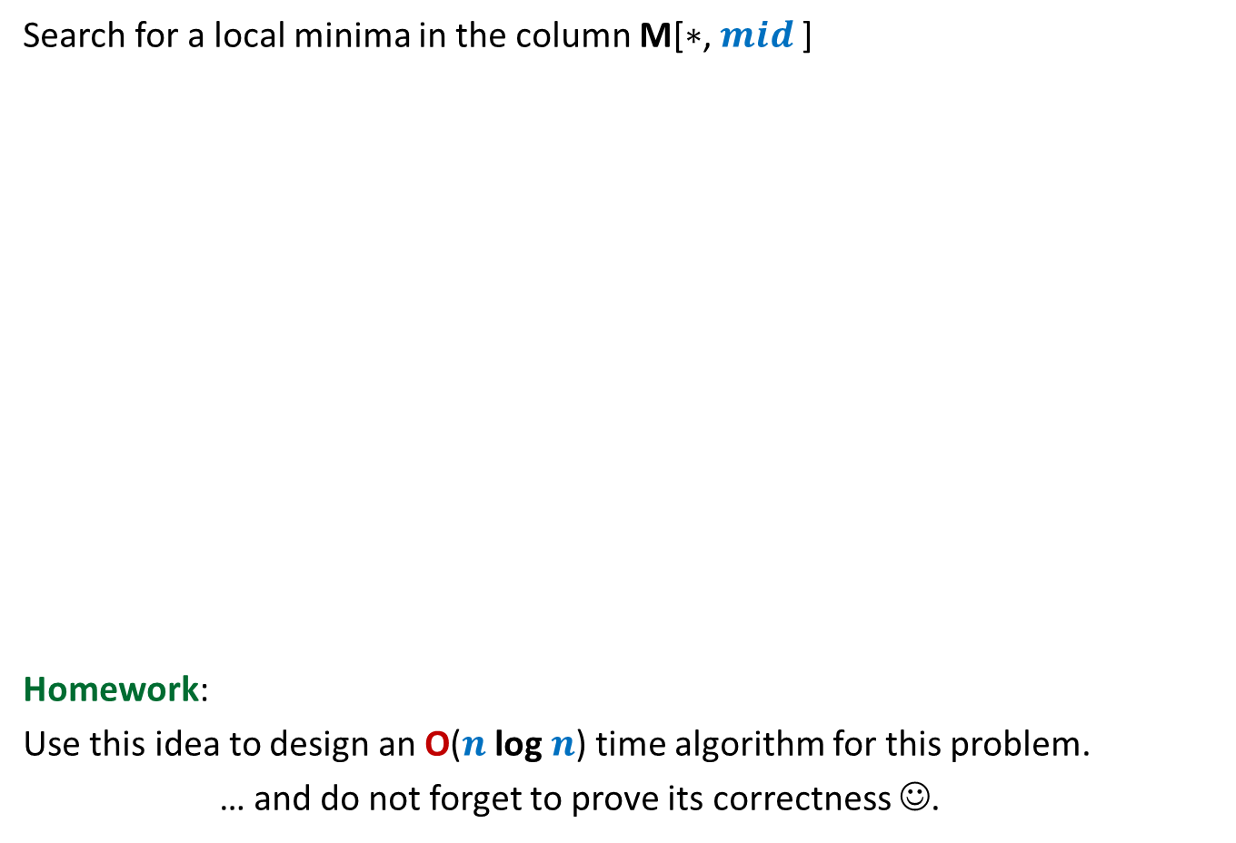


Local minima in a grid (extending the solution from 1-D to 2-D)
Under what circumstances even this smallest element is not a local minima ?
A local minima exists
in this region. Why ?
Search for a local minima in the column M[$∗$, $mid$]
Homework:
Use this idea to design an O($n$log $n$) time algorithm for this problem.
… and do not forget to prove its correctness ☺.
What if there is no local minima in the entire column.
$$mid$$
Smallest element
of the column
Execute Explore() from M[$i$, $mid+1$]
$$i$$
9
7

Slide 4

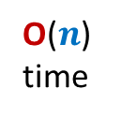
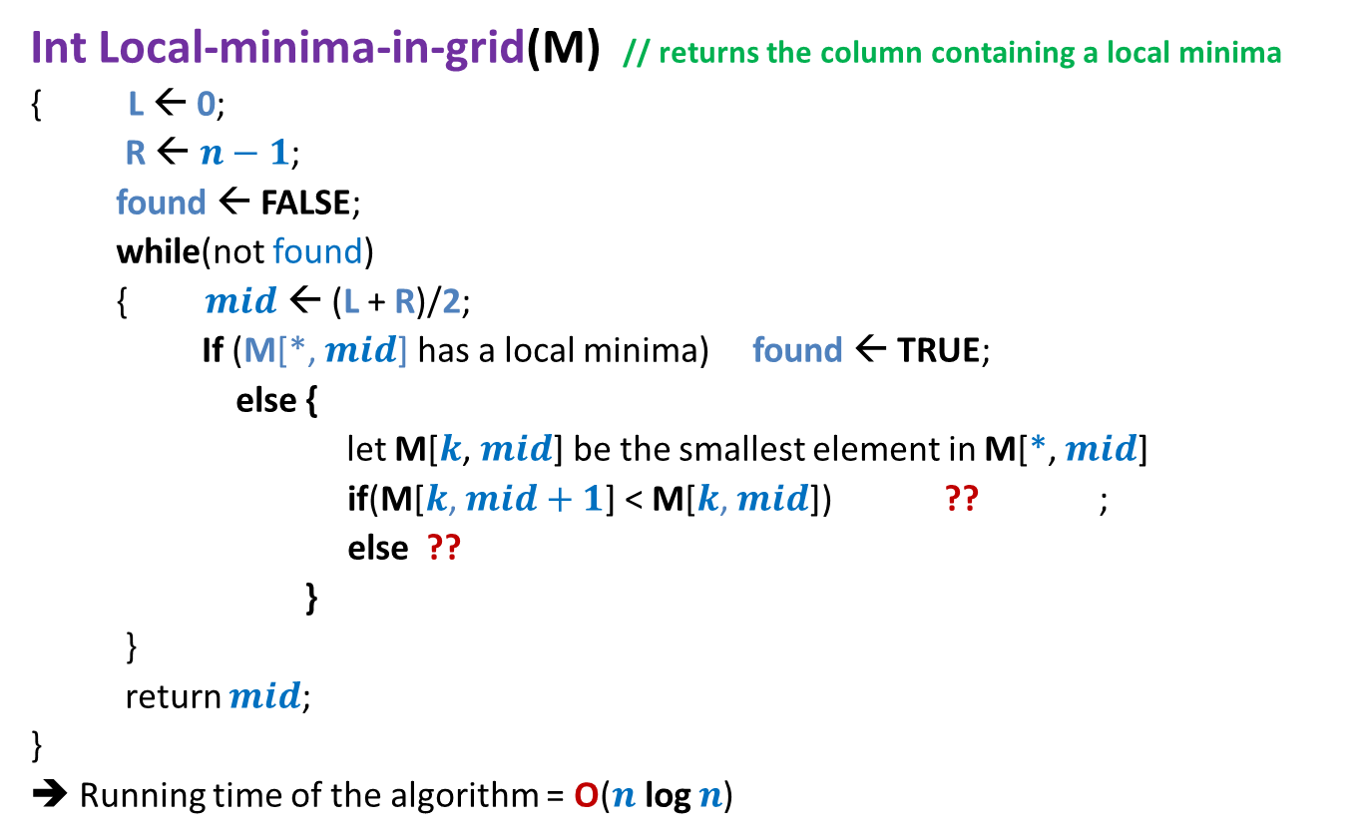



Local minima in a grid
Int Local-minima-in-grid(M) // returns the column containing a local minima
{ L ← 0;
R ← $n−1$;
found ← FALSE;
while(not found)
{ $mid$ ← (L + R)/2;
If (M[*, $mid$] has a local minima) found ← TRUE;
else {
let M[$k$, $mid$] be the smallest element in M[*, $mid$]
if(M[$k$, $mid+1$] < M[$k$, $mid$]) ?? ;
else ??
}
}
return $mid$;
}
➔ Running time of the algorithm = O($n$log $n$)
O($n$) time
O($n$) time
O($n$)
time
L← $mid+1$
R← $mid−1$
Proof of correctness ?

Slide 5







Local minima in a grid (Proof of Correctness)
$$L$$
$$R$$
P($i$) :
“A local minima of grid M exists in M[$L$,…, $R$].”
$$j$$
$$j′$$
$∃ j$ such that M[$j,L$] < M[$∗, L−1$]”
and
$∃ j′$ such that M[$j′,R$] < M[$∗, R+1$]”

Slide 6


Local minima in a grid
Theorem: A local minima in an $n$×$n$ grid storing distinct elements can be found in O($n$ log $n$) time.
How to improve it to O($n$) ?

Slide 7
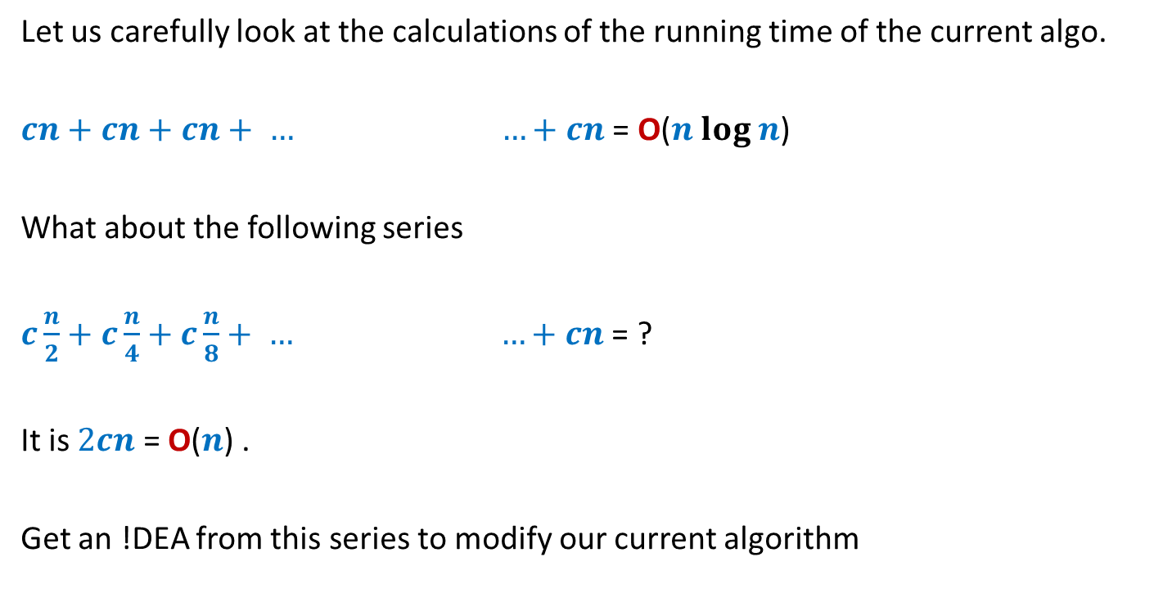

Local minima in a grid in O($n$) time
Let us carefully look at the calculations of the running time of the current algo.
$cn+cn+cn+ … …+cn$ = O($n log n$)
What about the following series
$c\frac{n}{2}+c\frac{n}{4}+c\frac{n}{8}+ … …+cn$ = ?
It is $2cn$ = O($n$) .
Get an !DEA from this series to modify our current algorithm
(log $n$terms)
(log $n$terms)

Slide 8
Local minima in a grid in O($n$) time
Bisect alternatively along rows and column
INCORRECT

Slide 9
Local minima in a grid in O($n$) time
50
96
97
98
99
95
94
93
92
91
90
60
89

Slide 10

Lessons learnt
No hand-waving works for iterative algorithms ☺
We must be sure about
What is P($i$)
Proof of P($i$).

Slide 11

Let us revisit the ($n log n$) algorithm

Slide 12
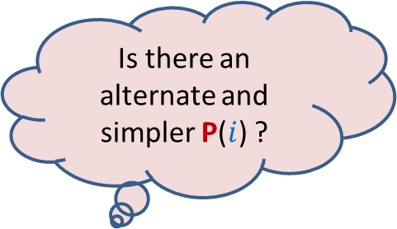
Local minima in a grid (Proof of Correctness)
$$L$$
$$R$$
P($i$) :
“A local minima of grid M exists in M[$L$,…, $R$].”
Is there an alternate and simpler P($i$) ?
$$j$$
$$j′$$
$∃ j$ such that M[$j,L$] < M[$∗, L−1$]”
and
$∃ j′$ such that M[$j′,R$] < M[$∗, R+1$]”

Slide 13
At any stage, what guarantees the existence of local minima in the region ?
At each stage, our algorithm may maintain a cell in the region
whose value is smaller than all elements lying at the boundary of the region ?
(Note the boundary lies outside the region)
Region
Boundary

Slide 14

Local minima in a grid Alternate O($n log n$) algorithm)
How will we maintain it after each iteration ?
What will be the cell in the beginning of 1st iteration ?
$$L$$
$$R$$
11
smallest
7
7
9
5

Slide 15

Local minima in a grid Alternate O($n log n$) algorithm
$$L$$
$$R$$
7
5

Slide 16
Local minima in a grid Alternate O($n log n$) algorithm
$$L$$
$$R$$
5
smallest
7
18
9
7

Slide 17
Local minima in a grid Alternate O($n log n$) algorithm
$$L$$
$$R$$
A neat pseudocode of this algorithm is given on the following slide.
5
7

Slide 18
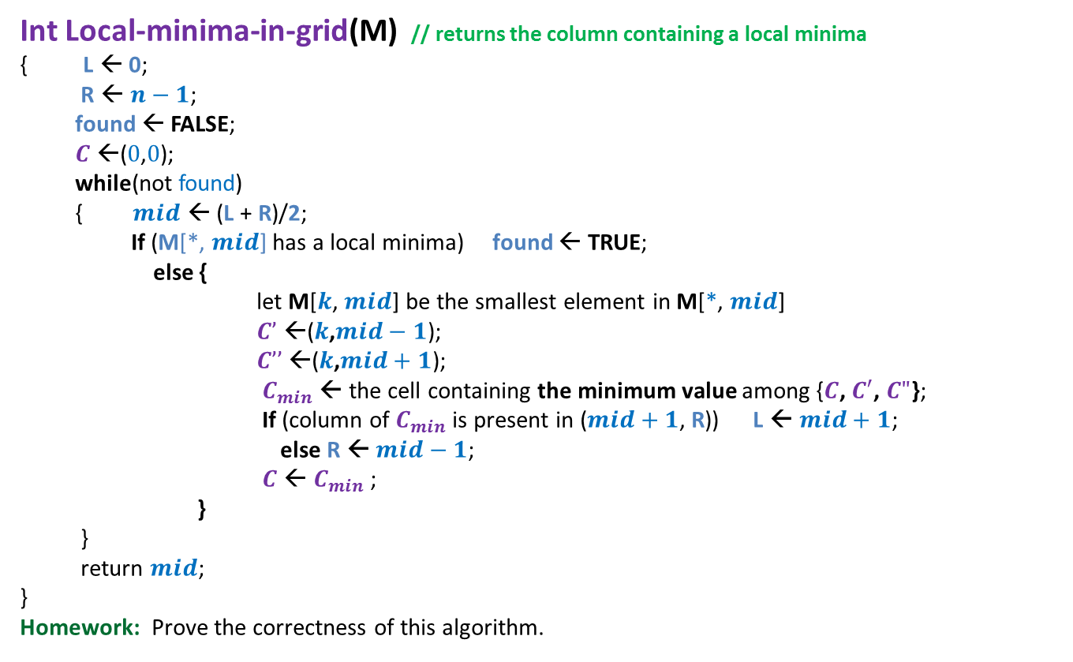

Local minima in a grid Alternate O($n log n$) algorithm
Int Local-minima-in-grid(M) // returns the column containing a local minima
{ L ← 0;
R ← $n−1$;
found ← FALSE;
$C$ ←($0$,$0$);
while(not found)
{ $mid$ ← (L + R)/2;
If (M[*, $mid$] has a local minima) found ← TRUE;
else {
let M[$k$, $mid$] be the smallest element in M[*, $mid$]
$C’$ ←($k$,$mid−1$);
$C’’$←($k$,$mid+1$);
$C_{min}$ ← the cell containing the minimum value among {$C$, $C′$, $C"$};
If (column of $C_{min}$ is present in ($mid+1$, R)) L ← $mid+1$;
else R ← $mid−1$;
$C$ ← $C_{min}$ ;
}
}
return $mid$;
}
Homework: Prove the correctness of this algorithm.
Extending it to O($n$) is easy now.
Do it as a homework.

Slide 19
Theorem:
Given an $n$× $n$grid storing $n^{2}$ distinct elements, a local minima can be found in O($n$) time.
Question:
On which algorithm paradigm, was this algorithm based on ?
Greedy
Divide and Conquer
Dynamic Programming

Slide 20
Proof of correctness of algorithms
Worked out examples:
GCD
Binary Search

Slide 21
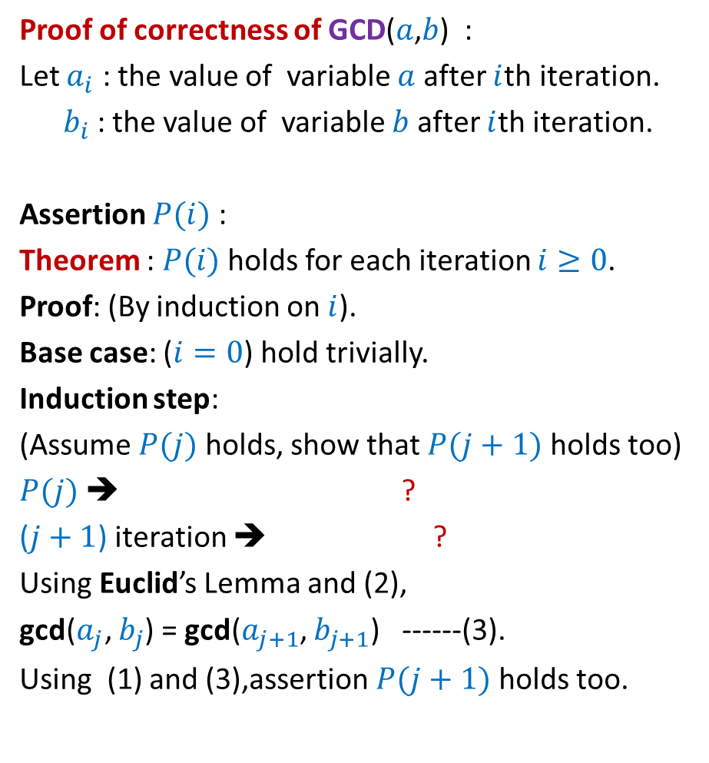
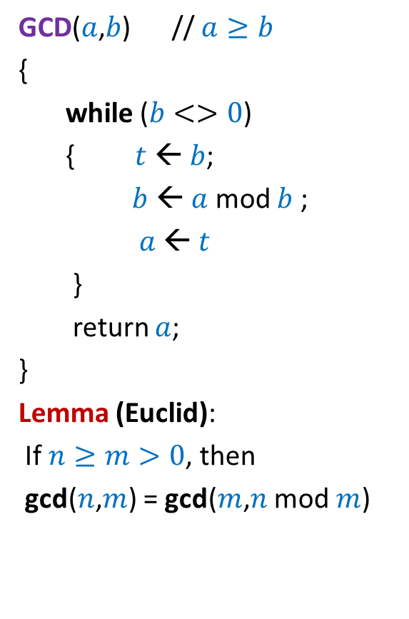



GCD
GCD($a$,$b$) // $a≥b$
{
while ($b<>0$)
{ $t$ ← $b$;
$b$ ← $a$ mod $b$ ;
$a$ ← $t$
}
return $a$;
}
Lemma (Euclid):
If $n≥m>0$, then
gcd($n$,$m$) = gcd($m$,$n$ mod $m$)
Proof of correctness of GCD($a$,$b$) :
Let $a_{i}$ : the value of variable $a$ after $i$th iteration.
$b_{i}$ : the value of variable $b$ after $i$th iteration.
Assertion $P(i)$ :
Theorem : $P(i)$ holds for each iteration $i≥0$.
Proof: (By induction on $i$).
Base case: ($i=0$) hold trivially.
Induction step:
(Assume $P(j)$ holds, show that $P(j+1)$ holds too)
$P(j)$ ➔ ?
($j+1$) iteration ➔ ?
Using Euclid’s Lemma and (2),
gcd($a_{j}$, $b_{j}$) = gcd($a_{j+1}$, $b_{j+1}$) ------(3).
Using (1) and (3),assertion $P(j+1)$ holds too.
gcd($a_{i}$, $b_{i}$) = gcd($a$,$b$)
gcd($a_{j}$, $b_{j}$) = gcd($a$,$b$). ----(1)
$a_{j+1}$= $b_{j}$ and $b_{j+1}$= $a_{j}$ mod $b_{j}$ ---(2)

Slide 22

Binary Search
Binary-Search(A[$0...n−1$], $x$)
L ← $0$;
R ← $n−1$;
Found ← false;
While ( ? )
{ mid ← (L+R)$/2$;
If (A[mid] $=x$) Found ← true;
else if (A[mid] $<x$) ? ;
else ? ;
}
if Found return true;
else return false;
So all we need to prove is that whenever code returns false , then indeed $x$ is not present in A[].
Observation: If the code returns true, then indeed output is correct.
L $≤$ R and Found = false
L ← mid + 1
This is because Found is set to true only when $x$ is indeed found.
R ← mid - 1

Slide 23
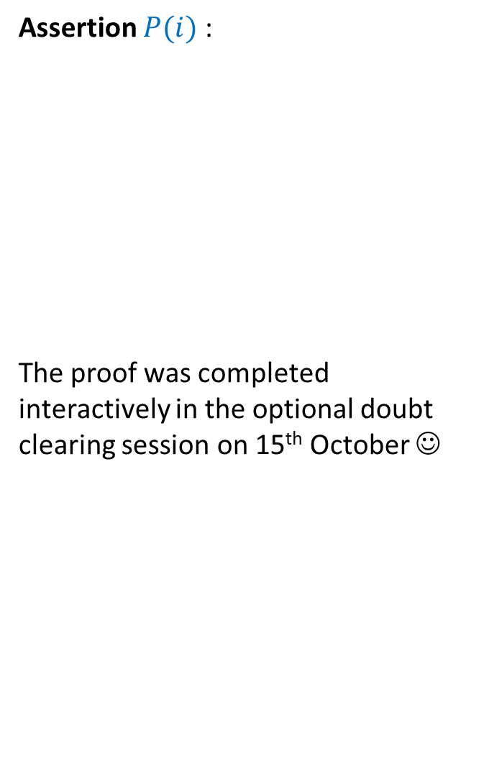



Binary Search
Binary-Search(A[$0...n−1$], $x$)
L ← $0$;
R ← $n−1$;
Found ← false;
While ( ? )
{ mid ← (L+R)$/2$;
If (A[mid] $=x$) Found ← true;
else if (A[mid] $<x$) ? ;
else ? ;
}
if Found return true;
else return false;
Assertion $P(i)$ :
The proof was completed interactively in the optional doubt clearing session on 15th October ☺
$x∉$ { A[0],…,A[L$−1$] }
and
$x∉$ { A[R+1],…,A[$n−$1] }
L
R
L $≤$ R and Found = false
A
L ← mid + 1
R ← mid - 1

Slide 24
Range-Minima Problem
A Motivating example
to realize the importance of data structures

Slide 25

Range-Minima Problem
Given: an array A storing $n$numbers,
Aim: a data structure to answer a sequence of queries of the following type
Range-minima(i,j) : report the smallest element from A[i],…,A[j]
Let A store one million numbers
Let the number of queries be 10 millions
Range-Minima(i,j) = -6
A
3 5 1 8 19 0 -1 30 99 -6 10 2 40 27 44 67
i=4
j=11

Slide 26
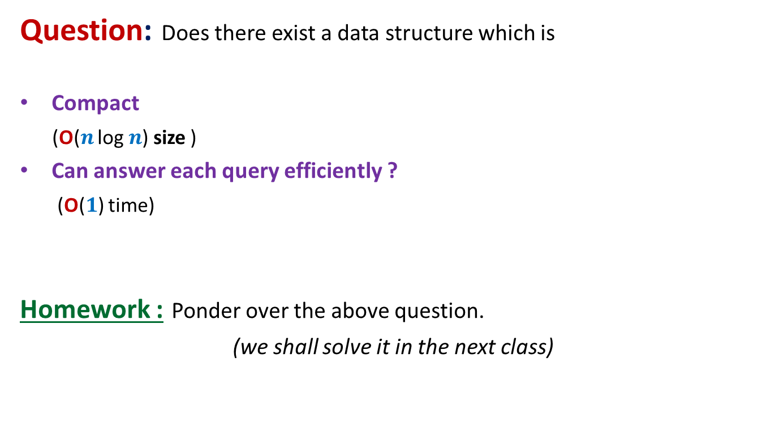
Range-Minima Problem
Question: Does there exist a data structure which is
Compact
(O($n$ log $n$) size )
Can answer each query efficiently ?
(O($1$) time)
Homework : Ponder over the above question.
(we shall solve it in the next class)

