Slide 1
Design and Analysis of Algorithms (CS345/CS345A)
Lecture 26
Generalization of Maximum Flow - II

Slide 2
Generalization of max-flow Problem
Part 2 Extending the capacity constraint
Let us first have a motivating problem that is solved using this generalization. ☺

Slide 3
Generalization of max-flow Problem
Part 2 Extending the capacity constraint

Slide 4
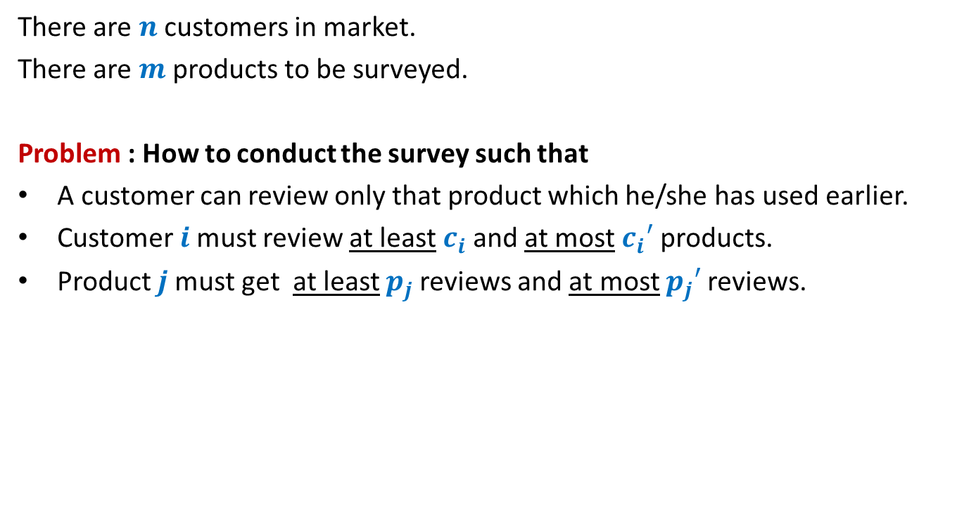
Survey Design Problem (As a motivating example)
There are $n$ customers in market.
There are $m$ products to be surveyed.
Problem : How to conduct the survey such that
A customer can review only that product which he/she has used earlier.
Customer $i$must review at least $c_{i}$and at most $c_{i}′$ products.
Product $j$must get at least $p_{j}$reviews and at most $p_{j}′$reviews.
Does this problem seem to have anything to do with flow ?
At least it does not appear on the first glance.

Slide 5
Generalization of max-flow Problem
Last class
Part 1 Extending the conservation constraint

Slide 6
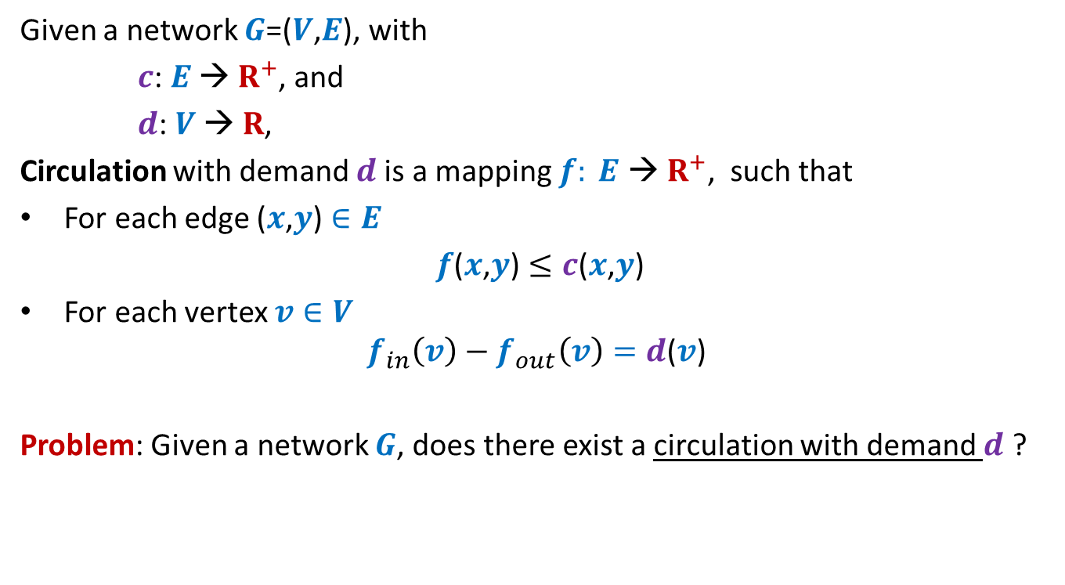
Circulation with demand
Given a network $G$=($V$,$E$), with
$c$: $E$ → $R^{+}$, and
$d$: $V$ → $R$,
Circulation with demand $d$is a mapping $f: E \text{→} R^{+}$, such that
For each edge ($x$,$y$) $∈E$
$f$($x$,$y$) $≤c$($x$,$y$)
For each vertex $v∈V$
$$f_{in}\left(v\right)−f_{out}\left(v\right)=d\text{(}v\text{)}$$
Problem: Given a network $G$, does there exist a circulation with demand $d$ ?

Slide 7
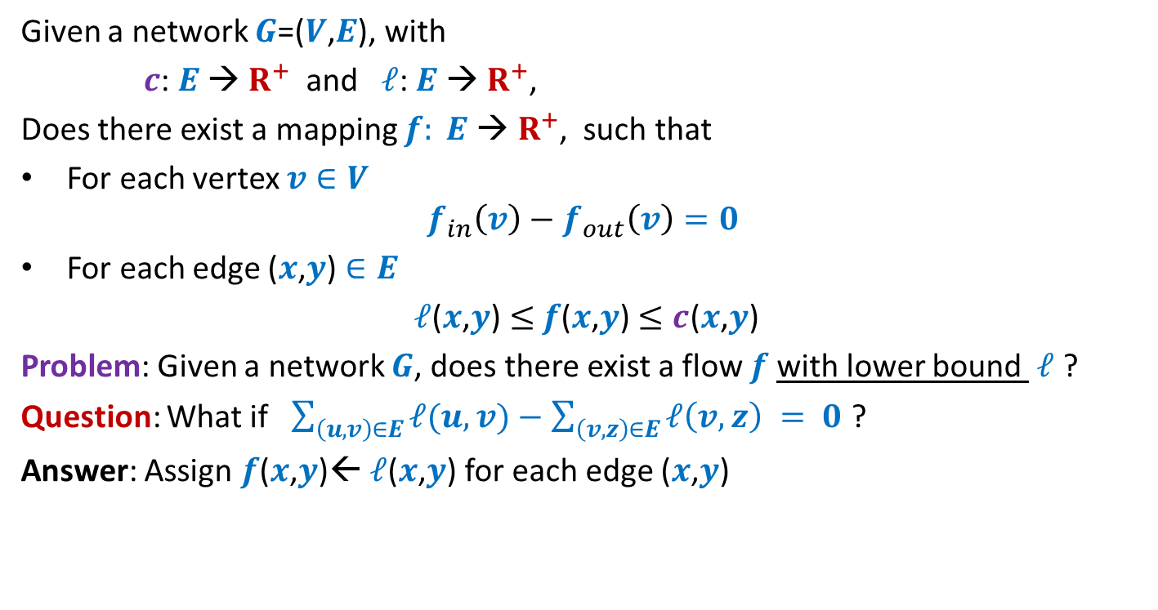
Flow with lower bound
Given a network $G$=($V$,$E$), with
$c$: $E$ → $R^{+}$ and $ℓ$: $E$ → $R^{+}$,
Does there exist a mapping $f: E \text{→} R^{+}$, such that
For each vertex $v∈V$
$$f_{in}\left(v\right)−f_{out}\left(v\right)=0$$
For each edge ($x$,$y$) $∈E$
$ℓ$($x$,$y$) $≤$ $f$($x$,$y$) $≤c$($x$,$y$)
Problem: Given a network $G$, does there exist a flow $f$with lower bound $ℓ$ ?
Question: What if $\sum_{\left(u,v\right)∈E}{ℓ(u,v)}−\sum_{\left(v,z\right)∈E}{ℓ\left(v,z\right)} = 0$ ?
Answer: Assign $f$($x$,$y$)← $ℓ$($x$,$y$) for each edge ($x$,$y$)

Slide 8

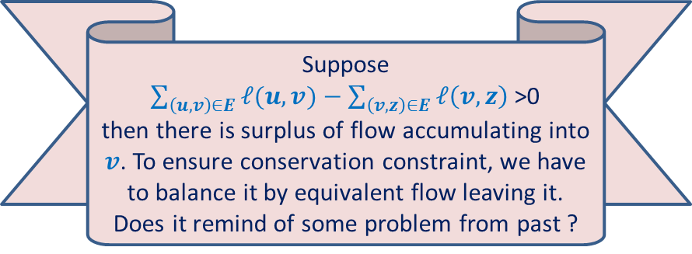

Flow with lower bound
Given a network $G$=($V$,$E$), with
$c$: $E$ → $R^{+}$ and $ℓ$: $E$ → $R^{+}$,
Does there exist a mapping $f: E \text{→} R^{+}$, such that
For each vertex $v∈V$
$$f_{in}\left(v\right)−f_{out}\left(v\right)=0$$
For each edge ($x$,$y$) $∈E$
$ℓ$($x$,$y$) $≤$ $f$($x$,$y$) $≤c$($x$,$y$)
Problem: Given a network $G$, does there exist a flow $f$with lower bound $ℓ$ ?
Question: What if $\sum_{\left(u,v\right)∈E}{ℓ(u,v)}−\sum_{\left(v,z\right)∈E}{ℓ\left(v,z\right)} = 0$ ?
Answer: Assign $f$($x$,$y$)← $ℓ$($x$,$y$) for each edge ($x$,$y$)
$$≠$$
Suppose
$\sum_{\left(u,v\right)∈E}{ℓ(u,v)}−\sum_{\left(v,z\right)∈E}{ℓ\left(v,z\right)}$>0
then there is surplus of flow accumulating into $v$. To ensure conservation constraint, we have to balance it by equivalent flow leaving it.
Does it remind of some problem from past ?
Reduce to
circulation with demand
$$v$$

Slide 9
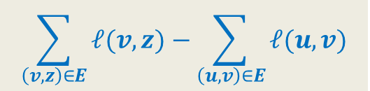
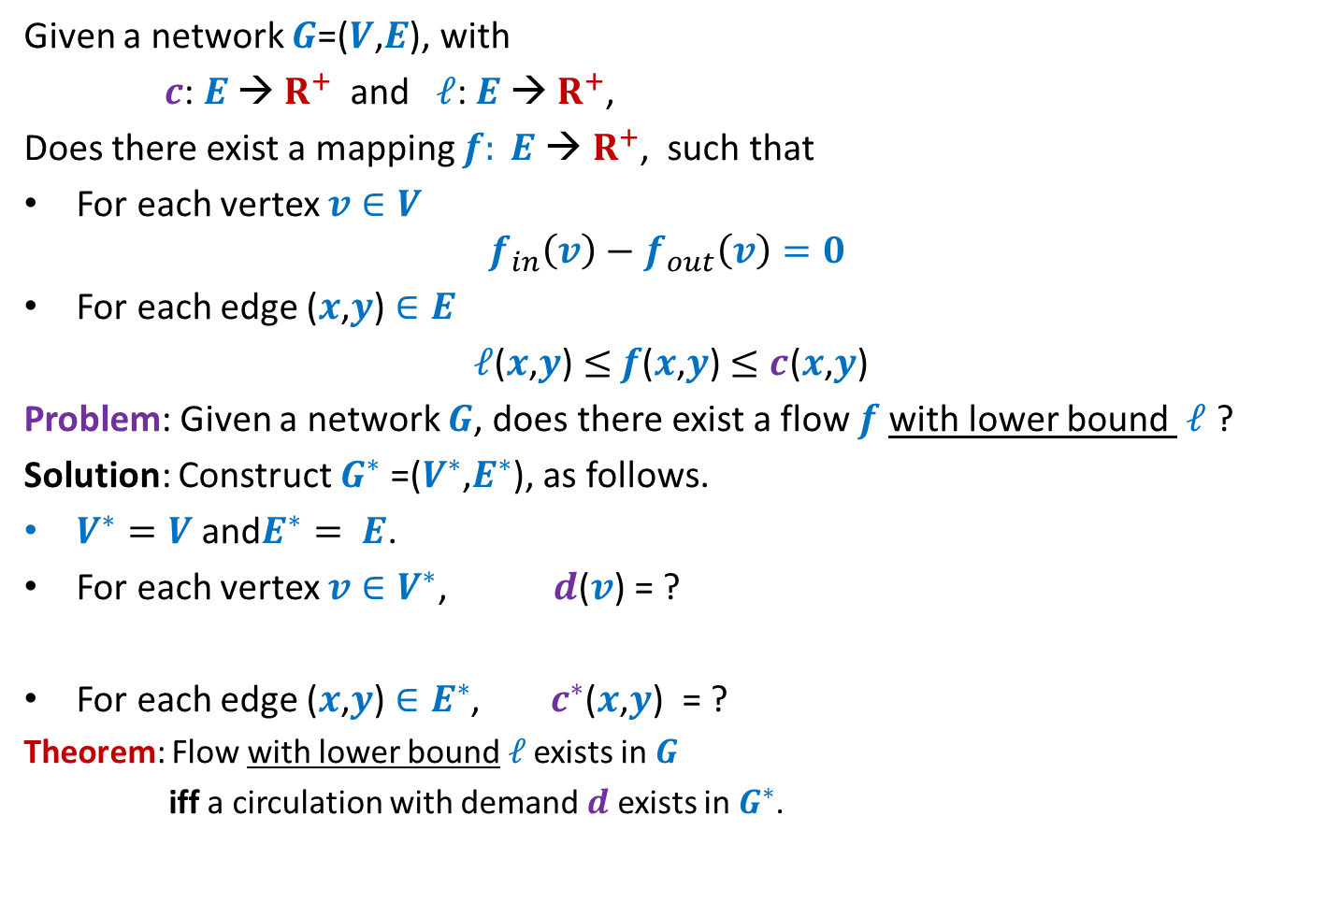

Flow with lower bound
Given a network $G$=($V$,$E$), with
$c$: $E$ → $R^{+}$ and $ℓ$: $E$ → $R^{+}$,
Does there exist a mapping $f: E \text{→} R^{+}$, such that
For each vertex $v∈V$
$$f_{in}\left(v\right)−f_{out}\left(v\right)=0$$
For each edge ($x$,$y$) $∈E$
$ℓ$($x$,$y$) $≤$ $f$($x$,$y$) $≤c$($x$,$y$)
Problem: Given a network $G$, does there exist a flow $f$with lower bound $ℓ$ ?
Solution: Construct $G^{∗}$ =($V^{∗}$,$E^{∗}$), as follows.
$V^{∗}=V$ and$E^{∗}= E$.
For each vertex $v∈V^{∗}$, $d$($v$) = ?
For each edge ($x$,$y$) $∈E^{∗}$, $c^{∗}$($x$,$y$) = ?
Theorem: Flow with lower bound$ℓ$ exists in $G$
iff a circulation with demand $d$ exists in $G^{∗}$.
$$\sum_{\left(v,z\right)∈E}{ℓ(v,z)}−\sum_{\left(u,v\right)∈E}{ℓ(u,v)}$$
$c$($x$,$y$) $− ℓ$($x$,$y$)

Slide 10
Applications of Flow with lower bound
Designing a Survey

Slide 11
Survey Design Problem (As a motivating example)
There are $n$ customers in market.
There are $m$ products to be surveyed.
Problem : How to conduct the survey such that
A customer can review only that product which he/she has used earlier.
Customer $i$must review at least $c_{i}$and at most $c_{i}′$ products.
Product $j$must get at least $p_{j}$reviews and at most $p_{j}′$reviews.
How to formulate the problem
as an instance of
a feasible flow with lower bound ?

Slide 12

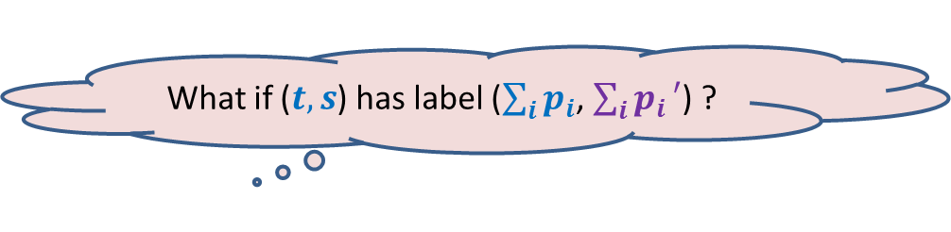



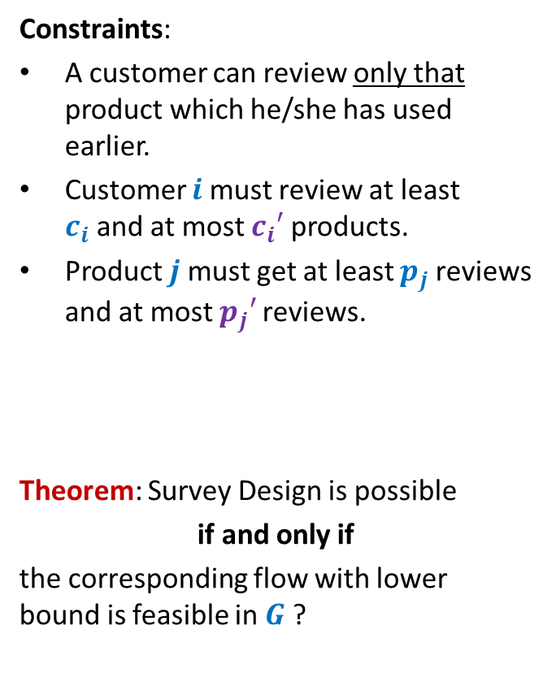



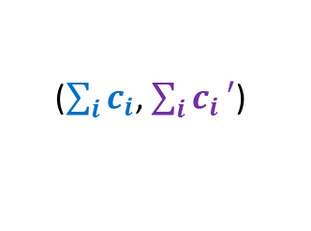



Survey Design Problem
$$G$$
($0$,$1$)
Constraints:
A customer can review only that product which he/she has used earlier.
Customer $i$must review at least $c_{i}$and at most $c_{i}′$ products.
Product $j$must get at least $p_{j}$reviews and at most $p_{j}′$reviews.
Theorem: Survey Design is possible
if and only if
the corresponding flow with lower bound is feasible in $G$ ?
Customers
Products
$$s$$
$$t$$
($p_{j},p_{j}′$)
($c_{i},c_{i}′$)
$$j$$
$$i$$
How to conserve flow at $s$ and $t$ ?
($\sum_{i}{c_{i}}$, $\sum_{i}{c_{i}}′$)
What if ($t,s$) has label ($\sum_{i}{p_{i}}$, $\sum_{i}{p_{i}}′$) ?
What if ($t,s$) has label ($0$, $∞$) ?
Make a sincere attempt to prove this Theorem on your own before seeing it on the next 2 slides.

Slide 13
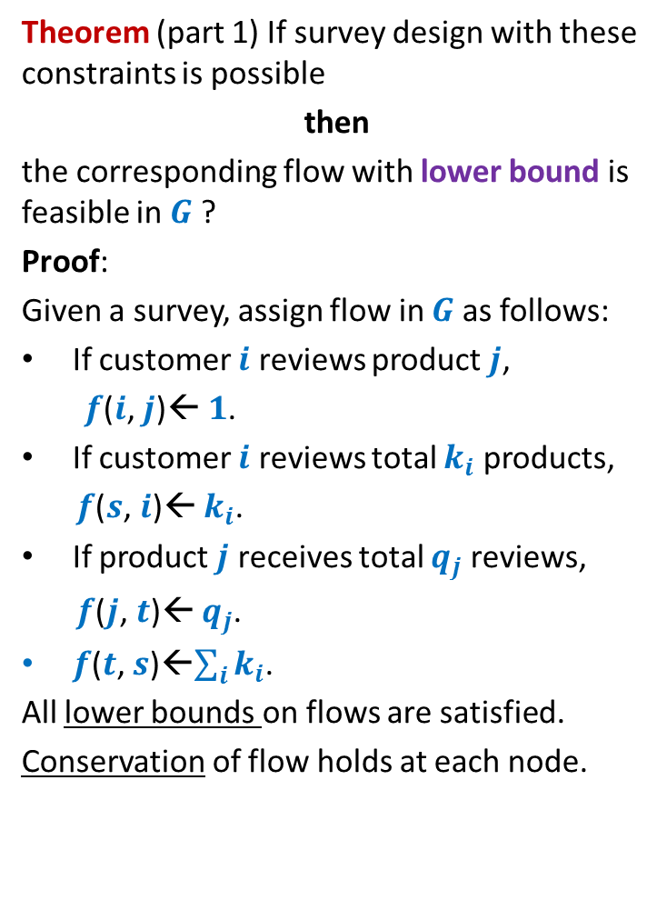
Survey Design Problem
$$G$$
Theorem (part 1) If survey design with these constraints is possible
then
the corresponding flow with lower bound is feasible in $G$ ?
Proof:
Given a survey, assign flow in $G$ as follows:
If customer $i$ reviews product $j$,
$f$($i$, $j$)← $1$.
If customer $i$ reviews total $k_{i}$ products,
$f$($s$, $i$)← $k_{i}$.
If product $j$ receives total $q_{j}$ reviews,
$f$($j$, $t$)← $q_{j}$.
$f$($t$, $s$)←$\sum_{i}{k_{i}}$.
All lower bounds on flows are satisfied.
Conservation of flow holds at each node.
($0$,$1$)
Customers
Products
$$s$$
$$t$$
($p_{j},p_{j}′$)
($c_{i},c_{i}′$)
$$j$$
$$i$$
($\sum_{i}{c_{i}}$, $\sum_{i}{c_{i}}′$)

Slide 14

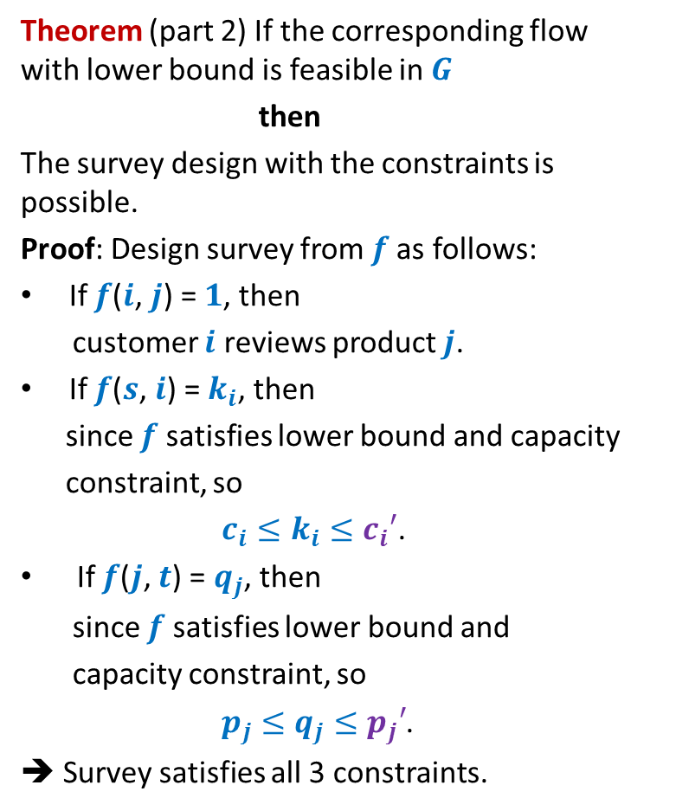

Survey Design Problem
$$G$$
Theorem (part 2) If the corresponding flow with lower bound is feasible in $G$
then
The survey design with the constraints is possible.
Proof: Design survey from $f$as follows:
If $f$($i$, $j$) = $1$, then
customer $i$ reviews product $j$.
If $f$($s$, $i$) = $k_{i}$, then
since $f$ satisfies lower bound and capacity
constraint, so
$c_{i}≤k_{i}≤c_{i}′$.
If $f$($j$, $t$) = $q_{j}$, then
since $f$ satisfies lower bound and
capacity constraint, so
$p_{j}≤q_{j}≤p_{j}′$.
➔ Survey satisfies all 3 constraints.
($0$,$1$)
Customers
Products
($c_{i},c_{i}′$)
$$i$$
$$s$$
$$t$$
($p_{j},p_{j}′$)
$$j$$
($\sum_{i}{c_{i}}$, $\sum_{i}{c_{i}}′$)

Slide 15
Applications of Flow with lower bound
An Airline Problem

Slide 16











An Airline Problem
There are $n$ cities to be served.
There are $m$ fights to be operated.
Flight $i$ has $4$ parameters:
$s$($i$) : source
$d$($i$) : destination
dep($i$) : departure time
arr($i$) : arrival time
Problem: What is the minimum no. of aeroplanes to serve all flights ?
($s$($i$), $d$($i$), dep($i$) , arr($i$))
What is the minimum number of aeroplanes to serve these flights ?
What is the minimum number of aeroplanes to serve these flights ?
What is the minimum number of aeroplanes to serve these flights ?
$$4$$
$$4$$
$$3$$
(Delhi, Bombay, $6$ AM , $8$AM
(Lucknow, Hyderabad, $11$ AM , $1$PM
(Bombay, Hyderabad, $7$AM , $9$AM
(Delhi, Chennai, $6$ AM , $9$AM
(Chennai, Bombay $11$ AM , $2$PM
(Bombay, Lucknow, $8:30$AM , $10:30$AM

Slide 17

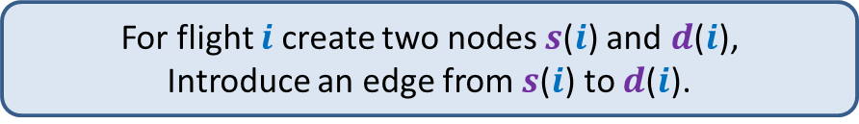





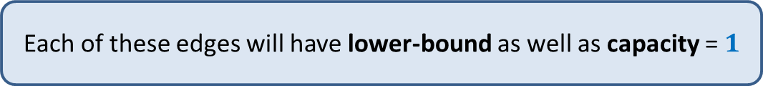

Constructing an instance of Flow with lower bound
($0$,$1$)
($1$,$1$)
($0$,$1$)
($0$,$1$)
($0$, $?$)
Add directed-edge from $d$($i$) to $s$($j$) if
destination($i$)=source($j$) and
Departure-time($j$)>Arrival-time($i$)
Introduce a source and a sink.
Add an edge from source to $s$($i$) for each flight $i$.
Add an edge from $d$($j$) to sink for each flight $j$.
For flight $i$create two nodes $s$($i$) and $d$($i$),
Introduce an edge from $s$($i$) to $d$($i$).
Each of these edges will have lower-bound as well as capacity = $1$

Slide 18
Constructing an instance of Flow with lower bound
($0$,$1$)
($1$,$1$)
($0$,$1$)
($0$,$1$)
($0$, $?$)
This will be one instance of flow with lower-bound.

Slide 19

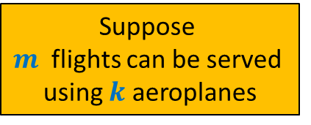
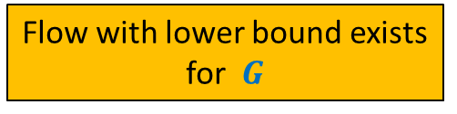


Constructing an instance of Flow with lower bound
($1$,$1$)
Suppose
$m$ flights can be served
using $k$ aeroplanes
$$G$$
How to compute the smallest number of aeroplanes ?
Flow with lower bound exists
for $G$
($0$, $?$)
>
$$k$$
$$1$$
$$3$$
$$2$$
$$4$$

