Slide 1
Crowd Supply
Course Workbook

Slide 2
Table of Contents
About this Workbook | Slide 3
Pre-Lab: Workshop Pre-requisites | Slide 4
Lab : Implementing the Vivado Design | Slide 7

Slide 3
About this Workbook
This workbook is designed to be used in conjunction with the Crowd Supply lab one workshop.
The contents of this workbook are created by Adiuvo Engineering & Training, Ltd.
If you have any questions about the contents, or need assistance, please contact Adam Taylor at adam@adiuvoengineering.com.

Slide 4
Pre-Lab Workshop Pre-requisites

Slide 5
Required Hardware
Pre-Lab
The following hardware is required to complete this series of labs
Digilent Basys3 Development board

Slide 6
Downloads and Installations
Pre-Lab
Step 1 – Download and install the following at least one day prior to the workshop. This may take a significant amount of time and drive space.
Vitis 2020.2 – Includes Vivado | Download
Source Project Files | Download

Slide 7
Lab Creating Pong on the Basys3

Slide 8
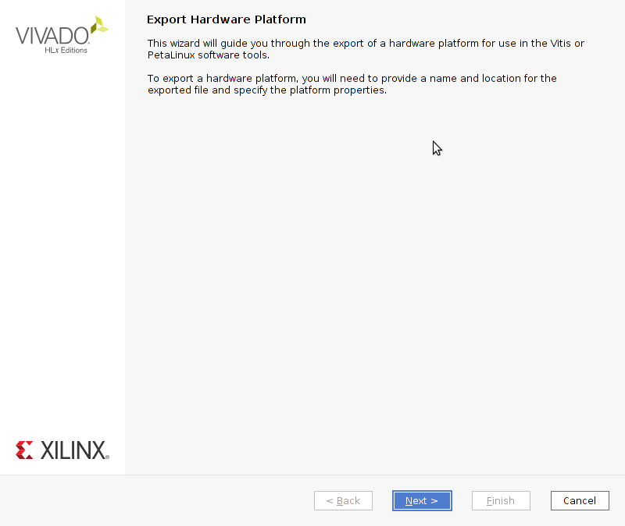
Crowd Supply: Lab One
Lab One
Step 1 – Picking up from last time we had just generated the bit stream. Now we need to export it, with the Vivado project open from the file menu select export hardware

Slide 9
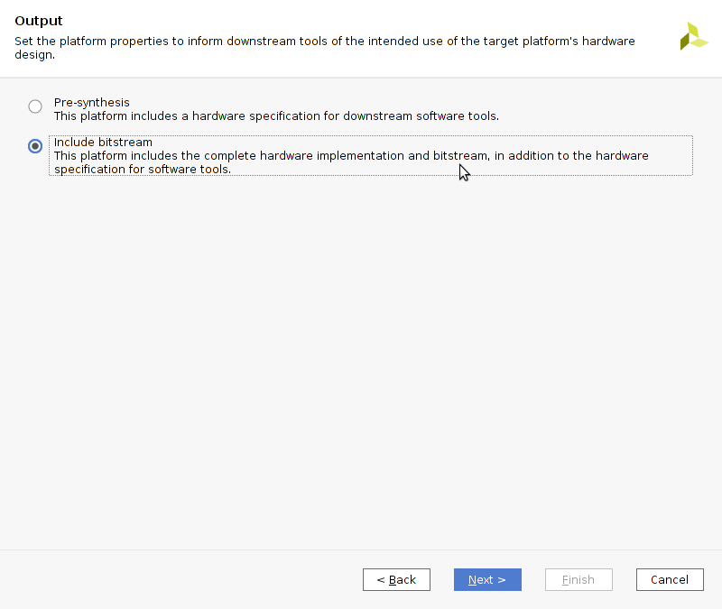
Crowd Supply: Lab One
Lab One
Step 1 – Select include bitstream

Slide 10
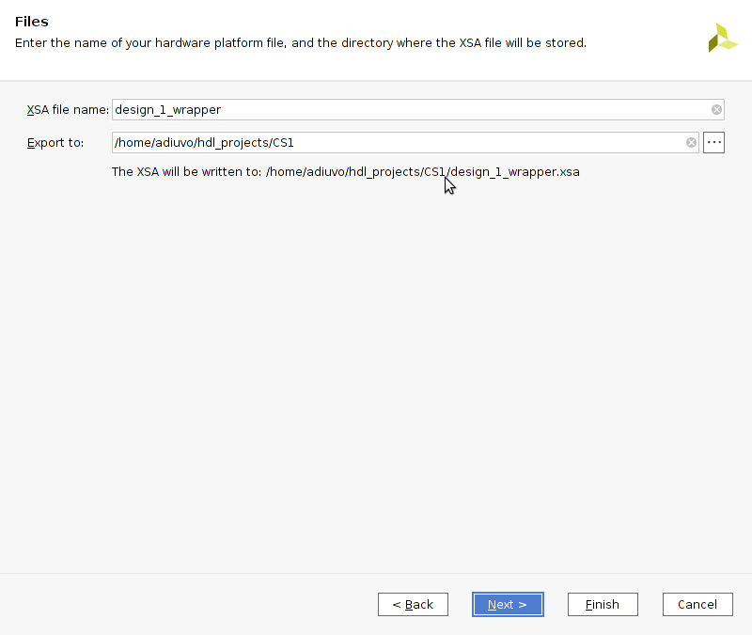
Crowd Supply: Lab One
Lab One
Step 1 – Leave the defaults unchanged and click next

Slide 11
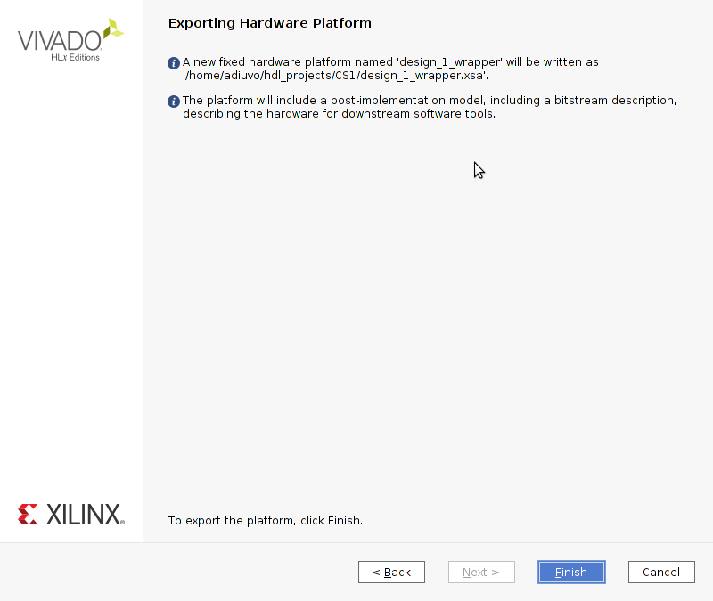
Crowd Supply: Lab One
Lab One
Step 1 – Click finish to export the hardware definition

Slide 12
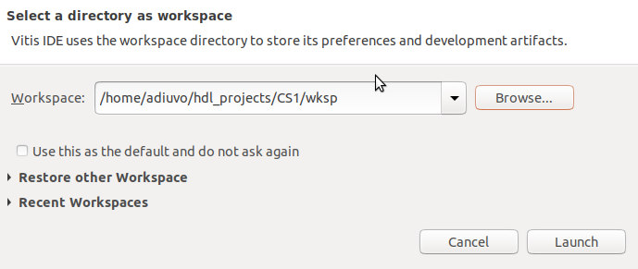
Crowd Supply: Lab One
Lab One
Step 1 – From the Vivado Tools menu select launch Vitis, at the pop up dialog select browse

Slide 13
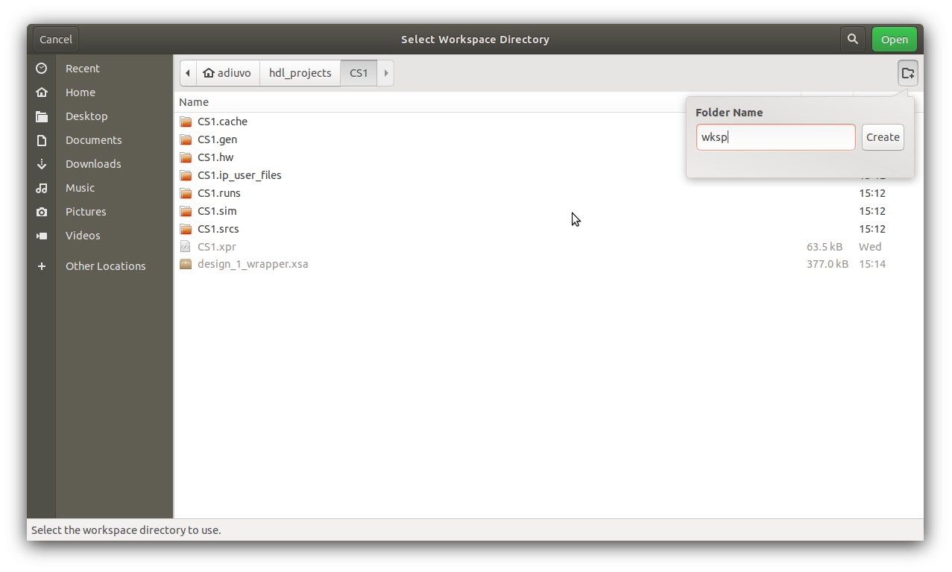
Crowd Supply: Lab One
Lab One
Step 1 – Create a new folder called wksp within the Vivado Project

Slide 14
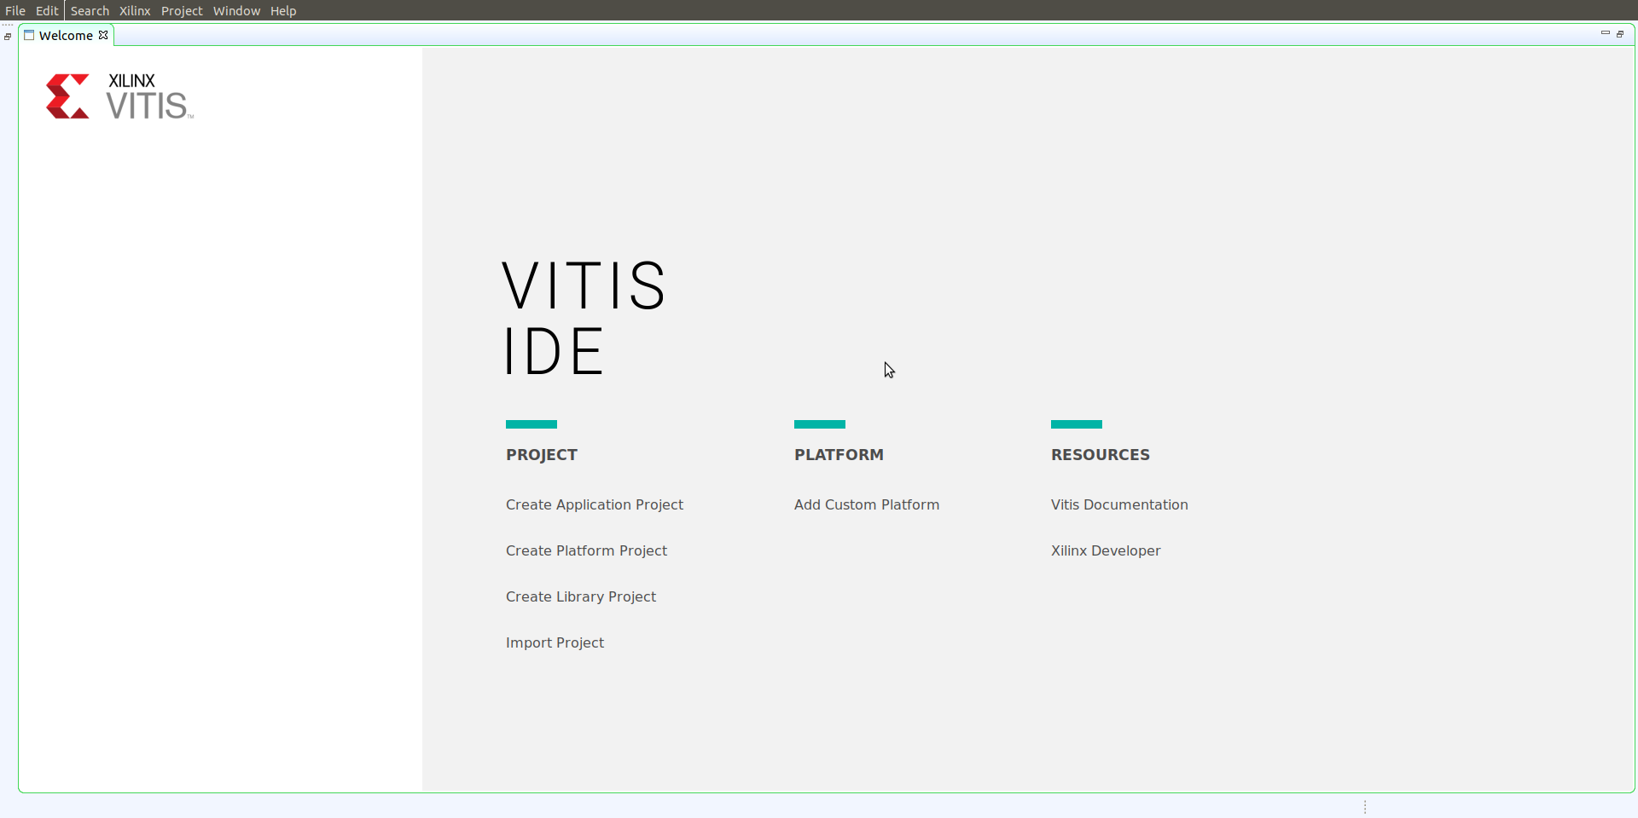
Crowd Supply: Lab One
Lab One
Step 1 – Select create application

Slide 15
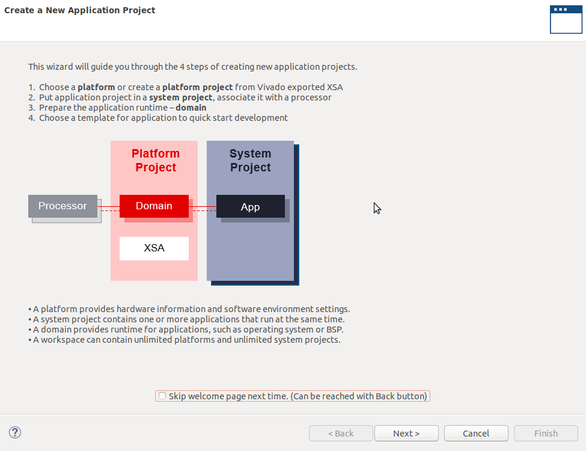
Crowd Supply: Lab One
Lab One
Step 1 – Click on next

Slide 16
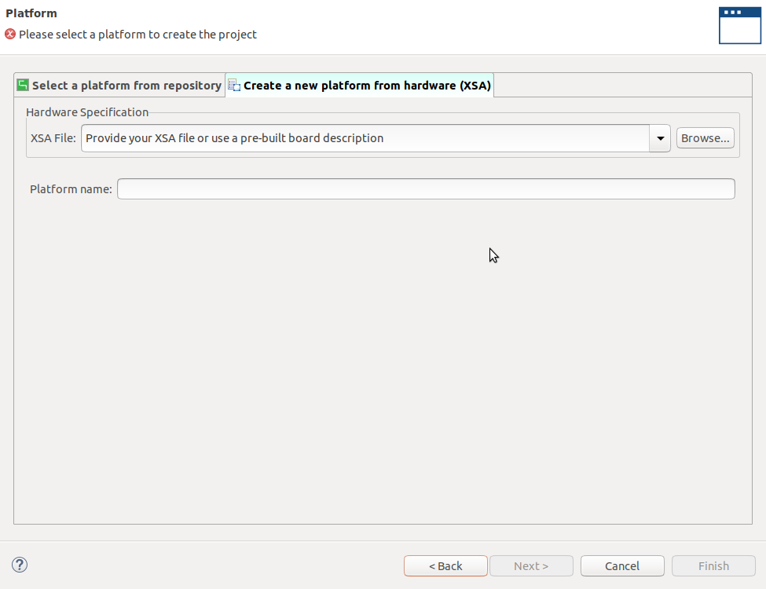
Crowd Supply: Lab One
Lab One
Step 1 – Select “create a new platform from hardware (XSA)” and click browse

Slide 17
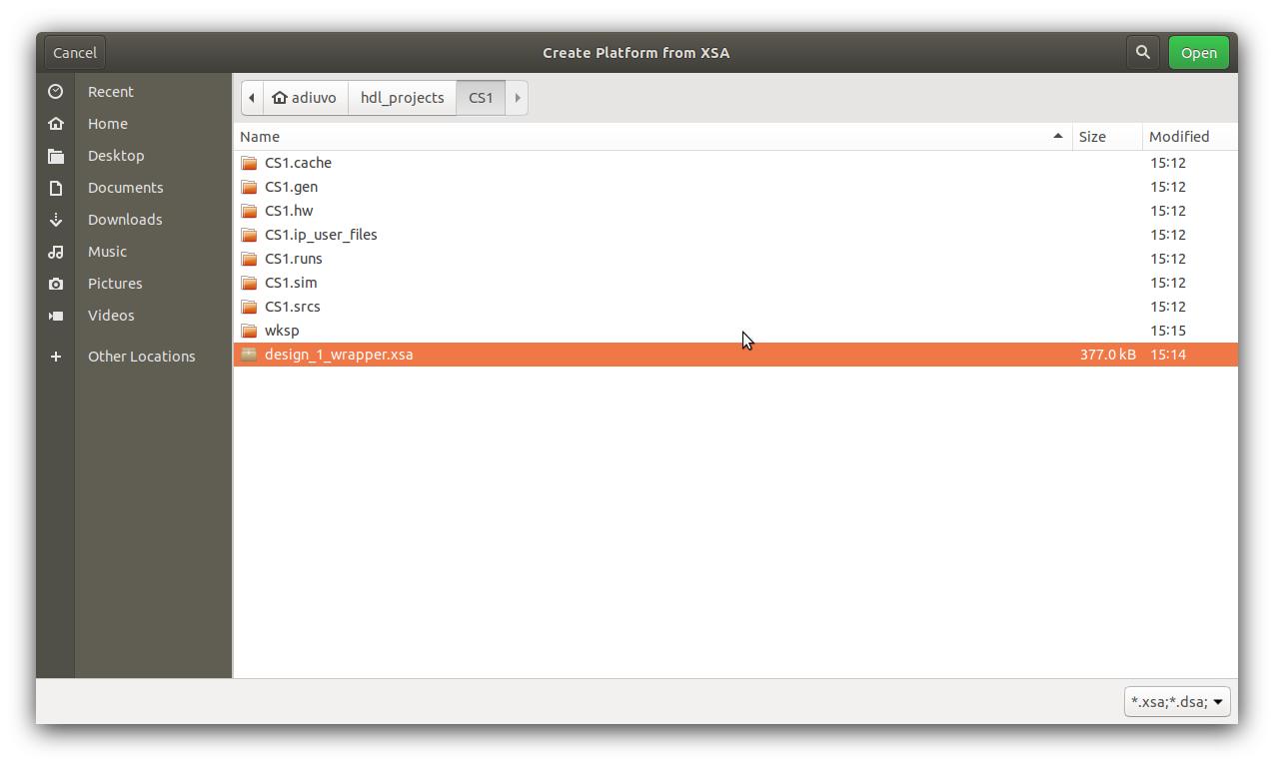
Crowd Supply: Lab One
Lab One
Step 1 – Navigate to the location of the XSA we just exported from Vivado, click Open

Slide 18
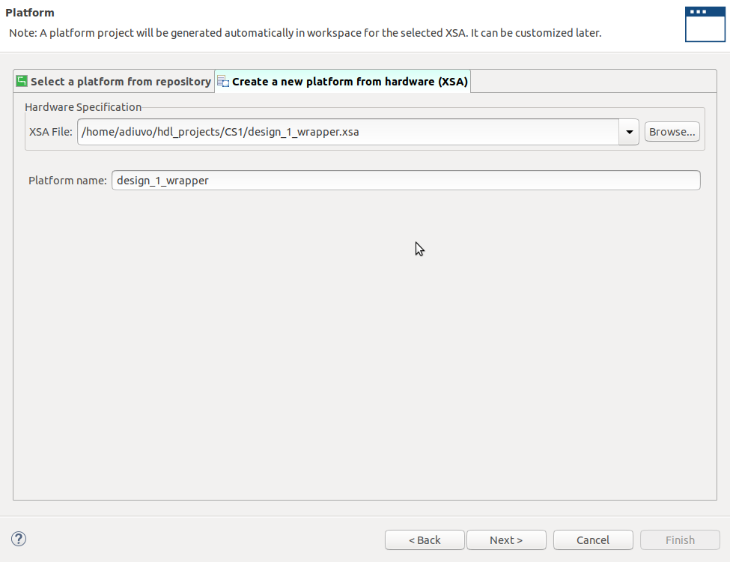
Crowd Supply: Lab One
Lab One
Step 1 – Click OK to use this as the platform

Slide 19
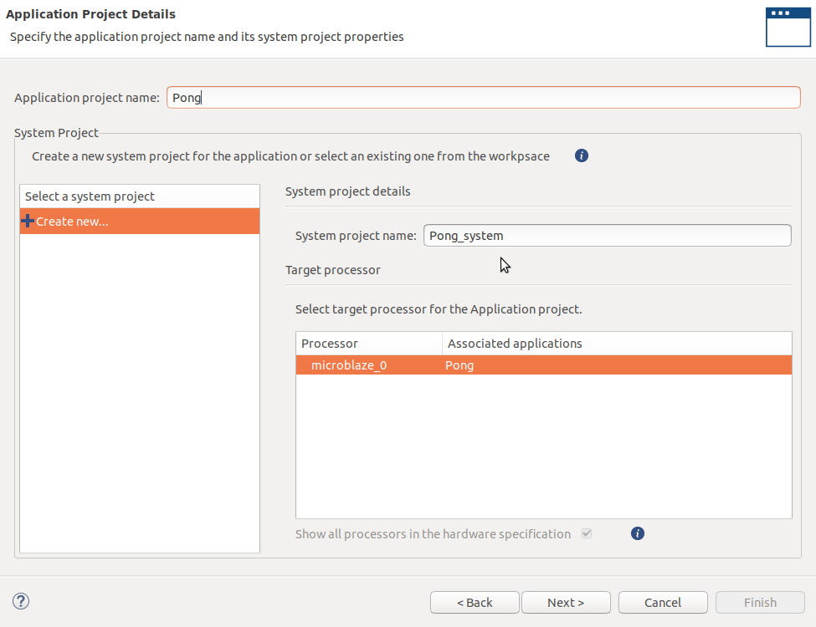
Crowd Supply: Lab One
Lab One
Step 1 – Enter a project name and click next

Slide 20
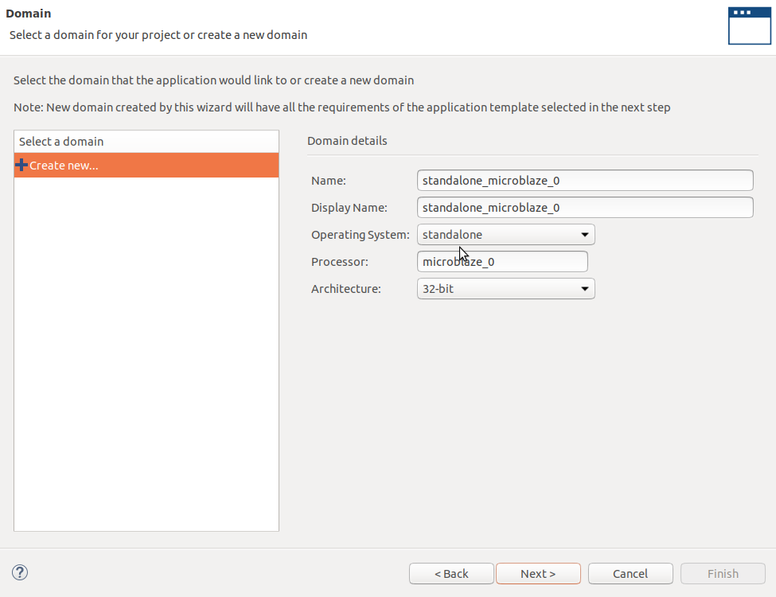
Crowd Supply: Lab One
Lab One
Step 1 – Leave the domains unchanged, clicked next

Slide 21
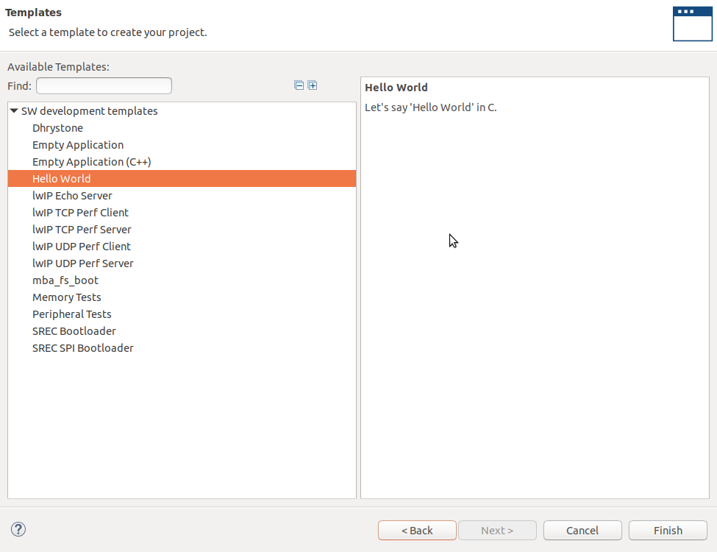
Crowd Supply: Lab One
Lab One
Step 1 – Select the hello world project click next

Slide 22
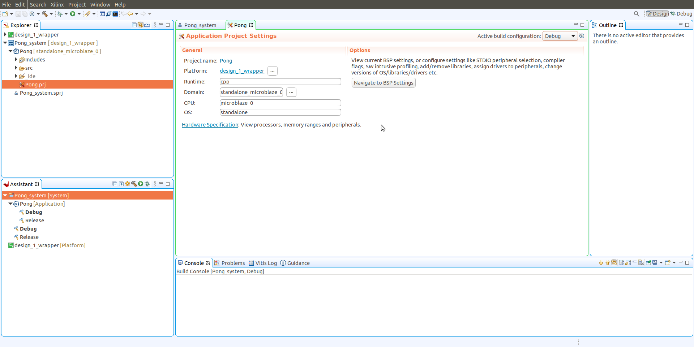
Crowd Supply: Lab One
Lab One
Step 1 – You will see a project be created as below – Connect the Basys3 to the development system using the USB cable and turn on the board

Slide 23
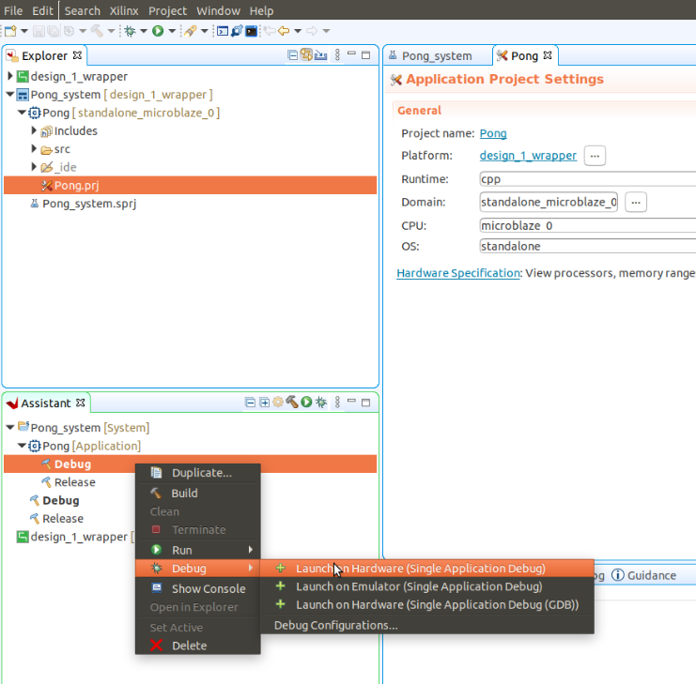
Crowd Supply: Lab One
Lab One
Step 1 – In the assistant window select the project, right click on release and from the Debug menu select launch on Hardware

Slide 24
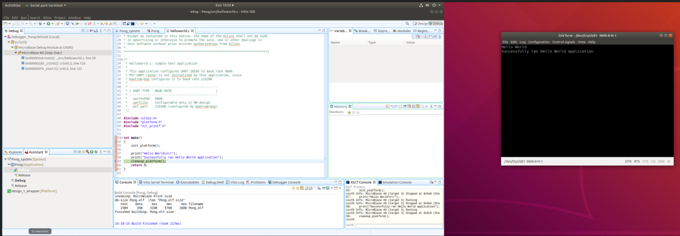
Crowd Supply: Lab One
Lab One
Step 1 – Open a terminal window (9600N1) when the debug is loaded single step through the design, and you will see the hello world in the terminal. This proves the MicroBlaze is working all OK so we can start with the application development.

Slide 25
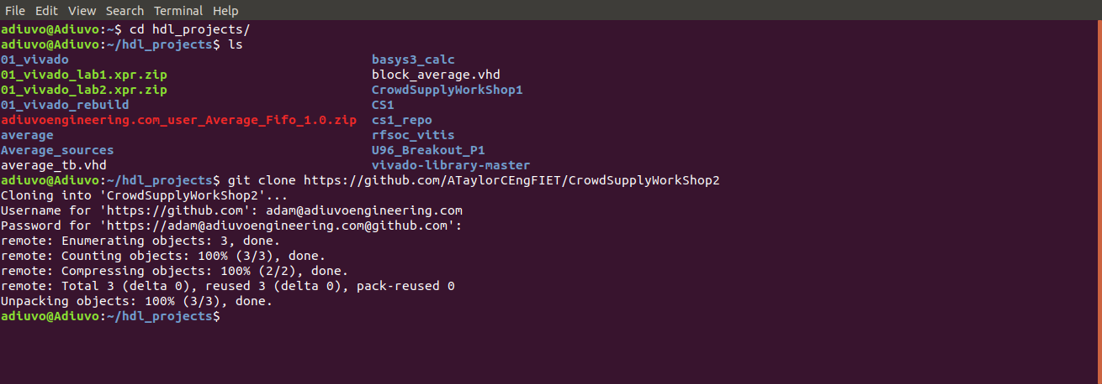
Crowd Supply: Lab One
Lab One
Step 1 – Clone the repository with the command
git clone https://github.com/ATaylorCEngFIET/CrowdSupplyWorkShop2

Slide 26
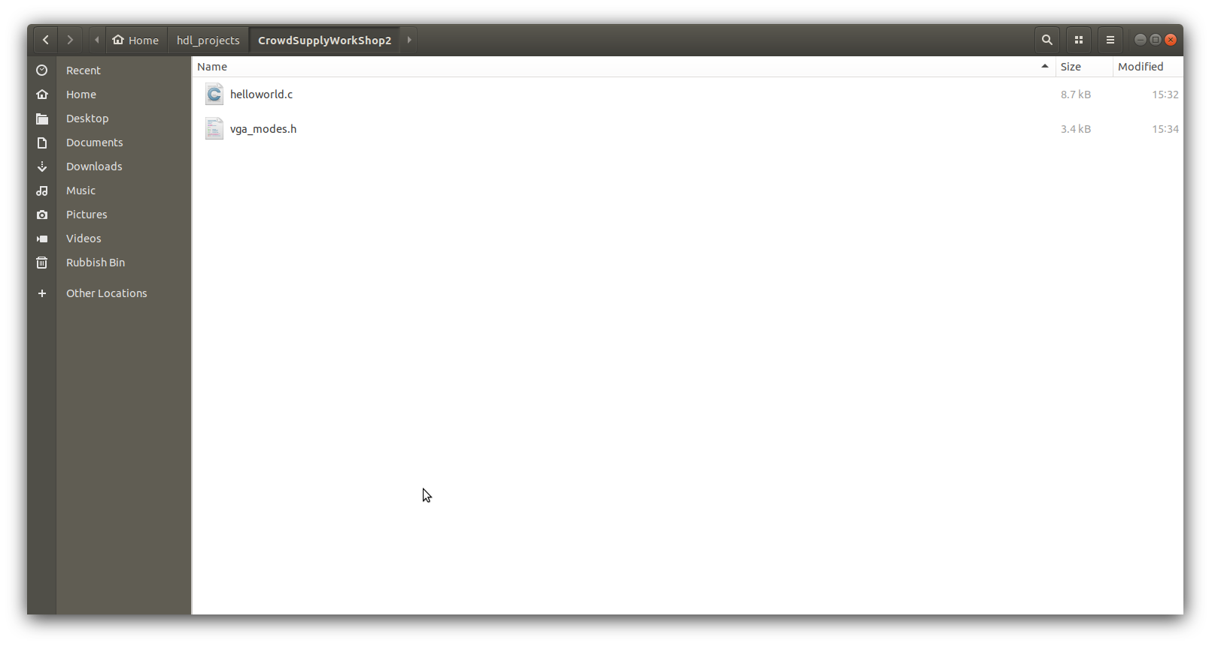
Crowd Supply: Lab One
Lab One
Step 1 – This will clone two source files from the repo – copy both these files

Slide 27
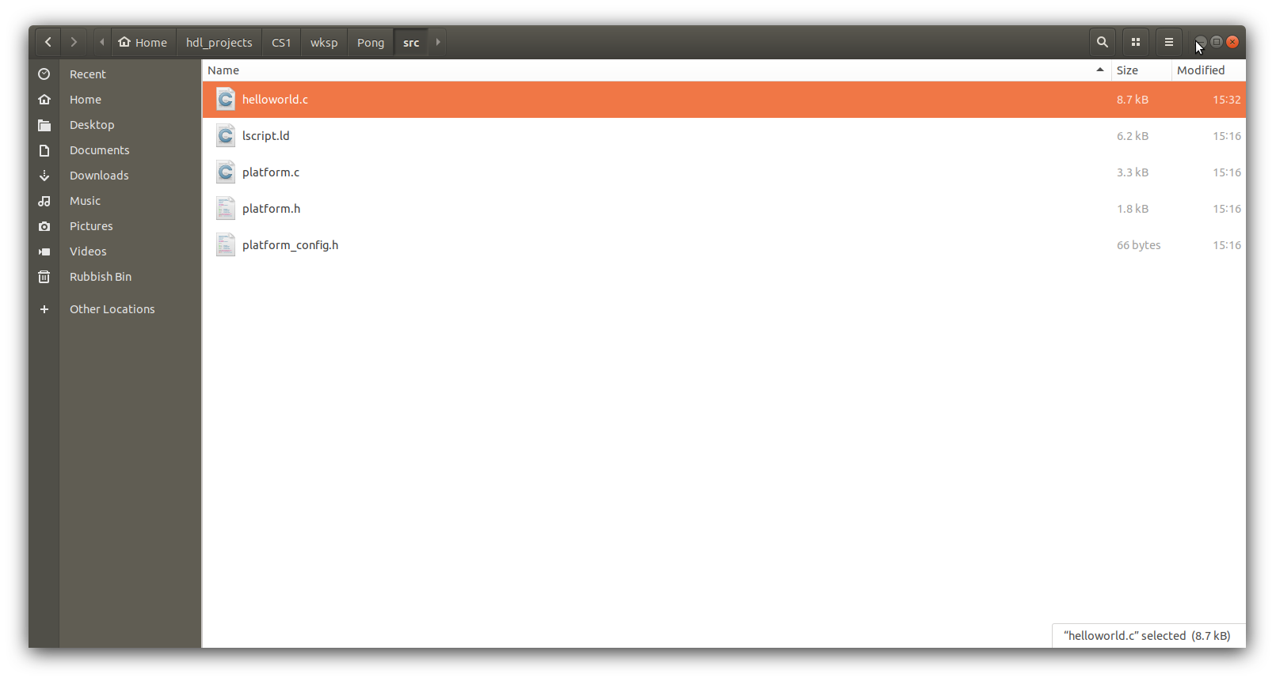
Crowd Supply: Lab One
Lab One
Step 1 – Copy them into the wksp files under the src for the previously created project

Slide 28
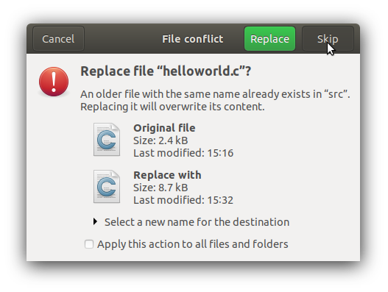
Crowd Supply: Lab One
Lab One
Step 1 – If prompted allow the helloworld.c file to be replaced

Slide 29
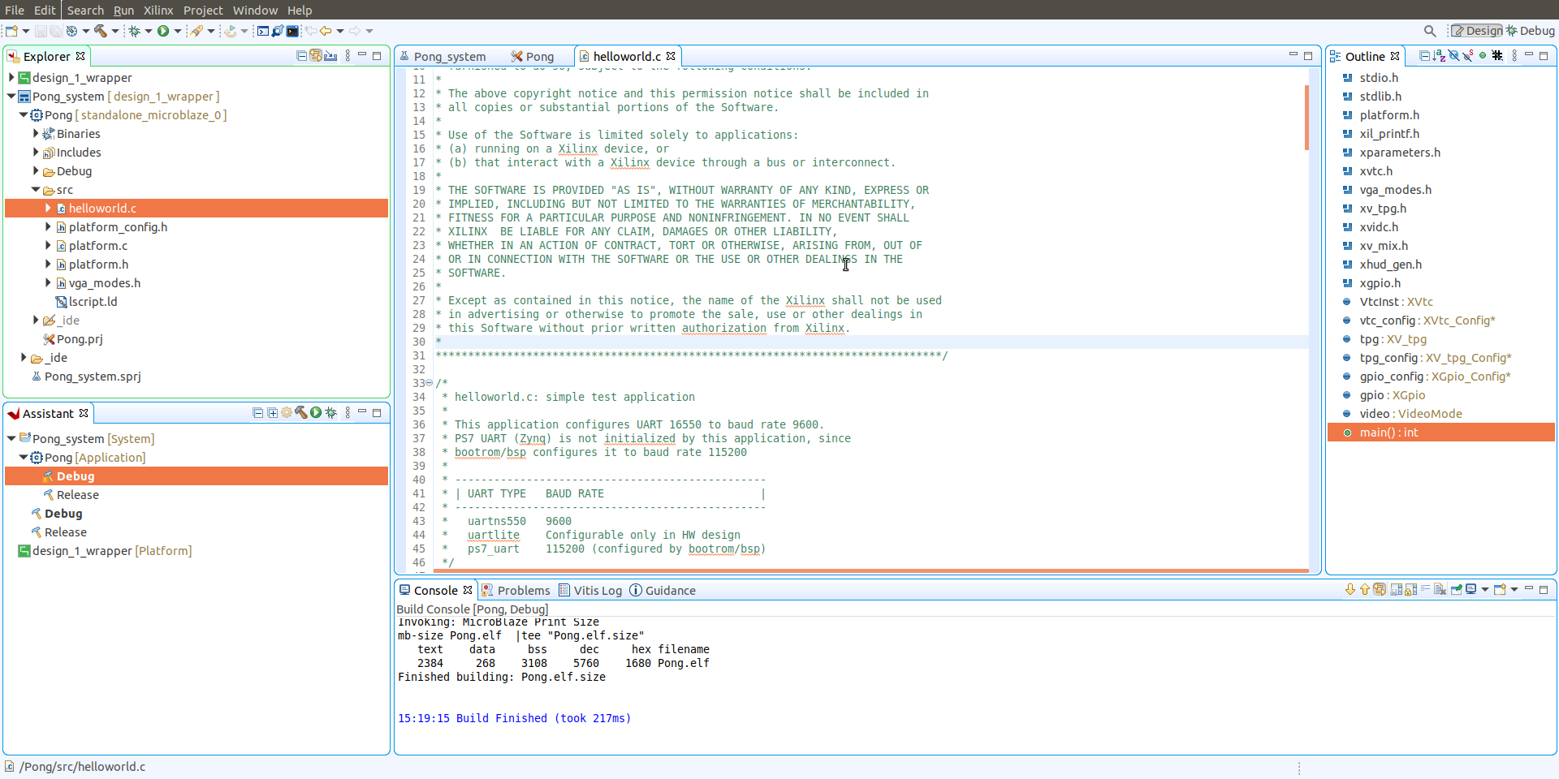
Crowd Supply: Lab One
Lab One
Step 1 – The Vitis project should now show, the new files we just copied in – click build project on the hammer

Slide 30
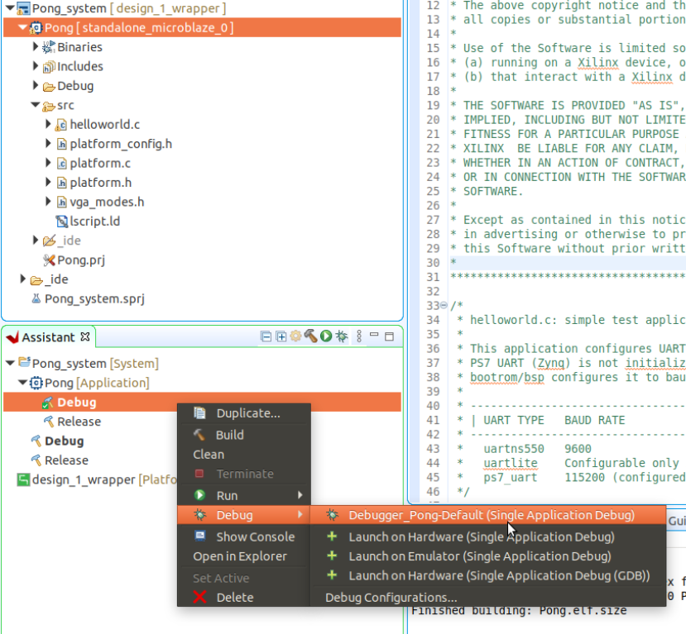
Crowd Supply: Lab One
Lab One
Step 1 – Open Vivado 2020.2. Once Vivado opens, open the Xhub Store

Slide 31
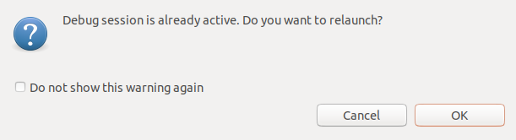
Crowd Supply: Lab One
Lab One
Step 1 – Open Vivado 2020.2. Once Vivado opens, open the Xhub Store

Slide 32
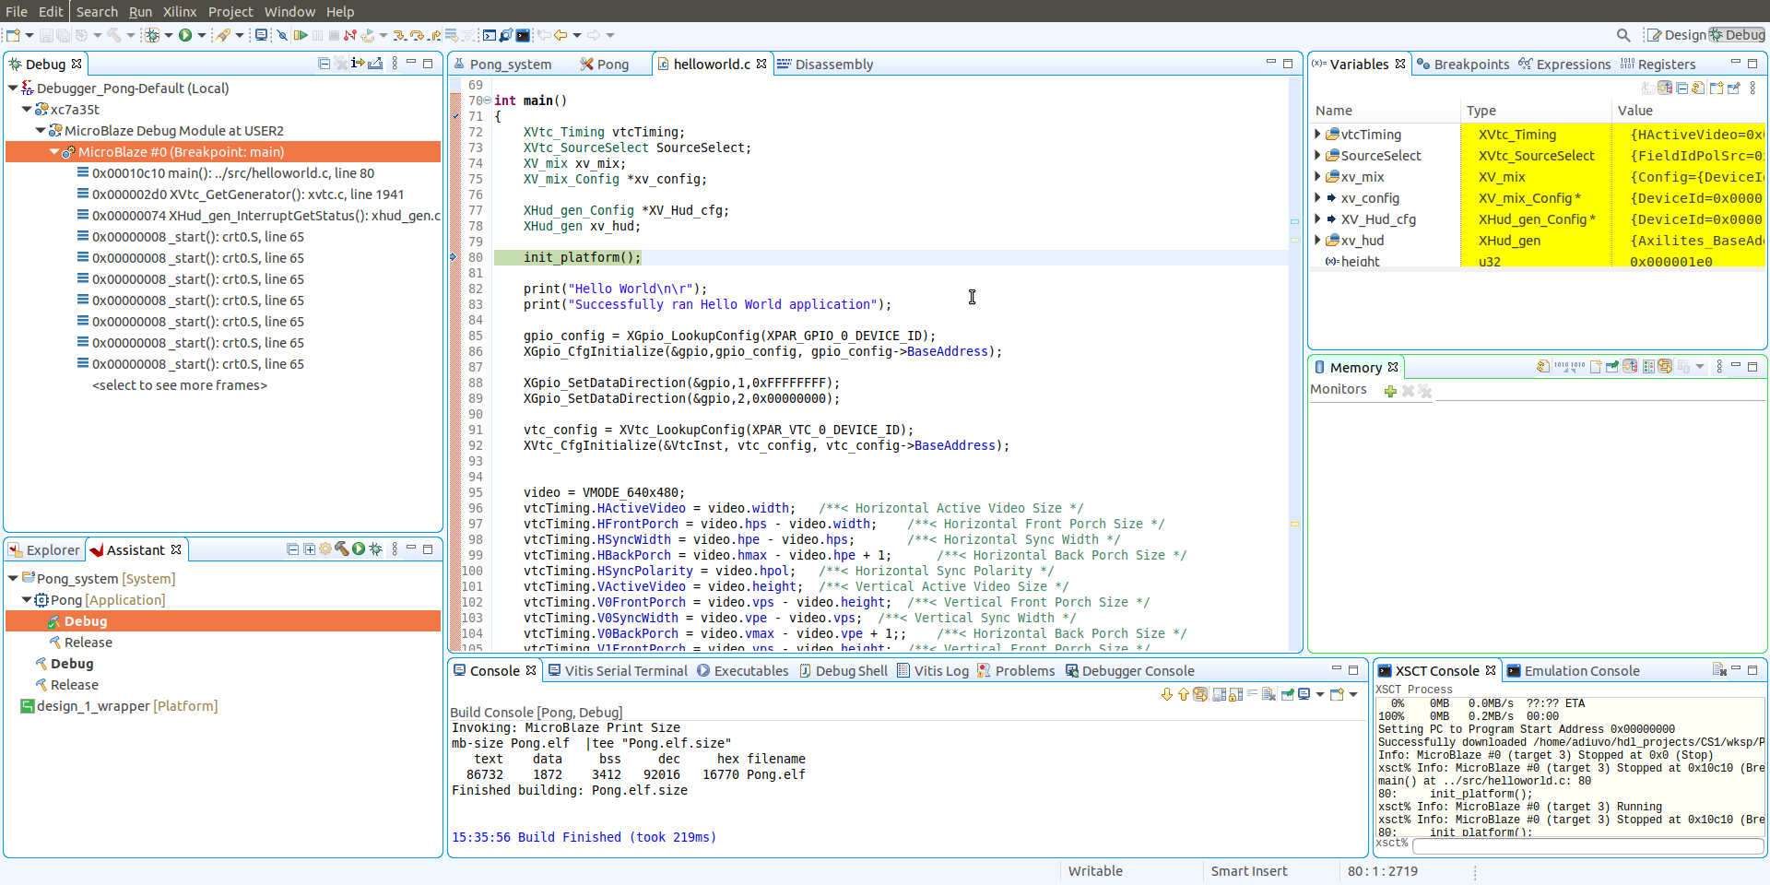
Crowd Supply: Lab One
Lab One
Step 1 – Once the build competes re-run the debug on hardware –with a VGA monitor attached, click on run – after a few seconds you should see the game appear on the screen

Slide 33
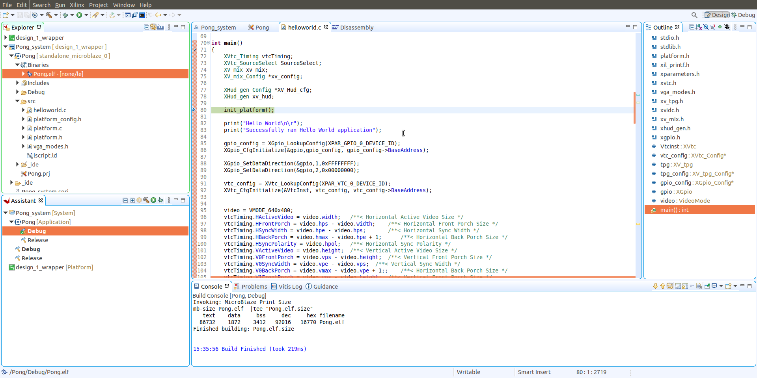
Crowd Supply: Lab One
Lab One
Step 1 – Expand the Binaries and you will see the ELF file which is running on the MicroBlaze – To use this on the board from power up we need to include it in the bitstream

Slide 34
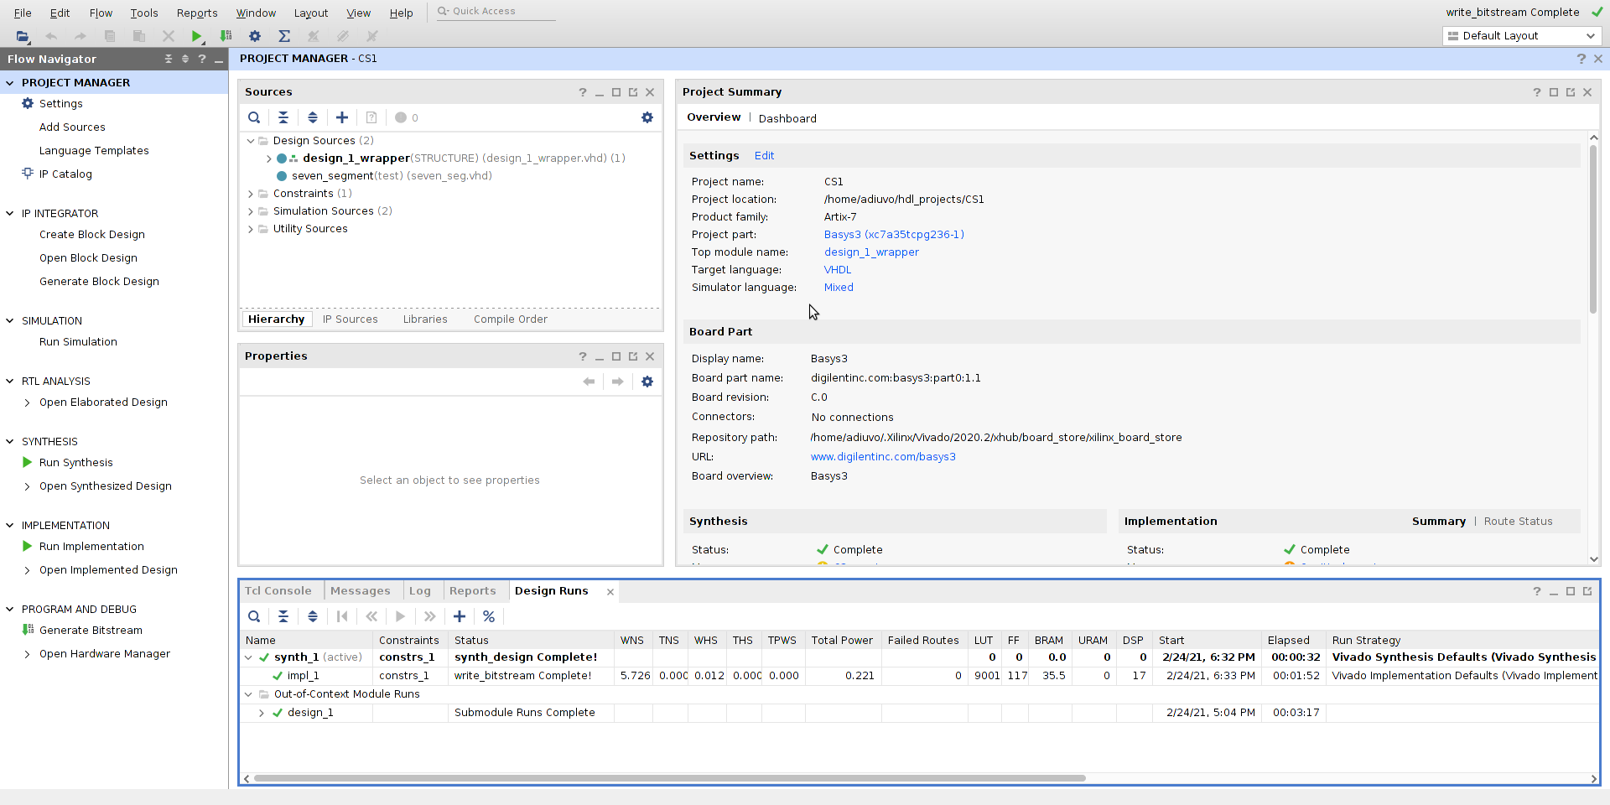
Crowd Supply: Lab One
Lab One
Step 1 – Switch back to Vivado

Slide 35
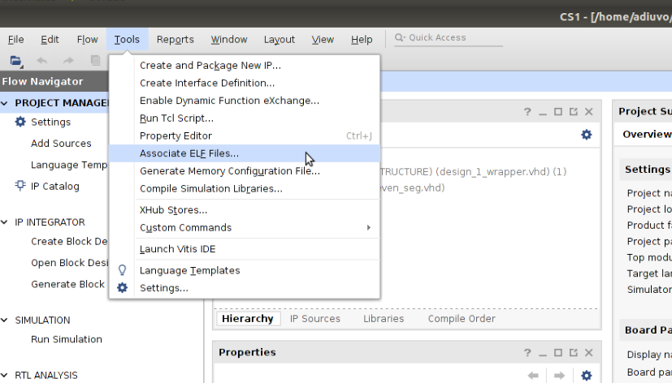
Crowd Supply: Lab One
Lab One
Step 1 – From the Tools menu select Associate ELF File

Slide 36
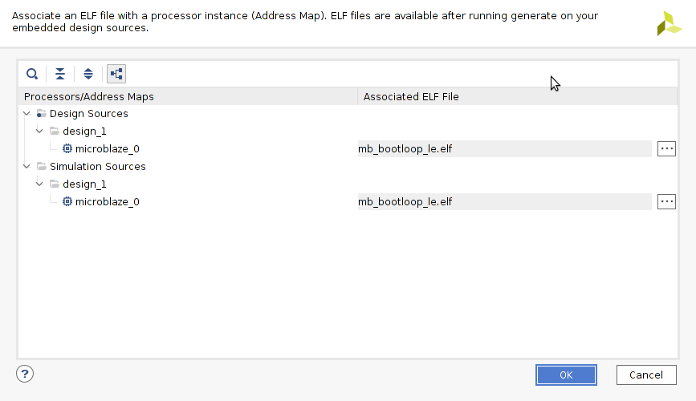
Crowd Supply: Lab One
Lab One
Step 1 – Select … on the MicroBlaze design sources

Slide 37
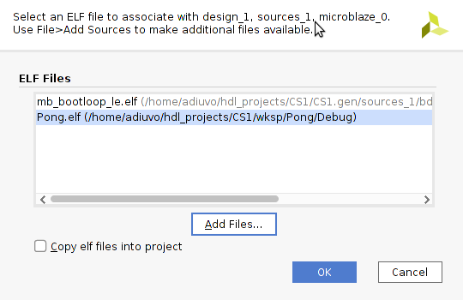
Crowd Supply: Lab One
Lab One
Step 1 – Click Add Files and select the ELF from Vitis Project we just created

Slide 38
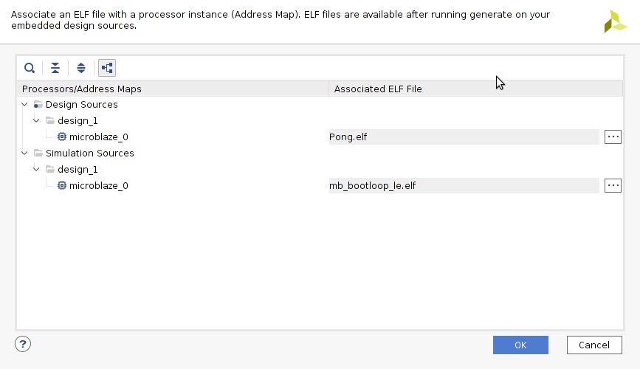
Crowd Supply: Lab One
Lab One
Step 1 – Select the PONG file

Slide 39
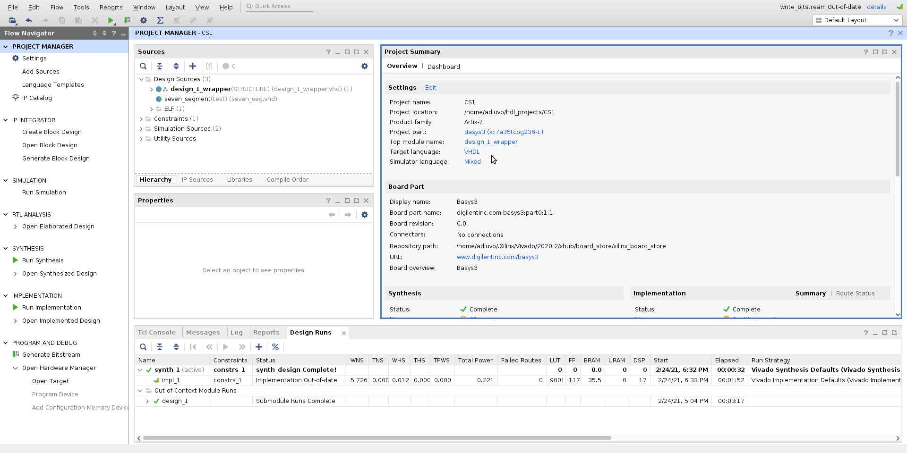
Crowd Supply: Lab One
Lab One
Step 1 – Select the design settings

Slide 40
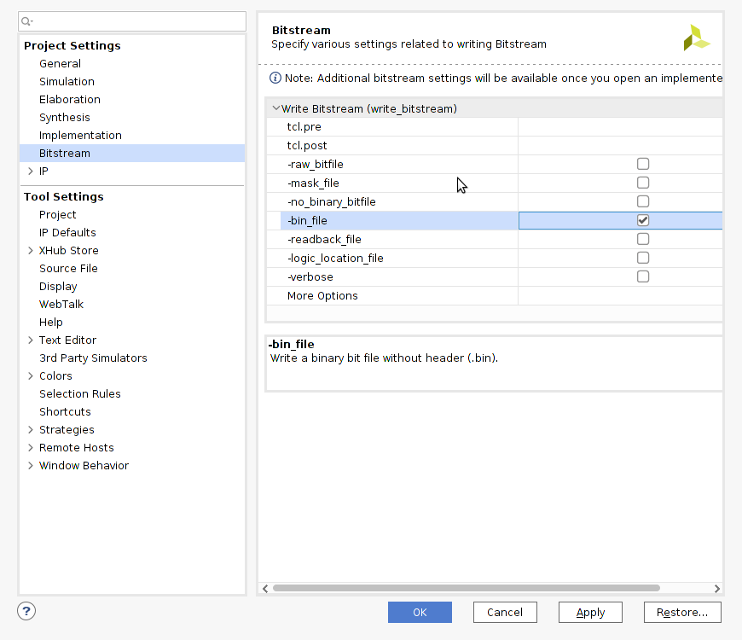
Crowd Supply: Lab One
Lab One
Step 1 – In the settings under bitstream select –bin_file

Slide 41
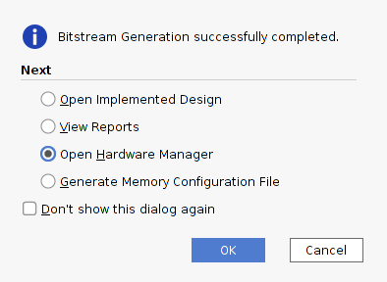
Crowd Supply: Lab One
Lab One
Step 1 – Rerun the bit stream generation and when it completes select open hardware manager

Slide 42
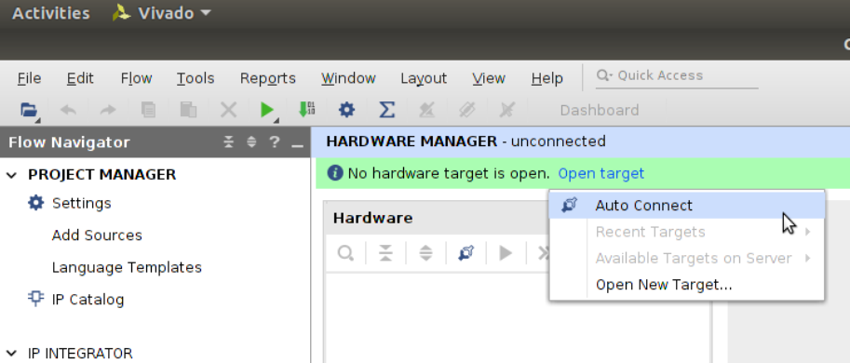
Crowd Supply: Lab One
Lab One
Step 1 – When the hardware manager opens select Open Target and Auto Connect

Slide 43
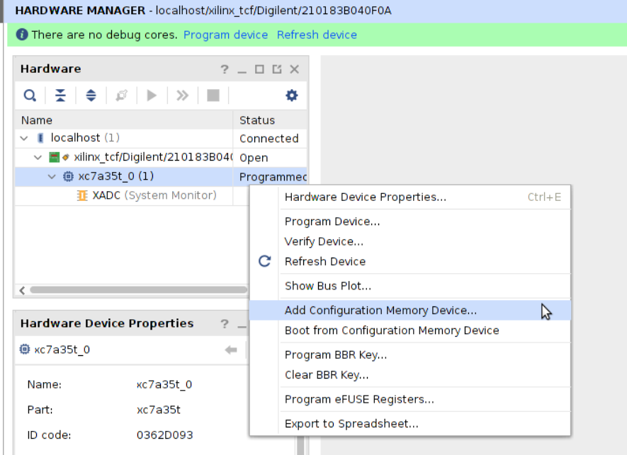
Crowd Supply: Lab One
Lab One
Step 1 – Select add configuration memory device

Slide 44
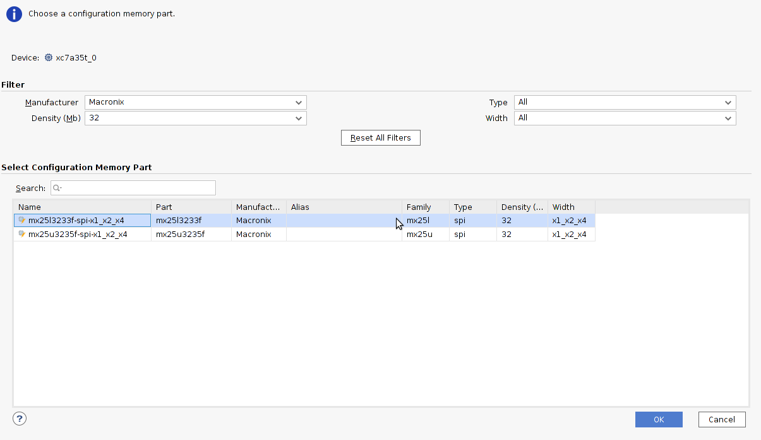
Crowd Supply: Lab One
Lab One
Step 1 – Select the appropriate memory device depending on the QSPI fitted

Slide 45
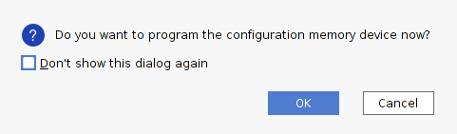
Crowd Supply: Lab One
Lab One
Step 1 – When prompted if you want to configure a memory device now click OK

Slide 46
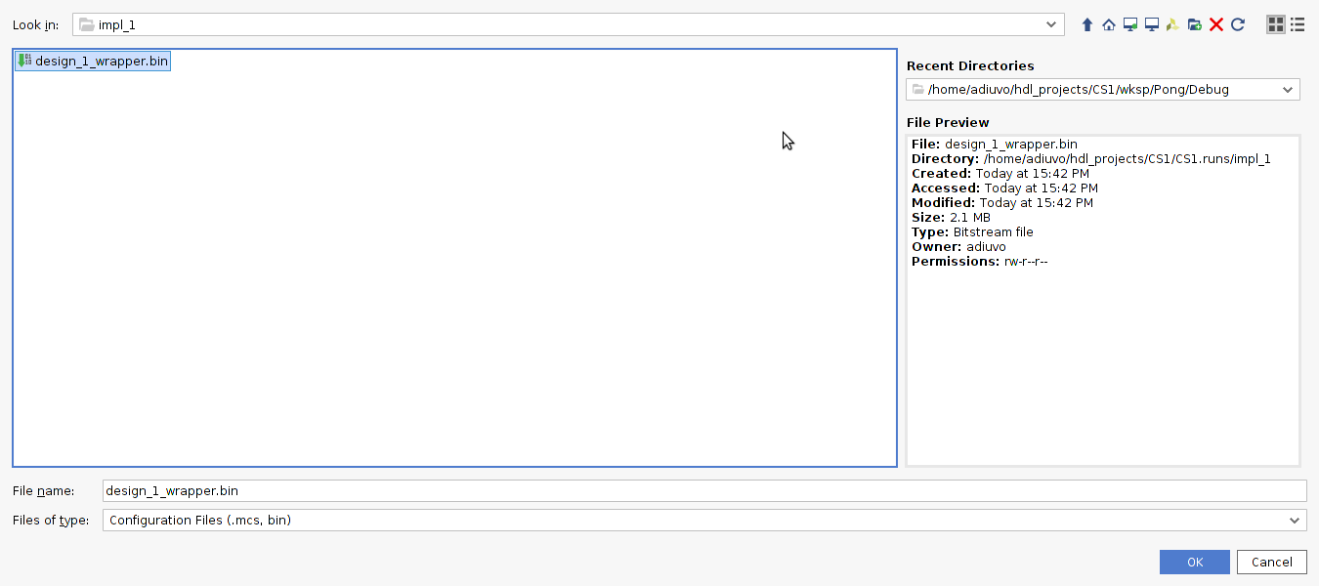
Crowd Supply: Lab One
Lab One
Step 1 – Select the BIN file just created from under the Vivado Project Runs / Implementation directory

Slide 47
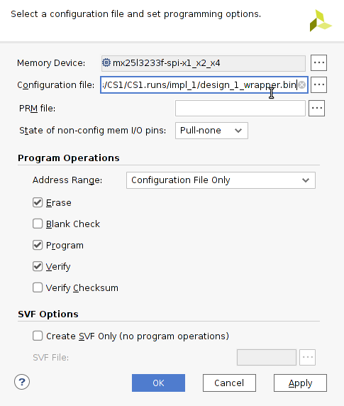
Crowd Supply: Lab One
Lab One
Step 1 – Click OK to start the programming of the flash – ensure the power is not disrupted while the write takes place

Slide 48
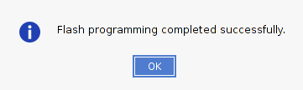
Crowd Supply: Lab One
Lab One
Step 1 – Once the flash is finished click OK, Close the hardware manager and the Vivado project.

