Slide 1
Creating Embedded Linux Solutions
Course Workbook

Slide 2
Table of Contents
About this Workbook | Page 3
Pre-Lab: Workshop Pre-requisites | Page 4
Lab 3: Creating Multi Processor Solutions | Page 7

Slide 3
About this Workbook
The contents of this workbook are created by Adiuvo Engineering & Training, Ltd.
If you have any questions about the contents, or need assistance, please contact Adam Taylor at adam@adiuvoengineering.com.

Slide 4
Pre-Lab Creating Embedded Linux Solutions

Slide 5
Required Hardware
Pre-Lab
Arty Z7-20
SD Card
Micro USB Cable

Slide 6
Downloads and Installations
Pre-Lab
Step 1 – Download and install the following at least 1 day prior to the workshop. This may take a significant amount of time and drive space.
Watch the video available here to show how to configure the installation
Vitis 2021.1 | Download
PetaLinux 2021.1 | Download

Slide 7
Lab 3 Creating Embedded Linux Solutions

Slide 8
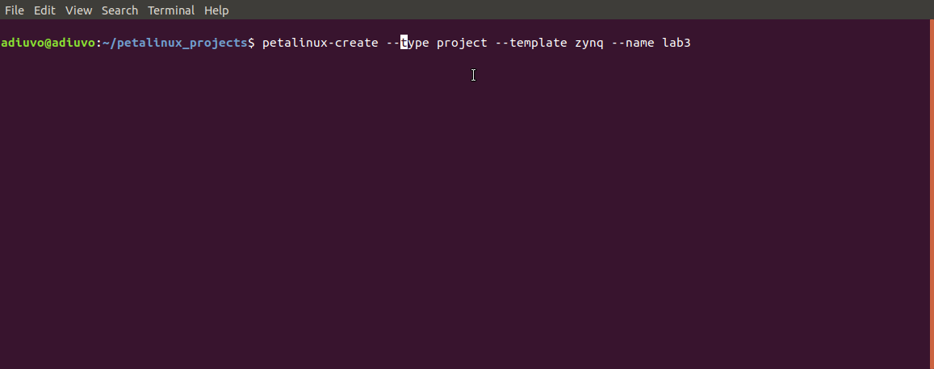
Lab 3: Creating Embedded Linux Solutions
Lab 3
Step 1 – Using a Linux Development machine with PetaLinux 2021.2 installed create a new project

Slide 9
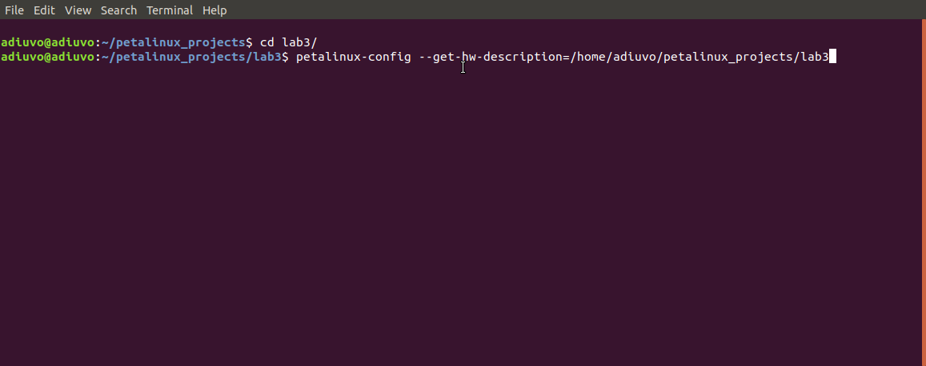
Lab 3: Creating Embedded Linux Solutions
Lab 3
Step 2 – Change directory into the project, import the XSA exported from Lab One

Slide 10
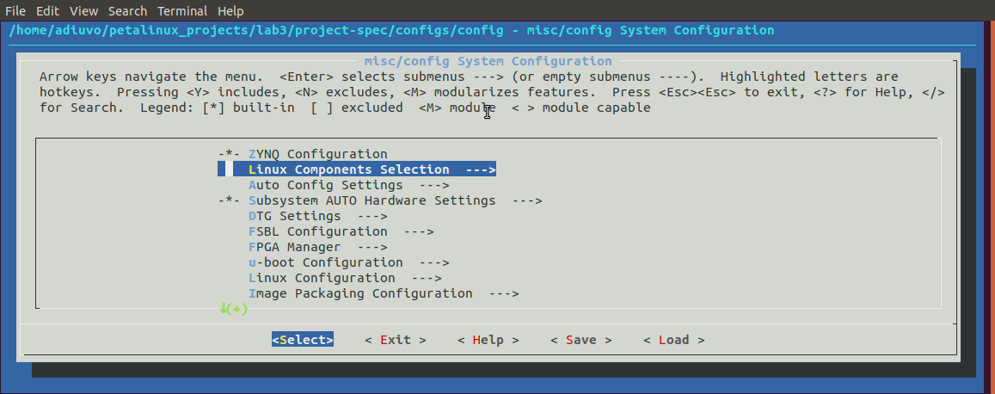
Lab 3: Creating Embedded Linux Solutions
Lab 3
Step 3 – Exist the dialog which is opened following the XSA Import.

Slide 11
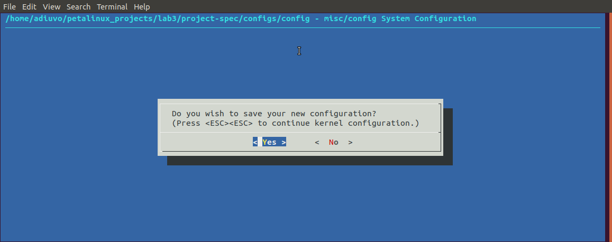
Lab 3: Creating Embedded Linux Solutions
Lab 3
Step 4 – When asked save any changes

Slide 12
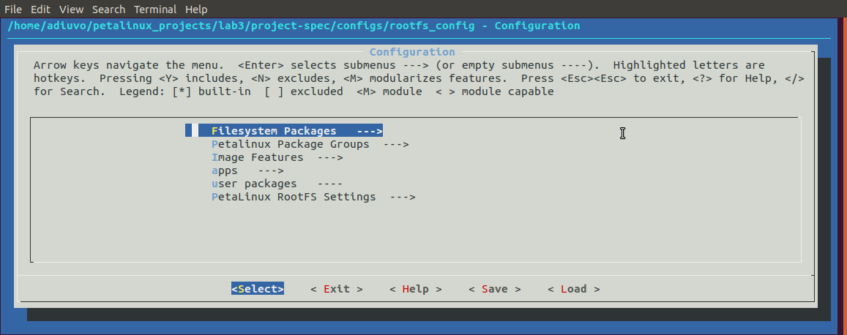
Lab 3: Creating Embedded Linux Solutions
Lab 3
Step 5 – Enter the command petalinux-config –c rootfs to examine the rootfs dialog. Close without saving changes after exploring the settings.

Slide 13
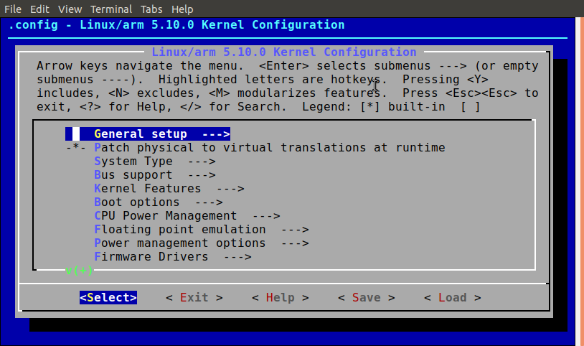
Lab 3: Creating Embedded Linux Solutions
Lab 3
Step 6 – Enter the command petalinux-config –c kernel to view the config settings, do not change anything and exist after exploring.

Slide 14
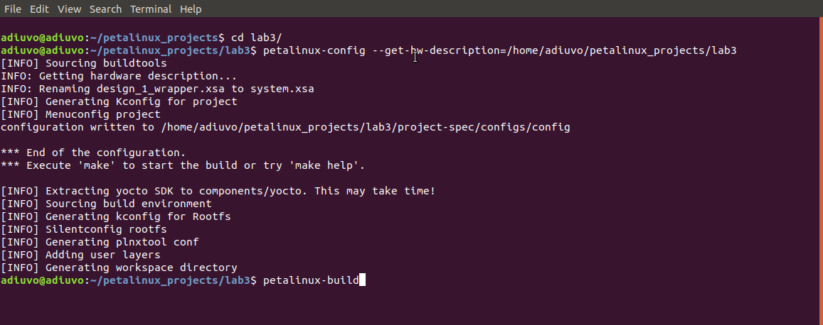
Lab 3: Creating Embedded Linux Solutions
Lab 3
Step 7 – Build the petalinux project with the command petalinux-build – this may take some time.

Slide 15
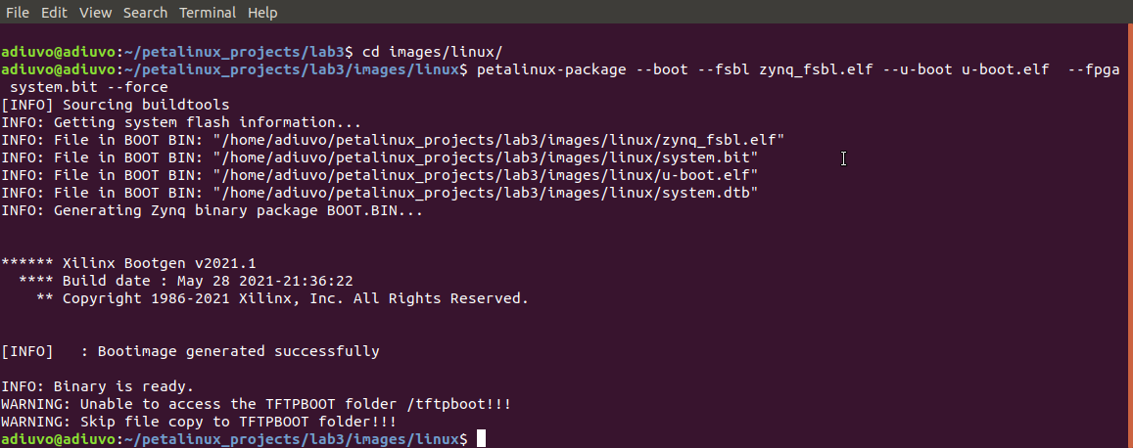
Lab 3: Creating Embedded Linux Solutions
Lab 3
Step 8 – Package the petalinux project to create the boot.bin necessary

Slide 16
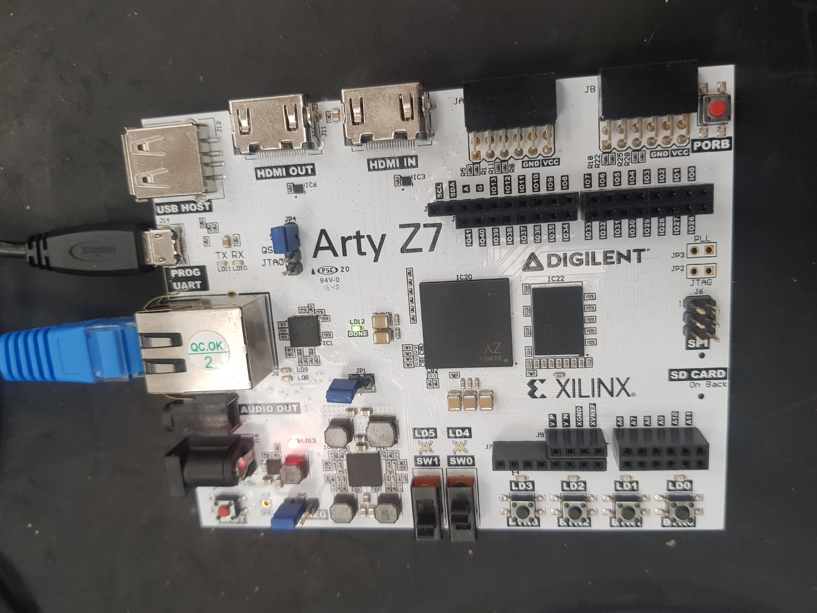
Lab 3: Creating Embedded Linux Solutions
Lab 3
Step 9 – Copy the image.ub boot.bin and boot.scr to the SD Card, insert in the Arty Z7 – ensure it is set for SD Card boot. Connect the power and Ethernet cable.

Slide 17
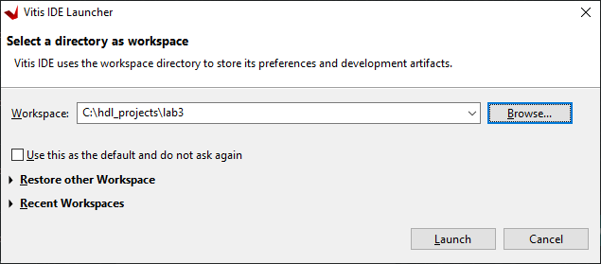
Lab 3: Creating Embedded Linux Solutions
Lab 3
Step 10 – Vitis will start and ask for the workspace, create a new directory using browse to store the projects.

Slide 18
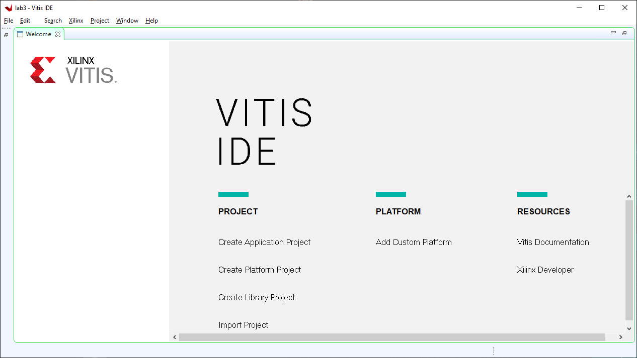
Lab 3: Creating Embedded Linux Solutions
Lab 3
Step 11 – Select Create Application Project

Slide 19
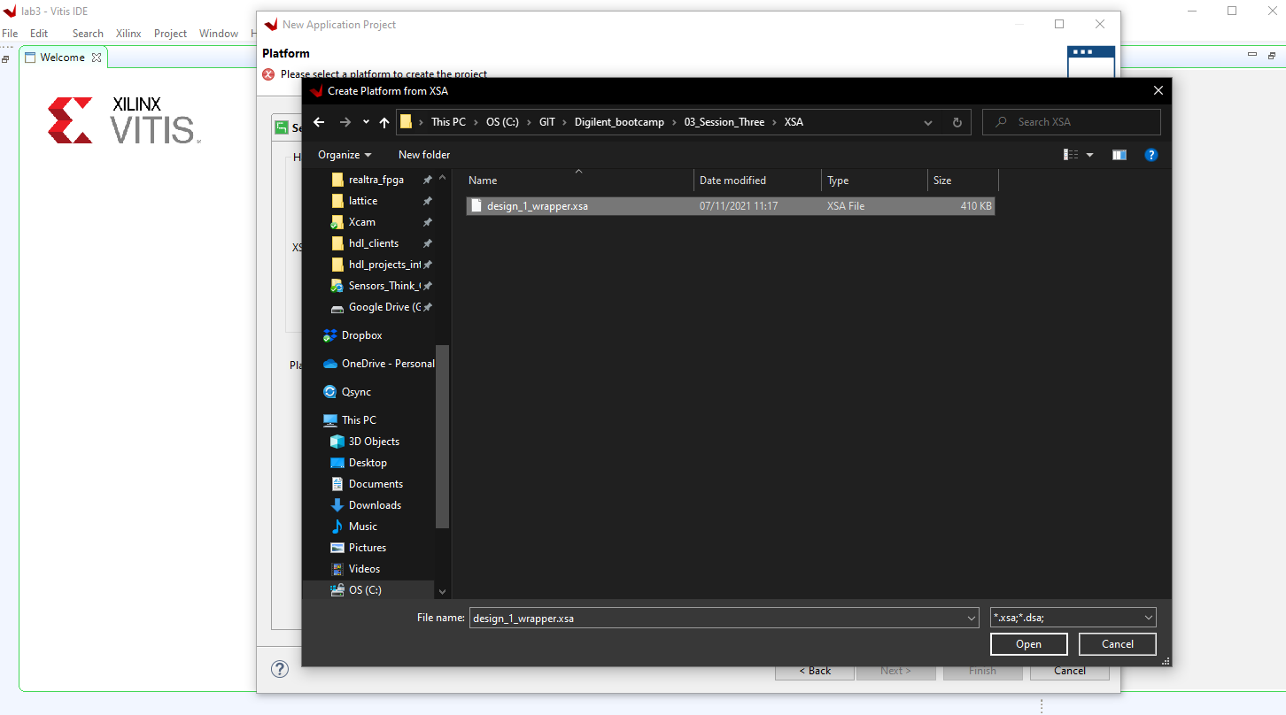
Lab 3: Creating Embedded Linux Solutions
Lab 3
Step 12 – Select the XSA downloaded with GitHub Repository under lab three

Slide 20
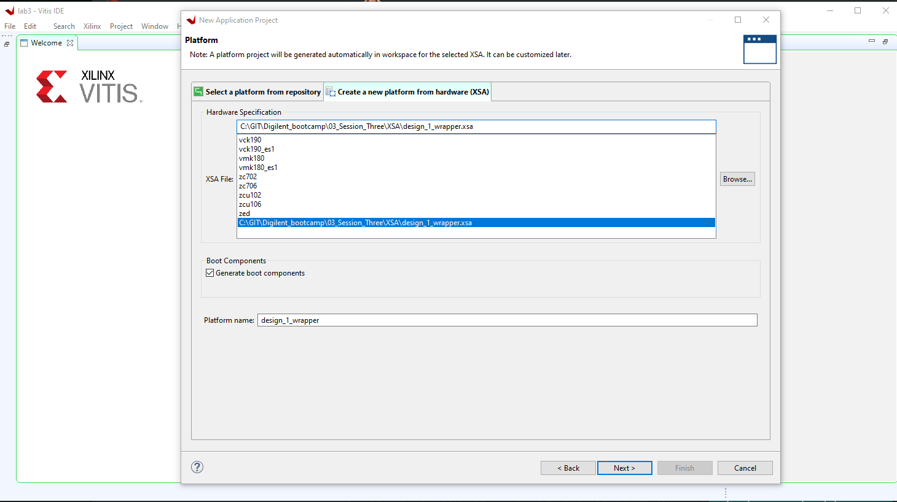
Lab 3: Creating Embedded Linux Solutions
Lab 3
Step 13 – Click next

Slide 21
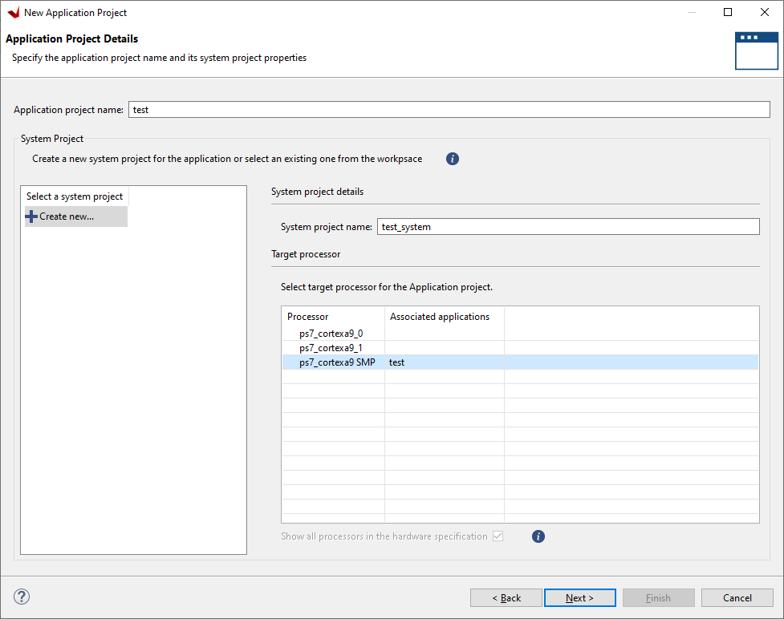
Lab 3: Creating Embedded Linux Solutions
Lab 3
Step 14 – Enter a name for the project and select the processors in SMP configuration

Slide 22
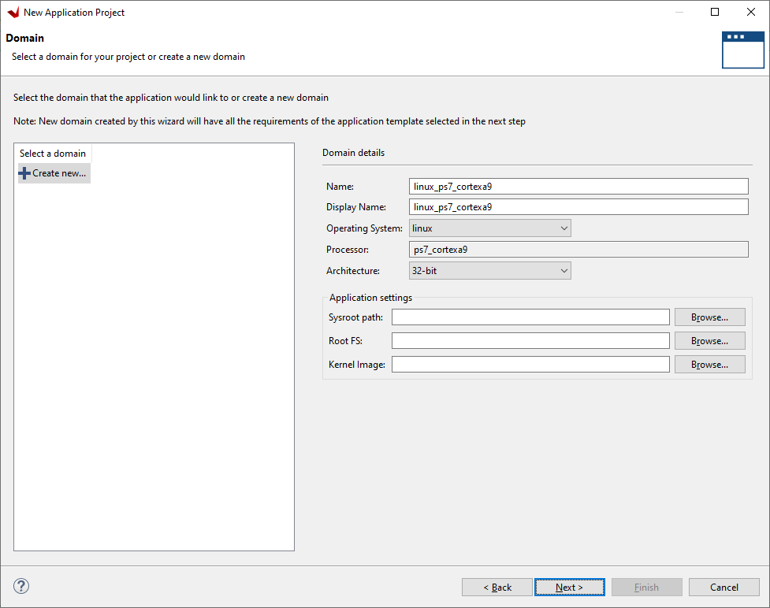
Lab 3: Creating Embedded Linux Solutions
Lab 3
Step 15 – Click Next on the Domain page

Slide 23
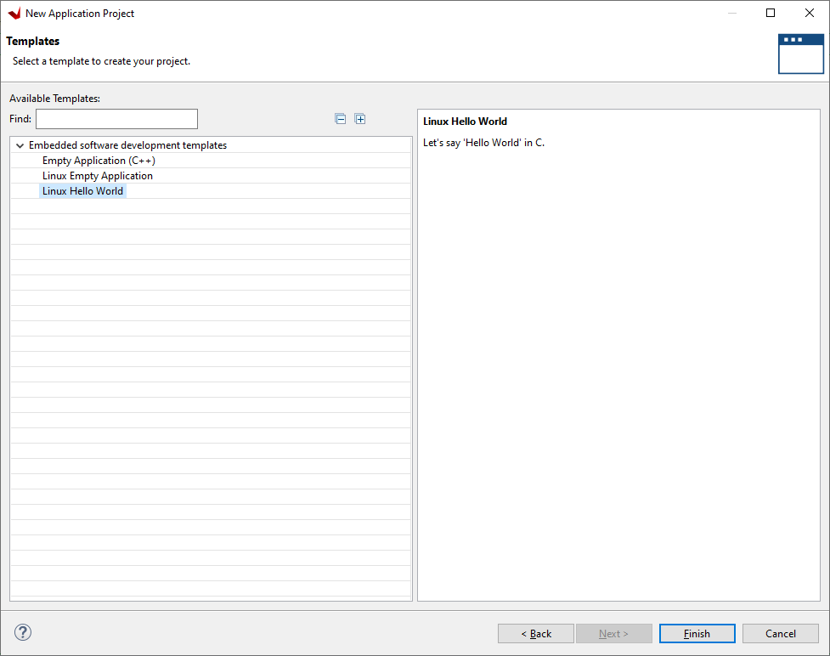
Lab 3: Creating Embedded Linux Solutions
Lab 3
Step 16 – Select the Linux Hello World application and click finish

Slide 24
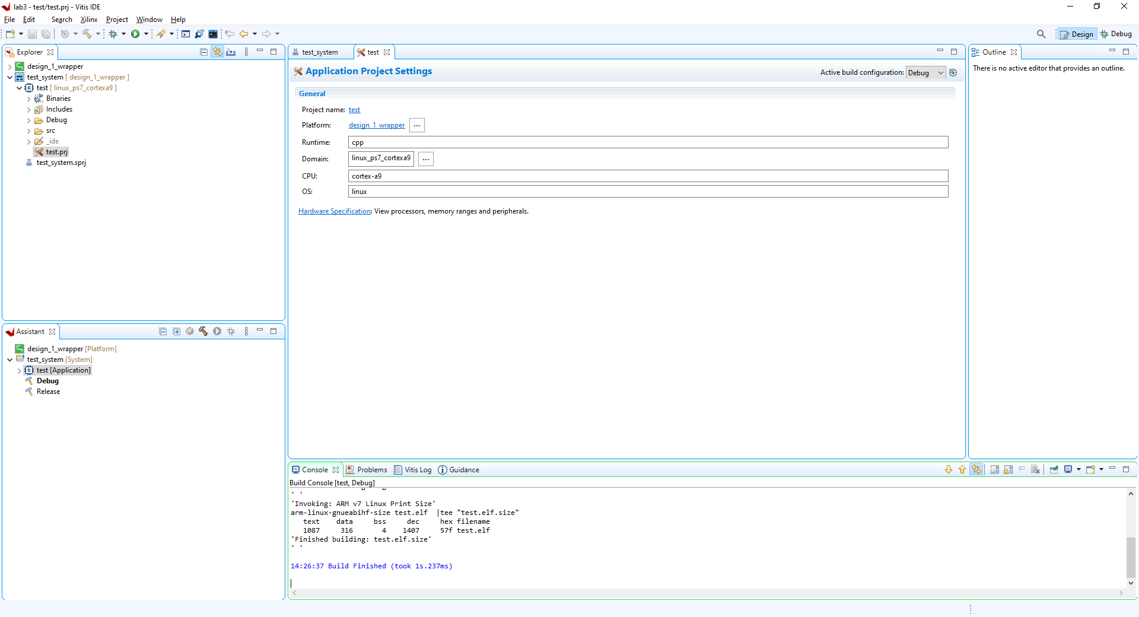
Lab 3: Creating Embedded Linux Solutions
Lab 3
Step 17 – Click on the Hammer to build the application

Slide 25
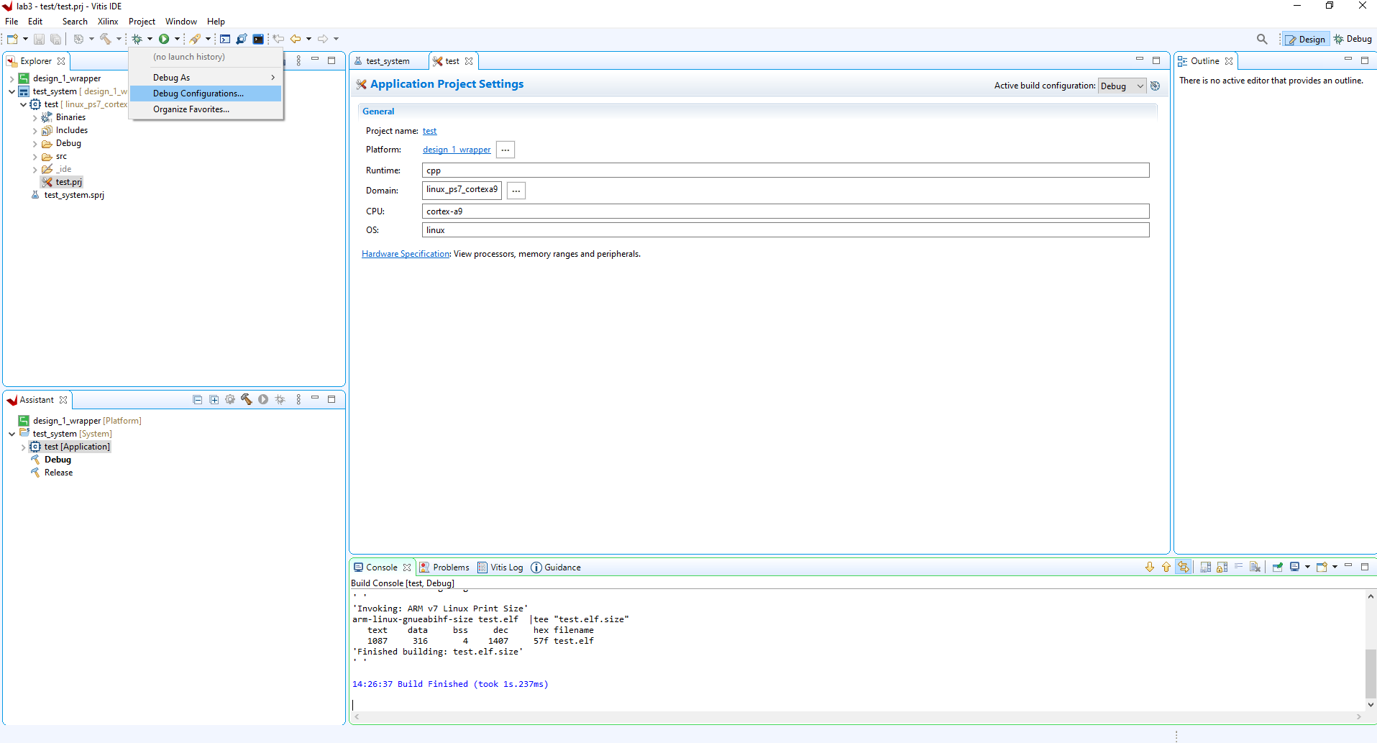
Lab 3: Creating Embedded Linux Solutions
Lab 3
Step 18 – Select the arrow by the green debug icon and select debug configuration

Slide 26
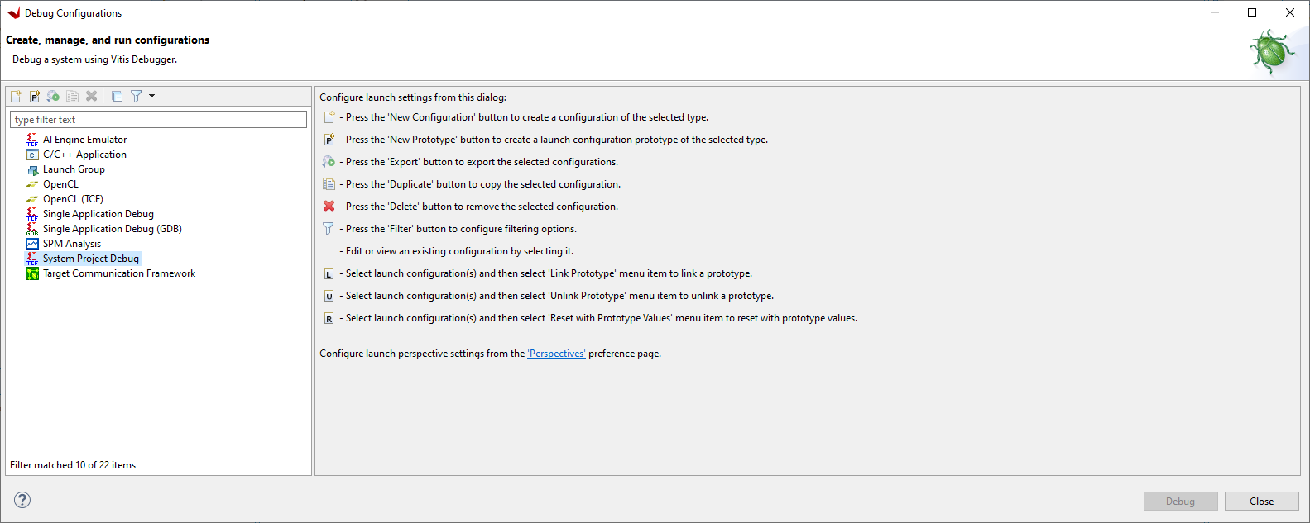
Lab 3: Creating Embedded Linux Solutions
Lab 3
Step 19 – Select System Project Debug and click new

Slide 27
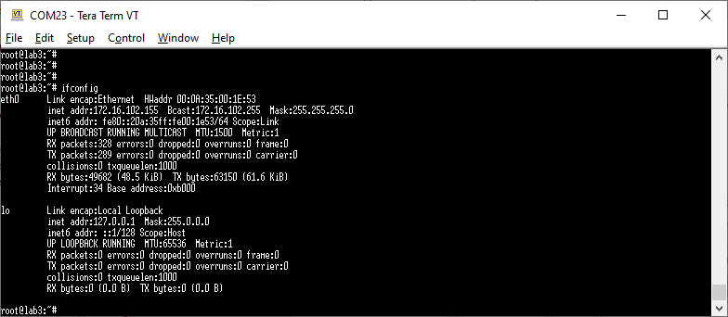
Lab 3: Creating Embedded Linux Solutions
Lab 3
Step 20 – Open a serial terminal 115200:n:1 and type the command ifconfig to list the IP Address of the board

Slide 28
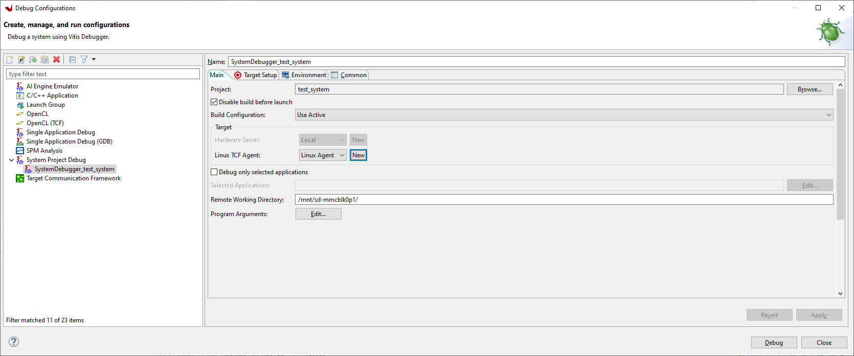
Lab 3: Creating Embedded Linux Solutions
Lab 3
Step 21 – Change the build configuration to Hardware and for Linux TCF Agent select new

Slide 29
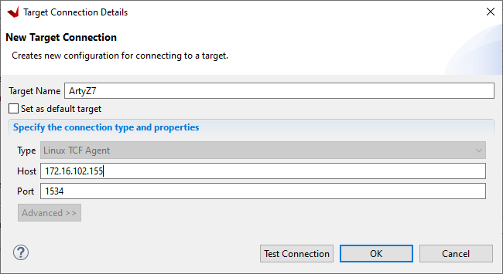
Lab 3: Creating Embedded Linux Solutions
Lab 3
Step 22 – Enter a name and enter the Ethernet IP address – Click test connection to verify the board can be seen.

Slide 30
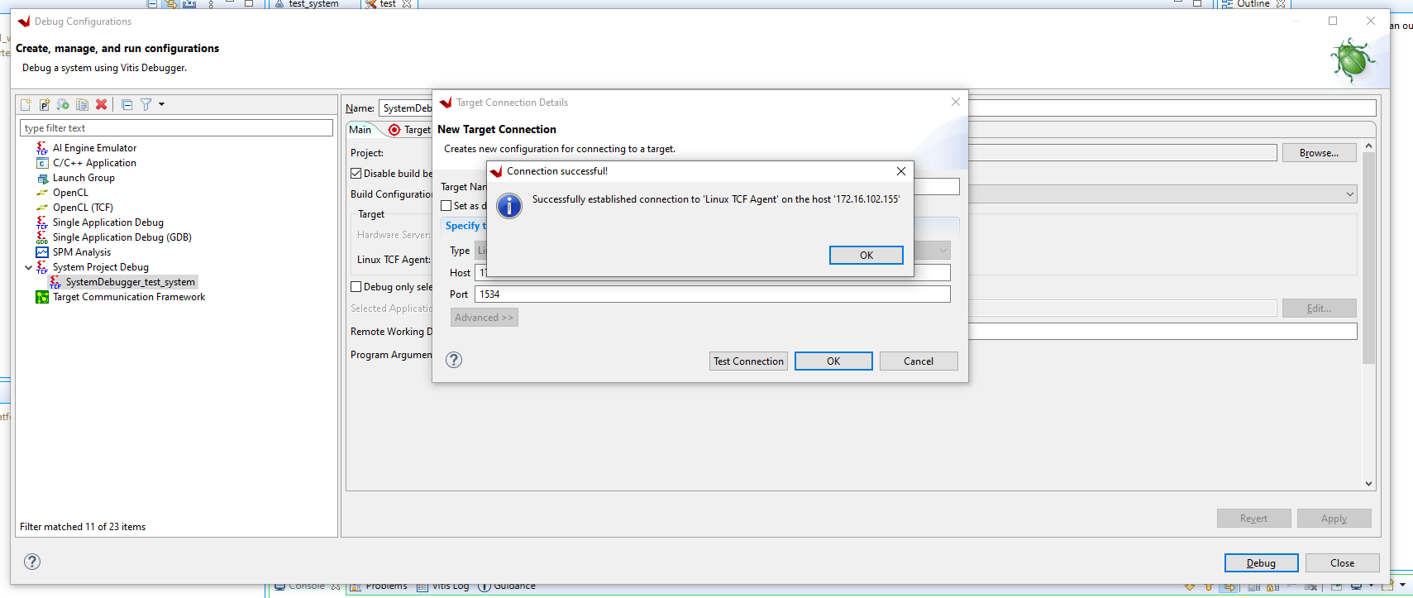
Lab 3: Creating Embedded Linux Solutions
Lab 3
Step 23 – Click OK when the connection is successful, click OK on the target connection and the click debug

Slide 31
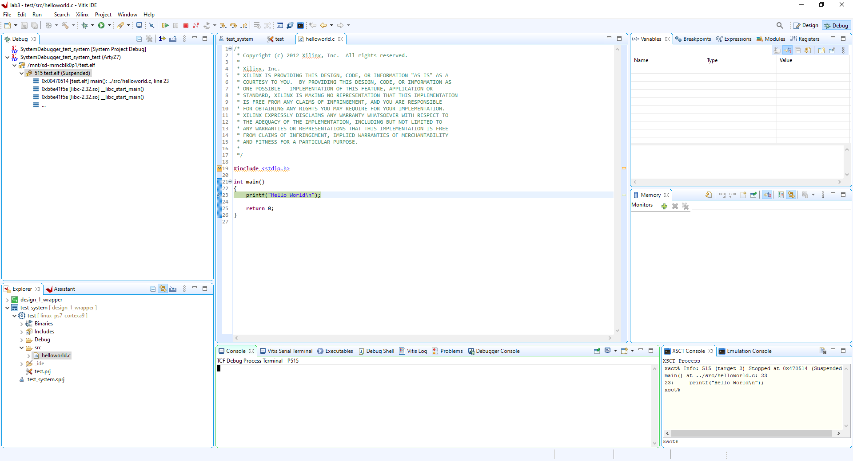
Lab 3: Creating Embedded Linux Solutions
Lab 3
Step 24 – The application will be downloaded to the target and paused for execution, press the run button

Slide 32
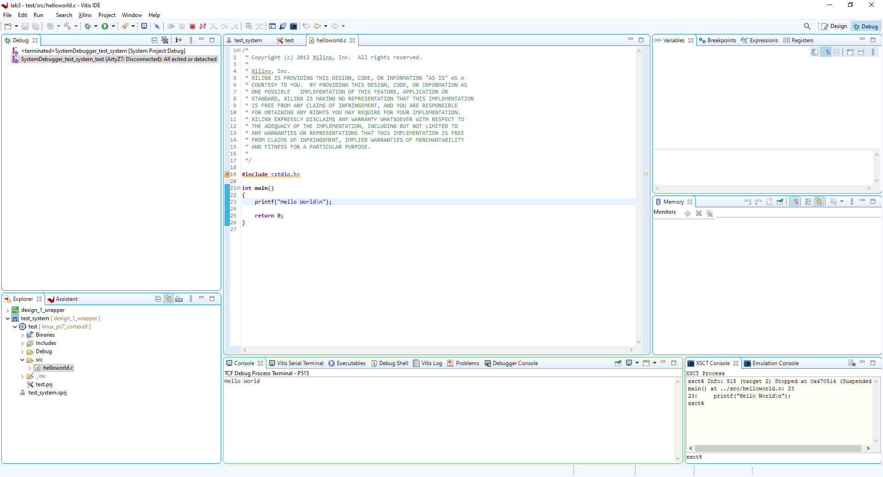
Lab 3: Creating Embedded Linux Solutions
Lab 3
Step 25 – Click on the run button and you will see the hello world appear in the console.

