Slide 1
Cellulose/MOFs composites Project
Anders Teigland, Alexandre Khaldi, Patrick Beldon, Tony Cheetham, Stoyan Smoukov
AIM: Improve mechanical properties of MOFs

Slide 2
Aim
Improve mechanical stability
Scalable synthesis

Slide 3
Background
ZIFS
High surface area
Thermally and chemically stable
Low shear modulus
Polymer composite
Mainly membranes
Improves mechanical properties and separation properties

Slide 4
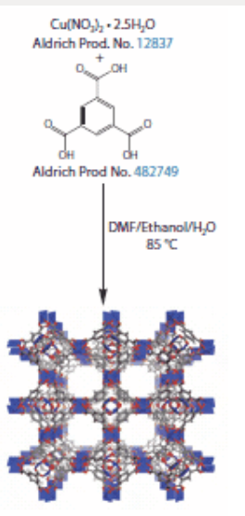
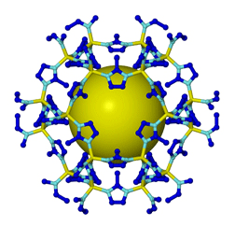
Mechanosynthesis
DOI: 10.1002/anie.201005547
Rapid Room-Temperature Synthesis of Zeolitic Imidazolate
Frameworks by Using Mechanochemistry**
Patrick J. Beldon, Lszl Fbin, Robin S. Stein, A. Thirumurugan, Anthony K. Cheetham, and
Tomislav Fris
ˇ
c
ˇ
ic
́
*
Depletion of mineral and energy sources is steering research
and technology towards more economically and environ-
mentally acceptable synthesis.
[1]
Mechanochemical synthesis
has shown significant potential for the clean and energy-
efficient construction of molecules and materials.
[2]
Modified
mechanochemical methods such as liquid-assisted grinding
(LAG) or ion- and liquid-assisted grinding (ILAG) were
recently demonstrated to be highly efficient for the selective
construction of pillared metal–organic frameworks (MOFs)
directly from a metal oxide.
[3,4]
We now extend these methods
to the synthesis of a very different family of metal–organic
materials. We report the direct and topologically selective
conversion of ZnO into porous and nonporous zeolitic
imidazolate frameworks (ZIFs)
[5]
based on imidazole
(
HIm
), 2-methylimidazole (
HMeIm
), and 2-ethylimidazole
(
HEtIm
) (Figure 1a,b). Topological diversity combined with
the retention of connectivity make ZIFs particularly interest-
ing targets and, consequently, significant attention has been
given to solvothermal ZIF screening.
[6]
The structure-direct-
ing effects of liquids and salts suggest LAG and ILAG as
milder alternatives for generating ZIFs.
[4,7]
Particular benefits
expected from oxide-based mechanosynthesis are short
reaction times and the ability to conduct reactions at room
temperature without generating strong acids or requiring a
base. We now demonstrate a mechanochemical approach for
ZIF synthesis and screening that provided six known and two
previously unknown ZIFs in a limited set of 48 experiments.
Previous work indicated that the mechanosynthesis of
metal imidazolates from a metal oxide is a challenging task.
Fernndez-Bertrn and co-workers
[8]
established that manual
grinding of ZnO and
HIm
leads to the partial formation of the
nonporous Zn(
Im
)
2
. Quantitative conversion of the oxide was
achieved only with a large excess of
HIm
. The same product
was obtained by Adams et al. in a two-step mechanochemical
process starting from ZnCl
2
and using the external base
technique.
[9]
In our hands, ball milling of ZnO and
HIm
for
30 min resulted in a mixture which, based on powder X-ray
diffraction (PXRD), contained ZnO,
HIm
, Zn(
Im
)
2
with the
Figure 1.
a) Imidazole ligands. b) The expected mechanochemical reac-
tion. c) PXRD patterns (from top to bottom; vertically offset): neat
grinding of ZnO and
HIm
; product of 60 min LAG of ZnO and
HIm
using DMF; simulated for cag topology ZIF-4; product of 30 min LAG
of ZnO and
HIm
using EtOH; simulated for zni topology Zn(
Im
)
2
;
product of 30 min ILAG involving ZnO,
HMeIm
, DMF and
NH
4
CH
3
SO
3
; simulated for SOD topology ZIF-8. Reflections of ZnO
are labeled with *.
[*] P. J. Beldon, Dr. T. Fris
ˇ
c
ˇ
ic
́
Department of Chemistry, University of Cambridge
Lensfield Road, Cambridge, CB2 1EW (UK)
E-mail: tf253@cam.ac.uk
Dr. L. Fbin
University College Cork, Department of Chemistry
Kane Building, College Road, Cork (Ireland)
Dr. R. S. Stein
Bruker UK Ltd, Banner Lane, Coventry CV4 9GH (UK)
Dr. A. Thirumurugan, Prof. A. K. Cheetham
Department of Materials Science and Metallurgy
University of Cambridge, Cambridge CB2 3QZ (UK)
[**] This work was supported by the Herchel Smith Fund (research
fellowship to T.F.) and the ERC (Advanced Investigator Award to
A.K.C.). We acknowledge the EPSPC for financial support admin-
istered though the University of Cambridge Nano Doctoral Centre
(P.J.B, T.F.).
Supporting information for this article is available on the WWW
under http://dx.doi.org/10.1002/anie.201005547.
Communications
9640
2010 Wiley-VCH Verlag GmbH & Co. KGaA, Weinheim
Angew.Chem.Int.Ed.
2010
,
49
, 9640 –9643
Metal organic frameworks (MOFs)
ZIF-8
HKUST-1
Zinc Nitrate
cupric nitrate
1
trimesic acid
2-Methylimidazole

Slide 5
Cellulose components
Cellulose nanorods
Cellulose sponge nanofibers
Air dried
Vacuum dried. Collapsed

Slide 6
ZIF-8-cellulose sponges composite

Slide 7
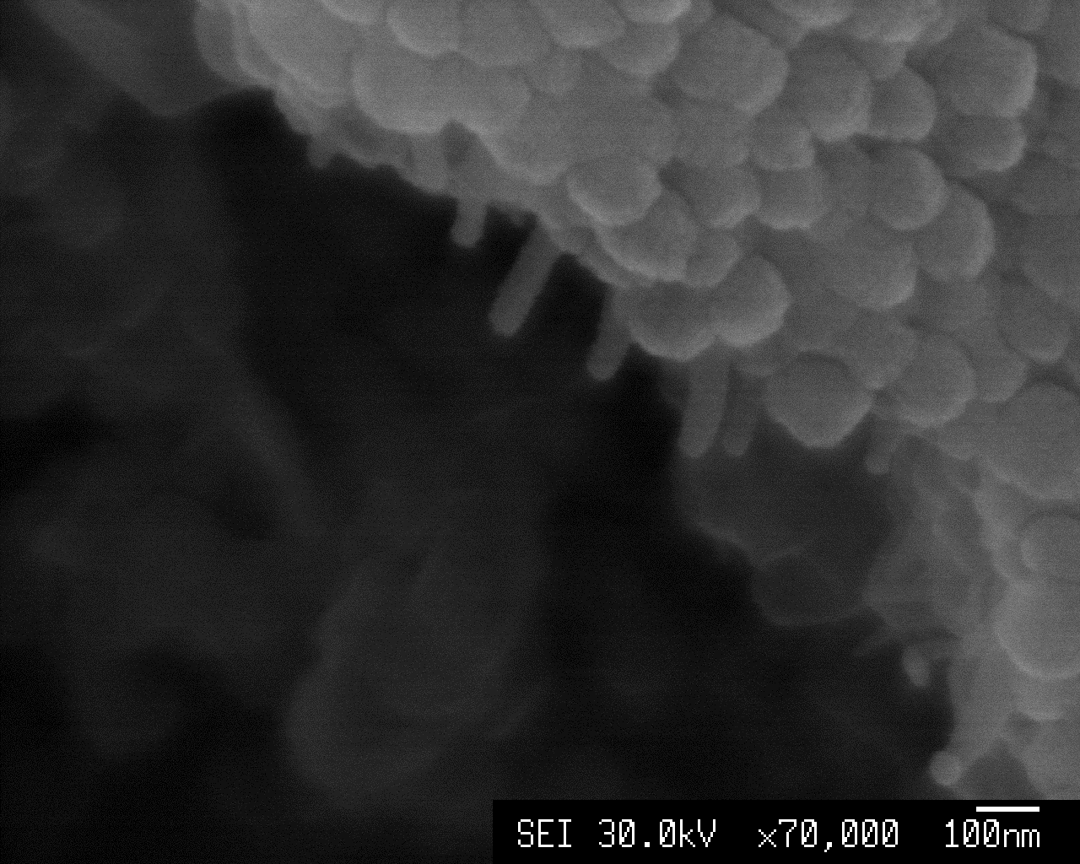
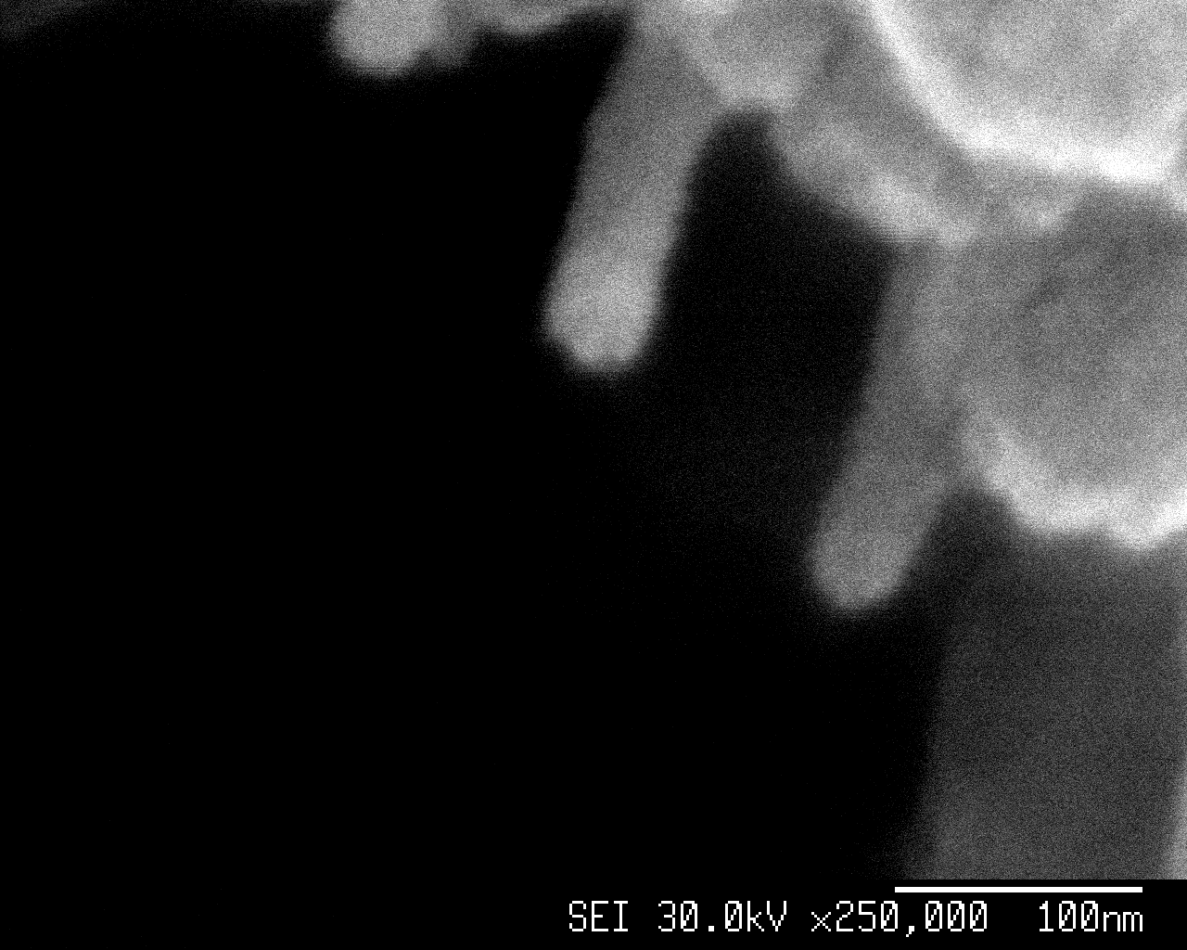
ZIF-8-cellulose nanorods composite

Slide 8
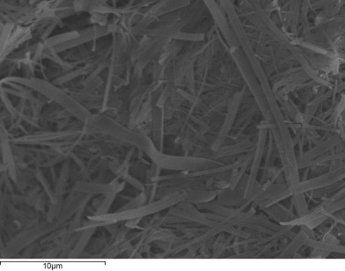
H-KUST cellulose sponge-composites
1) 2 ml (4.734g) of ethanol (99.5%) with 0.070 g (0.33 mmol) dissolved TMA
+nanocellulose sponge soaked for 4 hours
2) Addition2 ml (2g) of deionized water with dissolved 0.146 g (0.6 mmol) of cupric nitrate.
Air dried
Supernatant HKUST-1
Inverse
Cellulose sponge dissolved in EtOH
Cellulose sponge swelled in water
Vacuum dried

Slide 9
HKUST-1/nanorods composite

