Slide 1
Pre-processor for high troughput sequencing reads
Sophie Kilders, Luuk Wubben

Slide 2
In this presentation
Full suffix-prefix matching
Approximate suffix-prefix matching
Sequencing errors and error distribution
Finding the adapter sequence
De-multiplexing with barcodes
Summary
Conclusion

Slide 3
Full suffix-prefix matching
Find complete suffix-prefix matches
Challenge of different prefix sizes
Challenge of unknown alleles
Challenge of fast solution

Slide 4
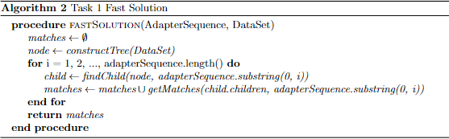
Full suffix-prefix matching
Two approaches used
Slow solution
Fast solution
Keyword trees
Advantages
Disadvantages

Slide 5
Approximate suffix-prefix matching
Similarities to previous task
Differences to previous task
Challenges of approximate matching
Unknown characters
Keeping a decent runtime

Slide 6
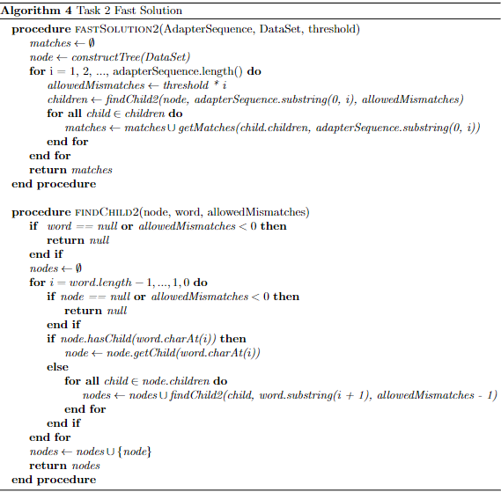
Approximate suffix-prefix matching
Return to two approaches
Slow solution
Fast solution
Advantages of keyword tree method
Challenges of keyword tree method
Overall hit in runtime

Slide 7
Sequencing errors
What they are
Why are they important
How can they be handled in algorithms

Slide 8

Error distribution
Error per sequence
Calculation method
Knowledge to be obtained
Error per nucleotide
Calculation method
Knowledge to be obtained

Slide 9
Finding the adapter sequence
Unknown adapter sequence
Challenge to identify
Different (potential) methods
Speed of different methods
Handling unknown alleles
Slowly scanning different prefix lengths
Too slow
Hard to implement
Hard to debug

Slide 10
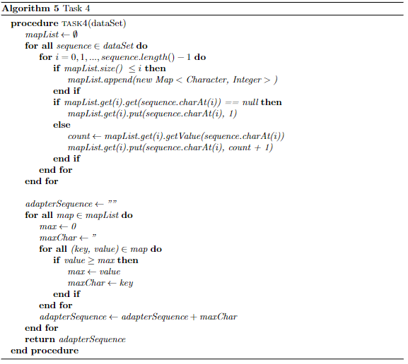
Finding the adapter sequence
Solution:
Find most common characters
Use appropriate data structures
Reconstruct adapter from most common characters

Slide 11
De-multiplexing with barcodes
Multi-step problem
Identify barcodes
Identify samples from barcodes
Analyse samples
Similar approach as previous problem
Identify most common characters
Reconstruct barcodes
Leaves last two steps

Slide 12
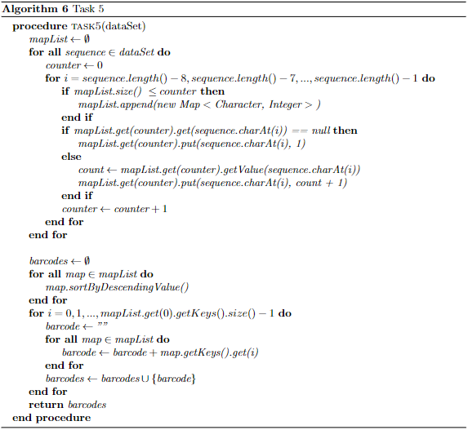
De-multiplexing with barcodes
Identify samples from barcodes
Map sequences to barcodes
Remove barcodes
Analyse samples
Sample size per barcode
Unique samples per barcode
Length distributions

Slide 13
Summary
Differences and advantages of full and approximate suffix-prefix matching
Challenges and solutions to finding adapter sequence
Identifying barcodes and multiplexed samples
Challenges of unknown alleles
Challenges of errors

Slide 14
Conclusion
Different problems can have similar solutions
Try to work smarter, not harder
Data structures of high importance
Room for optimalisation

