Slide 1

Features

Slide 2



AToMPM
“A Tool for Multi-Paradigm Modeling”
Successor of good old AToM³
Web-based, runs on the cloud
http://syriani.cs.ua.edu/atompm/atompm.htm
Demo: http://www.youtube.com/watch?v=iBbdpmpwn6M
E. Syriani, H. Vangheluwe, R. Mannadiar, C. Hansen, S. Van Mierlo and H. Ergin. AToMPM: A Web-based Modeling Environment. MODELS'13 Demonstrations, , CEUR, Miami FL, USA, 2013.

Slide 3
PURPOSE
Research framework from which you can generate domain-specific modeling web-based tools that run on the cloud
Open-source framework for designing DSML environments, performing model transformations, and manipulating and managing models
Runs completely over the web: OS, platform, device independent
Follows the MPM philosophy of “modeling everything explicitly, at the right level of abstraction(s), using the most appropriate formalism(s) and process(es)”
Completely modeled by itself

Slide 4
HIGHLIGHT OF FEATURES
Modeling in the cloud
Graphical vs. Textual Modeling
Synthesis of Domain-Specific Modeling Environments
Model Transformation, Code Generation and Debugging
Process Modeling
Collaborative Modeling
Modeled Plugin Framework

Slide 5
MODELING IN THE CLOUD
Thin client: all you need is an SVG-compliant web browser
Nothing is stored on the client
User files, models, all artifacts are saved in the cloud
Multi-user system
User access control at custom level of granularity
Package
Model
Model element

Slide 6
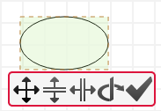
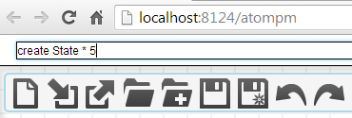
GRAPHICAL VS. TEXTUAL MODELING
Currently, primarily a graphical modeling environment
All model elements are displayed in SVG
Fully supports all static and dynamic SVG manipulation
CRUD operations performed by mouse clicks
Possible to write textual commands, modeled by a DSL
Useful for bulk operations

Slide 7
SYNTHESIS OF DOMAIN-SPECIFIC MODELING ENVIRONMENTS
Automatically supported
Default language is a simplified UML class diagram
Any modeling language can be used to define meta-models, as long as there is a transformation defined mapping that meta-modeling language to the default language
Static constraints can be expressed on top of the abstract syntax model using a textual DSL or via the Javascript API
Multiple concrete syntax can be assigned to the same abstract syntax
Custom views per user preference
Concrete syntax language is itself meta-modeled to represent geometric shapes

Slide 8
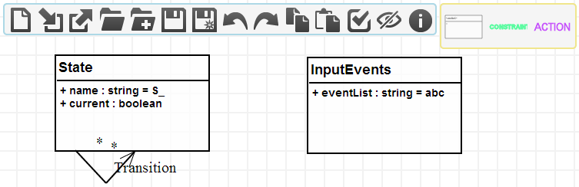
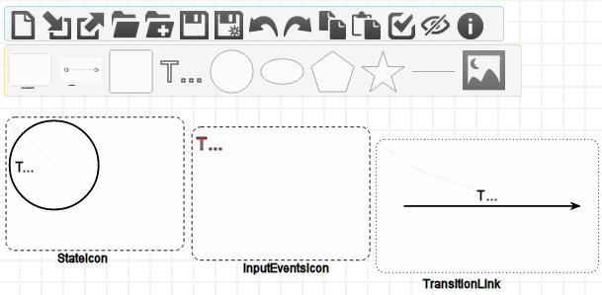
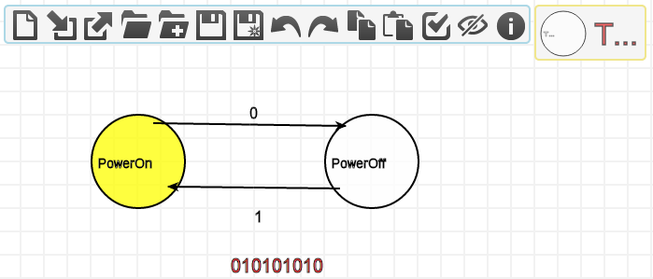
SYNTHESIS OF DOMAIN-SPECIFIC MODELING ENVIRONMENTS

Slide 9
MODEL TRANSFORMATION, CODE GENERATION AND DEBUGGING
All model transformations are based on T-Core
Minimal collection of model transformation operators
Execute automatically any custom-built rule-based transformation language
Language for designing domain-specific rules is automatically generated given the input and output meta-models of a transformation
Rules specified using concrete syntax of domain languages
Default MTL is MoTif
Any modeling language can be used to define the transformation language, as long as there is a higher-order transformation defined mapping that language to the T-Core language
Execution of transformation in release or debug mode
E. Syriani, H. Vangheluwe and B. LaShomb. T-Core: A Framework for Custom-built Transformation Languages. Journal on Software and Systems Modeling, jul 2013.

Slide 10
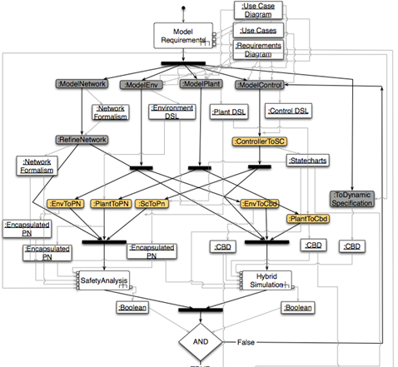
PROCESS MODELING
Any process enforced in AToMPM by a custom DSL based on UML activity diagrams
Example:
The process for defining a meta-model, then assigning the concrete syntax and, finally, generating the modeling environment is a process model
A chain of model transformations
Activities are either automatic (transformations, plugins) or manual

Slide 11
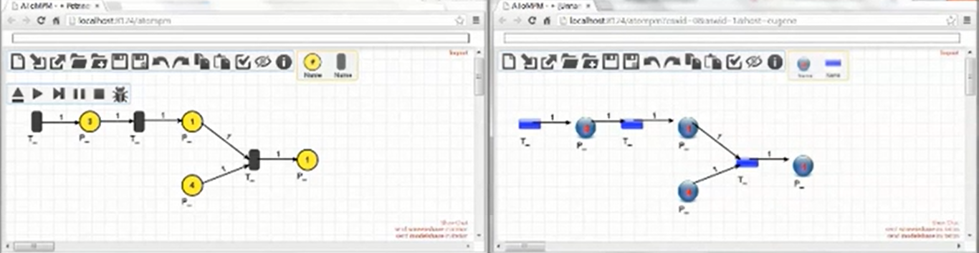
COLLABORATIVE MODELING
Online IDE ⇒ collaborate and share modeling artifacts
Multiple users can be logged in at the same time, each having their own view of the models
Visibility controlled with permission roles set by admin
Screenshare: Two or more clients to share the exact same canvas
Modelshare: Share the abstract syntax of a model between clients

Slide 12
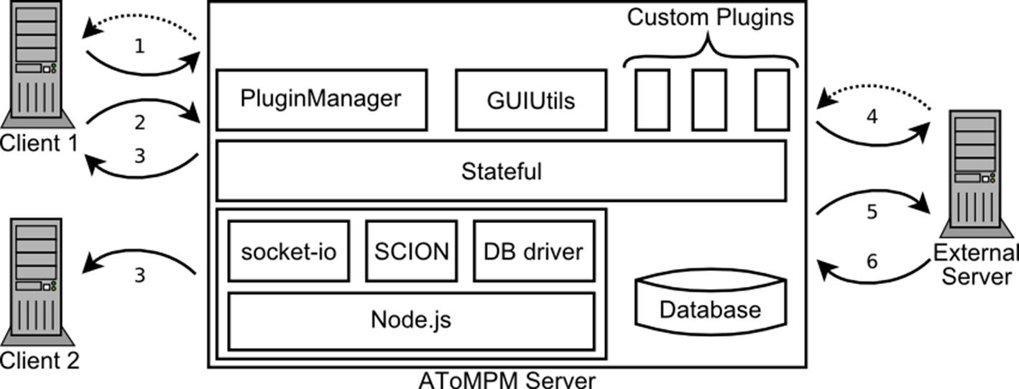
PLUGIN FRAMEWORK ARCHITECTURE
Asynchronous communication paths
Call-back for client sending request to server & receive result
Headless mode for sending batch commands
Broadcast to notify registered clients
Communication with external tools (local, remote) similar to clients

Slide 13
PLUGINS
Defined as models
Statecharts + Javascript code
Can wrap any other programming language, DLL, COM, etc.
Operate on models through ArkM³ API
Deployment specified as a custom UML component diagram
Explicitly model of plugins and their deployment

