Slide 1

Introductory Tutorial

Slide 2
In this tutorial, you will learn to…
Create a domains-specific language for modeling finite state automata (FSA)
Synthesize a modeling environment for designing FSA models
Design a simulator for FSA
For that, we will:
Define the abstract syntax
Define the concrete syntax
Define a model transformation for simulation

Slide 3
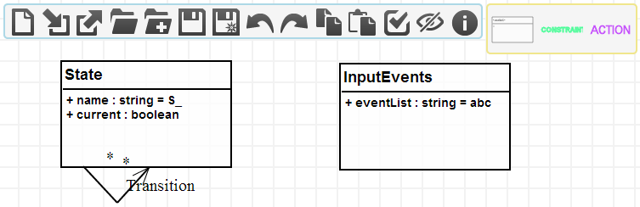
Abstract syntax
The first step is to build the metamodel
We can use class diagrams to do that

Slide 4
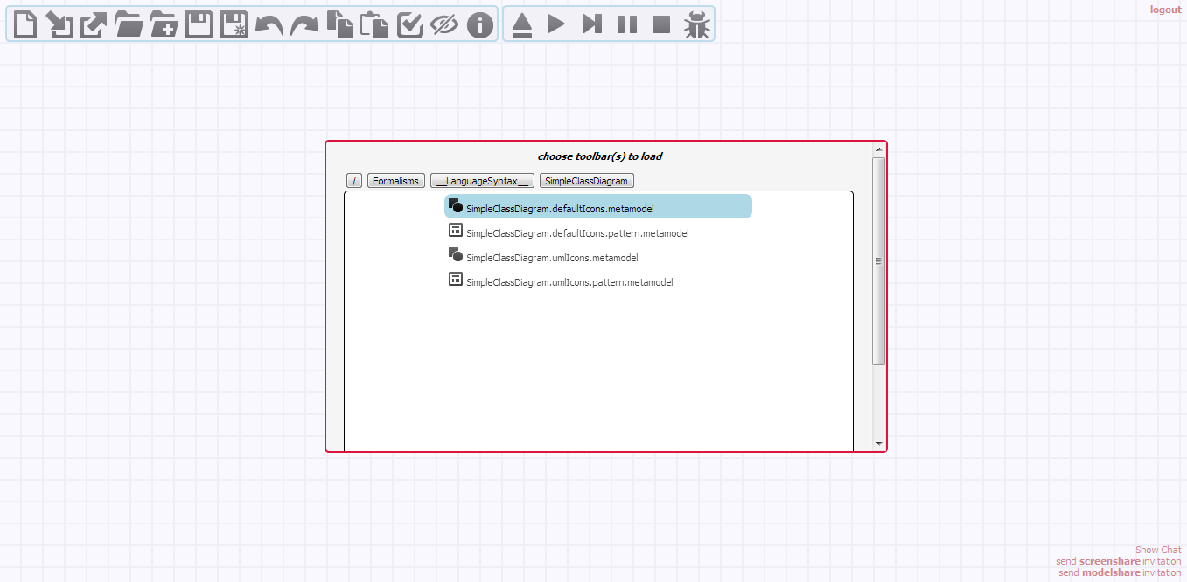
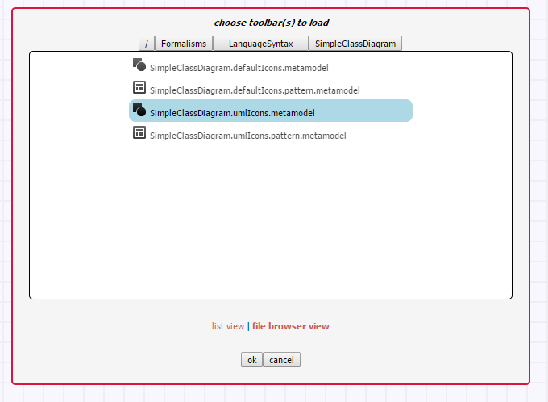
Build the metamodel
Load the SimpleClassDiagram formalism toolbar

Slide 5
Build the metamodel
Canvas actions
Click on the Class icon in the toolbar
Right click on the canvas to create a class
To edit its properties, middle click on the class with no selection, or select the class and press <INSERT>
Click OK to apply the changes
To create an association, right click on the source class and drag your mouse to the target class (which can be the same class), then release your mouse
Select the association and press <SHIFT> to move its control points
Select an element and press <CTRL> to scale or rotate the element
Move the cursor to the icon corresponding to the action you want to perform
Scroll down or up on that icon. When you are satisfied, click on the checkbox

Slide 6
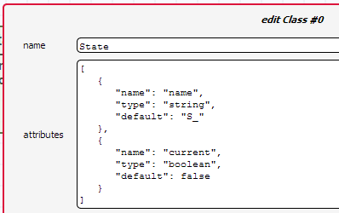
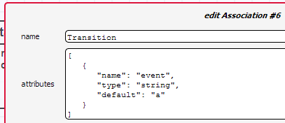
Build the metamodel
Draw the metamodel

Slide 7
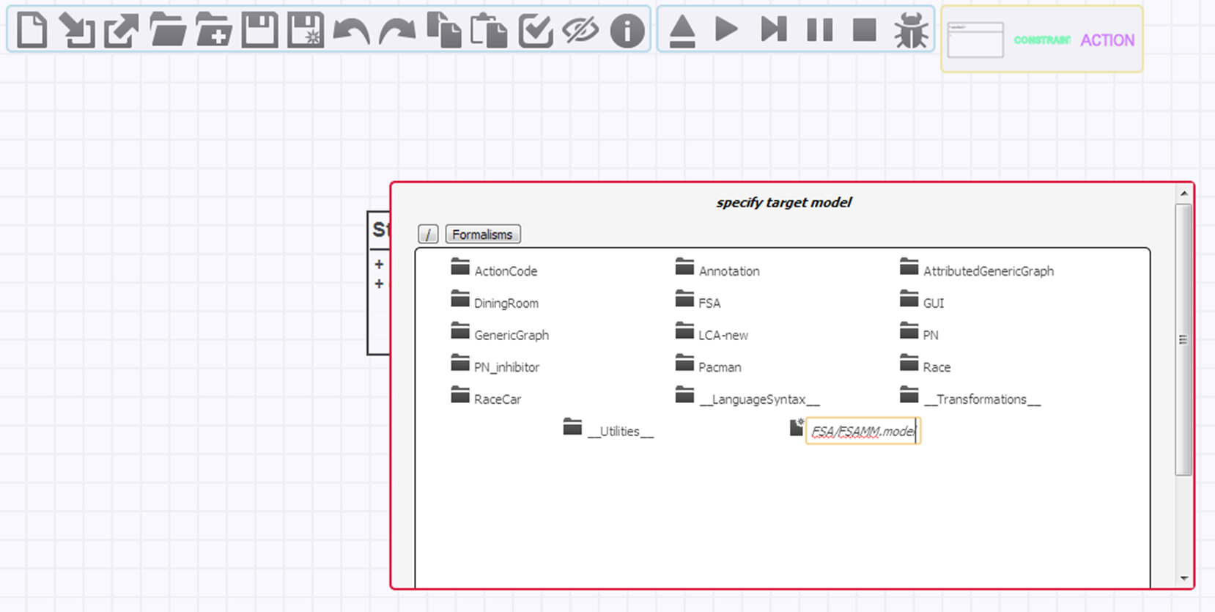
Build the metamodel
Save as your model under a new folder FSA
The file name must be NAME+“MM.model”

Slide 8
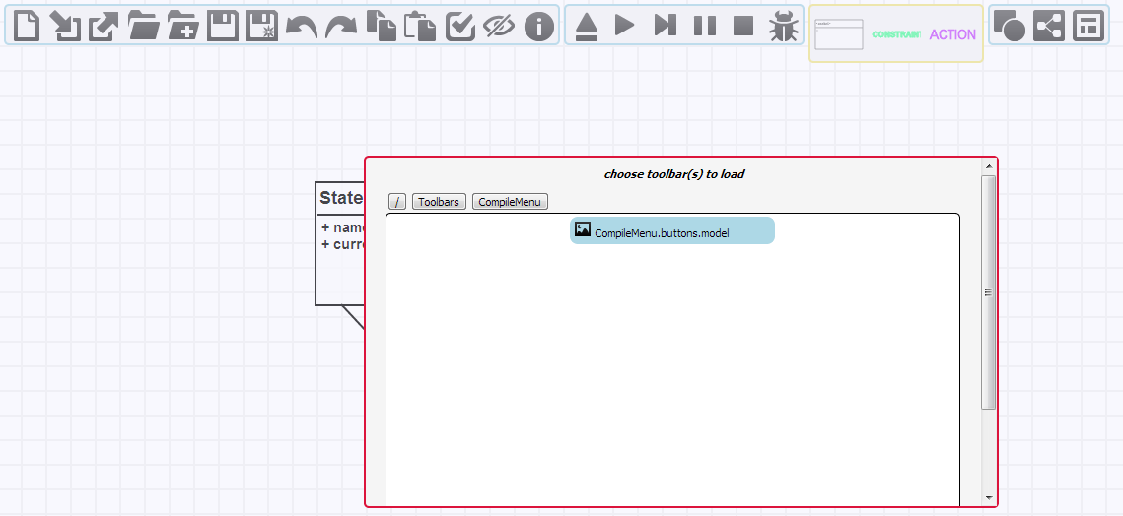
Build the metamodel
Load the CompileMenu toolbar

Slide 9
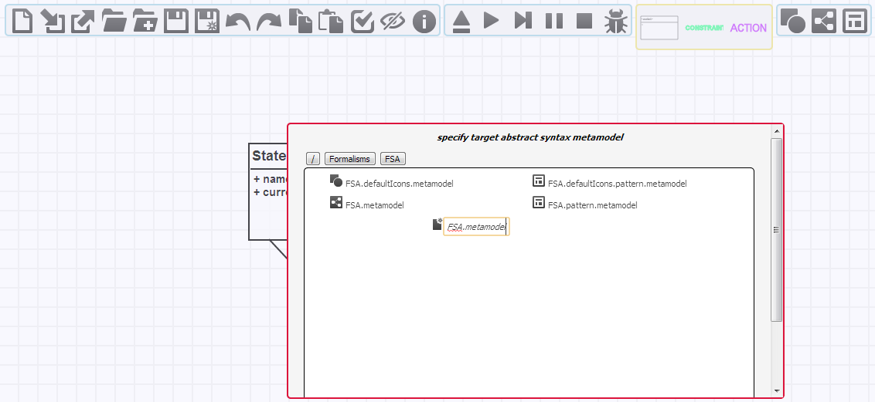
Build the metamodel
Generate the metamodel from this class diagram
The file name must be NAME+“.metamodel”

Slide 10
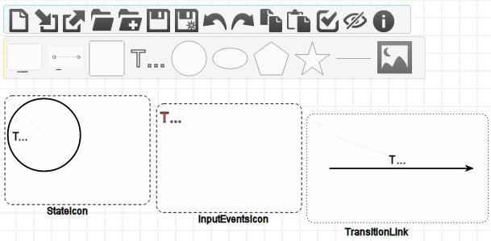
Concrete syntax
Then we assign one possible concrete syntax model to the metamodel
We can do that by drawing some shapes

Slide 11
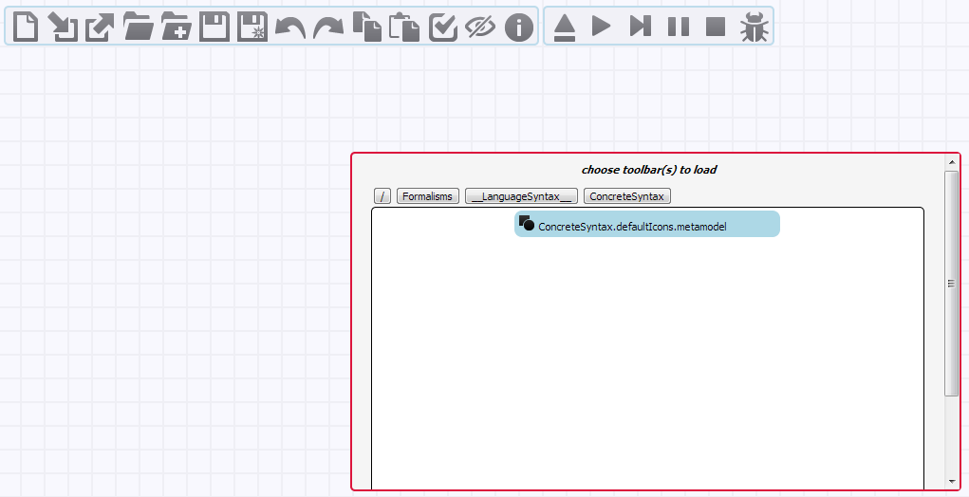
Concrete syntax
Load the ConcreteSyntax formalism toolbar

Slide 12
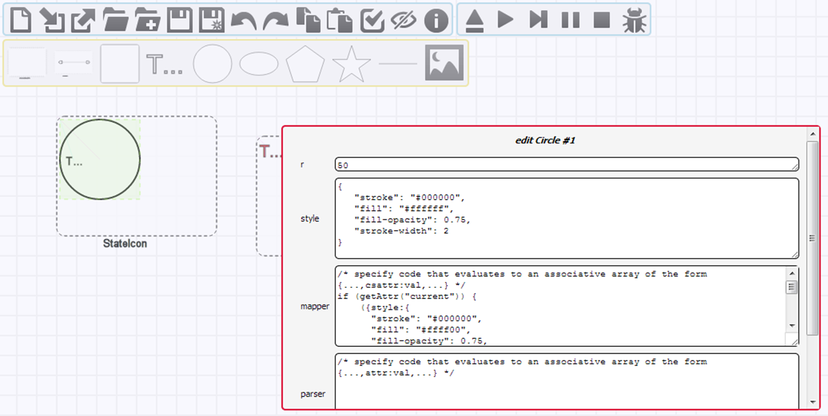
Build a concrete syntax
Draw the concrete syntax model

Slide 13
Build a concrete syntax
Drawing steps
Create an Icon instance on the canvas for classes of your metamodel
Its typename attribute must be in the form: CLASSNAME+“Icon”
Create the shape you want outside the icon
Modify resize it using its SVG attributes
You may have multiple shapes for the same class icon
Select the (group of) shape(s) and drag-n-drop it inside the icon close to the top left corner
For associations, create a Link instance on the canvas
To display some text, create a Text instance

Slide 14
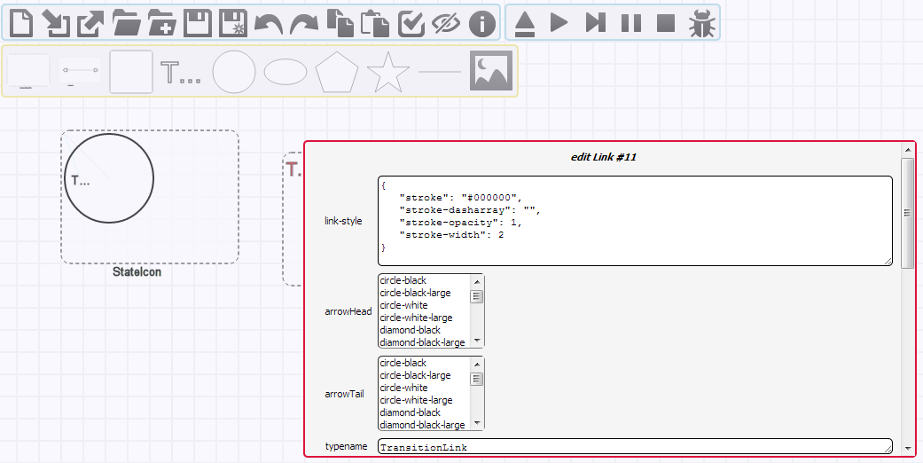
Build a concrete syntax
Draw the concrete syntax model

Slide 15
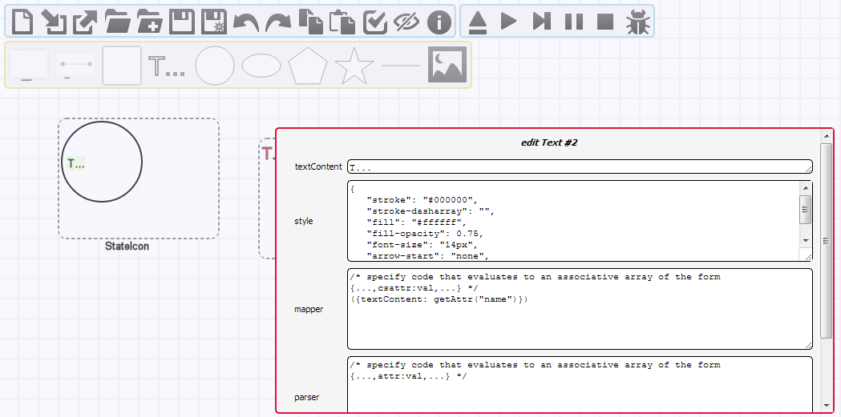
Build a concrete syntax
Display the name of the state

Slide 16
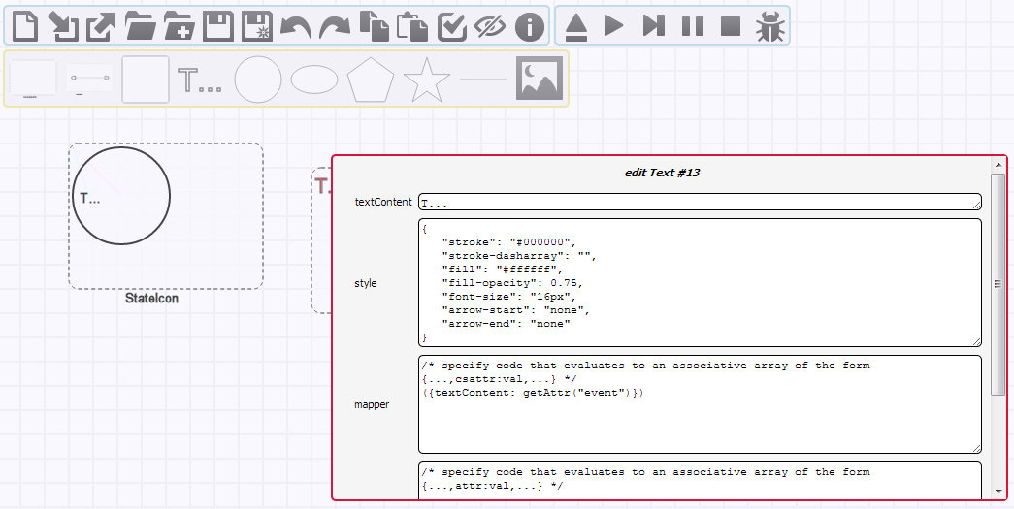
Build a concrete syntax
Display the event on the transition

Slide 17
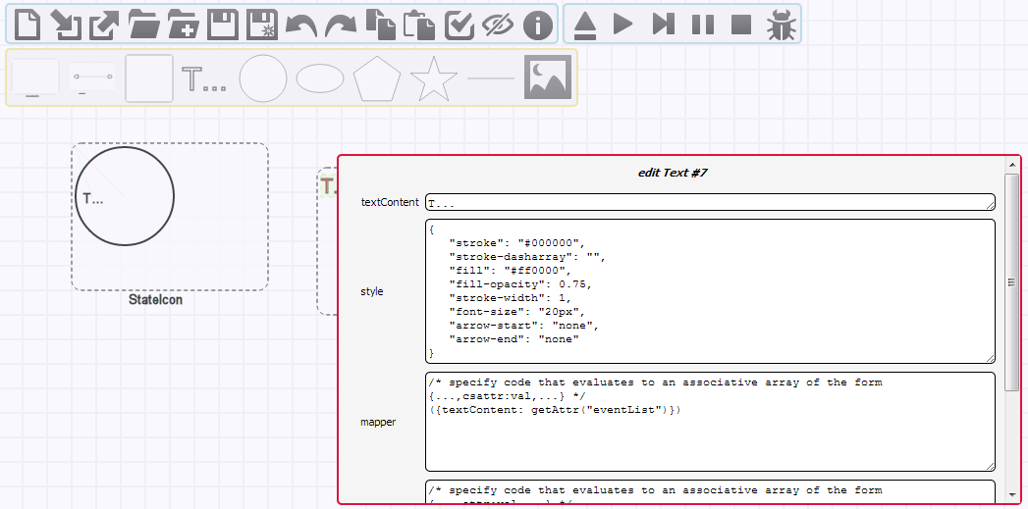
Build a concrete syntax
Display the event list

Slide 18
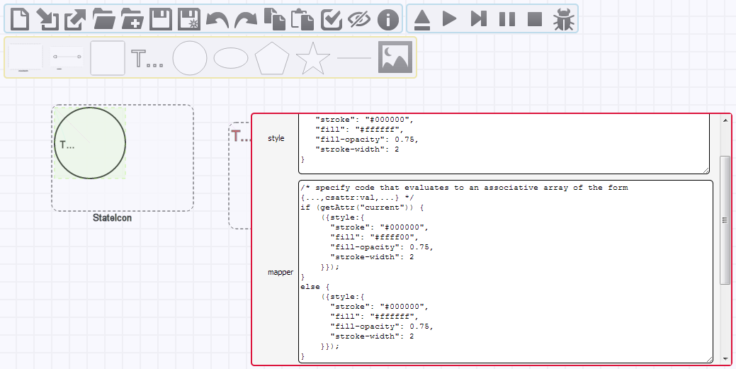
Build a concrete syntax
Change the color of the current state to yellow

Slide 19
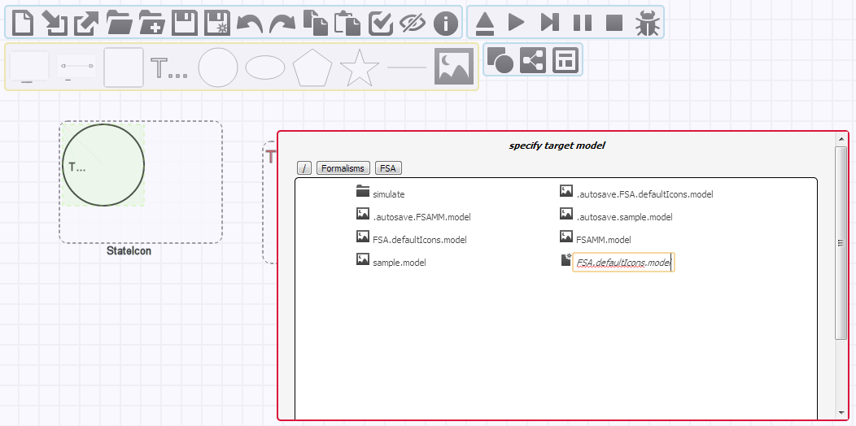
Build a concrete syntax
Save as the concrete syntax
The file name must be METAMODELNAME+“.”+“CONCRETESYNTAXNAME”+“Icons.model”

Slide 20
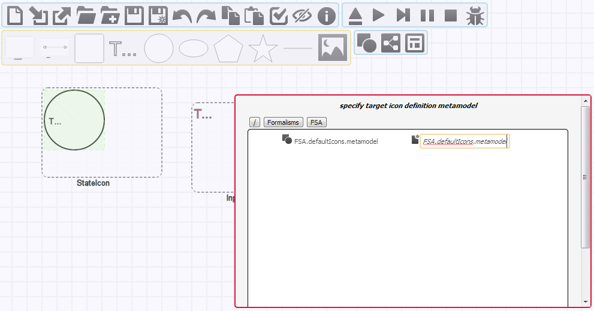
Build a concrete syntax
Generate a modeling environment
The file name must be METAMODELNAME+“.”+“CONCRETESYNTAXNAME”+“Icons.metamodel”

Slide 21
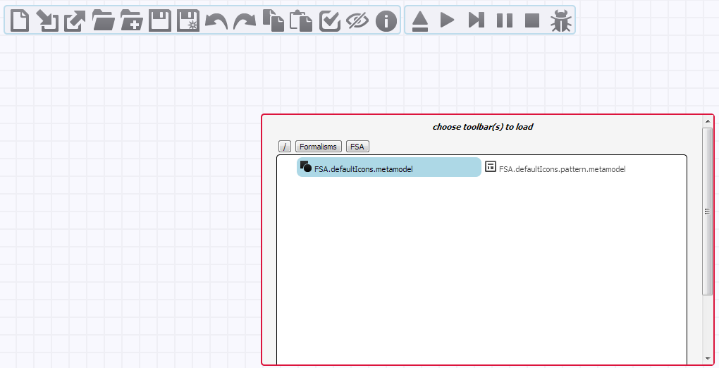
Build a model
Load the FSA formalism toolbar

Slide 22
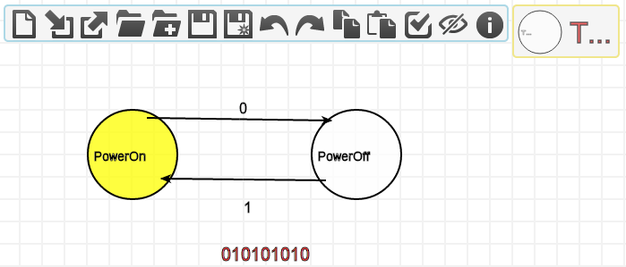
Build a model
The file name must be NAME+“.”+“model”

Slide 23
Behavior: Simulation
Now that we have defined the syntax of the language, we shall define its behavior
With a model transformation that serves as simulation
So how to do that?
Define the rules
Define the scheduling of the rules (control flow)

Slide 24
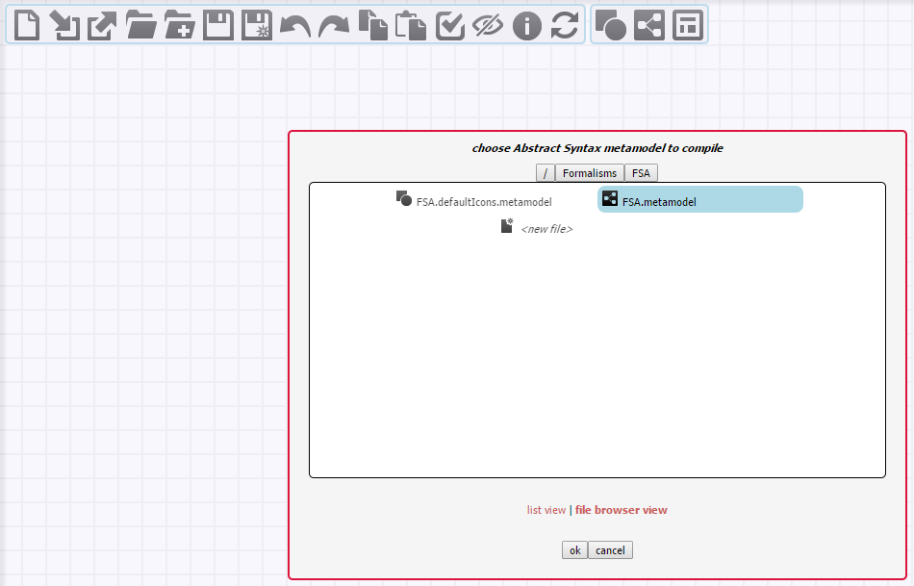
Build a rule
Generate a modeling environment for designing patterns of FSA
Select the file NAME+“.metamodel”

Slide 25
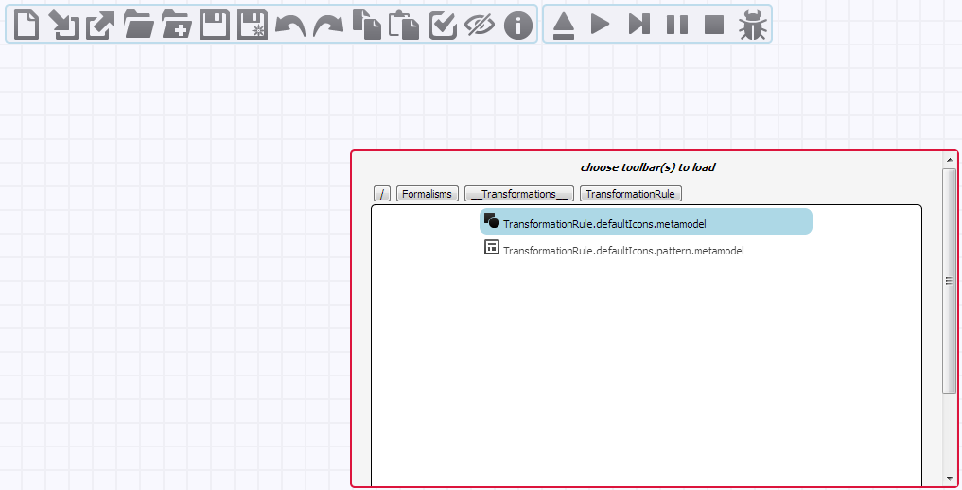
Build a rule
Load the TransformationRule formalism toolbar

Slide 26
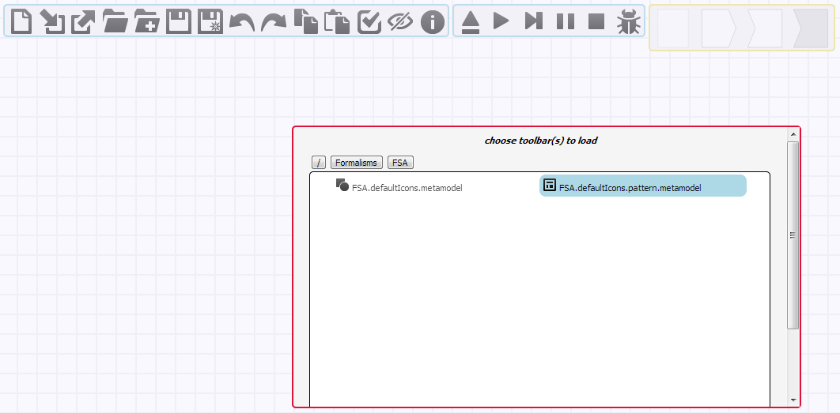
Build a rule
Load the FSA.pattern formalism toolbar

Slide 27
Define the rule
In this simple FSA example, we can assume that
An event is specified by one character
There is exactly one state that is current
This is a deterministic FSA so it is a DFA
We can therefore define the behavior of such FSAs with only one rule:
If there are two states connected by a transition such that the event on the transition is equal to the first input in the event list and the incoming state is the current state, then remove the first event from the event list and set the current state to be the outgoing state only

Slide 28
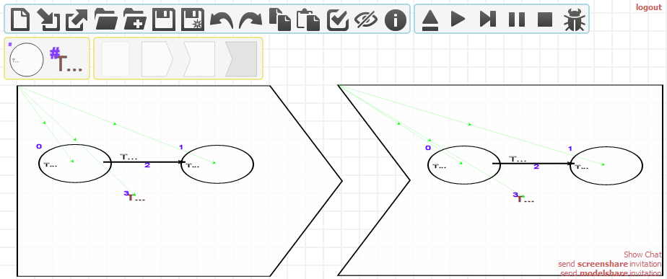

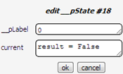
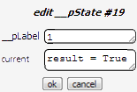

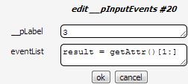
As a graph transformation rule

Slide 29
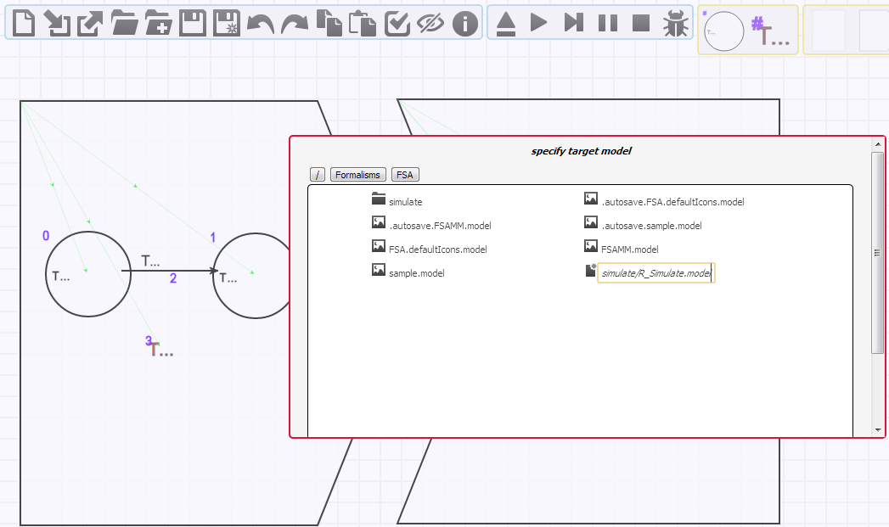
Build the rule
Save as the transformation rule
The file name must be “R_”+NAME+“.model”

Slide 30
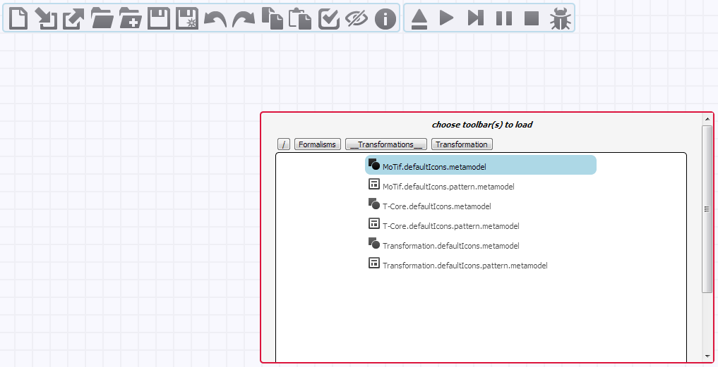
Build the rule scheduling
Load the MoTif formalism toolbar

Slide 31
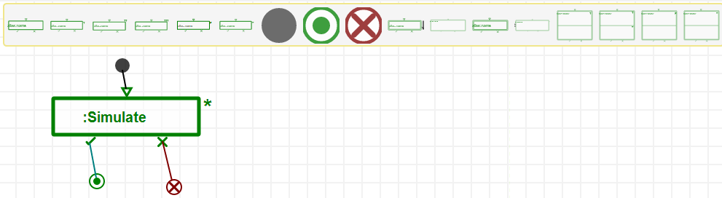
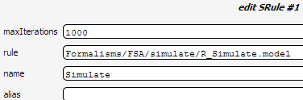
Rule scheduling
Using the MoTif language, we can execute our simulate rule as an SRule
SRule: Apply the rule recursively as long as possible
Find a match, rewrite the model, then re-match, rewrite the model, etc.

Slide 32
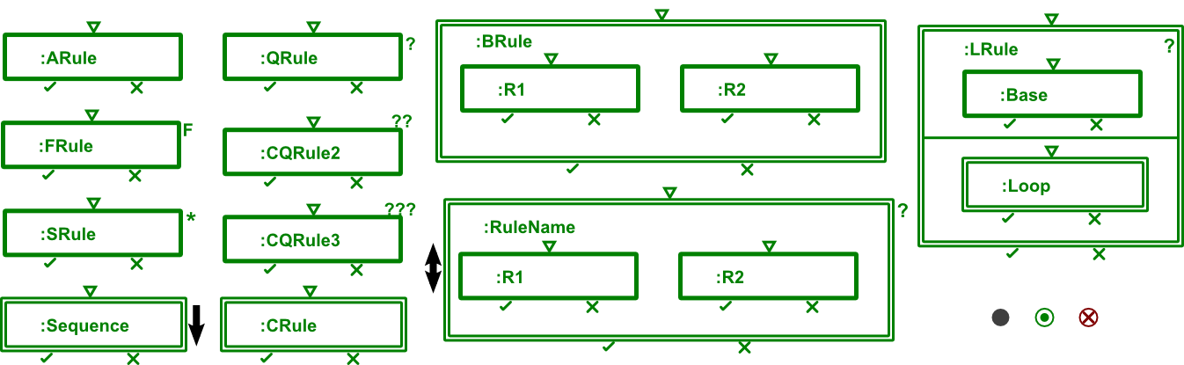
MoTif constructs
ARule: (atomic) Applies the rule on one match
FRule: (for all) Applies the rule on all matches found in parallel
SRule: (star) Applies the rule recursively as long as matches can be found

Slide 33
MoTif constructs
QRule: (query) Finds a match for the LHS
CQRule2,3: (composite queries) Nested query for 2 or 3 levels
Sequence: Applies a set of rules in ordered sequence
CRule: (composite) Refers to another (sub-)transformation

Slide 34
MoTif constructs
BRule: (branch) non-deterministically selects one successful branch of execution
BSRule: (branch star) Recursive BRule
LRule: (loop) For each match of the base rule, apply the loop rule
Start, EndSuccess, EndFail pseudo-states

Slide 35
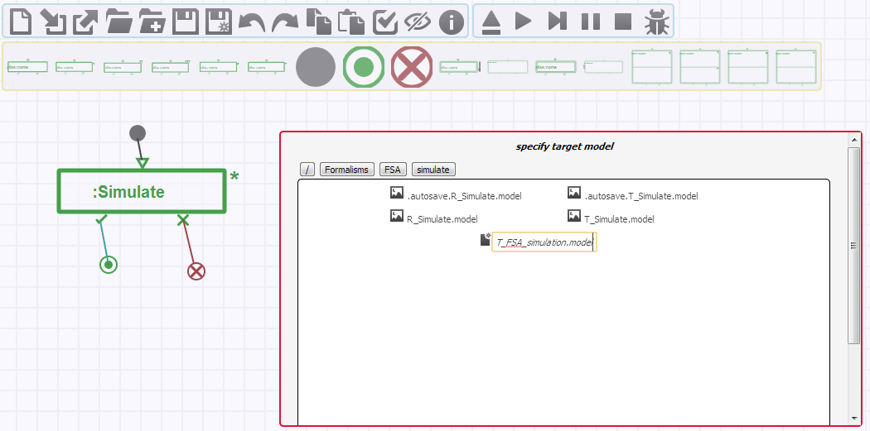
Build the rule scheduling
Save as the MoTif model
The file name must be “T_”+NAME+“.model”

Slide 36
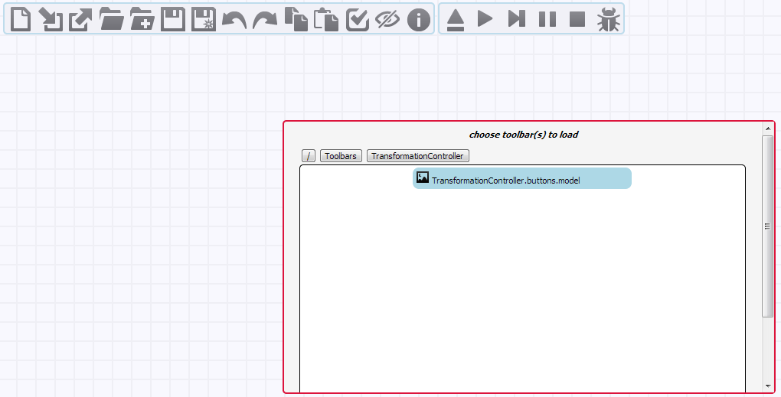
Execute the model transformation
Load the TransformationController toolbar

Slide 37
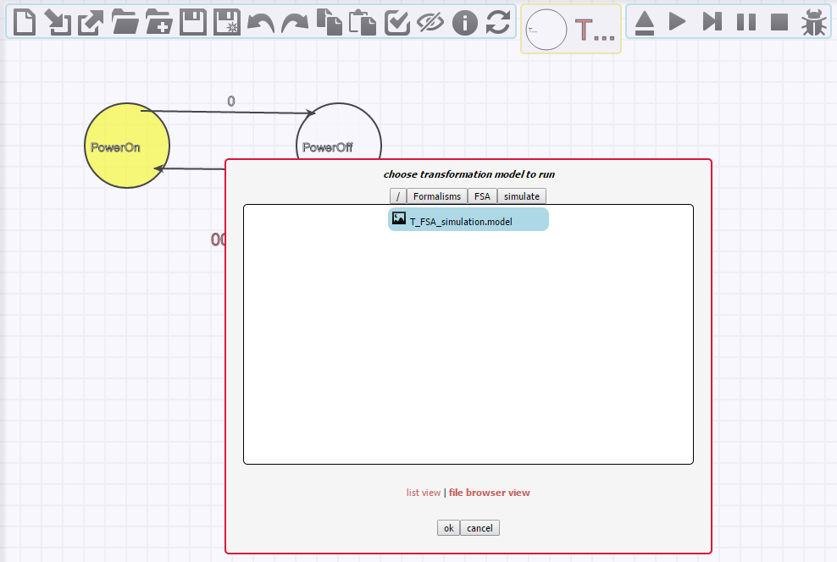
Execute the model transformation
Build/open an FSA model & load the T_FSA_simulation transformation

Slide 38
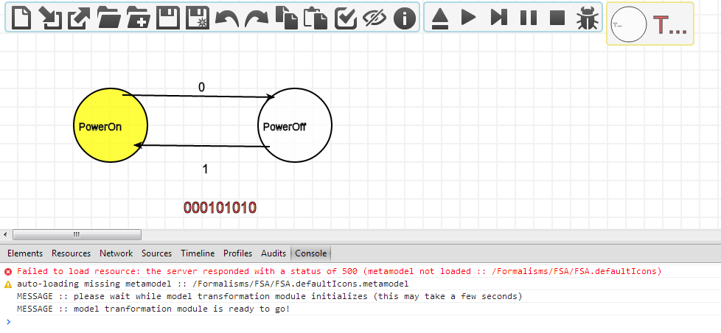
Execute the model transformation
Press <SHIFT>+<CTRL>+i to view the chrome console

Slide 39
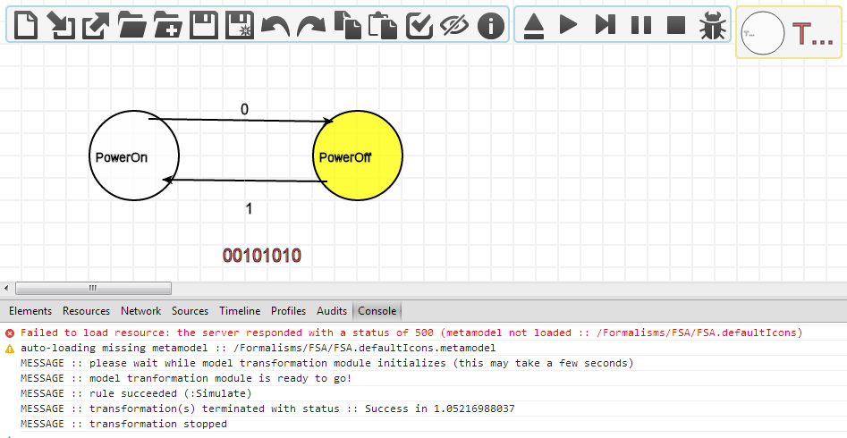
Execute the model transformation
Execute the transformation
Continuously or step-by-step

