Slide 1
Overview of Blackboard Notification Redesign Software Engineering COMP 4110
University of Massachusetts Lowell
Fall 2022
Team Members:
Cam Benassi
Alvin Tran
Caleb Bergen
Tony Choma
Leonard Nguyen
Customer: Students & Professors
Instructor: Dr. James Daly*
*Please direct all inquiries to the instructor.

Slide 2
Project Overview
Motivation For Project
The current notification system is confusing as the UI is unusable on mobile and confusing on desktop.
The system is also lacking in key search and filter features making it hard to see what you want.
Improving on the existing notification system that Blackboard has

Slide 3
Overview of Features
Clear notification cards with easy to read titles and other notification info
Multiple different filters such as
Filter by Class
Filter by Category
Notification Search
View Unread Only
Clear ability to mark notification as read

Slide 4
Domain Research
MERN stack technologies
Tailwind CSS
Library
Components
React Components
Heroku full stack application deployment

Slide 5
Project Constraints
Schedule: Time
Platform Requirements: Project must be compatible with Heroku
Scope: Project must be localized to the notification system & all directly affected pages

Slide 6
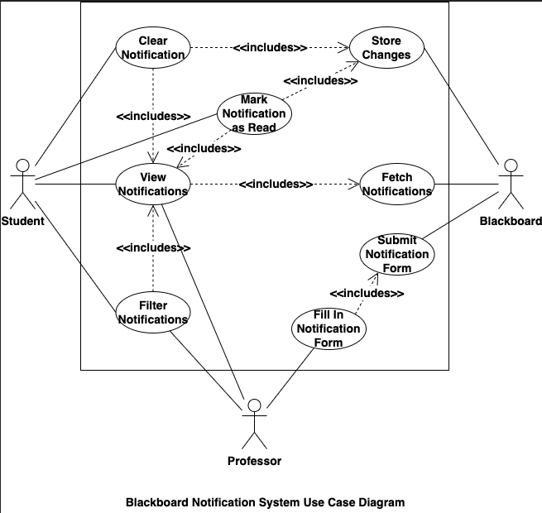
Part II: Model-based View of System

Slide 7
Part II: Model-based View of System
Key Use Cases
View Notifications
Fetch Notifications
Fill in Notification Form

Slide 8
Part II: Model-based View of System
View Notifications Use Case
Allows the Student and Professor to see their list of Notifications

Slide 9
Part II: Model-based View of System
Fetch Notifications Use Case
Grabs all notifications for the user from the server

Slide 10
Part II: Model-based View of System
Fill in Notification Form Use Case
Allows the professor to create new notifications

Slide 11
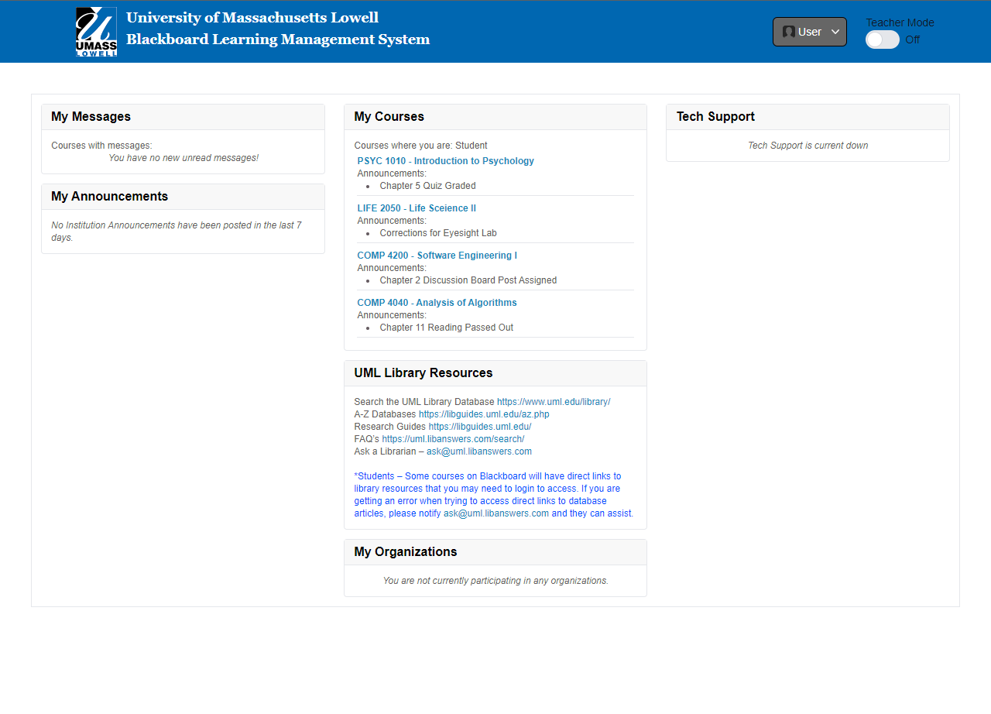
Part III: Demonstration - Student Scenario

Slide 12
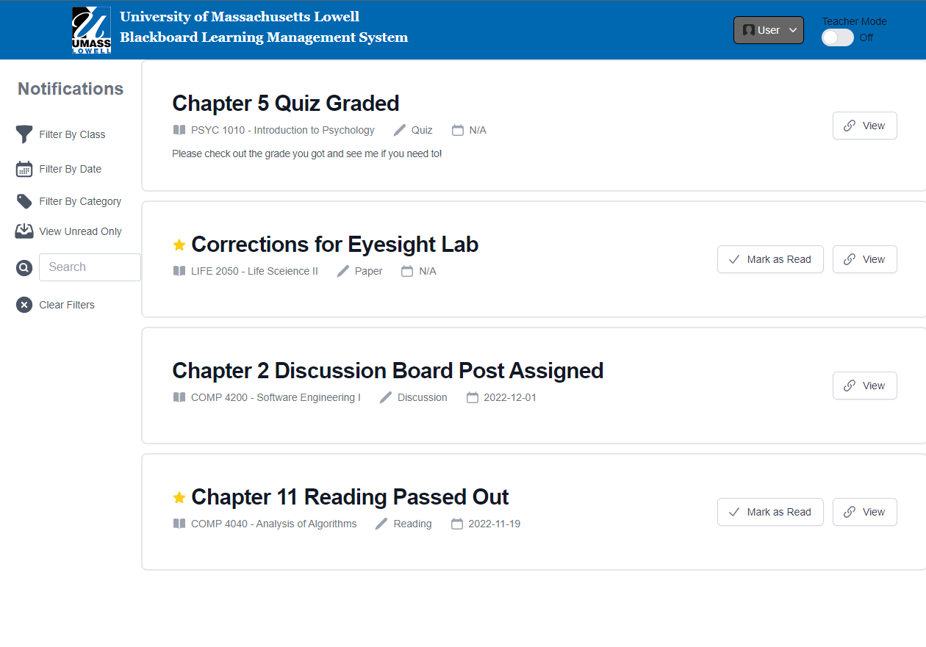
Part III: Demonstration - Student Scenario

Slide 13
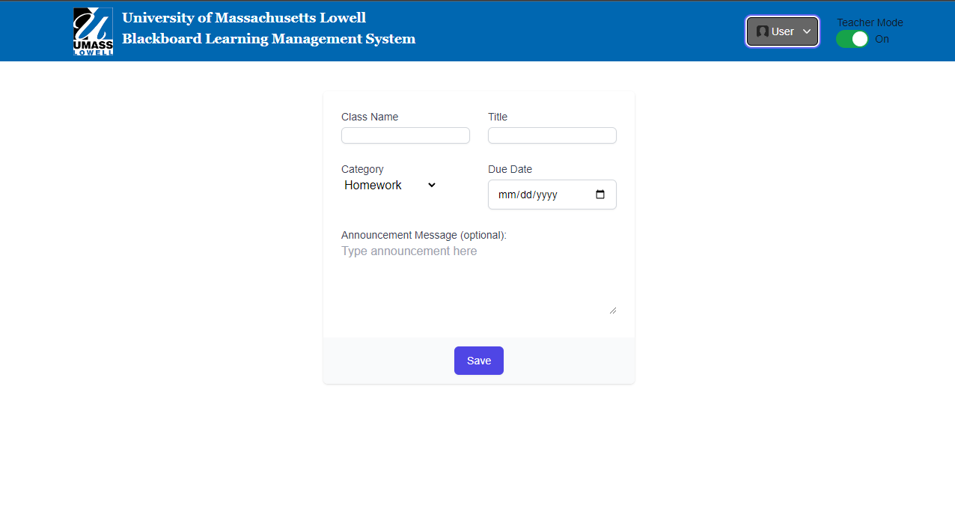
Part III: Demonstration - Teacher Scenario

Slide 14
Part III: Demonstration - Website Link
https://swelms.herokuapp.com/

Slide 15
Acknowledgements
We gratefully acknowledge and appreciate the participation of our customer, students and professors, from Blackboard.

