Slide 1
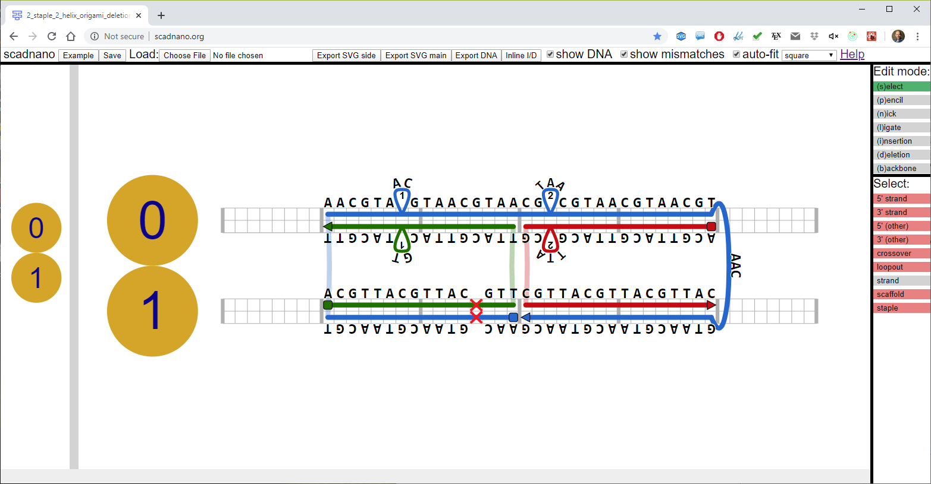
menu
helix
insertions
5’ end
crossover
loopout
3’ end
offset 3 on helix 1
deletion
side view
main view

