Slide 1
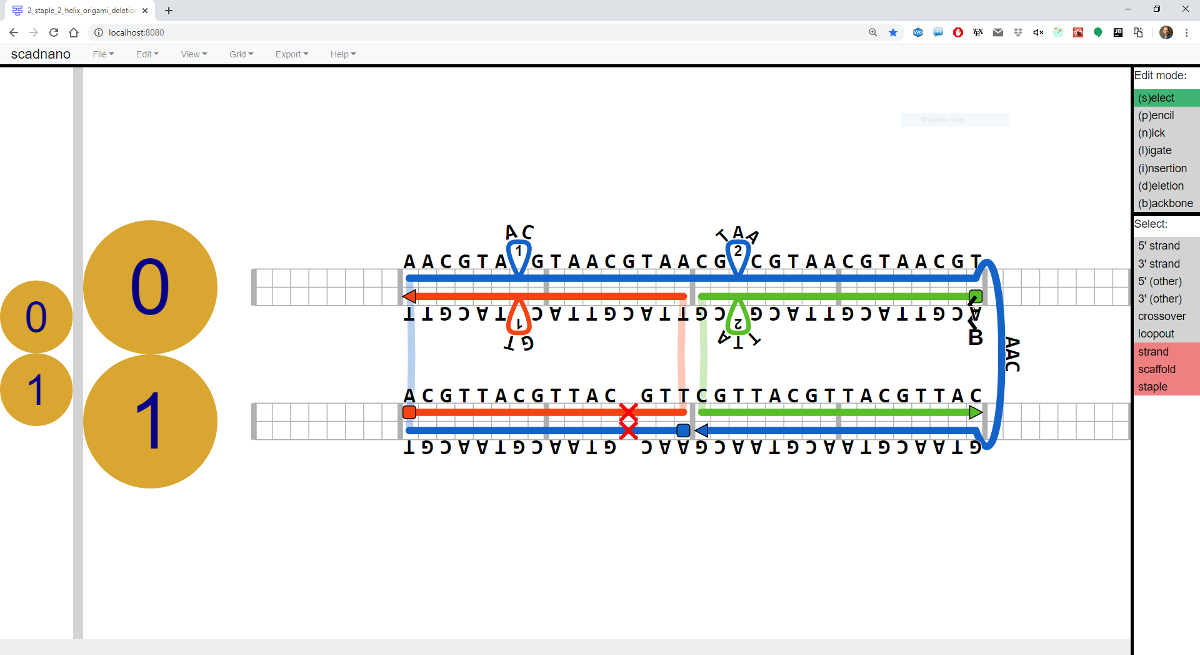
insertions
helix
5’ end
crossover
biotin modification
loopout
3’ end
offset 3 on helix 1
deletion
side view
main view

