Slide 1
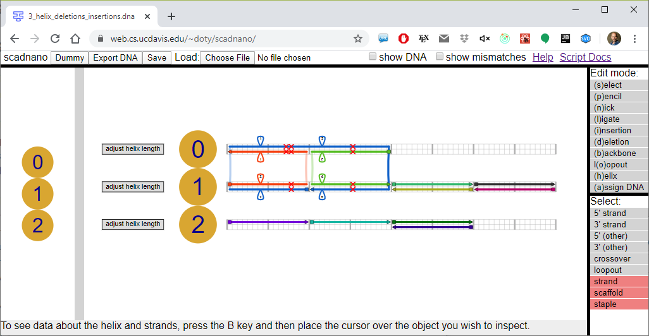
menu
helix
insertion
deletion
loopout
crossover
5’ end
3’ end
side view
main view

