Slide 1
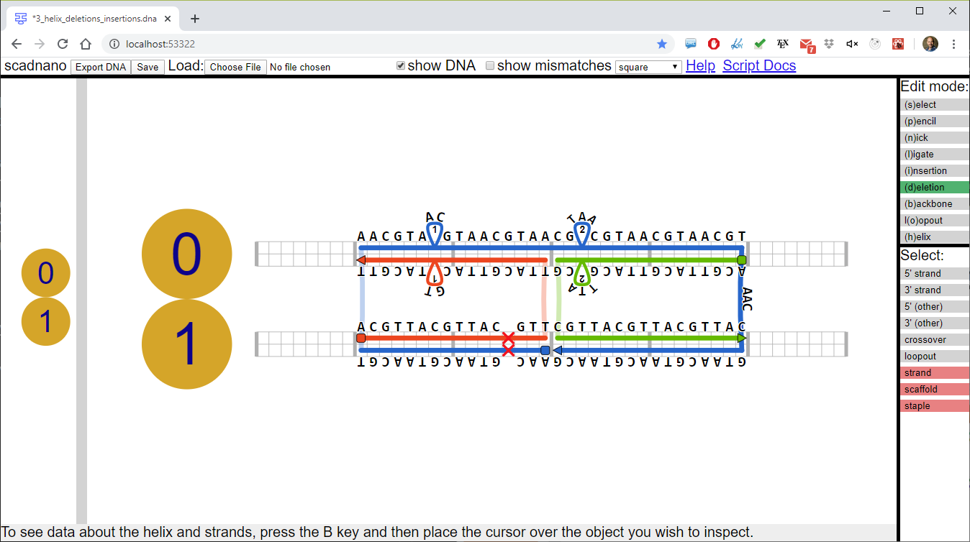
menu
insertions
helix
5’ end
loopout
crossover
3’ end
offset 3 on helix 1
deletion
side view
main view

