Slide 1
Debugging Deadlocks
Debugging simple Deadlocks
Notes:
Synchronization problems are a large category in software defects.

Slide 2
Topics
Race Conditions
Atomic data access vs visibility
Deadlock: Nested locks
Deadlock: Dispatcher / Message Queue
Exercise

Slide 3
Topics
Race Conditions
Atomic data access vs visibility
Deadlock: Nested locks
Deadlock: Dispatcher / Message Queue
Exercise

Slide 4
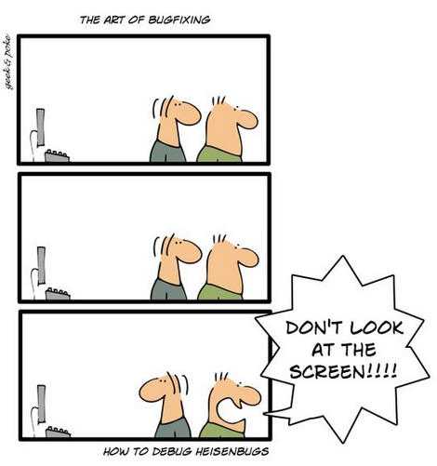
Race Conditions
“A race condition is a condition of a program where its output depends on relative timing of multiple threads.”
This often causes so called „Heisenbugs“
Notes:
Source https://www.baeldung.com/cs/race-conditions
For example, attach the debugger and the behavior is different.

Slide 5
Race condition – Banking example
source.Balance = 100;
target.Balance = 0;
TransferMoney(100, source, target);
void TransferMoney(decimal amount, Account source, Account target)
{
if (source.Balance < amount)
{
return;
}
source.Balance -= amount;
target.Balance += amount;
}
„Check-Then-Act“ Pattern
Notes:
Hello World Example
Explain Race Condition with Check-Then-Act Pattern.

Slide 6
Locks
Lock are implemented in C# using the Monitor class
object _lock = new object();
try
{
Monitor.Enter(_lock);
// Code inside here can only be executed only by one thread at a time.
// Other threads must wait
}
finally
{
Monitor.Exit(_lock);
}
Short version
lock (_lock)
{
// Code inside here can only be executed only by one thread at a time.
// Other threads must wait
}
Notes:
Monitor only inprocess
Reentrant
https://sharplab.io

Slide 7
Race condition – Banking example
object _lock = new object();
void TransferMoney(decimal amount, Account source, Account target)
{
lock(_lock)
{
if (source.Balance < amount)
return;
source.Balance -= amount;
target.Balance += amount;
}
}
string Report(Account a, Account b)
{
lock (_lock)
{
return $"A = {a.Balance} B={b.Balance}";
}
}
Notes:
We use the same lock to protect the same resoure!

Slide 8
Race conditions – more examples
„Read Modify Write“ Pattern
// Assume _i == 0
tmp = _i;
tmp = tmp + 1
_i = tmp
Increment operator is compiled to „read modify write“ code
.locals init (
[0] int32 _i
)
…
IL_0003: ldloc.0
IL_0004: ldc.i4.1
IL_0005: add
IL_0006: stloc.0
…
_i++
Notes:
Executing the lines does not always result in _i==2
Ldloc.0 lädt die Variable mit dem Index 0 auf den Auswertestapel.
Stloc.0 nimmt das oberste Ergebnis auf dem Auswertestapel und speichert es in die Variable mit dem Index 0.

Slide 9
Topics
Race Conditions
Atomic data access vs visibility
Deadlock: Nested locks
Deadlock: Dispatcher / Message Queue
Exercise

Slide 10
Atomic data access
Non atomic read / write operations
Int64 value = 0;
Thread1:
value = 0x0000FFFF
Thread2:
value = 0x56781234
Notes:
See demo DemoNonAtomicAccess if you want to try it.

Slide 11
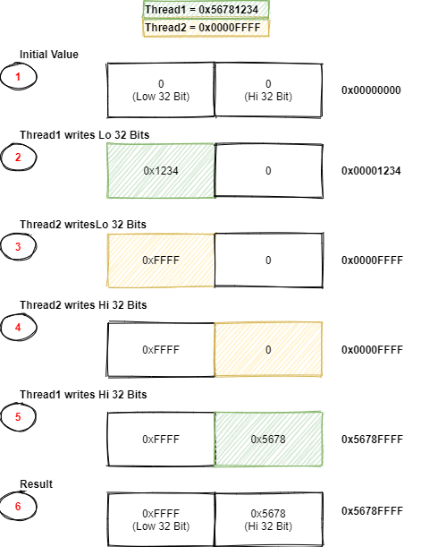
write to int 64 (32 bit application)

Slide 12
Visibility
If a thread changes a variable,
when do other threads see this change?
Notes:
See Demo DemoCachingDeadlock
https://web.archive.org/web/20160323025740if_/http://blog.coverity.com/2014/03/12/can-skip-lock-reading-integer/#.VvIGLj_4_mE
http://blog.coverity.com/2014/03/12/can-skip-lock-reading-integer/
https://ericlippert.com/2011/05/26/atomicity-volatility-and-immutability-are-different-part-one/

Slide 13
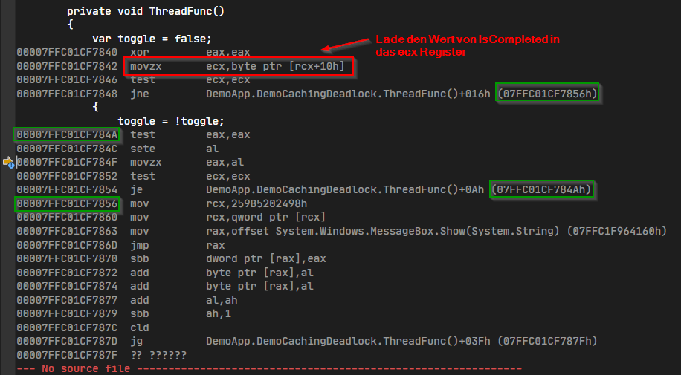
Visibility
Notes:
See Demo DemoCachingDeadlock
https://web.archive.org/web/20160323025740if_/http://blog.coverity.com/2014/03/12/can-skip-lock-reading-integer/#.VvIGLj_4_mE
http://blog.coverity.com/2014/03/12/can-skip-lock-reading-integer/
https://ericlippert.com/2011/05/26/atomicity-volatility-and-immutability-are-different-part-one/

Slide 14

Summary Race conditions
Don‘t
Make assumptions about how the compiler works or the CPU executes code.
Just tell the compiler which variables are shared between threads.
Do
Use locks
Fixes all previous mentioned problems: race conditions, non atomic data access, visibility and instruction reordering.
Notes:
Don‘t
Überlegungen wie: „Wenn Thread x hier ist, dann hat Thread y diesen Code schon ausgeführt ..“ machen keinen Sinn.
Oft funktioniert es trotzdem, aber der Code ist trotzdem nicht korrekt.
Atomar aber nicht sichtbar.
Wir sagen dem Compiler was zwischen Threads ausgetauscht wird. Der Rest geht uns nichts an.
Sehr selten.
Do:
Es gibt speziellere Mechanismen wie Interlocked, volatile. Aber locks löst alle Probleme.

Slide 15

Deadlock
A deadlock occurrs when two or more threads are stuck because they are waiting for each other.
Notes:
Locks are the cure for race conditions and other problem. However, they introduce the next problem

Slide 16
Topics
Race Conditions
Atomic data access vs visibility
Deadlock: Nested locks
Deadlock: Dispatcher / Message Queue
Exercise

Slide 17
The classical deadlock – nested locks
public void Run()
{
var w1 = new Thread(Worker1);
var w2 = new Thread(Worker2);
w1.Start();
w2.Start();
w1.Join();
w2.Join();
}
private readonly object _lockForResourceA = new object();
private readonly object _lockForResourceB = new object();
public void Worker1()
{
lock (_lockForResourceA)
{
lock (_lockForResourceB)
{
DoWork();
}
}
}
public void Worker2()
{
lock (_lockForResourceB)
{
lock (_lockForResourceA)
{
DoWork();
}
}
}

Slide 18
Demo
Demo –
Nested locks
Notes:
Siehe Markdown

Slide 19
SuMmary – nested locks
How to fix?
Acquire nested locks always in the same order.
Use timeouts and try again
Maybe a single lock can be used on a higher level?
Notes:
Timeouts compared to a toy.

Slide 20
Summary
Look for threads that are blocked. Look for threads that contain code from your code base. Ignore all other callstacks for the moment. For example
Thread.Join
Task.Wait
lock statements
WaitHandle.WaitOne
Dispatcher.Invoke
Etc
Follow the wait chain and build wait graph to understand the problem.
Or create a dump file and use an analyzer (Visual Studio, DebugDiag)
nested locks always in the same order (Nested Locks Pattern)
Give threads unique names to identify them in threads window
Lock only small sections.
Never fire events when still holding a lock
Design thread safe classes with an proper API
GetXXX may return outdated state.
Use immutable data structurs.

Slide 21
Topics
Race Conditions
Atomic data access vs visibility
Deadlock: Nested locks
Deadlock: Dispatcher / Message Queue
Exercise

Slide 22
Message Queue / Dispatcher related deadlock
Longer operations should not run in the UI thread. While the operation runs the messages are not processed!
Longer operations are executed as background operation in a different thread
Deadlocks often happen when these background operations are finished and the result is given to the UI thread to display.

Slide 23
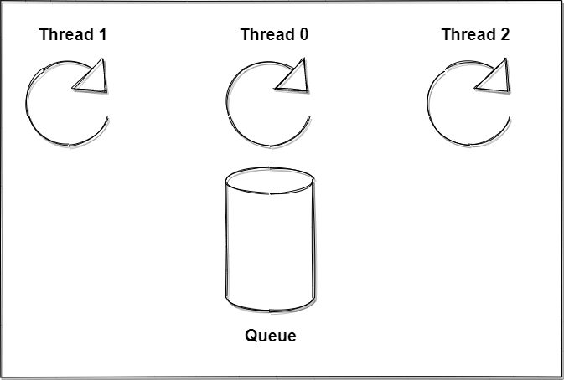
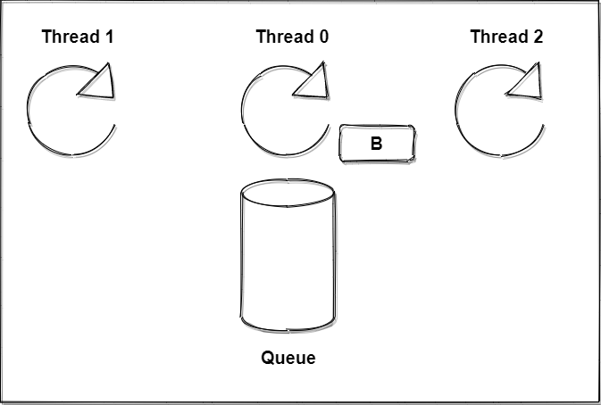
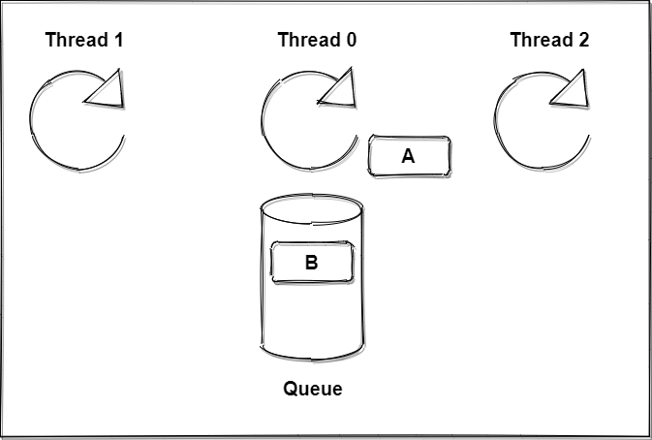
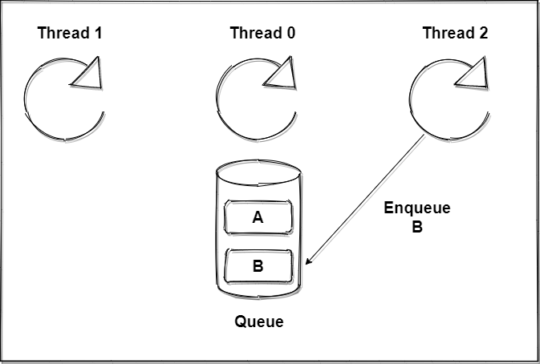
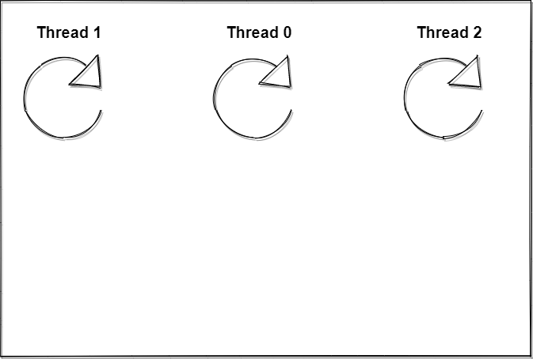
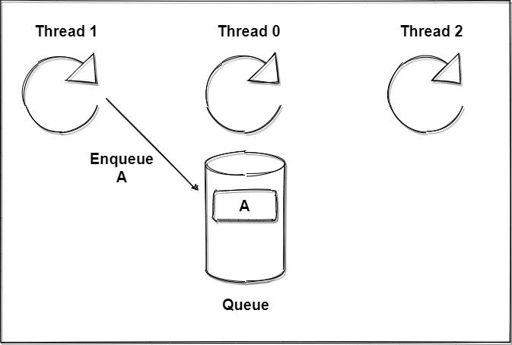
QueUES

Slide 24
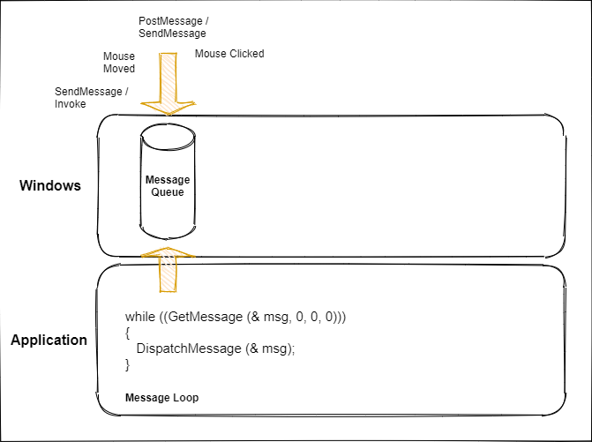
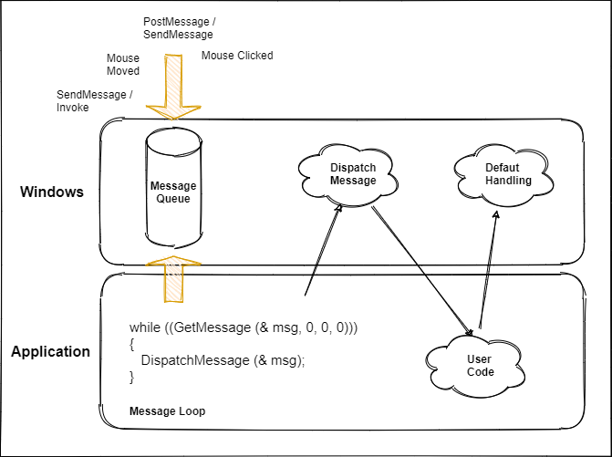
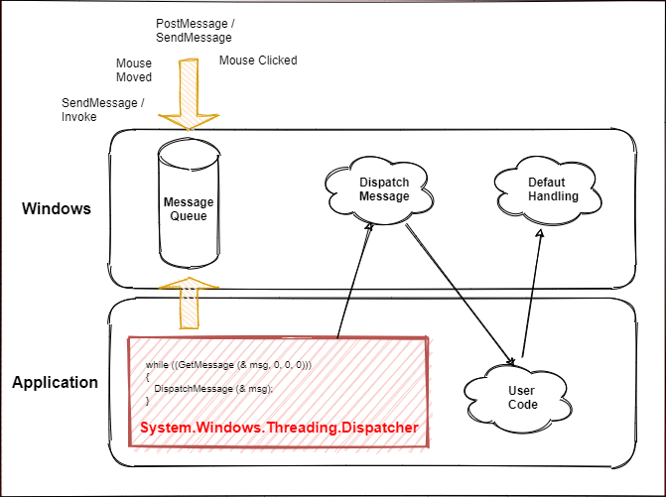
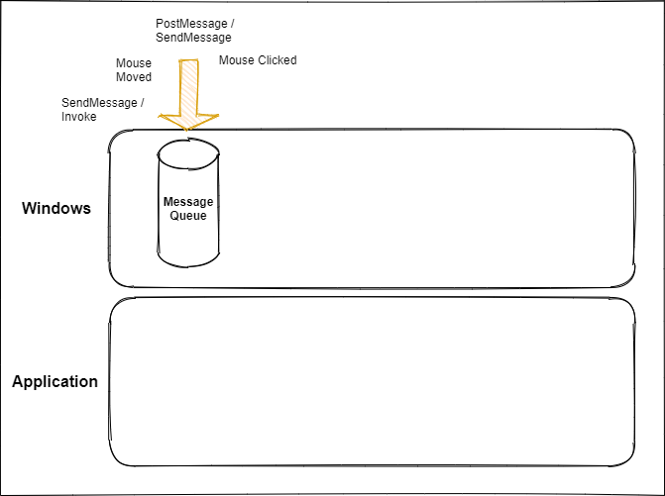
How the windows message queue works
We can enqueue work for the UI
thread via
Dispatcher.BeginInvoke
Dispatcher.Invoke
Notes:
Concept is universal.
Do not block the message queue.

Slide 25
Demo
Demo – Dispatcher / Message Queue Deadlock

Slide 26
Summary - The Dispatcher deadlock
How to fix it?
Avoid waiting / blocking in the UI thread.
BeginInvoke is often the fastest way to get it to work. But BeginInvoke is often also just a workaround. We can structure the code often in a better ways.
When using async await the Parallel Tasks Window is helpful.

Slide 27
Topics
Race Conditions
Atomic data access vs visibility
Deadlock: Nested locks
Deadlock: Dispatcher / Message Queue
Exercise

Slide 28
Exercise –
Find and fix the deadlock

Slide 29
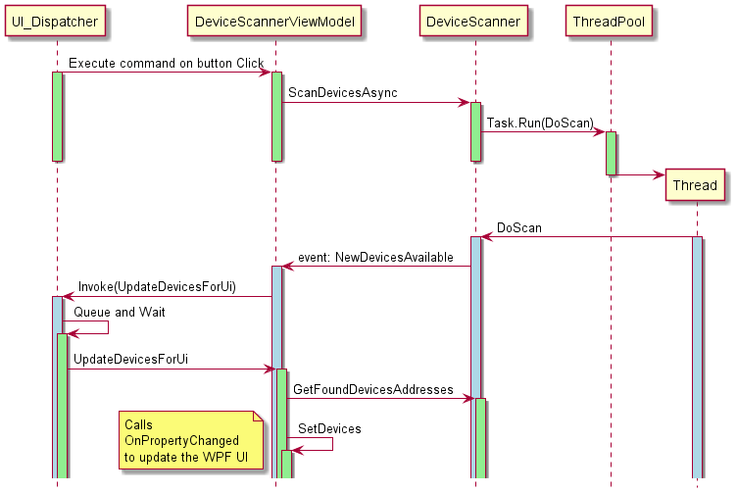
Exercise 01
Notes:
Show the application how it works and explain what it should do!

Slide 30
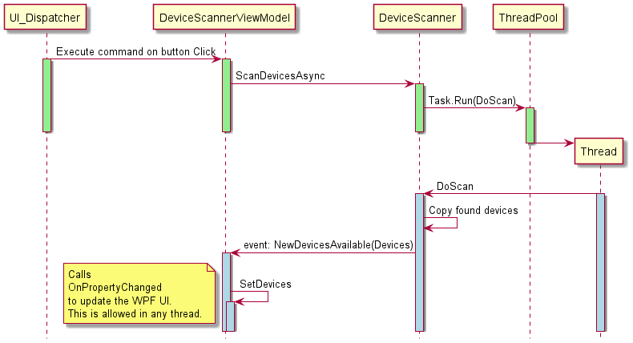
Exercise 01 - Fix
Notes:
No event inside lock statement.
Cloned data passed directly. Does not require a lock to get the data.
Less noisy calls

Slide 31
Solutions
BeginInvoke Simple but often not the best solution. Can have unwanted side effects.
Fire event outside lock.
Pass data that belongs to the event as as event argument. Pass copy of data.
Assumtion that WPF PropertyChanged event has to happen in UI thread is wrong.

Slide 32
Removed
Notes:
https://docs.microsoft.com/de-de/troubleshoot/dotnet/framework/wpf-render-thread-failures

Slide 33
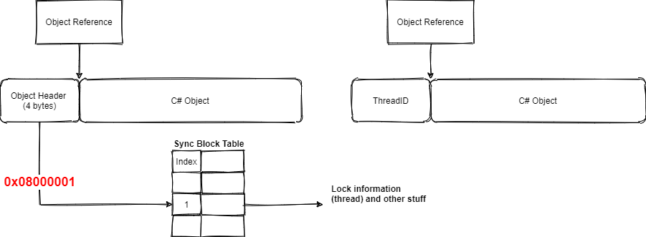
Where is the lock information stored?
The lock Information is stored as part of the locked object itself
Pre Visual Studio 2019 16.5
Source: Pluralsight – Advanced Debugging in .NET
Notes:
https://stackoverflow.com/questions/3523544/identify-the-thread-which-holds-the-lock
Monitor only inprocess
Reentrant
If we only ever use the object for locking the object header contains the thread id. This is called a thin lock.
If other information needs to be stored like the hashcode the object header contains an index into the so-called sync block table where all the information the CLR wants to store is located.
Caution.
WinDbg provides commands to read and interpret such structure. (SOS DLL). Each –NET Framework version brings its own fitting SOS.dll
But here the object layout is stable! WinDbg is not part of this presentation.

Slide 34
Race conditions – More examples
„Check then act“ pattern
if (_instance == null)
{
_instance = new Singleton();
}
using (_lock)
{
if (_instance == null)
{
_instance = new Singleton();
}
}

Slide 35
Summary: some tips we learned on the way
Aquire nested locks always in the same order (Nested Locks Pattern)
Give threads unique names to identify them in threads window
Lock only small sections.
Never fire events when still holding a lock
Design thread safe classes with an proper API
GetXXX may return outdated state.
Use immutable data structures.

Slide 36
Race conditions – More examples
Obj.Calculate();
var result = Obj.GetResult();
WriteToLogFile(result)
Rewrite the interface to be more thread friendly. Calculate has to be thread safe itself.
var result = Obj.Calculate();

