Slide 1
Before we Start (1/2) The demo application
Directory structure of the Demo Application
Demo
- App
- ThirdPartyLibrary.dll
- Prism.dll
- DemoApp.exe
- Symbols
- DemoApp.pdb

Slide 2
Before we Start (2/2) Symbol files
Symbol files (PDB = program database) are generated when a project is compiled.
They are generated beside the output assembly.
Symbol files contain the mapping from IL Code back to source code. The debugger cannot debug source code if the PDB file is missing!
Notes:
Hier Symbole gleich erklären. (Walkthrough 02)

Slide 3
Memory dumps
Memory Dumps & Debugging 3rd Party Libraries
Notes:
Memory dumps are an invaluable tool for debugging.
In this first chapter we handle code we wrote.

Slide 4
TOpics
What are Memory Dumps?
Different types of Memory Dumps
How to create Memory Dumps?
Demo: Creating and analyzing a Memory Dump

Slide 5
Memory dumps
A memory dump is a snapshot of a running process writen it to a file.
Memory dumps are an important tool for troubleshooting
Helpful for capturing crashes on production systems.
For capturing rare conditions for later analysis based on triggers. (Hangs, crashes, CPU spikes, memory leaks etc)
Many tools to analyze Memory Dumps: Visual Studio, Memory Profiler, DebugDiag etc.
Notes:
Especially useful if the bug can only be reproduced on the production system and you cannot install Visual Studio.
Capture rare bugs especially on a production system without access to. Can be written automatically when special contitions like crashes, high CPU occur.
DebugDiag, Memory Profiler etc.
Automatic analysis saves time.

Slide 6
Memory dumps – Types of memory dumps
Two types of memory dumps
Full dump Large but contains full process memory. Keep in mind that a full Memory Dump contains all memory which may include passwords, connection strings etc.
Mini dumps Configurable. Dump content depends on the used tool. The memory dump contains at least the call stacks for all threads. But can contain as much information as a full dump. https://docs.microsoft.com/en-us/windows/win32/api/minidumpapiset/ne-minidumpapiset-minidump_type
Notes:
Procdump /ma
Default is only thread and exception information.
Size:
Since a memory dump is the process memory written to a file, the file‘s size is equal to the process‘s memory. This can be quite large. Therefore different kind of memory dump exists. The minimum information is the callstacks for all threads and exception information.

Slide 7
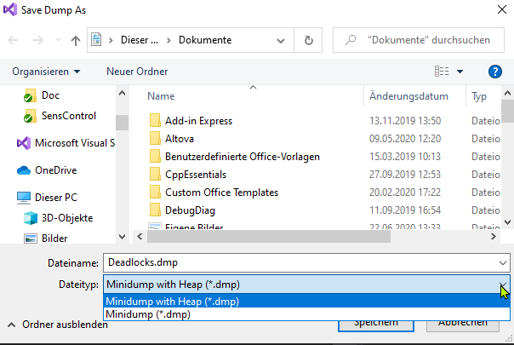
Memory dumps – How to create a dump file
Visual Studio Debug -> Save Dump As …
Notes:
MiniDump With Heap similar to breaking into debugger.
Minidump just contains the callstacks (+ expection).

Slide 8
Memory dumps – How to create a dump file
Task Manager
Details -> Right Click on Process -> Create Dump
Not recommended! Dumping a 32 bit application on a 64 bit Windows may not be usable in all tools. 32 bit version here: C:\Windows\SysWOW64\taskmgr.exe
Process Explorer
Procexp.exe captures a 32-bit or 64-bit dump, depending on the process’ bitness
https://docs.microsoft.com/en-us/sysinternals/downloads/process-explorer
Notes:
Explain Image Highjacking
HKEY_LOCAL_MACHINE\SOFTWARE\Microsoft\Windows NT\CurrentVersion\Image File Execution Options\taskmgr.exe
// 32 Bit Notepad starten
C:\Windows\SysWOW64\notepad.exe
// WinDbg x64
wow64win!NtUserGetMessage+0x14
wow64win!whNtUserGetMessage+0x2e
wow64!Wow64SystemServiceEx+0x15a
wow64cpu!ServiceNoTurbo+0xb
wow64cpu!BTCpuSimulate+0x9
wow64!Wow64LdrpInitialize+0x12d
LdrpInitializeProcess+0x1932

Slide 9
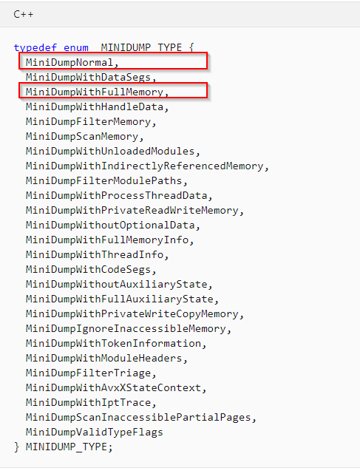
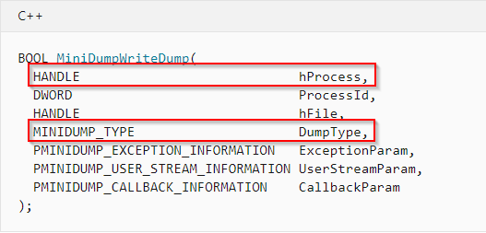
Memory dumps – How to create a dump file
Programmatically
https://docs.microsoft.com/en-us/windows/win32/api/minidumpapiset/nf-minidumpapiset-minidumpwritedump

Slide 10
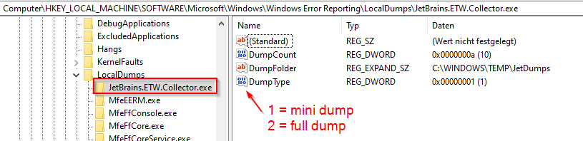
Memory dumps – How to create a dump file
Windows Error Reporting (WER)
Windows can be configured to write a memory dump automatically whenever an application crashes.
HKEY_LOCAL_MACHINE\SOFTWARE\Microsoft\Windows\Windows Error Reporting\LocalDumps\[Application]
Notes:
Count = Ringbuffer
Explain WER

Slide 11
Memory dumps – How to create a dump file
Procdump.exe
Most flexible way to create memory dumps.
Create dumps on the fly (frozen applications)
Create dump when an application crashes
Create dump on triggers like CPU thresholds, performance counters etc.
By default, ProcDump will capture a 32-bit dump of a 32-bit process when running on 64-bit Windows.
https://docs.microsoft.com/en-us/sysinternals/downloads/procdump

Slide 12
Procdump examples
Create a dump file on the fly (minidump with full process memory)
Automatically choses right bitness
procdump –ma <process id or name>
Create dump on second-chance exception
procdump –ma –e <process id or name>
Attaches to running process and dumps on first chance exceptions
procdump -e 1 -n 1000 <process id or name>
Create 2 dumps if the CPU threshold exceeds 60% for more than 3 seconds.
procdump –c 60 –s 3 –n2 <process id or name>
Notes:
No exe allowed!
TODO Explain First Chance / Second chance exceptions with example.
- Usage
- Exception settings dialog.
-ma = Dump with full process memory

Slide 13
How to open a memory dump file?
Variousl tools can open and analyze Memory
Visual Studio
Memory Profiler (i.e. JetBrains dotTrace)
Analysis Tools
DebugDiag https://www.microsoft.com/en-us/download/details.aspx?id=58210
ClrMd
Notes:
https://www.microsoft.com/en-us/download/details.aspx?id=58210
https://github.com/microsoft/clrmd

Slide 14
Demo
Demo –
Creating and analyzing a Dump File
Notes:
Walkthrough 030
Walkthrough 040
Walkthrough 050

Slide 15
Summary – SymBOls and mapping to source code
Option 1: Studio 2019 can decompile code directly from the Memory Dump. The pdb file is recreated on the fly. (Not in memory dump without memory.)
Option 2: Showing source code when analyzing a memory dump is possible if:
The exact source code must be available
Symbol files (PDB = program database) must be available to map IL code back to source code lines
Better results when code was not JIT optimized.
Option 3 Source Link (-> Debugging 3rd Party Libraries)
Notes:
Zusammenfassung nach dem Walkthrough
Beim Analysieren eines Dump files will man oft vom kompilierten IL Code wieder auf den Quellcode zurückschließen z.B. um die Absturzstelle zu untersuchen.
Also mehr als nur den Callstack sehen. Wenn man den Code selber geschrieben hat, verwendet man meistens einer dieser beide Wege.
Wir schauen später noch mit Source Link einen anderen Weg an in nuget Pakete zu debuggen.
PDB Datei wird beim Kompilieren mit erstellt. (Projekteinstellung) Diese legt man entweder auf einem Symbol Server ab (Microsoft), liefert sie mit aus oder behält sie einfach so vor. PDB Dateien mappen IL code zurück zu Sourcecode Zeilen. Sie müssen zum Source Code passen.
Wenn der Jit Compiler allerdings zu sehr optimiert hat kann man es sein dass man den Quellcode nicht mehr exakt zuordnen kann. Aber meisten trotzdem genug.

Slide 16
Memory dumps
Debugging into 3rd party code
(nuget Pakete mit Source Link Unterstützung,
Beispiel prism)
Notes:
Die wichtigsten Ideen im Dump File schon kennen gelernt. Das alles funktioniert auch hier.
Hier Soruce Code stepping.
Bsp Nuget (Prism)
Kein Code => Decompiler
Source Link
Hier geht es darum Code zu debuggen wo der Urheber das nicht explizit unterbindet oder sogar unterstützt.
Obsuzierung Anmerken.

Slide 17
Topics
Review PDB Files and problems with optimized release code
Prepare Visual Studio to debug 3rd party libraries.:
Option: Decompile IL Code
Option: Using Source Link
Demo
Notes:
If a library supports Source Link, we can directly debug the library. The correct source code is downloaded on the fly from a public repository.
We do not consider obfuscated assemblies here.

Slide 18
Topics
Review PDB Files and problems with optimized release code
Prepare Visual Studio to debug 3rd party libraries.:
Option: Decompile IL Code
Option: Using Source Link
Demo

Slide 19
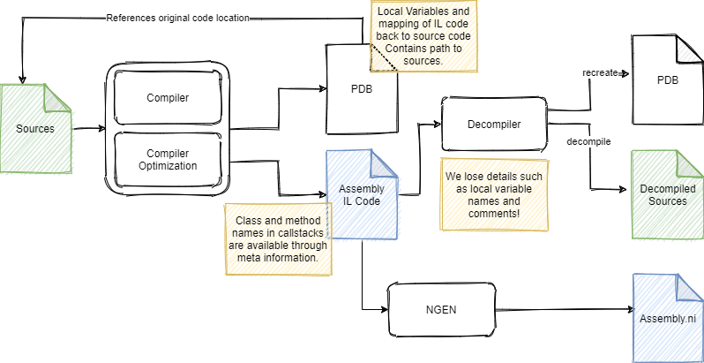
Debugging optimized release code 1/3
Notes:
Review symbol files and introduce optimization.
https://github.com/MicrosoftDocs/visualstudio-docs/tree/master/docs/debugger
PDB:
Source file names and their lines (Mapping IL code back to source code lines)
Local variable names
Code may look different. And we lose names of local variables. The compiler does not optimize very much.
Later the Jit Compiler does most of the optimization.

Slide 20
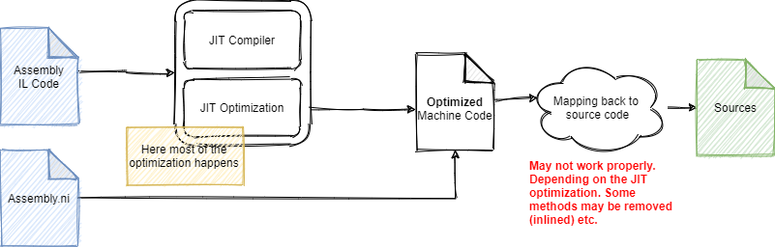
Debugging optimized release code 2/3
Notes:
The debugger may not evaluate some local variables.
They do not exist anymore. Also, whole methods may disappear in the callstack because they were inline.

Slide 21
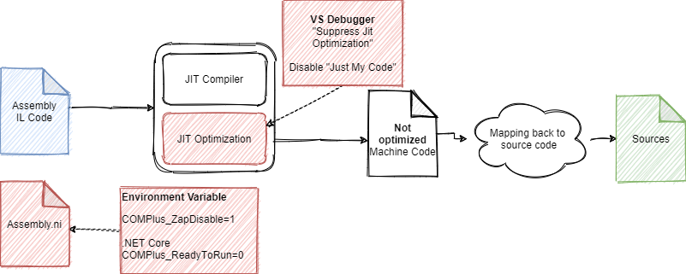
Debugging optimized release code 3/3
Notes:
Note
You can disable the JIT optimization per module by providing an *.ini file.
Could also be done via ini file. See Cheat Sheet: https://github.com/ATrefzer/WinDbg)
[.NET Framework Debugging Control]
GenerateTrackingInfo=1
AllowOptimize=0
„Just My Code“ must be disabled. Otherwise, symbol files for 3rd party libraries are not loaded, and Breakpoints do not hit.

Slide 22
Topics
Review PDB Files and problems with optimized release code
Prepare Visual Studio to debug 3rd party libraries.:
Option: Decompile IL Code
Option: Using Source Link
Demo

Slide 23
Relevant Optioins to decompile IL code
General
Add environment variables to disable native images
COMPlus_ZapDisable =1
COMPlus_ReadyToRun = 0 (Only .NET Core > 2.x)
In Visual Studio
Disable „Just my Code“
Otherwise no external PDBs are loaded
Enable „Suppress JIT optimization in module Load)
Disable again after debugging. May slow down debugging.
Do not attach but start with debugger
Notes:
If you attach with the debugger, some modules may have already been JIT compiled.
Visual Studio and Resharper provide the same function!
Resharper
Modules -> Load Symbols with ReSharper Decompiler. (F11 is possible)
In case of problems try Resharper „Process Explorer“ and click „Enable Debugging“
https://www.jetbrains.com/help/resharper/Debugging_Without_Source_Code.html#debugging
Studio:
Modules -> Decompile Sources to Symbol Files
Set function breakpoint. In Source not fund Page -> Decompile
Once decompiled: Modules -> Extract Source Code
https://docs.microsoft.com/de-de/visualstudio/debugger/decompilation?view=vs-2019
dnSpy: Out of the Box
Achtung Resharper greift vor wenn er Dateien bereits dekompiliert hat.
%LOCALAPPDATA%\JetBrains\Shared\vAny\DecompilerCache.
%LOCALAPPDATA%\Temp\.vsdbgsrc\5dd3dacd98f7bffc3213fc13bb9b5220ef99c7c6a3d307bd2459425e1655d9\Random.cs
%LOCALAPPDATA%\SourceServer\a66b5bcbb4748a3dbe1567c55c3cddff261b6b93a0ed637d0563e78a03ad7cb2\src\Prism.Core\Commands\DelegateCommand.cs

Slide 24
Topics
Review PDB Files and problems with optimized release code
Prepare Visual Studio to debug 3rd party libraries.:
Option: Decompile IL Code
Option: Using Source Link
Demo

Slide 25
What is Source link
Technology to embed meta information in the PDB files about the commit hash in a public source control repository
The debugger can download the correct source code version on the fly from the (public) repository.
Supported by Visual Studio, Jetbrains Rider.
Source Link is used by .NET Core Assemblies and an increasing number of NUGET packages.
Notes:
Früher: Source Server. Nicht mehr aktuell
Older .NET Frameworks require the „Enable .NET Framework source stepping“ options.
Beispiele: SICK GitLab Repositories
Modernere Variante, als source Server.
https://github.com/NuGetPackageExplorer/NuGetPackageExplorer
Open nuget package and see commit hash.

Slide 26
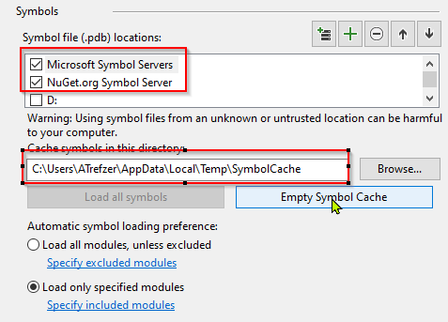
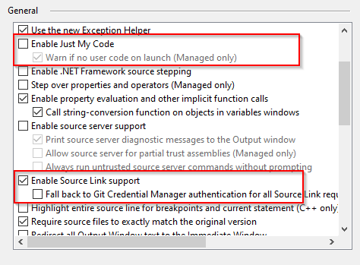
source link – Studio settings
Visual Studio Settings: Debug -> Options -> Debugging
Symbols General
Notes:
For older .NET Frameworks use Enable .NET Framework source stepping to download pdbs.
https://devblogs.microsoft.com/dotnet/improving-debug-time-productivity-with-source-link/
https://docs.microsoft.com/de-de/visualstudio/debugger/how-to-debug-dotnet-framework-source?view=vs-2019
Source Link is a technology that allows to add source code download information in pdb files.
Used by .NET Framework and more and more open-source packages.
The downloaded source code contains also the comments.

Slide 27
Topics
Review PDB Files and problems with optimized release code
Prepare Visual Studio to debug 3rd party libraries.:
Option: Decompile IL Code
Option: Using Source Link
Demo

