Slide 1
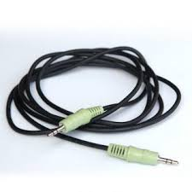
PC
Attiny85
Play wav file
Attiny85 with AudioBootLoader

