Slide 1
Plan
1 Complete evaluation (10 min)
2 Presentation of exam project
3 Enroll in groups and start exam project

Slide 2
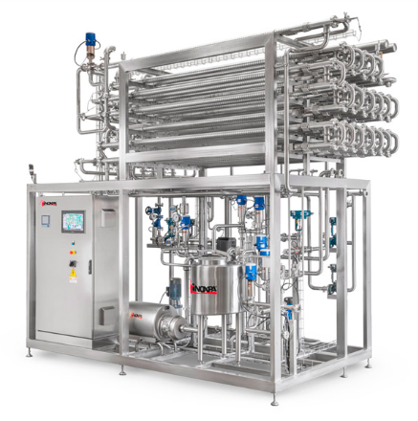
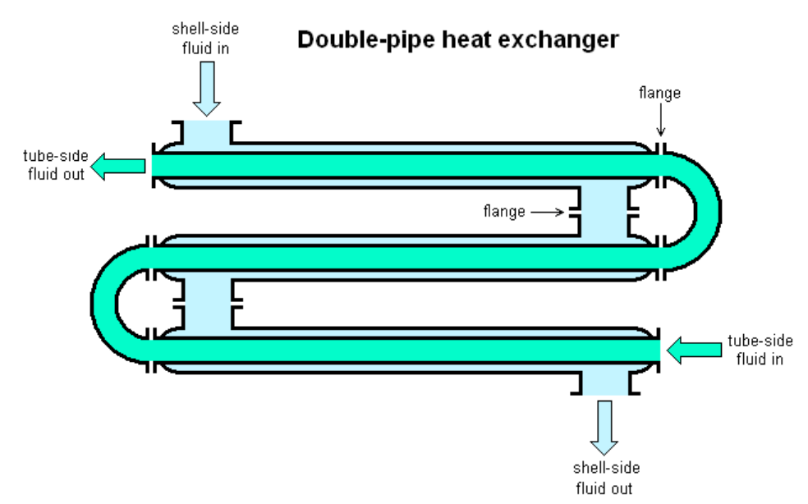
UHT process unit
Countercurrent pipe heat exchanger
Steam in
Milk out
Milk in
Steam /condensated water out

Slide 3
170 °C
Steam in
Where is heat transfered?
Milk out
? °C
144 m³/day
Depends on length of pipe
Milk in
20 °C
Inner Ø = 40 mm
Steam /condensated water out
170 °C

Slide 4
Help on project
Help from instructors/teachers until the 4th of Dec.
Solutions on old exercises (see tips)
Read description of project carefully (all info is there)
You can still perform well at exam despite code or model not working!
Deadline is 23th of Dec 11.59 PM

