Slide 1
Plan
Short intro to 2D models (5 min)
Exercise on 2D model with heat bed (1 hour)
Break (5-10 min)
Example of 2D model in COMSOL (10-20 minutes)

Slide 2
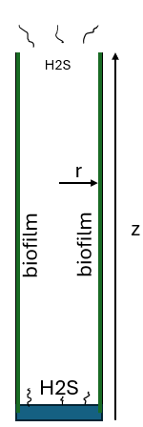
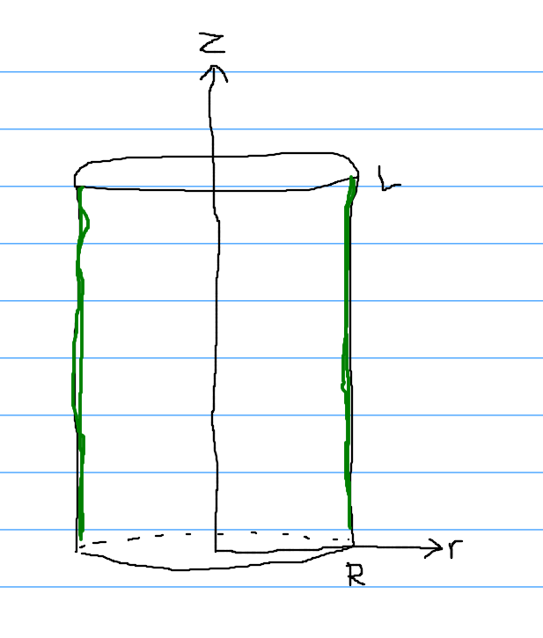
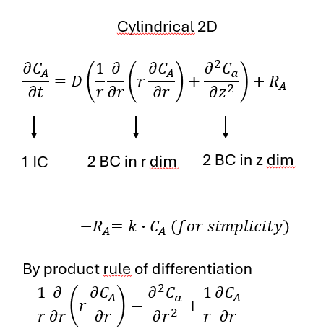
2D model example

Slide 3

solve_ivp() expects a 1D array, but we intuitively understand the problem as 2D
r
0 1 2 3
0 [0,0] [0,1] [0,2] [0,3]
1 [1,0] [1,1] [1,2] [1,3]
2 [2,0] [2,1] [2,2] [2,3]
3 [3,0] [3,1] [3,2] [3,3]
Before solve_ivp() call
2D array with np.zeros()
c_flat = c.flatten(order='F')
Inside ”rates” function
c_flat.reshape((Nz, Nr), order='F')
z
Make it ”flat” before solve_ivp()
0 1 2 3
0 [0,0] [0,1] [0,2] [0,3]
1 [1,0] [1,1] [1,2] [1,3]
2 [2,0] [2,1] [2,2] [2,3]
3 [3,0] [3,1] [3,2] [3,3]
0 1 2 3
0 [0,0] [0,1] [0,2] [0,3]
1 [1,0] [1,1] [1,2] [1,3]
2 [2,0] [2,1] [2,2] [2,3]
3 [3,0] [3,1] [3,2] [3,3]

Slide 4
Governing equation for diffusion only in 2D rectangular coordinates
Interior points: $\frac{∂C[i,j]}{∂t}=D (\frac{c\left[i+1, j\right]−2c\left[i, j\right]+c\left[i−1,j\right]}{∆z^{2}}+\frac{c\left[i, j+1\right]−2c\left[i, j\right]+c\left[i,j−1\right]}{∆r^{2}})$
z
robin
[Ni, Nj]
Ghost point top
Ni
At top:
$\frac{∂C[Ni, j]}{∂t}=D (\frac{c\left[Ni+1, j\right]−2c\left[Ni, j\right]+c\left[Ni−1,j\right]}{∆z^{2}}+\frac{c\left[Ni, j+1\right]−2c\left[Ni, j\right]+c\left[Ni,j−1\right]}{∆r^{2}})$
At right:
$\frac{∂C[i,Nj]}{∂t}=D(\frac{c\left[i+1, Nj\right]−2c\left[i, Nj\right]+c\left[i−1,Nj\right]}{∆z^{2}}+\frac{c\left[i, Nj+1\right]−2c\left[i, Nj\right]+c\left[i,Nj−1\right]}{∆r^{2}})$
robin
Ghost point right
top right corner:
$\frac{∂C[Ni,Nj]}{∂t}=D(\frac{c\left[Ni+1, Nj\right]−2c\left[Ni, Nj\right]+c\left[Ni−1,Nj\right]}{∆z^{2}}+\frac{c\left[Ni, Nj+1\right]−2c\left[Ni, Nj\right]+c\left[Ni,Nj−1\right]}{∆r^{2}})$
Ghost point top
Ghost point right
r
Nj

