Slide 1
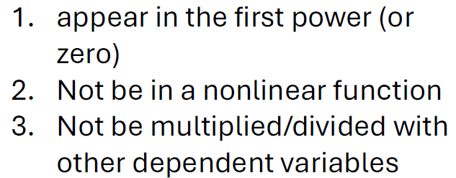
Algorithm for stability analysis
When is it linear?
Yes
Is the system linear?
No
dependent (state) variables must:
Determine equilibrium points/ steady state point by solving
du/dt = 0 (solution = u*)
Use fsolve
(se demos/fsolve.py)
Construct the A matrix in dudt = Au
Use np.array
Calculate the jacobian matrix and evaluate at equilibrium points
Use numdifftools.Jacobian
(se demos/jacobian.py)
Calculate eigenvalues of A
Use np.linalg.eigvals
Calculate eigenvalues of the jacobian evaluated at equilibrium points
Use np.linalg.eigvals
Look up meaning of eigenvalues

Slide 2
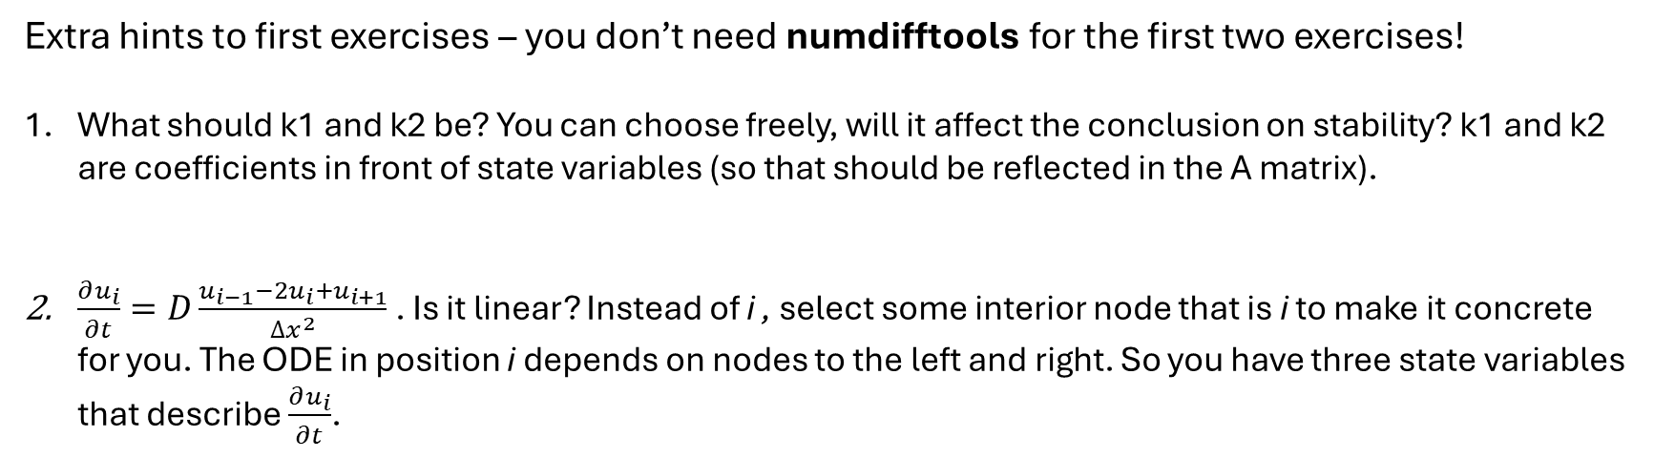
Extra hints to first exercises – you don’t need numdifftools for the first two exercises!
What should k1 and k2 be? You can choose freely, will it affect the conclusion on stability? k1 and k2 are coefficients in front of state variables (so that should be reflected in the A matrix).
$\frac{∂u_{i}}{∂t}=D\frac{u_{i−1}−2u_{i}+u_{i+1}}{∆x^{2}}$ . Is it linear? Instead of i , select some interior node that is i to make it concrete for you. The ODE in position i depends on nodes to the left and right. So you have three state variables that describe $\frac{∂u_{i}}{∂t}$.
[ ]
u2
u3
u4
i-1
i
i+1
du2dt
0
1
2
3
4
5
6
7
x
du3dt
BC node
BC node
interior nodes
du4dt
3. There is two equilibrium points here (see ”demos/fsolve.py” on how to find them). The interesting one is NOT [0,0]
4. Look in stability scheme from last lecture slides (last slide)
5. Recall that explicit euler formula is: $y\left[i+1\right]=y\left[i\right]+∆t ∙ \frac{dy[i]}{dt}$

Slide 3
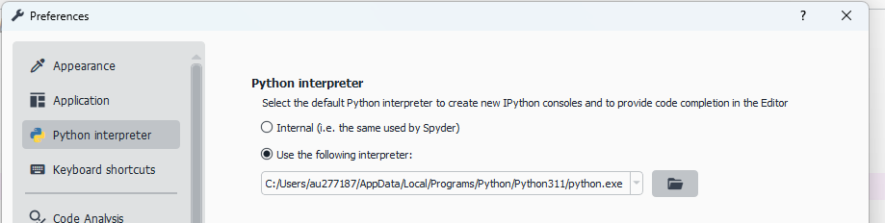
Spyder: numdifftools not installed!
In command prompt:
Install location needs to match with where spyder looks
If not you have two options:
Change path in spyder to the one shown in the command prompt
Change where you install packages
Use AI (e.g.) chatgpt. Be specific about your errors and your file locations when you talk with it. Give it the path shown in spyder and in the command prompt so it can give specific answer to you.

