Slide 1
Plan
Menti on 2D models 5-10 min
Some common pitfalls 5 min
Lecture on stability 15 min
Break 10 min
Exercises 1 hour

Slide 2



Slide 3
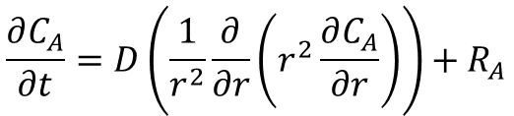
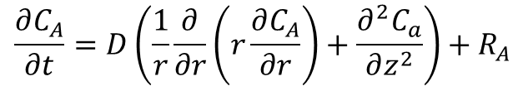
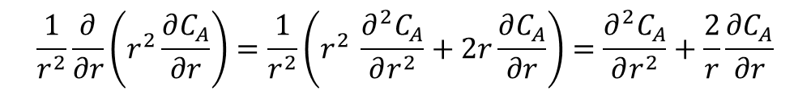
Some misunderstandings
Cylindrical 2D
Spherical 1D
$$\frac{∂C_{A}}{∂t}=D\left(\frac{1}{r}\frac{∂}{∂r}\left(r\frac{∂C_{A}}{∂r}\right)+\frac{∂^{2}C_{a}}{∂z^{2}}\right)+R_{A}$$
$$\frac{∂C_{A}}{∂t}=D\left(\frac{1}{r^{2}}\frac{∂}{∂r}\left(r^{2}\frac{∂C_{A}}{∂r}\right)\right)+R_{A}$$
r is NOT constant. Need to use product rule of differentiation
$$\frac{1}{r^{2}}\frac{∂}{∂r}\left(r^{2}\frac{∂C_{A}}{∂r}\right)=\frac{1}{r^{2}}\left(r^{2} \frac{∂^{2}C_{A}}{∂r^{2}}+2r\frac{∂C_{A}}{∂r}\right)=\frac{∂^{2}C_{A}}{∂r^{2}}+\frac{2}{r}\frac{∂C_{A}}{∂r}$$

Slide 4
What is advection!?
Movement of the bulk. Look for ”velocity, flow” in problem text.
Can advection occur in a solid material?
A mixer is stirring a reactor – is it advection?

Slide 5
Stability and stiffness
Modelling Fall 2025
Frederik Dalby

Slide 6
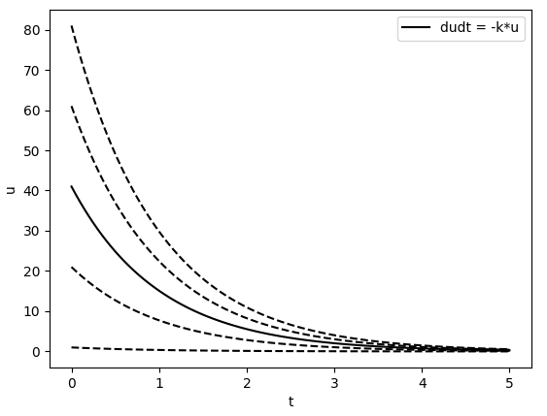
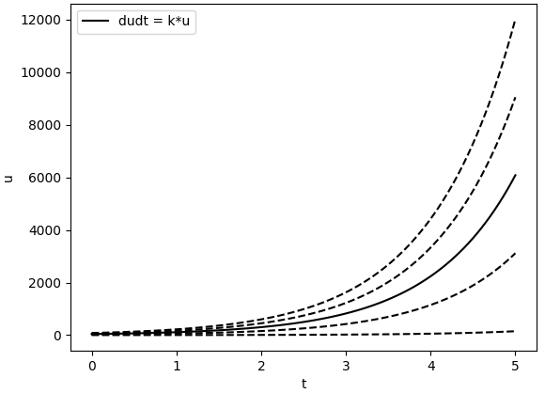




Stability of an ODE/ODE system
A solution is stable if every solution, which starts sufficiently close to the solution remains close to the solution for all t > t0
$$u(t)+δu(t)$$
$$u0 + δu0$$
Asymptotically stable
unstable
$$u0$$
$$u(t)$$

Slide 7
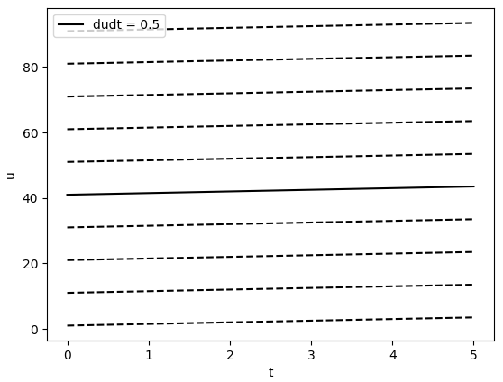
Stable (but not asymptotically)

Slide 8
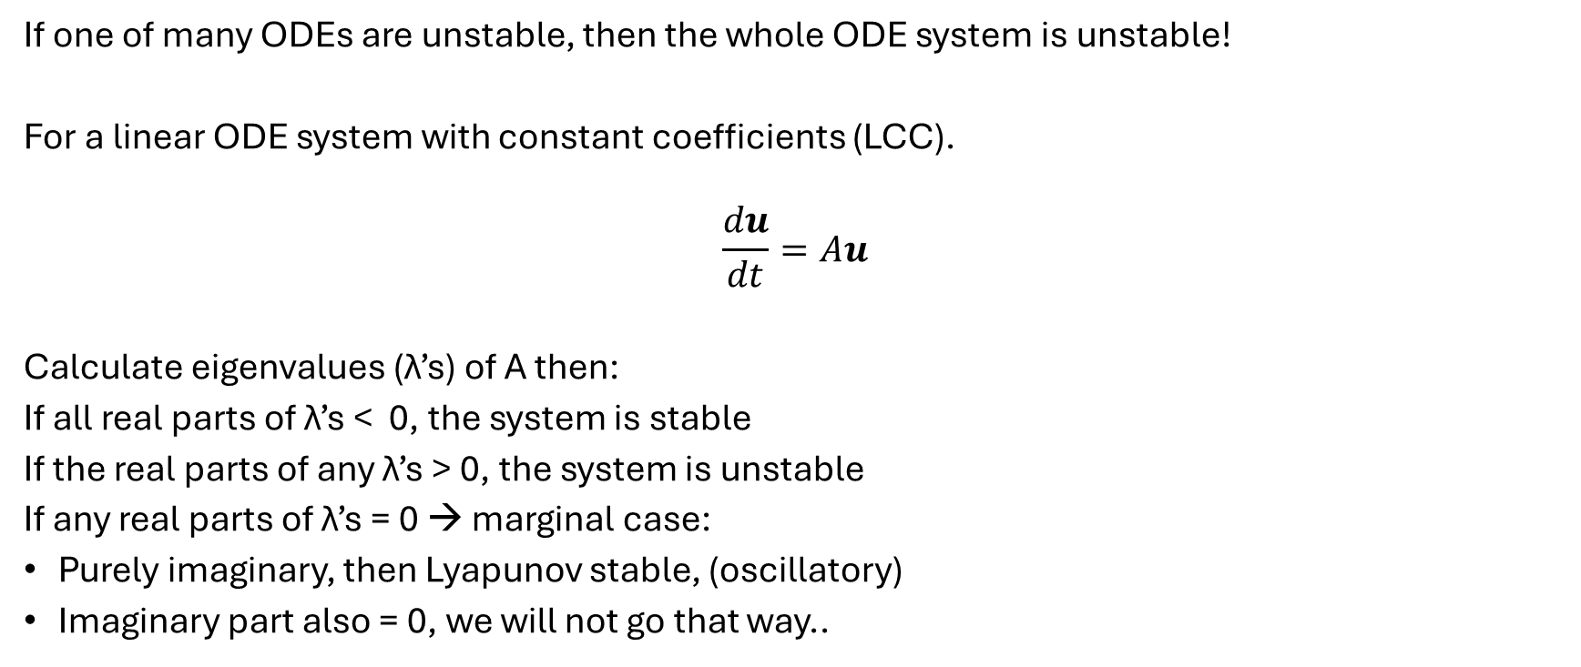
ODE system
If one of many ODEs are unstable, then the whole ODE system is unstable!
For a linear ODE system with constant coefficients (LCC).
$$\frac{du}{dt}=Au$$
Calculate eigenvalues (λ’s) of A then:
If all real parts of λ’s < 0, the system is stable
If the real parts of any λ’s > 0, the system is unstable
If any real parts of λ’s = 0 → marginal case:
Purely imaginary, then Lyapunov stable, (oscillatory)
Imaginary part also = 0, we will not go that way..
Python call is np.linalg.eigvals(A)

Slide 9
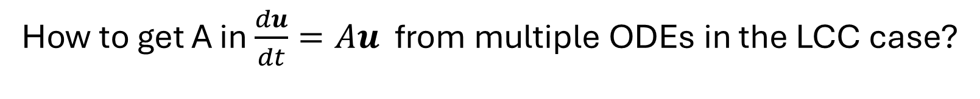
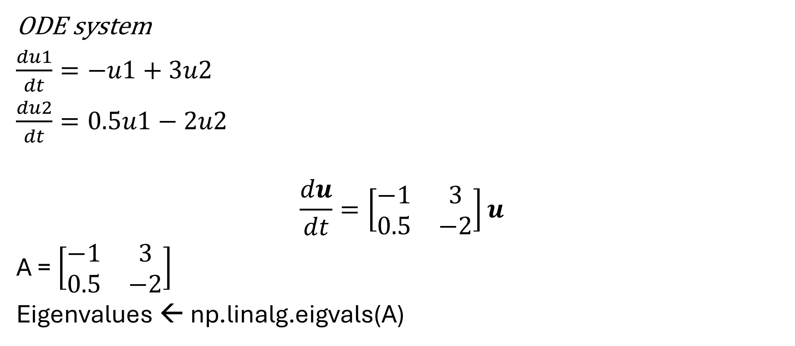
How to get A in $\frac{du}{dt}=Au$ from multiple ODEs in the LCC case?
ODE system
$\frac{du1}{dt}=−u1+3u2$
$\frac{du2}{dt}=0.5u1−2u2$
$$\frac{du}{dt}=\left[\begin{matrix}−1 & 3 \\ 0.5 & −2\end{matrix}\right]u$$
A = $\left[\begin{matrix}−1 & 3 \\ 0.5 & −2\end{matrix}\right]$
Eigenvalues ← np.linalg.eigvals(A)
Columns are coefficient in front of
u1
u2
du1/dt
Rows are the different ODEs
du2/dt

Slide 10
Stability in non-linear ODE systems

Slide 11
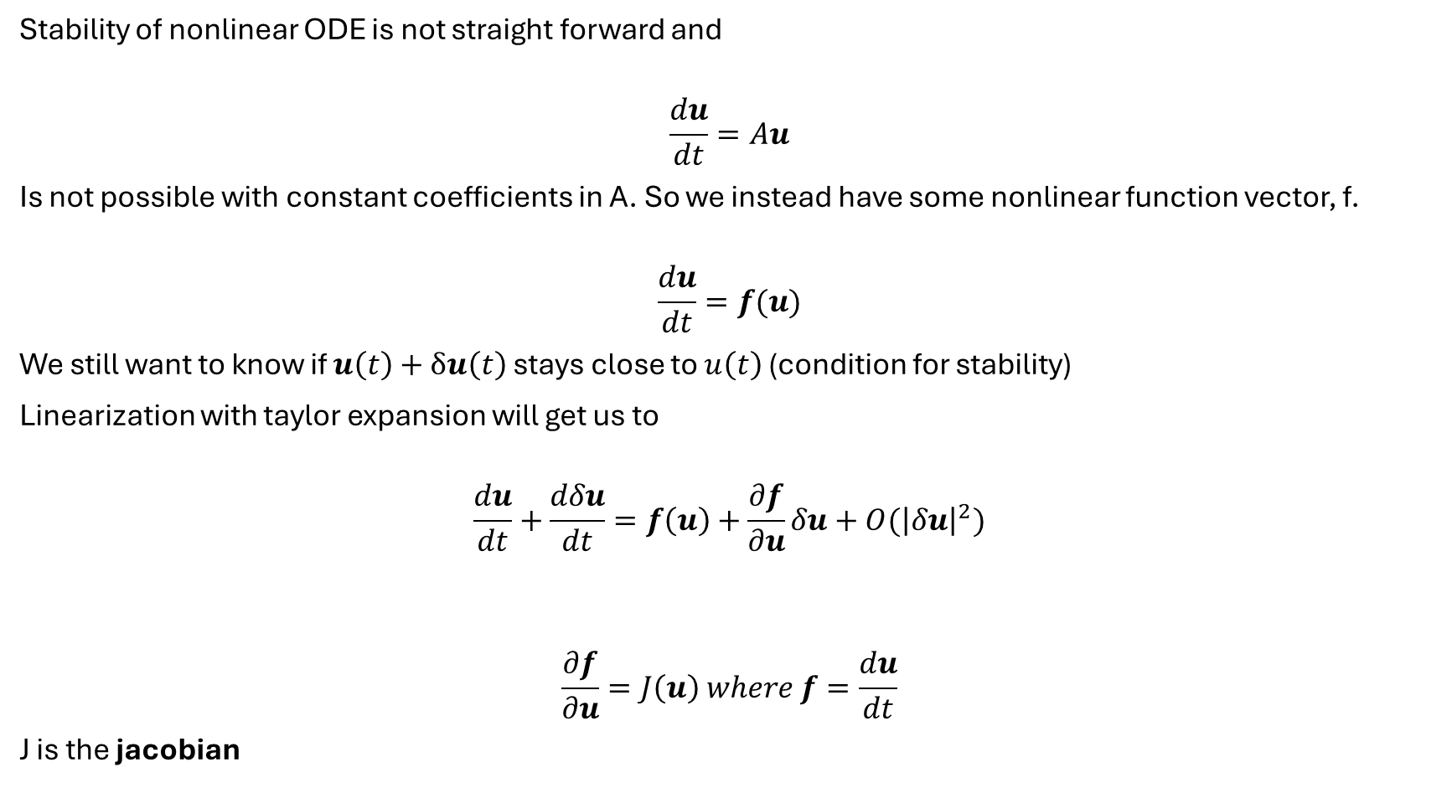
Stability of nonlinear ODE is not straight forward and
$$\frac{du}{dt}=Au$$
Is not possible with constant coefficients in A. So we instead have some nonlinear function vector, f.
$$\frac{du}{dt}=f(u)$$
We still want to know if $u\left(t\right)+δu\left(t\right)$ stays close to $u\left(t\right)$ (condition for stability)
Linearization with taylor expansion will get us to
$$\frac{du}{dt}+\frac{dδu}{dt}=f\left(u\right)+\frac{∂f}{∂u}δu+O({\left|δu\right|}^{2})$$
$$\frac{∂f}{∂u}=J\left(u\right) where f=\frac{du}{dt}$$
J is the jacobian

Slide 12

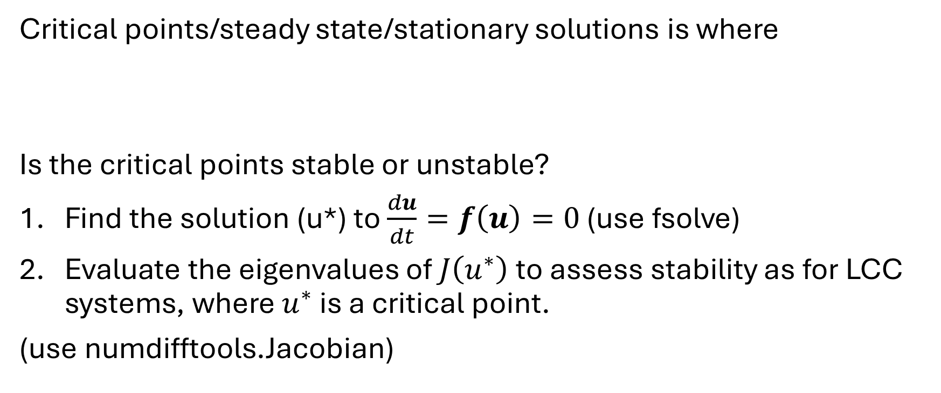
Stability of the nonlinear ODE system around critical points
Critical points/steady state/stationary solutions is where
Is the critical points stable or unstable?
Find the solution (u*) to $\frac{du}{dt}=f\left(u\right)=0$ (use fsolve)
Evaluate the eigenvalues of $J\left(u^{∗}\right)$ to assess stability as for LCC systems, where $u^{∗}$ is a critical point.
(use numdifftools.Jacobian)
$$\frac{du}{dt}=f\left(u\right)=0$$

Slide 13
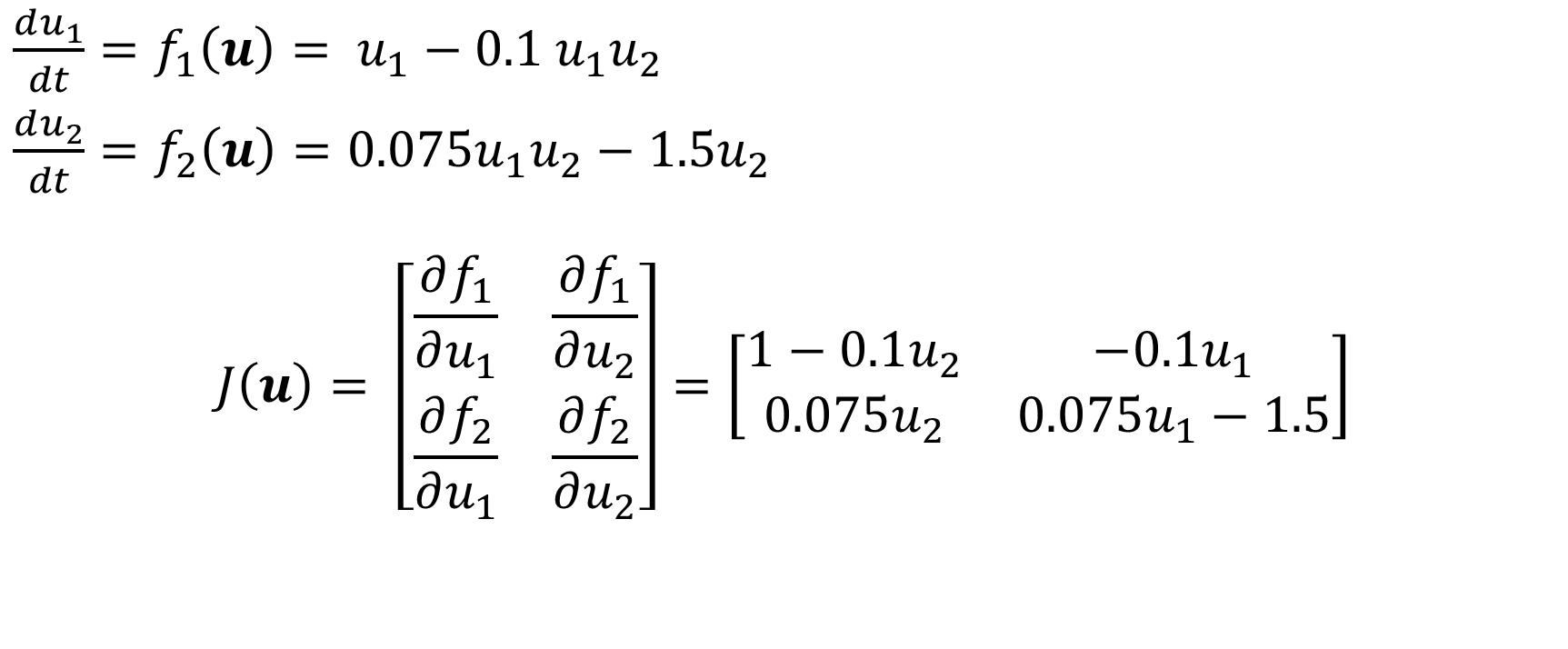

$$J\left(u\right)=\frac{∂f}{∂u} where f=\frac{du}{dt}$$
$\frac{du_{1}}{dt}=f_{1}\left(u\right)= u_{1}−0.1$ $u_{1}u_{2}$
$\frac{du_{2}}{dt}={f_{2}\left(u\right)=0.075u}_{1}u_{2}−1.5u_{2}$
$$J\left(u\right)= \left[\begin{matrix}\frac{∂f_{1}}{∂u_{1}} & \frac{∂f_{1}}{∂u_{2}} \\ \frac{∂f_{2}}{∂u_{1}} & \frac{∂f_{2}}{∂u_{2}}\end{matrix}\right]=\left[\begin{matrix}1−0.1u_{2} & −0.1u_{1} \\ 0.075u_{2} & 0.075u_{1}−1.5\end{matrix}\right]$$
Demonstration python

Slide 14
Stiffness in ODE solutions
Stable ODE system (from analytical point of view) can still result in unstable solution if care is not taken!
Stability of solution depends on both method of discretization and time integration method!
Some solvers with adaptive stepsize → avoid stability issue, but increase time to solve it
Stiffness ratio. Largest/smallest eigenvalue. Rule of thumb: above 1000 it is stiff

Slide 15
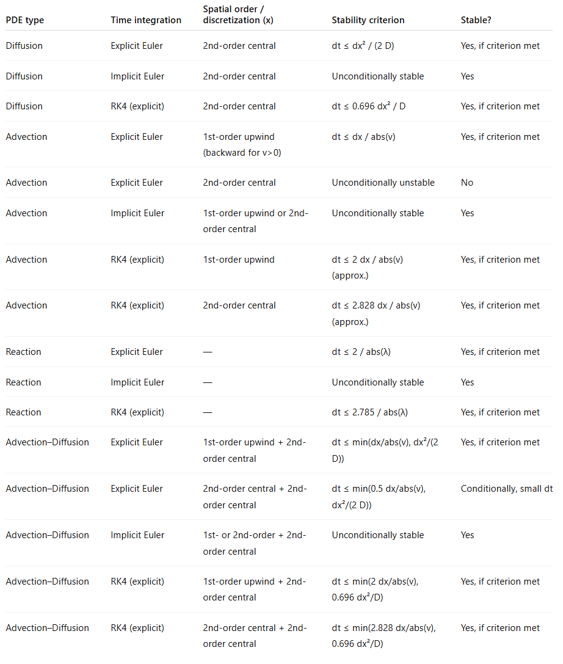
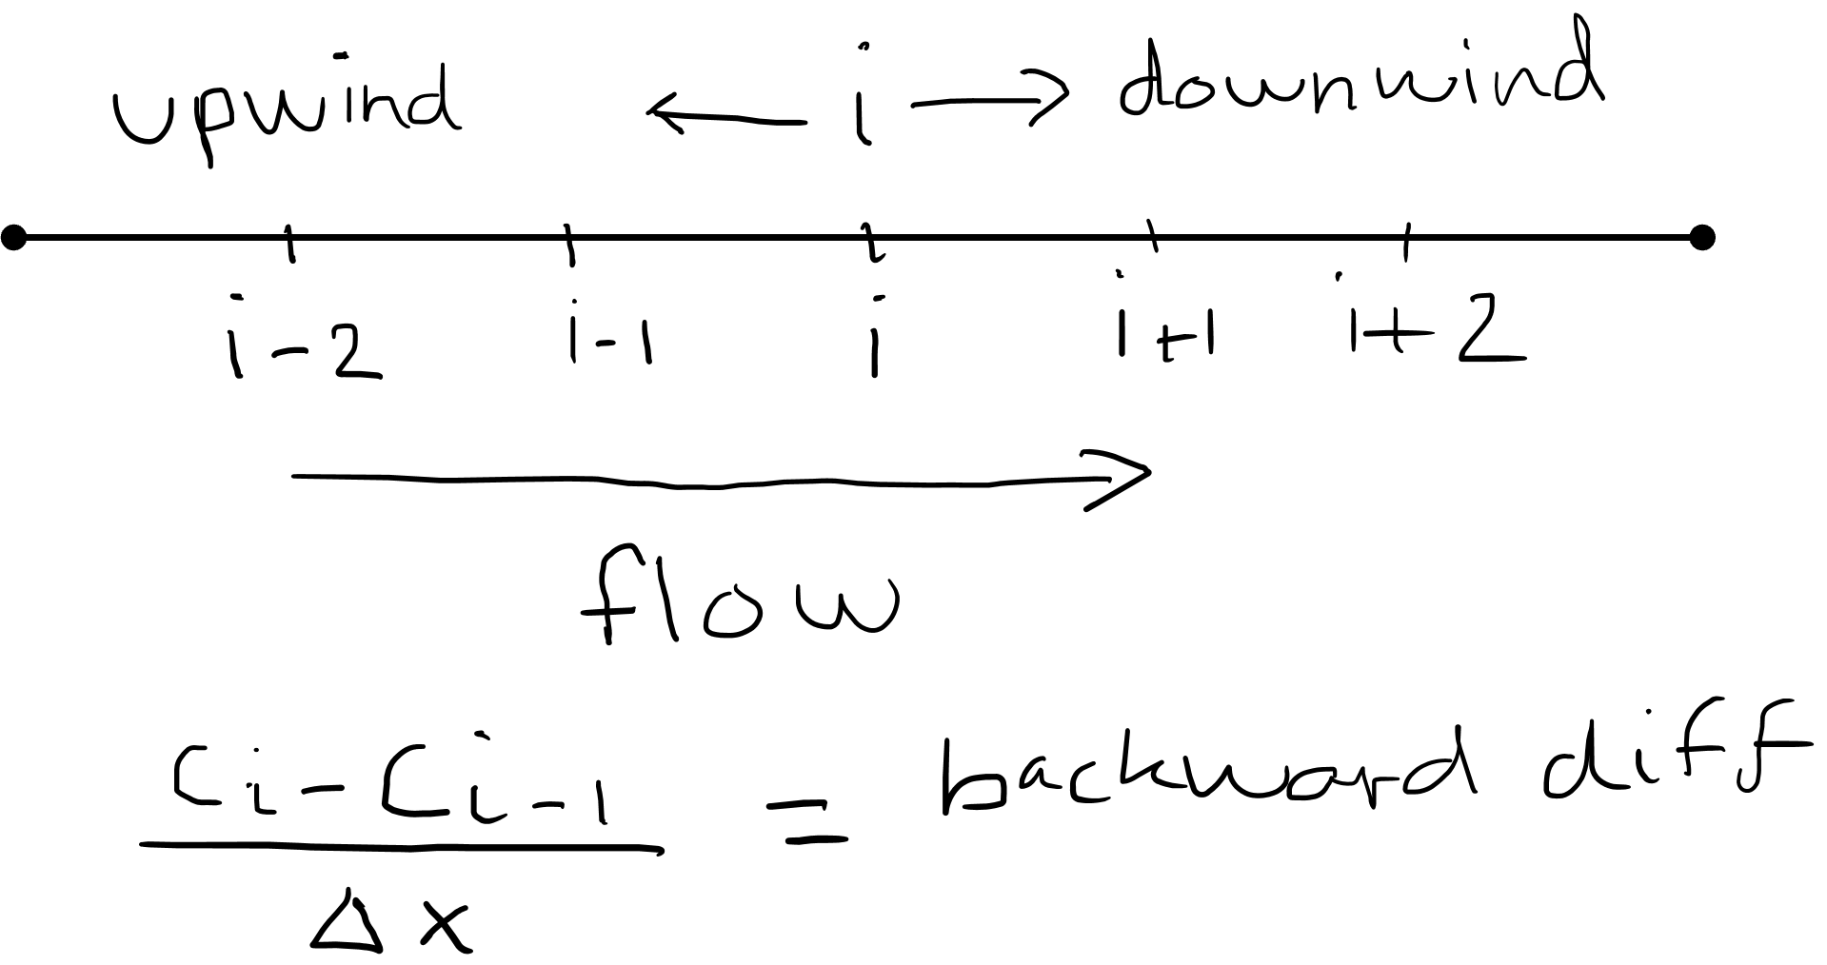
Upwind:when using finite difference, you have to use the method that includes the upwind state variable.

