Slide 1
Coupling mass and energy balance

Slide 2
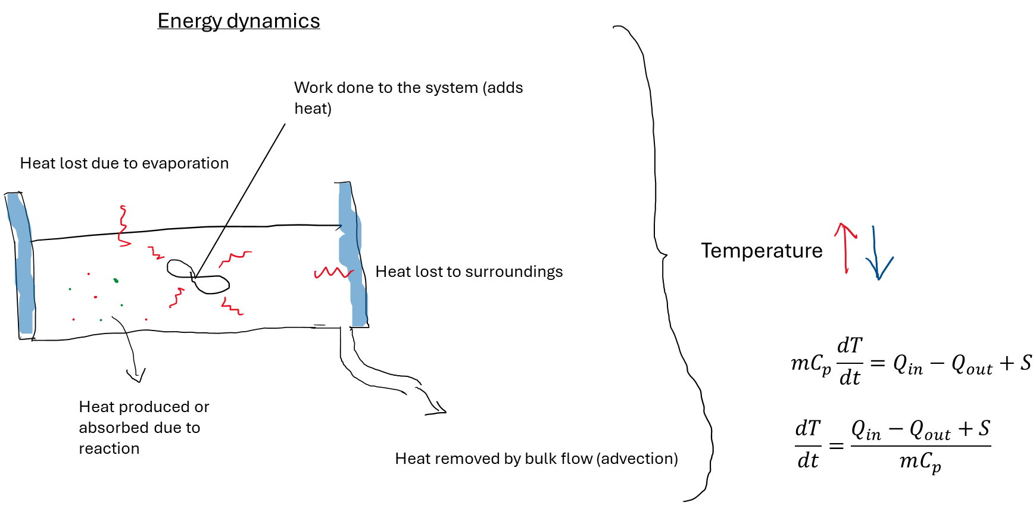

Slide 3
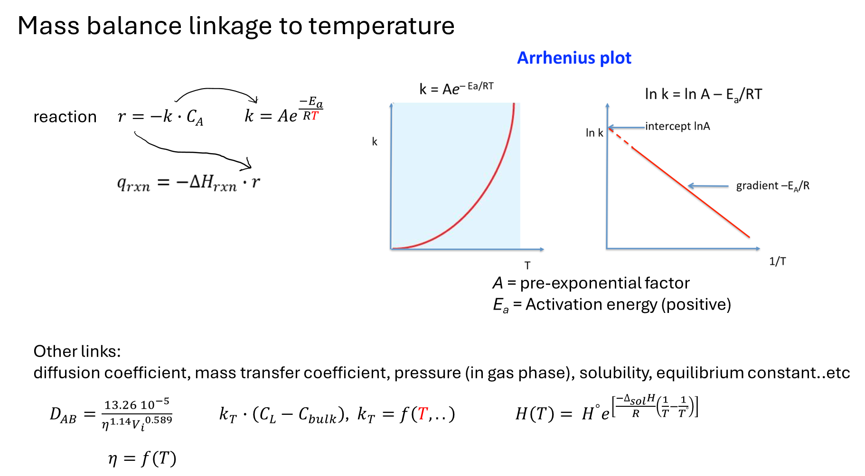

Slide 4
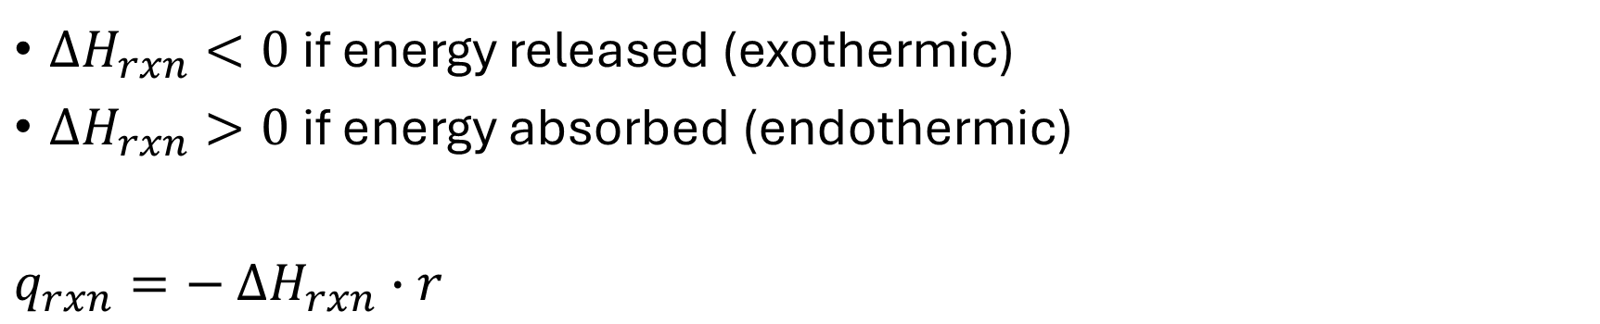
$∆H_{rxn}<0$ if energy released (exothermic)
$∆H_{rxn}>0$ if energy absorbed (endothermic)
$q_{rxn}=−$ $∆H_{rxn}∙r$
positive
Discuss with classmate
How does an irreversible exothermic reaction affect q_{rxn} and r and the system as a whole?
How does an irreversible endothermic reaction affect q_{rxn} and r and the system as a whole?

Slide 5





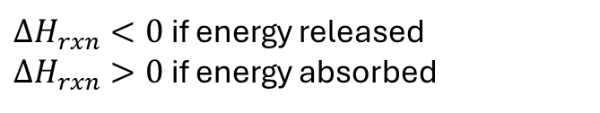



Batch reactor, first order reaction, tracing only reactant A, where A → B and the reaction generates energy (exothermic reaction!)
mass balance of A
Conservation equation:
Constitutive equation:
Governing equation:
$$acc=in −out+generated −consumed$$
$$r=k∙C_{A}$$
r: $\frac{mass}{volume time}$, k: $\frac{1}{time},C_{A}: \frac{mass}{volume}$
$$k=Ae^{\frac{−E_{a}}{RT}}$$
$$\frac{{dM}_{A}}{dt}=−rV$$
$\frac{dM_{A}}{dt}$: $\frac{mass}{time}$
energy balance
Conservation equation:
Constitutive equation:
Governing equation:
$$acc=in −out+generated −consumed$$
$q_{rxn}$: $\frac{J}{volume time}$, $∆H_{rxn}$: $\frac{J}{mass}, r:\frac{mass}{volume time}$
$$q_{rxn}=−∆H_{rxn}·r$$
$${m∙C}_{p}\frac{dT}{dt}=q_{rxn}V$$
$∆H_{rxn}<0$ if energy released
$∆H_{rxn}>0$ if energy absorbed
Tip: Sometimes generated and consumed is just condensed to ”S”, which stands for ”source”.
S basicly represents all the stuff that is not from heat advection and heat diffusion!
Example: heat removed or added from jacket, agitation, evaporation, heat from reaction, heat of fusion…

Slide 6
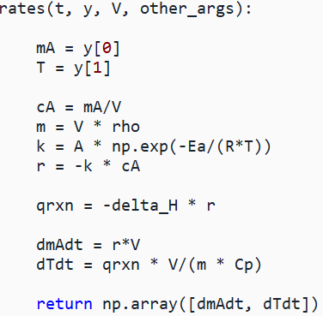
In 0D:
Mass balance of A + heat balance → 2 state variables
Pseudo code

Slide 7







In 1D : Mass balance of A at x positions + heat balance at x positions → two state variables x positions (mini project 2).
Governing equation:
Constitutive equation:
Governing equation final
Mass balance
$$\frac{∂C_{A}}{∂t}=D\frac{∂^{2}C_{A}}{{∂x}^{2}} −v\frac{∂C_{A}}{dx}−r$$
$$r=k∙C_{A}$$
$$k=Ae^{\frac{−E_{a}}{RT}}$$
$$\frac{∂C_{A}}{∂t}=D\frac{∂^{2}C_{A}}{{∂x}^{2}}−k∙C_{A}$$
No heat advection
Energy balance
Conservation equation:
Constitutive equation:
Governing equation:
$$ρC_{p}\frac{∂T}{∂t}=k\frac{∂^{2}T}{{∂x}^{2}} −v\frac{∂T}{dx}+S$$
$${S= q}_{rxn}=−∆H_{rxn}·r$$
$\frac{∂T}{∂t}=$ $\frac{k}{ρC_{p}}\frac{∂^{2}T}{{∂x}^{2}}+\frac{q_{rxn}}{ρC_{p}}$

Slide 8
Discuss with a classmate
You have 3 chemical species and a heat balance that you want to track in a model. You remember this from a quick glitch at the code.
x_grid = np.arange(0, 1 + 0.1, 0.1) # meters
tmax = 100 # seconds
sol = solve_ivp(…..t_eval = np.linspace(0, tmax, 50))
What is the dimensions of the sol.y? (approximately)
What does sol.y[16, 25] most likely represent? (approximately)
Notes:
A) 4 species * 11 positions = 44 rows in sol.y, linspace says 50 time points, so 50 columns in sol.y. B) species 2 at position around 0.5 m and after ca. 50 seconds.

Slide 9
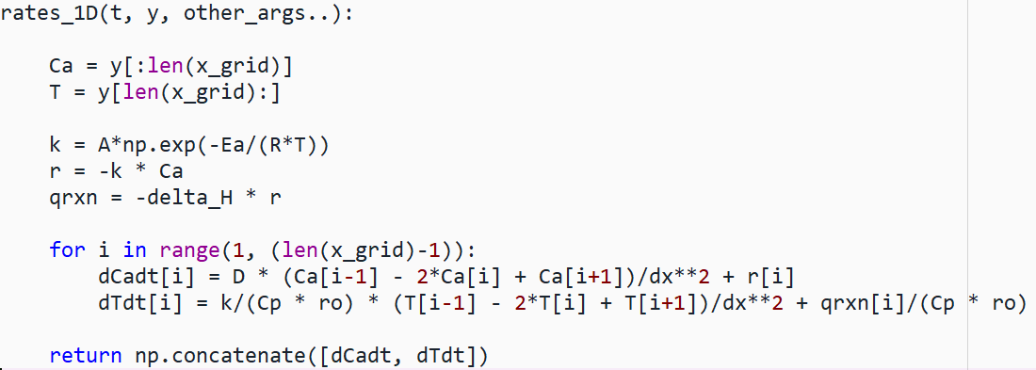
Pseudo code (without BCs)
Could also be in loop with indexing directly
The 1D version is on concentration basis.
Integration (e.g. trapz method over space) of output gives you the total mass in system! (Like in mini project2)

