Slide 1
Model formulation
27/08/2026

Slide 2
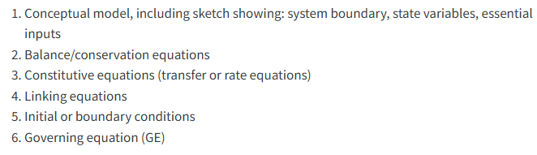
Steps in model formulation

Slide 3
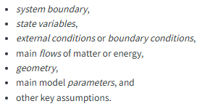
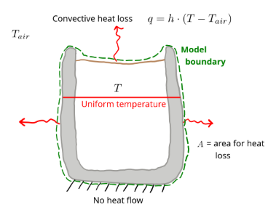
Making the conceptual model

Slide 4
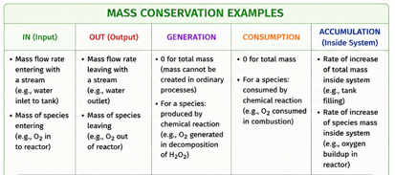
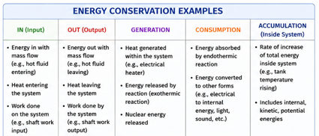

Mass and energy conservation
For mechanistic and physically-based models
Balance equation or general conservation equation
Accumulation = In – Out + Generation - Consumption
Rate of change $(\frac{dy}{dt})$
Special case
In and Out cross the system boundary.
Generation and consumption occurs within the boundary
0 = In – Out + Generation - Consumption

Slide 5
In??
Out??
Generation??
Consumption??

Slide 6
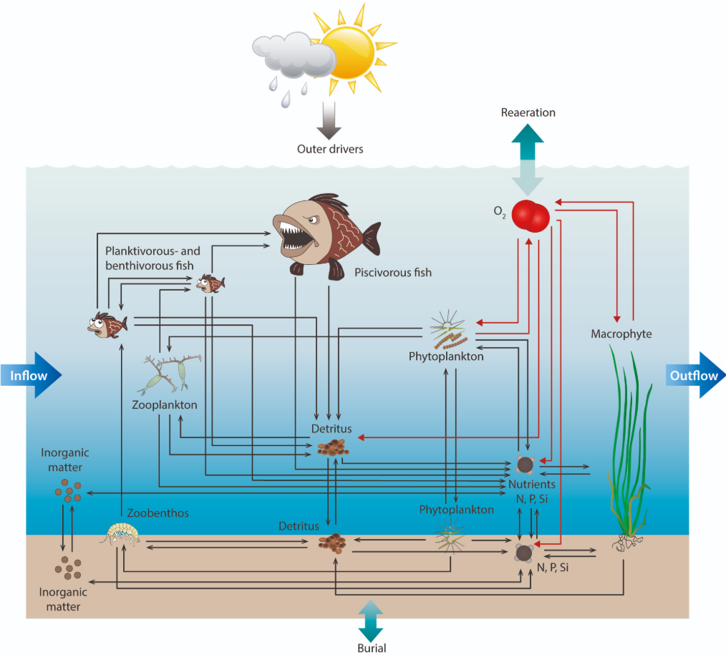

The WET model
Multiple species
Multiple domains
Species × domains = N state variables
Must have N conservation equations!
Consumption from
water domain
Generation from water domain
In from sediment domain
Out from water domain to sediment

Slide 7
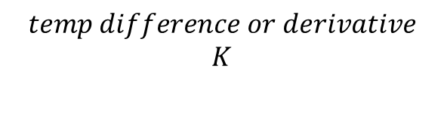
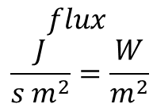
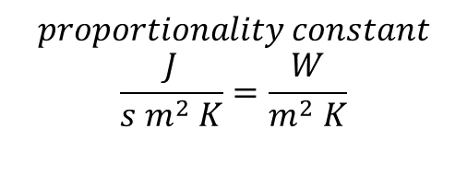
Constitutive equations
Substituting physical laws (Chapter 4, 5, 6) into the conservation equation
Accumulation = – Out
Newtons law of cooling
What physical phenomena drives ”Out”?
It is heat transfer by convection!
$$flux$$
$$\frac{J}{s m^{2}}=\frac{W}{m^{2}}$$
Newtons law of cooling
$$proportionality constant$$
$$\frac{J}{{s m}^{2} K}=\frac{W}{m^{2} K}$$
$$temp difference or derivative$$
$$K$$

Slide 8
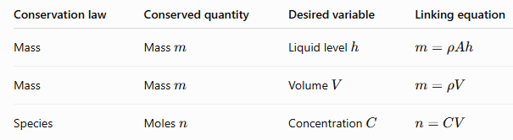



Linking equations
Energy conservation equation, but temperature as state variable → we need to link them
$$accumulation=−out$$
$$∆Q$$
$$h∙(T_{s}−T_{∞})$$
$$Q= c_{p}∙m∙T$$
Other relevant linking equations

Slide 9
Governing equation
Assemble everything into the final differential equation that has to be solved
$$accumulation=in−out+generation −consumption$$
1. Eliminate terms
$accumulation=−out$
2. Substitute laws
$accumulation=−h∙(T_{s}−T_{∞})$
3. Add derivative and fix unit accordingly
$\frac{dQ}{dt}=−A ·h∙(T_{s}−T_{∞})$
4. Apply linking equations if needed
$c_{p}∙m∙\frac{dT}{dt}=−A ·h∙(T_{s}−T_{∞})$
5. Rearrange
$\frac{dT}{dt}=\frac{−A·h}{c_{p}∙m}∙(T_{s}−T_{∞})$
Arrive at Governing equation (GE)

