Slide 1
Coupling mass and energy balance

Slide 2
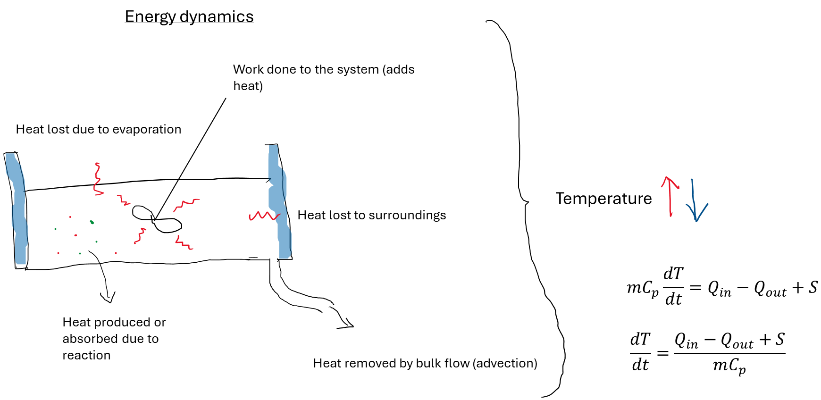

Slide 3
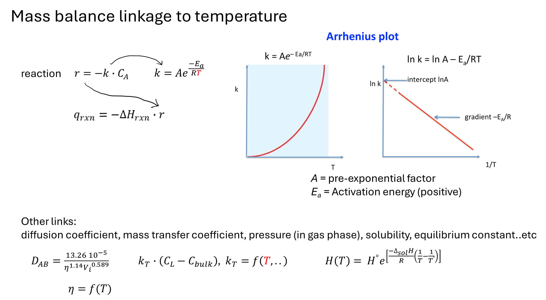

Slide 4
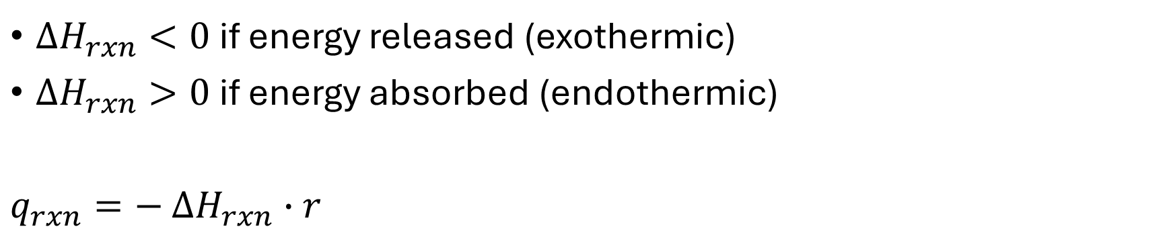
$∆H_{rxn}<0$ if energy released (exothermic)
$∆H_{rxn}>0$ if energy absorbed (endothermic)
$q_{rxn}=−$ $∆H_{rxn}∙r$
Discuss with classmate
How does an irreversible exothermic reaction affect q_{rxn} and r and the system as a whole?
How does an irreversible endothermic reaction affect q_{rxn} and r and the system as a whole?

Slide 5





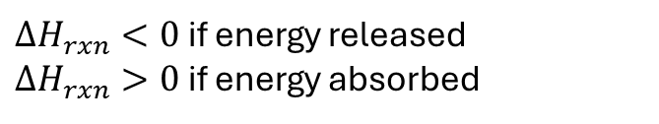



Batch reactor, first order reaction, tracing only reactant A, where A → B and the reaction generates energy (exothermic reaction!)
mass balance of A
Conservation equation:
Constitutive equation:
Governing equation:
$$acc=in −out+generated −consumed$$
$$r=k∙C_{A}$$
r: $\frac{mass}{volume time}$, k: $\frac{1}{time},C_{A}: \frac{mass}{volume}$
$$k=Ae^{\frac{−E_{a}}{RT}}$$
$$\frac{{dM}_{A}}{dt}=−rV$$
$\frac{dM_{A}}{dt}$: $\frac{mass}{time}$
energy balance
Conservation equation:
Constitutive equation:
Governing equation:
$$acc=in −out+generated −consumed$$
$q_{rxn}$: $\frac{J}{volume time}$, $∆H_{rxn}$: $\frac{J}{mass}, r:\frac{mass}{volume time}$
$$q_{rxn}=−∆H_{rxn}·r$$
$${m∙C}_{p}\frac{dT}{dt}=q_{rxn}V$$
$∆H_{rxn}<0$ if energy released
$∆H_{rxn}>0$ if energy absorbed
Tip: Sometimes generated and consumed is just condensed to ”S”, which stands for ”source”.
S basicly represents all the stuff that is not from heat advection and heat diffusion!
Example: heat removed or added from jacket, agitation, evaporation, heat from reaction, heat of fusion…

Slide 6
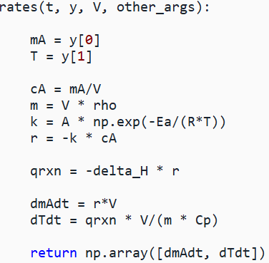
In 0D:
Mass balance of A + heat balance → 2 state variables
Pseudo code
-

Slide 7







In 1D : Mass balance of A at x positions + heat balance at x positions → two state variables x positions
Governing equation:
Constitutive equation:
Governing equation final
Mass balance
$$\frac{∂C_{A}}{∂t}=D\frac{∂^{2}C_{A}}{{∂x}^{2}} −v\frac{∂C_{A}}{dx}+R$$
$$−R=r=k∙C_{A}$$
$$k=Ae^{\frac{−E_{a}}{RT}}$$
$$\frac{∂C_{A}}{∂t}=D\frac{∂^{2}C_{A}}{{∂x}^{2}}−k∙C_{A}$$
No heat advection
Energy balance
Conservation equation:
Constitutive equation:
Governing equation:
$$ρC_{p}\frac{∂T}{∂t}=k\frac{∂^{2}T}{{∂x}^{2}} −v\frac{∂T}{dx}+S$$
$${S= q}_{rxn}=−∆H_{rxn}·r$$
$\frac{∂T}{∂t}=$ $\frac{k}{ρC_{p}}\frac{∂^{2}T}{{∂x}^{2}}+\frac{q_{rxn}}{ρC_{p}}$

Slide 8
Discuss with a classmate
You have 3 chemical species and a heat balance that you want to track in a model. You remember this from a quick glitch at the code.
x_grid = np.arange(0, 1 + 0.1, 0.1) # meters
tmax = 100 # seconds
sol = solve_ivp(…..t_eval = np.linspace(0, tmax, 50))
What is the dimensions of the sol.y? (approximately)
What does sol.y[16, 25] most likely represent? (approximately)
Notes:
A) 4 species * 11 positions = 44 rows in sol.y, linspace says 50 time points, so 50 columns in sol.y. B) species 2 at position around 0.5 m and after ca. 50 seconds.

Slide 9
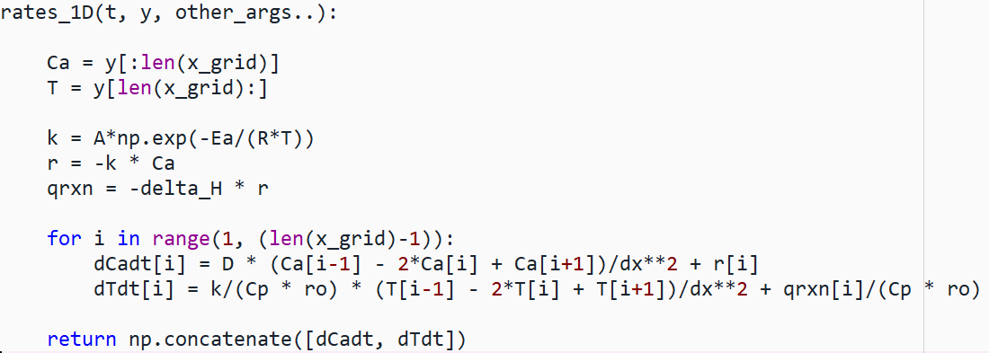
Pseudo code (without BCs)
Could also be in loop with indexing directly
-
The 1D version is on concentration basis

