Slide 1
Review and tips for group exercises

Slide 2
Remember the algorithm for 1D problems
Choose coordinate system based on geometry of your model domain
What are your assumptions about mass and energy transport (directions for different modes of transfer)?
Eliminate terms starting from the PDE GEs in the book/slides
Consider how many and which BCs and ICs you need!
Discretize your problem in python, handle BCs separately (outside loop if needed)
Make a plot so you can answer the actual question for the problem

Slide 3
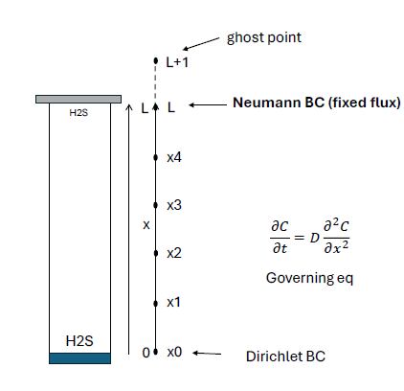
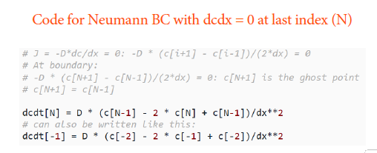
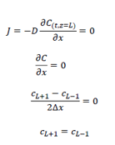
Neumann BC

Slide 4
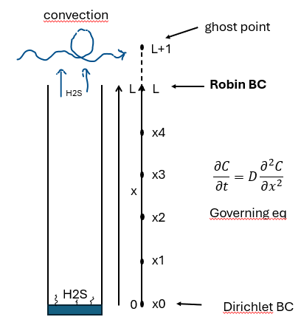
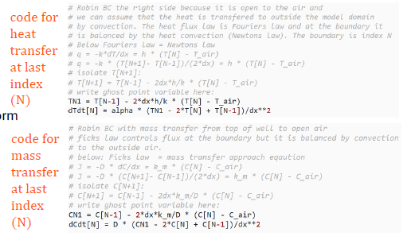
Robin BC

Slide 5
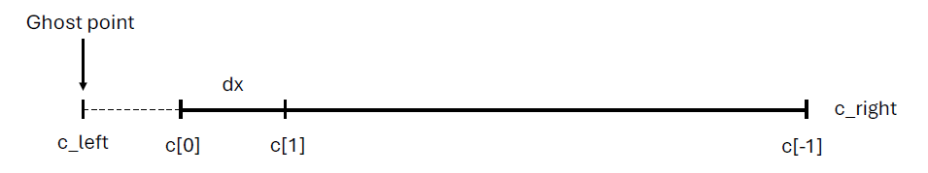
What happens when we change dx?
Ghost point
Control volumes/cells
dx
c_left
c[0]
c[1]
c[-1]

Slide 6
Multiple state variables
Numeric analysis: system of ODEs representing multiple chemical species (0D)
c0 = np.array([10, 0, 0])
c0 = np.array([10, 0, 0],
[0, 0, 0],
[0, 0, 0])
Initial condition is a 1D array passed to solve_ivp() and rates()
A
B
C
Position 0 m
Position 1 m
Initial condition is a 2D array!
Cannot be passed to solve_ivp() and rates
Position 2 m
A
B
C

Slide 7
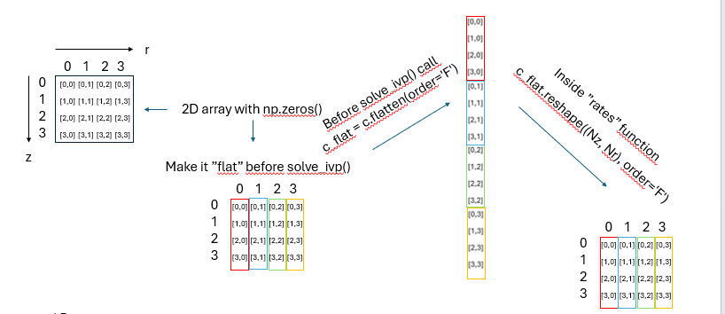
Flatten and reshape in python
State variables
Spatial dimension
Inside ”rates” function
c_flat.reshape((N_{nodes}, N_{state vars}) order = ‘F’)
1D array
1D array
Alternative:
np.concatenate((CA_0, CB_0))

