Slide 1
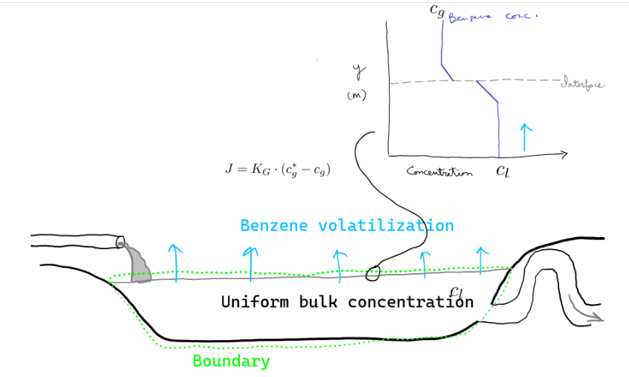
Mini project 1
NH₃
Pay attention to:
Mass transfer from liquid to air phase (liquid or gas phase units?), tips doc
Urea hydrolysis rate constant? See Appendix G, G.3
Mass transfer coefficient? See Appendix G, G.1 + tips doc

