Slide 1
Notes from last time on model formulation
Linking equations are not always needed!
The salt water problem did not have any ”reel” constitutive equations?
The slurry cooling problem had two state variables (m, T)
Two state variables → two conservation equations → two governing equations
You choose units, as long as they match. Heat and mass transfer coefficient units can be derived by unit analysis

Slide 2
Solving and implementing models
31-08-2026

Slide 3
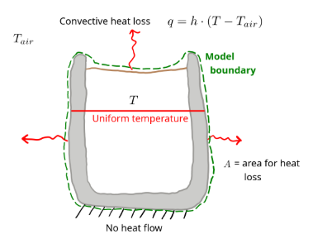

Methods for solving models numerically
Governing equation for the coffee cup example
$$\frac{dT}{dt}=−\frac{A∙h}{m∙c_{p}}∙\left(T−T_{air}\right)$$
We now need to solve it. And ODE like that is solved by integration
Numerically
Analytically

Slide 4







Analytically
It is a first order ODE! → We can solve it analytically
$$\frac{dT}{dt}=−\frac{A∙h}{m∙c_{p}}∙\left(T−T_{air}\right)$$
constant
Separating variable and integrate
State variable
substitute
constant
$$θ=(T−T_{air})$$
$$k=\frac{A ∙ h}{c_{p} ∙ m}$$
$$\frac{dθ}{dt}=−k∙θ$$
$$θ=θ_{0}∙e^{−k ∙t}$$
You should be able to recognize a first order ODE and memorize its solution!

Slide 5

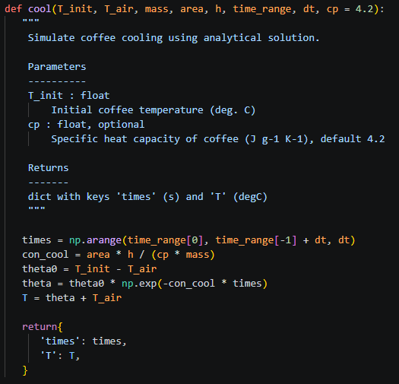



Implement the model in python
$$\frac{dT}{dt}=−\frac{A∙h}{m∙c_{p}}∙\left(T−T_{air}\right)$$
Import packages first
$$θ=θ_{0}∙e^{−k ∙t}$$
Define function + input arguments
$$θ_{0}=T_{0}−T_{air}$$
Document your model using ”””
Function containing your model
Analytical solution of governing ODE + solve call
Return output variables as dictionary

Slide 6
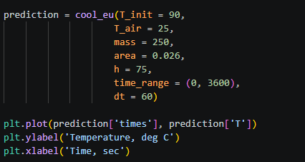
Call your model function with desired inputs
Plot output

Slide 7
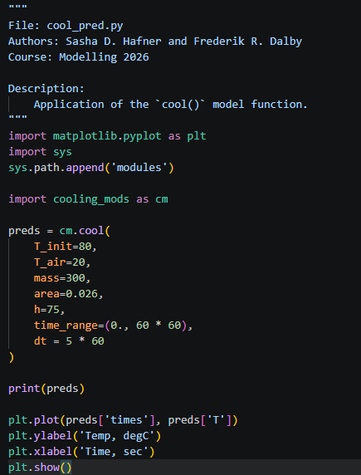
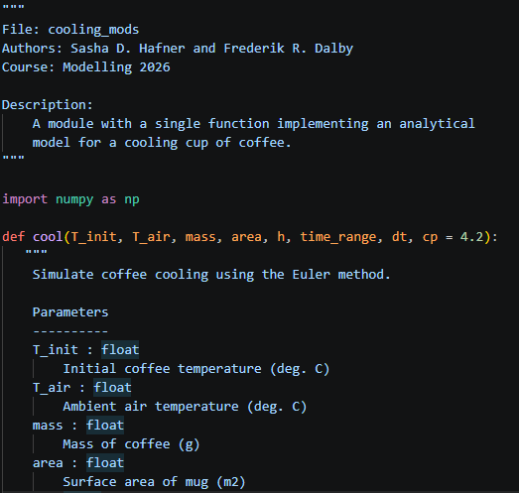
Using modules instead of single script
Rather than a single script (as in the previous slides)
Save your model function code separately
Load and call that modle from another script
Keeps things
clean, separated, easier to read
Filename
Call model function name as function within cm module
Model filename
Loading model filename as ”cm”
(like when you import packages like numpy as ”np”)
Model function name

Slide 8
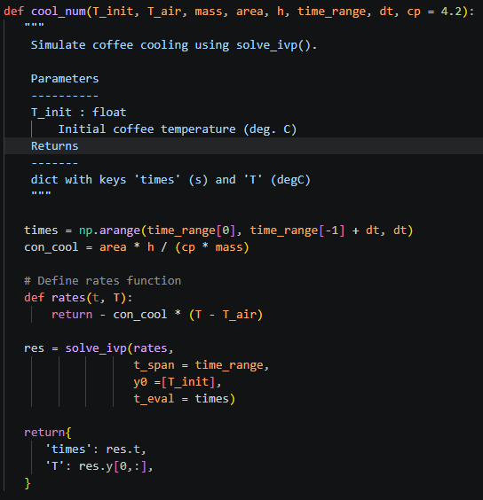
A numerical model
Same procedure, but expand model function
with rates() and solve_ivp() call

Slide 9
Tips for implementing
Start with everything in same script
Make sure it works → then separate in model and prediction files
Modifying the one file might not be updated in other script.
Restart session or use the importlib.reload function

