Slide 1
Model classification
Modelling Fall 2026
Frederik Dalby

Slide 2
Why do we need to classify models?
How can we solve it?
How does the output look?
What assumptions can be made?
How much can we trust it?
Can we use it to understand underlying mechanisms?

Slide 3


Examples of model descriptions in litterature

Slide 4
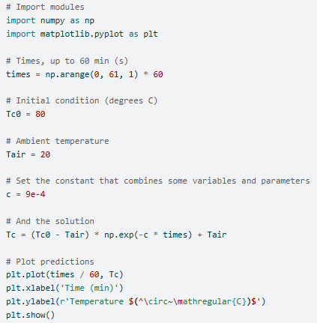
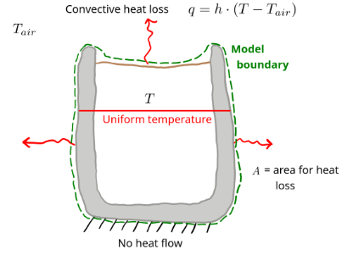


Stages in model development
Conceptual
Mathematical model
Computer model
Model development

Slide 5

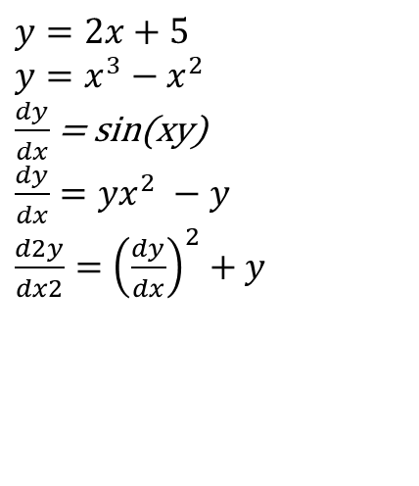
Linear vs nonlinear model
The dependent variable must:
appear in the first power (or zero)
Not be in a nonlinear function
Not be multiplied/divided with other dependent variables
$y=2x+5$
$$y=x^{3}−x^{2}$$
$\frac{dy}{dx}$= sin(xy)
$\frac{dy}{dx}=yx^{2} −y$
$\frac{d2y}{dx2}={\left(\frac{dy}{dx}\right)}^{2}+y$
Nonlinear
Notes:
Mentimeter quiz. Use actual equations that represent real systems? Look into definition in Dutta book.

Slide 6
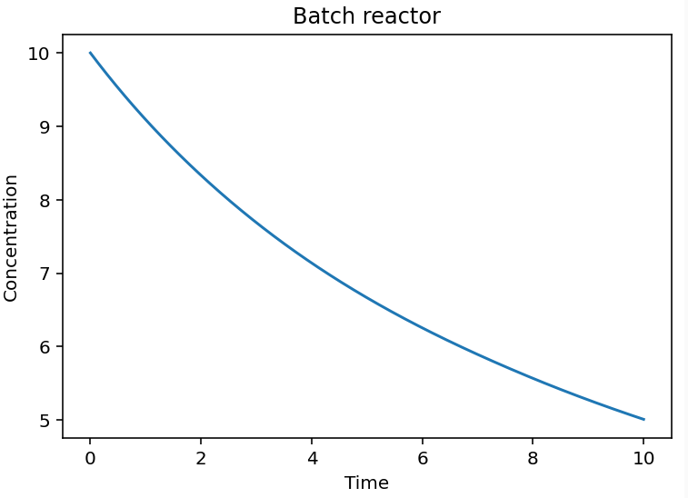
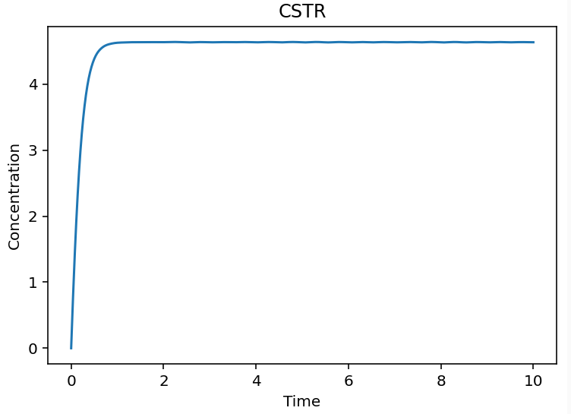





Steady-state versus transient
Transient/dynamic/non-steady-state
The dependent variable changes with time
Batch reactor (first order reaction) $\frac{dC}{dt}=−kC$ CSTR (first order reaction) $\frac{dC}{dt}=\frac{Q}{V}\left(C_{in}−C\right)−kC$

Slide 7
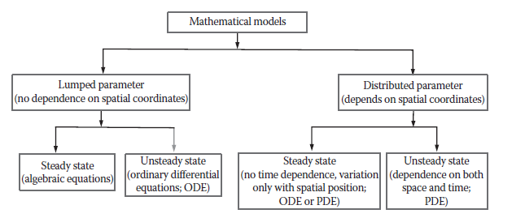
Lumped parameter versus distributed parameter
Does state variable and parameters vary in space? Closely related to PDEs!
Models are often hybrids with some parameters being lumped and some being distributed
Clarifier/settling tank
stagnant
Binay Kanti Dutta. 2020. Mathematical Methods in Chemical and Biological Engineering
Excess sludge
Notes:
Come up with examples. Actually parameter means state variable also? Check some other source for a definition.

Slide 8
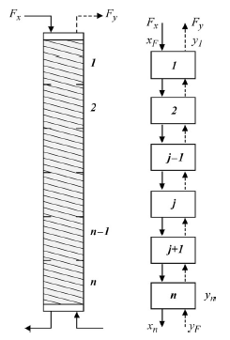
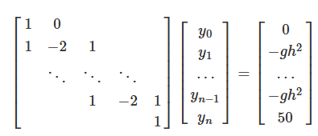

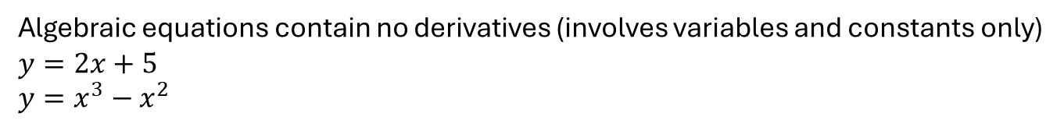
Continuous and discrete models
differential equation: $\frac{dy}{dt}=−kC$
difference equation: $y_{i+1}= y_{i}+∆t ∙ f(t_{i},y_{i})$
Looks familiar?
Algebraic equation
Algebraic equations contain no derivatives (involves variables and constants only)
$y=2x+5$
$y=x^{3}−x^{2}$
The finite difference method converted to system of algebraic equations
An equation or system with both differential and algebraic equations is a ”Differential-algebraic equation/model”

Slide 9
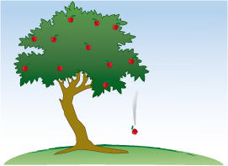
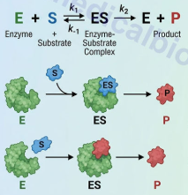
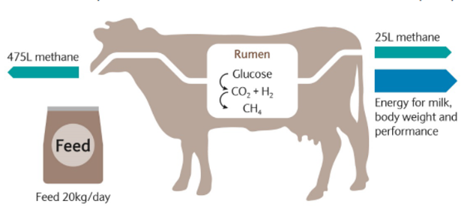
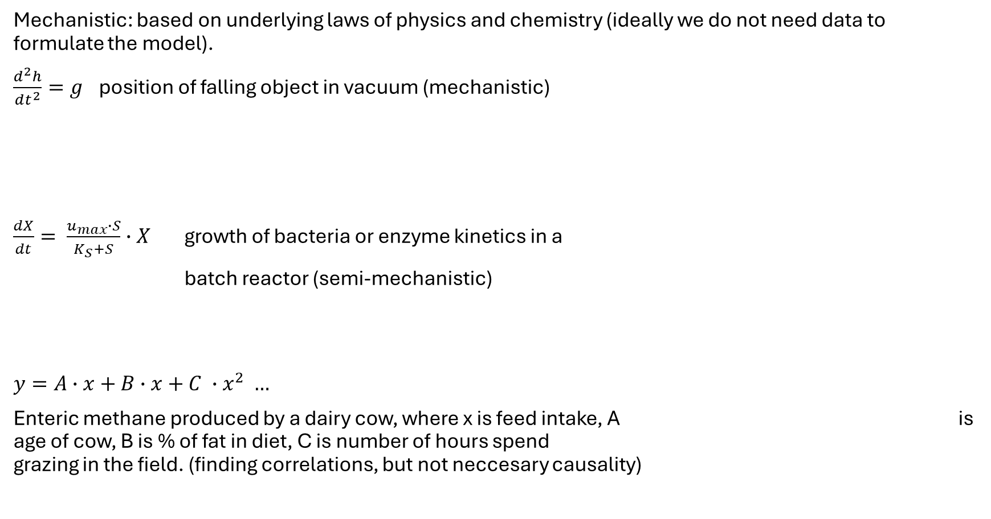
Mechanistic or emperical
Mechanistic: based on underlying laws of physics and chemistry (ideally we do not need data to formulate the model).
$\frac{d^{2}h}{dt^{2}}=g$ position of falling object in vacuum (mechanistic)
$\frac{dX}{dt}= \frac{u_{max}∙S}{K_{S}+S}∙X$ growth of bacteria or enzyme kinetics in a
batch reactor (semi-mechanistic)
$y=A∙x+B∙x+C ∙x^{2} …$
Enteric methane produced by a dairy cow, where x is feed intake, A is age of cow, B is % of fat in diet, C is number of hours spend grazing in the field. (finding correlations, but not neccesary causality)

Slide 10
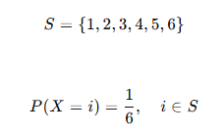

Deterministic or stoichastic
Deterministic models have fixed numbers for parameters (inherently there is no uncertainty)
Example: Income = hourly rate * hours worked
Stoichastic model are somewhat random
Example: Chance of rolling 6
Example2: Chance of heart attack?
Deterministic universe?

Slide 11
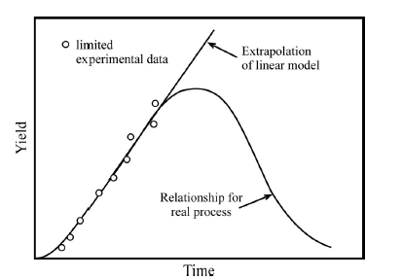

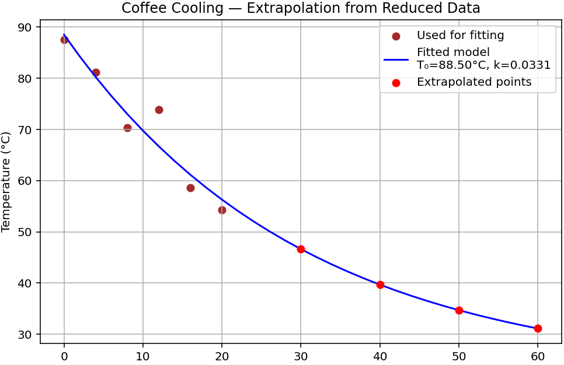
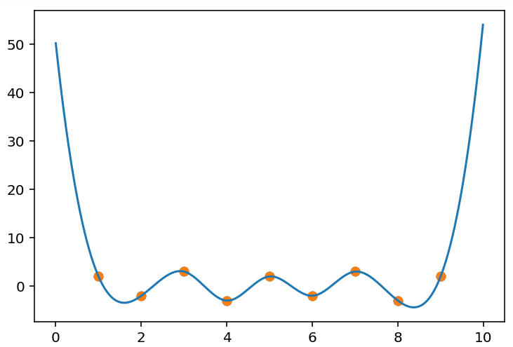
Interpolation/extrapolation
Applying a model within observed data range is interpolation
Applying it outside of the observed data range is risky and is called extrapolation
Depending on the model it is more or less risky to extrapolate
Interpolation
CubicSpline()

Slide 12
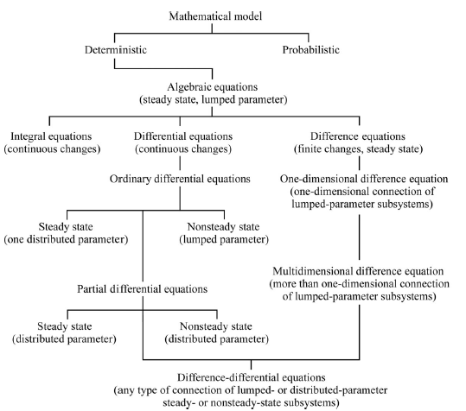
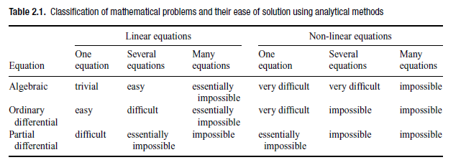

Complexity
Analytical solvable or numerical solutions needed?

Slide 13
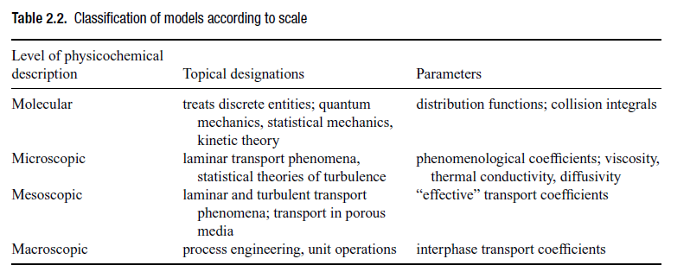
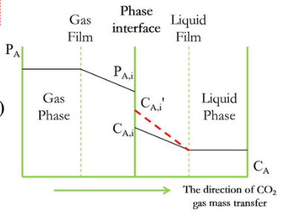


Model scale
Often involves stoichastic models
Detail of internal system
Distributed parameter models
Lumped models
Microscopic approach: descretization, diffusion
Macroscopic approach: average bulk concentrations,
average mass transfer coefficient

Slide 14

Menti quiz:
https://www.menti.com/al4yuib4sox4
3494 9134

