Slide 1
Convergence and stability

Slide 2
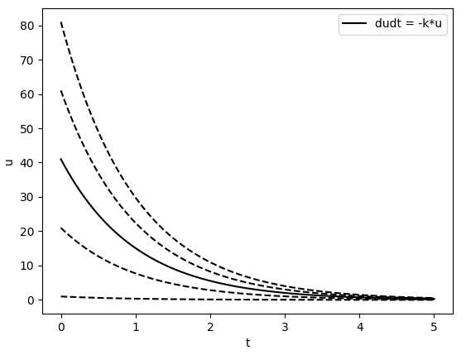
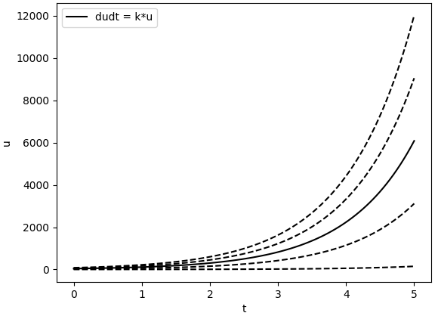




Stability of the ODE/ODE system
A solution is stable if every solution, which starts sufficiently close to the solution remains close to the solution for all t > t0
$$u(t)+δu(t)$$
$$u0 + δu0$$
Asymptotically stable
unstable
$$u0$$
$$u(t)$$

Slide 3
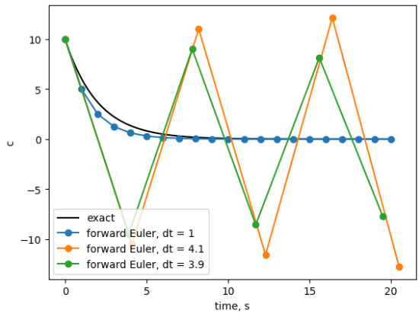
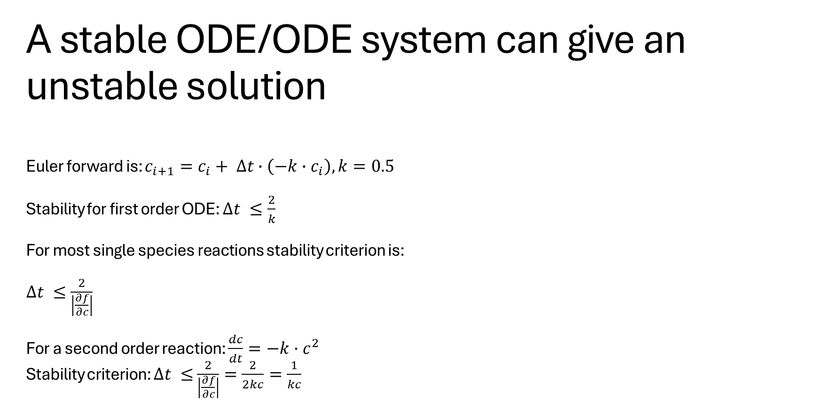

A stable ODE/ODE system can give an unstable solution
Euler forward is: $c_{i+1}=c_{i}+ ∆t∙\left(−k∙c_{i}\right), k=0.5$
Stability for first order ODE: $∆t ≤\frac{2}{k}$
For most single species reactions stability criterion is:
$∆t ≤\frac{2}{\left|\frac{∂f}{∂c}\right|}$
For a second order reaction: $\frac{dc}{dt}=−k·c^{2}$
Stability criterion: $∆t ≤$ $\frac{2}{\left|\frac{∂f}{∂c}\right|}=\frac{2}{2kc}=\frac{1}{kc}$
$\frac{dc}{dt}=−k·c$ is a stable ODE with analytical solution:
$$c=c_{0}e^{−kt}$$
c change with time,
so stability criterion changes with time as well

Slide 4
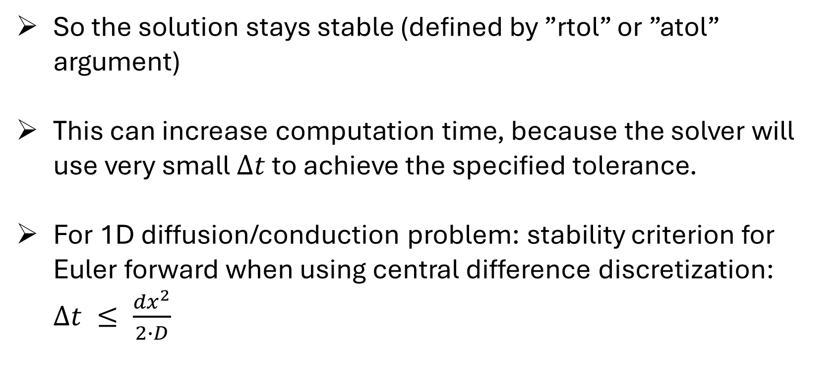
Solver methods in solve_ivp adapts time steps
So the solution stays stable (defined by ”rtol” or ”atol” argument)
This can increase computation time, because the solver will use very small $∆t$ to achieve the specified tolerance.
For 1D diffusion/conduction problem: stability criterion for Euler forward when using central difference discretization: $∆t ≤ \frac{{dx}^{2}}{2∙D}$

Slide 5
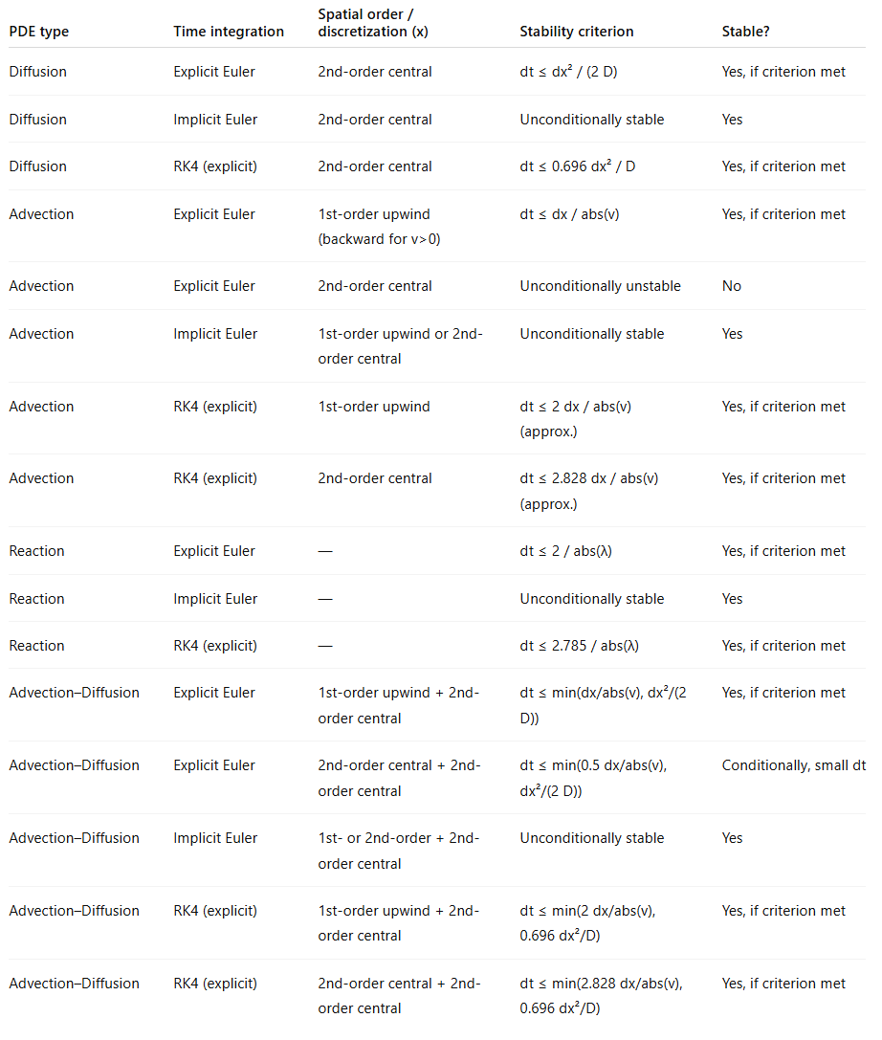
For more advanced problems, stability criteria change – out of scope – but nice to know that criteria depends on both the equation, time integration method, and discretization method! ☺

Slide 6
When we test convergence we need the solution to be stable or with only small error in the time integration
Solve_ivp ensures stable output, but we have to ensure the grid size is appropriate
Smaller dx → more accurate, but higher requirements for solve_ivp to keep stable solution
We are interested in the dx that gives an accurate solution (depends on the tolerance needed), but with minimum solve_ivp simulation time!
We will test different dx’es emperically to find the optimal dx.

Slide 7
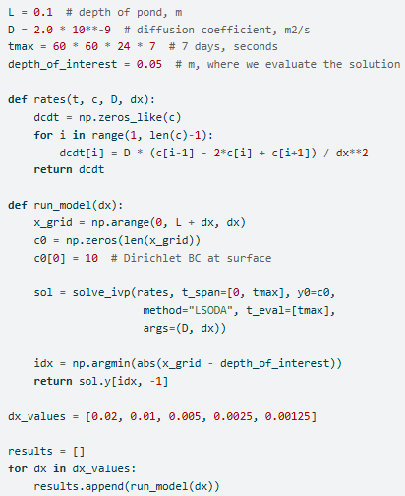
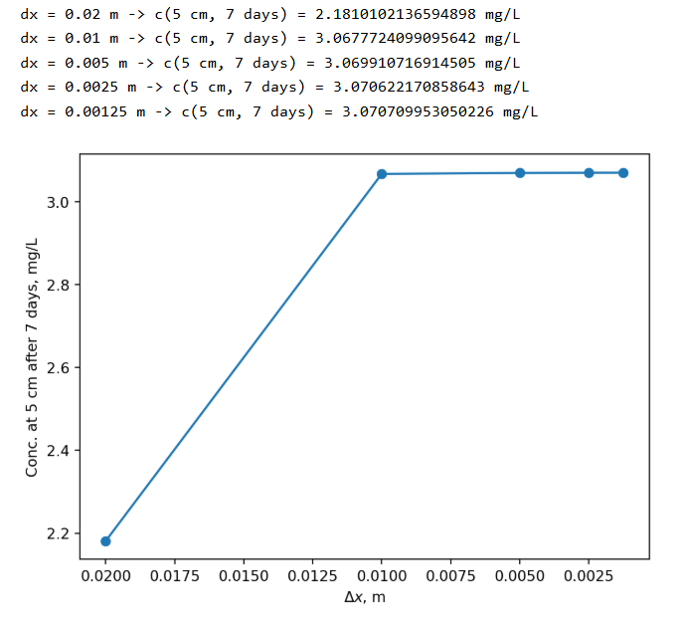
Example in book

