Slide 1
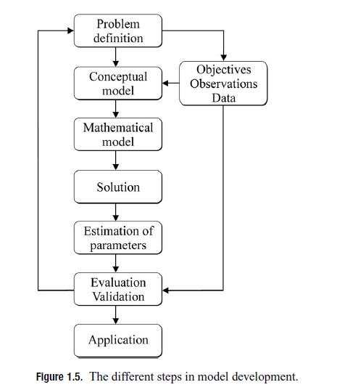
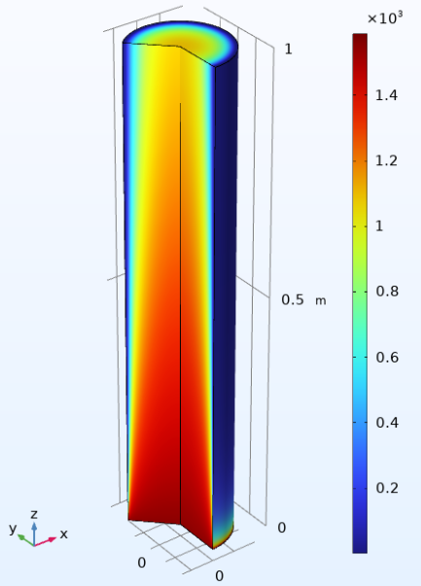
Introduction to modelling Modelling Fall 2026 5 ECTS, 2 x 2 hours a week

Slide 2




Instructors and teachers
Sasha Hafner (Senior researcher, BCE)
Anne Mortensen (Ph.d. student, BCE)
Peter van Nes (Ph.d. student, BCE)
Frederik Dalby (Tenure track assistant professor, BCE)

Slide 3
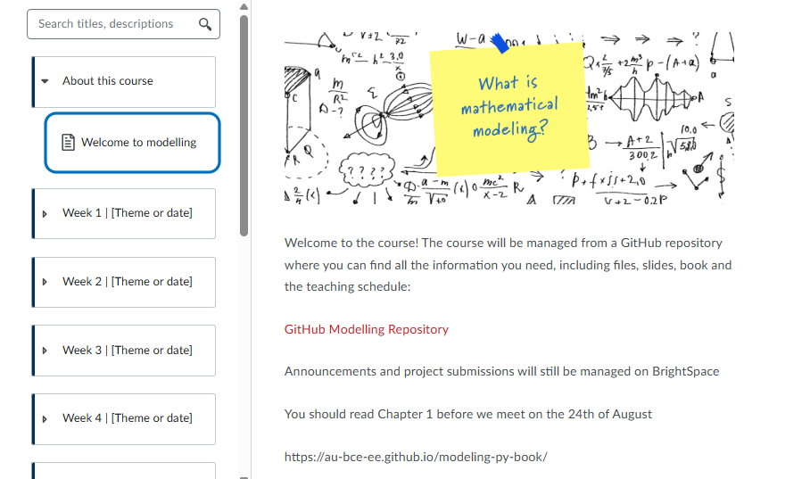
GitHub repository
Repository structure
Book
Learning outcomes
Exam
Link to repository IMPORTANT!

Slide 4
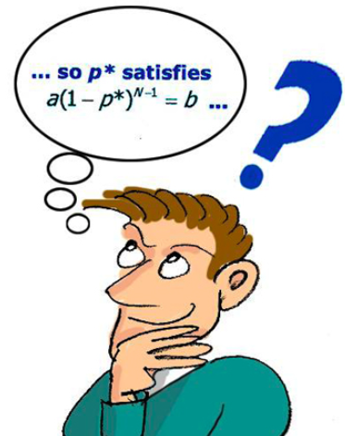
”A mathematical model is an abstract description of a
concrete system using mathematical concepts and language”, wikipedia
What is a mathematical model?
“A mathematical model is a representation of a real-world system using mathematical language and structures such as equations, functions, variables, and parameters”, ChatGPT
“All models are abstractions of real systems and processes. Nevertheless, they serve
as tools for engineers and scientists to develop an understanding of important systems
and processes using mathematical equations” Rasmuson et al. 2014
”All models are wrong but some are useful”

Slide 5
But what is mathematical modelling?

Slide 6








An open fermentor, which operates in batch mode and contains a solution of water with two reactants that react to produce some product. The reactor is cooled on the outside and mixed with a stirrer

Slide 7







How much heat should be removed from the system to maintain a temperature of 20 ℃?
How long time does it take to convert 90% of reactant A?
Will the reactor dry out due to water evaporation?
At what speed should the mixer spin to prevent particles from settling?
Etc…
Is the reaction exothermic? → propably, since it is a fermentation reaction, which is normally exothermic
Is heat production constant? → No because it is a batch system
Does the question make sense then? → No. So we need more accurate problem statement
Problem definition: What should the cooling flowrate be through the cooling jacket over time and until 90% of reactant A is converted from the system to maintain a constant temperature of 20 ℃?

Slide 8



What do we know about the system?
Do we have data?
Do we need to make assumptions?
Identify physical/chemical principles of relevance?

Slide 9



Independent variable → time
Dependent variable → Many! (but we are interested in ”heat removed” from the system (which depends on other time dependent variables)
Or are we interested in temperature of the system?
Boundary of system to model?
Mass balance
Energy balance

Slide 10
Basics learned in Numerical Analysis! (hopefully) ☺
Additional solution theory in this course
Implement different BCs
Implement in higher dimensions

Slide 11


Rate constants: k * A * B
Heat transfer coefficients: Q = h * A * (T2-T1)
Size of tank, cooling fluid flow rate,
Surface area of cooling jacket etc.

Slide 12
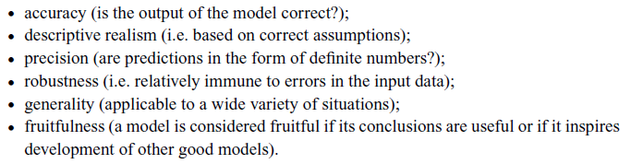

Reformulate model in iterative approach

Slide 13
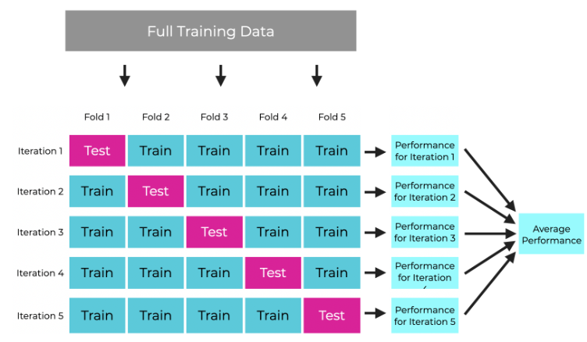
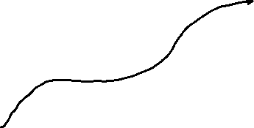

How can we quantify accuracy with metrics?
Mean squared error (MSE)
Root mean squared error (RMSE)
Mean absolute error (MAE)
R-squared or adjusted R-squared (R^2)
How can we quantify generality?
Leave-out part of data approach (cross validation)

Slide 14

Use the model for your application in order to
Save money
Reduce ressources
Increase knowledge
Improve your system efficiency
Return to model scheme if the system is changed
Notes:
Idea from Sasha: Show example of a model from wastewater for example?

Slide 15

Waste water model application (example)
Compressed air
Influent waste water
Clarifier/settling tank
Activated sludge (microbes that consume organic matter)
mixed
stagnant
Recycling sludge stream
Excess sludge
Use to control recycling stream and compressed air flow
(saves money for energy and ensures clean stream out of clarifier)

