Slide 1
Code and Generativity

Slide 2
Generativity
- Rules
- Repetition, but with variation
- Emergence
Example: https://rawgit.com/RaggedyAnn/OldMinis/master/5th%20weekly%20mini%20exercise/treeGenerator/index.html

Slide 3
Winnie’s code
https://auap.github.io/AP2017/class07/sketch07/index.html

Slide 4
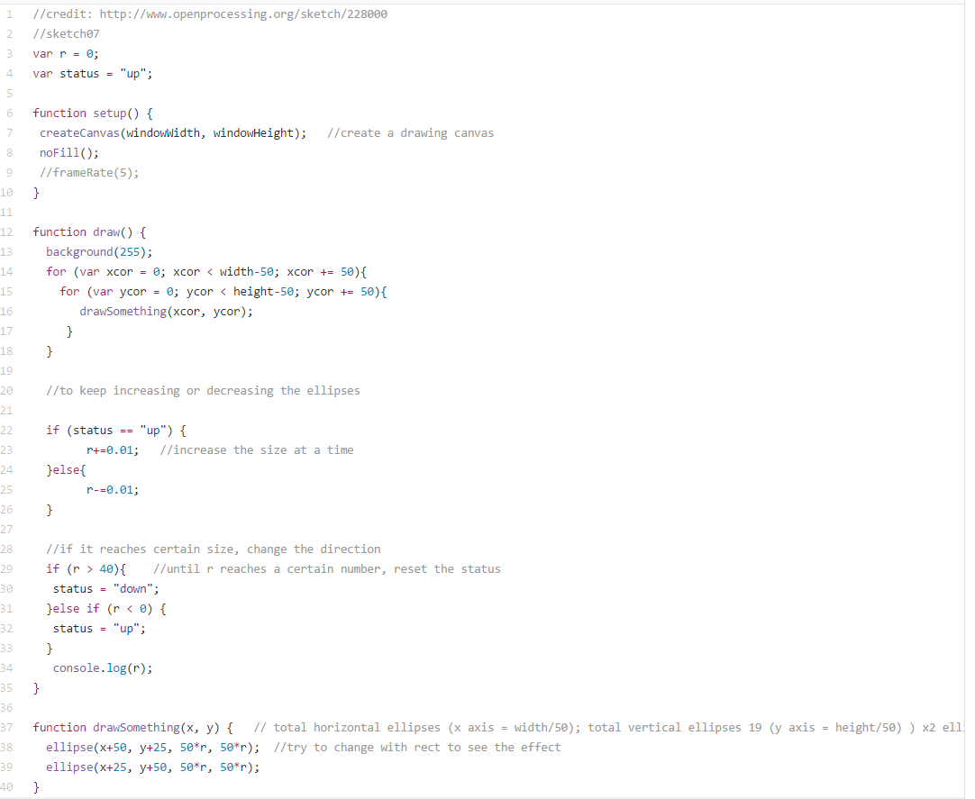

Slide 6
Sæt jer i Studiegrupper!
Kig på hinandens sidste miniExes
Præsentér, stil spørgsmål og giv feedback til hinanden
Tag noter!
45 minutter

Slide 7
3, 2, 1 –CODE!
Mini ex:
Generative program with at least 3 basic rules.
README:
Give a title to your piece and describe your program with a screenshot.
What are the rules that you have employed in your program?
What constitutes generativity?
What is the aesthetics of generativity?

