Slide 1
DIGITAL GAMES TO SOLVE LOGICAL AND MATHEMATICAL PROBLEM
MATH'S THAT CHANGE THE WORLD!! SIMPLE LIVING, HIGH THINKING!!

Slide 2

ABOUT OUR TOY IDEA
OVERVIEW OF IDEA
This app (game) is comprises of several sub-games which contain the concept of programming, logic building and the integration of maths which will allow the young youth to have advance perspective of the tech computation that is necessity in latest education policy.
YOUR APPROACH TOWARDS IDEA DEVELOPMENT
After observing the new out-growing world in tech sector we have developed the vision of making the young youth of india understand the fundamental of technologies in a fun way so that new and potential brains will develop the concept in their early stage of life.
2. TIME COMPLEXITY EVALUATION
Lets have example fo two girl fo radheeka and anisha and give them a task to find the total sum whole 10 numbers starting from 1 to 10. Radheeka started counting the addition from 1 took almost a minute to answer which is “55”. In the other hand anisha smartly know a formula in AP that is n*(n+1)/2 and found the value in just 10 seconds. Here we can say the time complexity of anisha is much faster i.E, 10 sec than the radheeka’s time complexity i.E, 1 min. In programming same logic is applied the only difference is the above paragraph is a real life example which is designed in our app.
THEME OF OUR APP WITH EXAMPLES
In general programming languages there are concepts like flow of control, time complexities and it is quite difficult to fit that in to a child’s mind but with the help of an interactive and fun-designed game that can be done easily user friendly and our app is focus on that policy.
For more specificity we have included examples.
LOGIC GATE INTERACTIVE GAME
Logic gates are the fundamental of computing in technologies.Suppose there are three boys a, b and c. C wants to go to theatre but his father told him that he will allow him only if at-least any one of his friend (A and B) will go with him. Now the occurrence of C going to theatre will happen if either A or B will go with C. For example if A decided to go then it doesn’t matter the decision of B, C will go anyway.Or gate works exactly if we consider the children as wire and their decision of going as “on” and not going as “off”.Our app have same concept comprising of interactive puzzles.

Slide 3
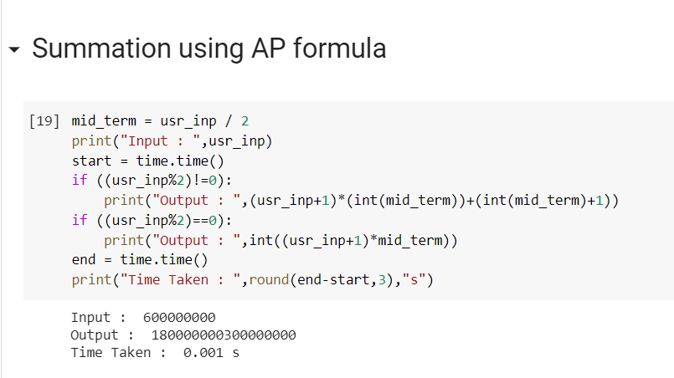
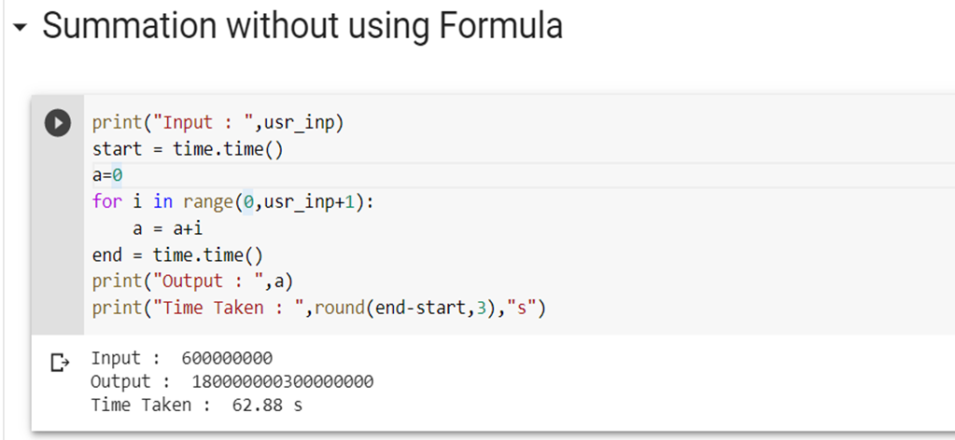
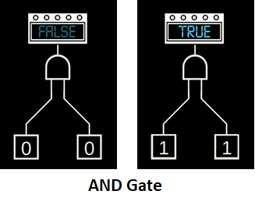
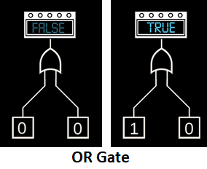
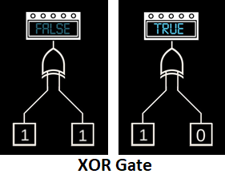
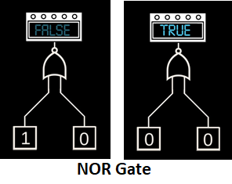
BIG CONCEPT
In the final product the UI will look much more user friendly and this is only the over view

Slide 4
Team Profile
Team Members
Tushar : Email – tushar@s.amity.edu
Phone - +917004659787
Priyanshu Patel : Email - priyanshu.patel@s.amity.edu
Phone - +919644558877
Roshan Bishi : Email - roshan.bishi@s.amity.edu
Phone - +916372813901
Aniket Sharma : Email - aniket.sharma3@s.amity.edu
Phone - +916204388476

