Slide 1
Introduction to Descriptive Statistics in R
Johanne Brandhøj Würtz
Digital Information Specialist at the Royal Danish Library - AUL
BSS Datalab
BSS

Slide 2

Agenda
Purpose and Competencies
Introduction to Rstudio
Introduction to R
Download data on general elections in Denmark
Data preparation in R
Data analysis and visualization

Slide 3

Purpose and skills
Apply the programming language R for statistical calculations and data visualization.
Familiarity with the programming application RStudio.

Slide 4
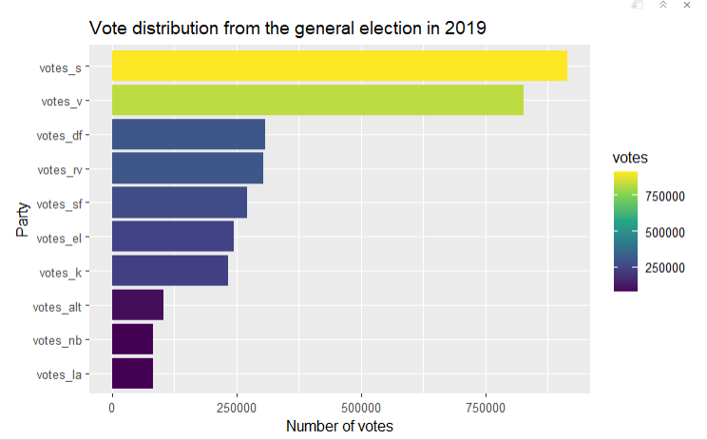
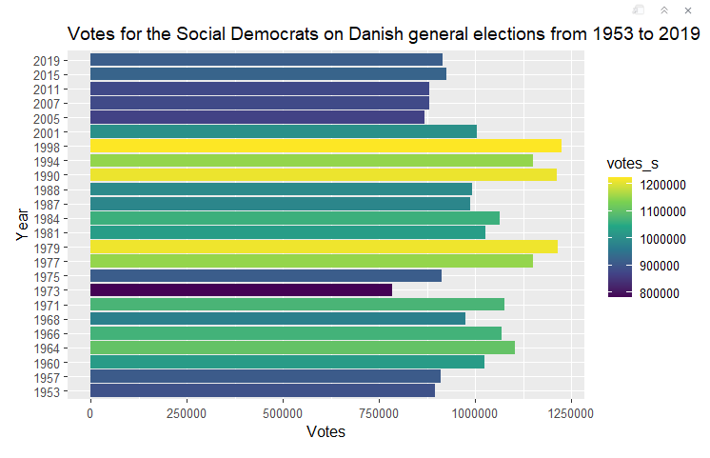
Outputs from the workshop

Slide 5
Introduction to R and Rstudio
Install R
Download the latest version of R to your computer. Remember to choose a version that is compatible with your computer's operating system. R is the 'language' we will use for programming.
R can be downloaded here: https://posit.co/download/rstudio-desktop/
Install RStudio
Download the latest version of RStudio to your computer. Remember to choose a version that is compatible with your computer's operating system. RStudio is the application in which we write our code. It is RStudio that we open when we need to program.
RStudio can be downloaded here: https://posit.co/download/rstudio-desktop/

Slide 6



Coding basics in R
R is basically just a calculator
You can use R to do basic math calculations (and use more advanced functions)
A function is a collection of tasks we want R to do in order to get a specific result.
Instead of clicking on different buttons we must write out these commandos
We have access to simple functions in base R, but we will often install packages to get access to more advanced functions
When writing code in R, we follow a fixed syntax or structure
We first specify the name of the function and then we specify the arguments:
You can create new objects with the assignment operator:
Object names must start with a letter and can only contain letters, numbers, _ and .
We write our code in scripts so we can save, access, edit and run them later
You can write comments. R will ignore any text after # for that line
There are different types of data in R (e.g. logical, numeric, integer, character, factor)
These can be stored in a vector, list, matrix or dataframe

Slide 7

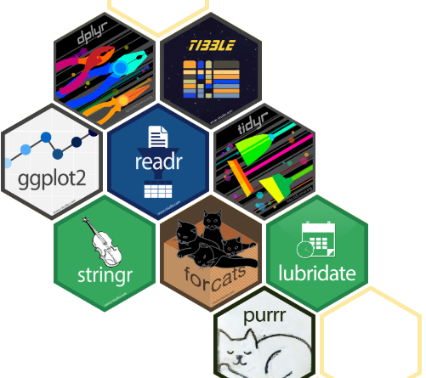
Packages in R
R is an open source programming language
We must install a package to get access to the functions inside it
We only have to install the package once, but we must load the package into the script every time we want to use it
Packages
Like Sims – the expansion packs adds functionality to the base game
Packages contains extra functions
Ode to the nerds (Open source)
Not one way to the goal but plenty

Slide 8
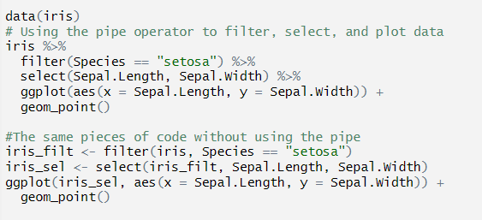
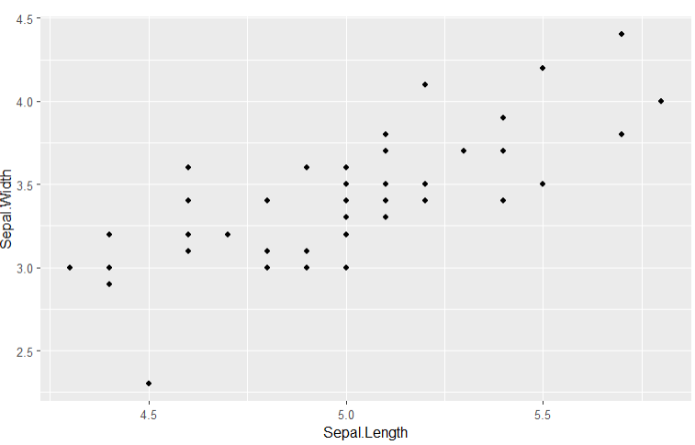
Why use pipes
In the:
First do:
Then do:
Then do:
dataset %>%
a %>%
b %>%
c
The pipe operator is used to pass the output of one function as the input to another function
It is used to chain multiple functions together in a readable way
It is used to avoid nested functions and make code more readable
It is used to avoid intermediate variables and make code more readable
=

Slide 9
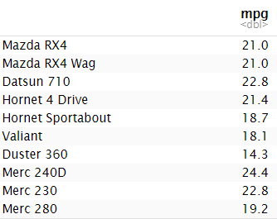

Other ‘fun’ elements when coding in R
$ vs. [ ] vs. [[ ]]
The $ operator is used to extract a single column from a data frame as a vector.
The [ ] operator is used to extract a single column from a data frame as a data frame.
The [[ ]] operator is used to extract a single column from a data frame as a vector, but it can also be used to extract a single element from a list.
= vs. ←
In R, the ← operator is used for assignment, while the = operator is used for both assignment and argument specification in functions.
Best practice is to use ← for assignment and = for argument specification in functions.

Slide 10

Link to Github
https://github.com/AUL-BSS-Datalab/StatisticsIntroR.git

