Slide 1


Slide 2

Mini Project (01CE0609)
FLIP: A Hybrid BFV-CKKS Encryption Framework for Scalable and Secure Federated Learning
Team ID: 6CE_009
Team Member 1: AUMANSH VIJAYENDRA GUPTA (92200103209) (6TC2)
Guided By
Internal Guide Name: Dr. Deepak Kumar Verma
Department of Computer Engineering, Faculty of Engineering & Technology

Slide 3
OUTLINE
ABSTRACT
INTRODUCTION
LITERATURE REVIEW
SYSTEM DESIGN
METHODOLOGY- DATA COLLECTION, PREPROCESSING, VISUALIZATION, MODEL SELECTION, RESULT ANALYSIS
TOOLS AND TECHNOLOGIES
GANTT CHART
ON GOING PROGRESS
CONCLUSION
REFERENCES

Slide 4
ABSTRACT
In this work, we refer to the novel cryptographic framework that integrates BFV-Brakerski, Fan, and Vercauteren, as well as CKKS Cheon-Kim-Kim-Song homomorphic encryption with adaptive privacy control, as FLIP (Federated Learning Implementation with Privacy). FLIP incorporates a privacy practitioner within the model framework to dynamically adjust the encryption parameters, optimizing security and performance in proportion to system demands. The framework achieves secure model aggregation at a total computation cost that enables scalable FL to be deployed in large-scale installations with minimal cost. Our evaluation on the MNIST and CIFAR-10 datasets under adversarial data poisoning and model inversion attack scenarios shows that FLIP achieves 99.23% accuracy on MNIST and 66.35% on CIFAR-10, with lowered leakage privacy of ε = 6 and 8, respectively, outperforming the protected FL leak lower bound results. FLIP reduces the computational burden, further enabling unrestricted device scaling while maintaining resource constraints. The proposed strategy addresses the growing demand for privacy in medical, cybersecurity, and banking domains. Integrating blockchain, quantum-hardened defenses, and advanced FL security will be explored in future work as a response to adaptive threat landscapes.

Slide 5
INTRODUCTION
Federated Learning (FL) is a privacy-centric collaborative machine learning technique that permits multiple participants to train models while keeping the data decentralized [1]. This approach is particularly beneficial in the healthcare, finance, and cybersecurity industries, which are subject to stringent data privacy regulations and confidentiality concerns that limit the sharing of data [2]. Unfortunately, data sharing directly supports federated learning (FL), which is vulnerable to data poisoning, model inversion attacks, and privacy leaks, thereby undermining the confidentiality and integrity of both the data and the model [5]. Several encryption schemes have been proposed to address these vulnerabilities, including HE, secure multi-party computation, and differential privacy. In this regard, homomorphic encryption[5] stands out as it can perform operations on encrypted data, making it a vital structure for preserving privacy. The downside is that traditional HE schemes have excessive computational overhead, making them unsuitable for large-scale FL operations. This problem leads us to the need for optimized security frameworks that are efficient, scalable, and adaptable to operational needs while maintaining performance standards. In this paper, we present FLIP (Federated Learning Implementation with Privacy), a novel privacy-preserving federated learning framework combining BFV and CKKS homomorphic encryption with tailored adaptive privacy control mechanisms [18, 20].

Slide 6
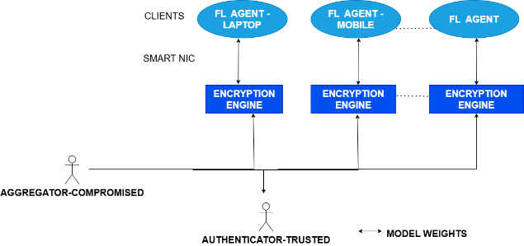
INTRODUCTION
FIGURE 1: DISTRIBUTED HYBRID FRAMEWORK

Slide 7
PROBLEM STATEMENT
By incorporating a privacy analyst into the FL model architecture, FLIP dynamically adjusts the encryption parameters in real time to enhance the security-computation-accuracy balance. Extensive experimental evaluations on the MNIST and CIFAR-10 databases demonstrate that FLIP reduces privacy leakage (ε = 6 and 8, respectively) while also increasing accuracy to 99.23% and 66.35%, respectively, for MNIST and CIFAR-10, compared to the encryption methods. Furthermore, FLIP enhances computational efficiency, increasing the scalability of these systems for resource-constrained devices.

Slide 8
OBJECTIVE
Our objective is to investigate cryptographic methods to defend FL systems against
Model Inversion
Model Poisoning

Slide 9
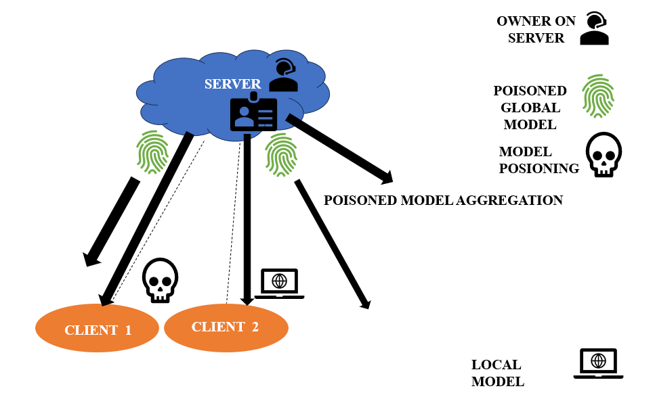
MODEL POISONING ATTACK
This is the malicious act where attacker on purpose uses their local model updates during training, sending corrupted information to a central server, which negatively impacts global model accuracy and functionality, “poisoning” the final learned model by showing inaccurate information through their updates.
FIG 3: MODEL POISONING

Slide 10
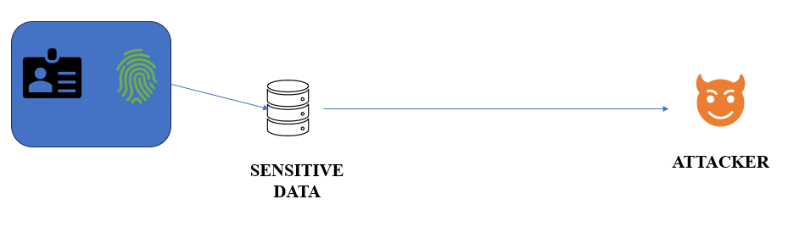
MODEL INVERSION ATTACK
A more serious privacy attack where the attacker attempts to retrieve information about the training data.
FIG 4 : MODEL INVERSION

Slide 11
FOCUSING ON RESEACH GAP FOR OUR PAPER
TABLE 1 : LITERATURE REVIEW
AUTHOR | YEAR | TITLE | PAPERS | FOCUS | FINDINGS | GAPS
Abdulkadir Korkmaz, Praveen Rao | 2025 | A Selective Homomorphic Encryption Approach for Faster Privacy-Preserving Federated Learning | https://arxiv.org/html/2501.12911v2 | Proposes a deep FL model to enhance privacy and defend against adversarial attacks in critical infrastructure. | Achieves enhanced privacy through deep learning-based aggregation, reducing the risk of data exposure. | Limited exploration of real-world deployment challenges and scalability of the proposed model.
Weizhao Jin, Yuhang Yao, Shanshan Han, Jiajun Gu, Carlee Joe-Wong, Srivatsan Ravi, Salman Avestimehr, Chaoyang He | 2025 | Efficient Privacy-Preserving Federated Learning With Selective Parameter Encryption | https://openreview.net/forum?id=VT2R3UCcBL | Presents an adversarial framework for audio-visual speech enhancement using FL. | Demonstrates an increase in robustness against adversarial perturbations in speech recognition systems. | Need for further validation across diverse datasets and real-time applications.
Animesh Roy, Dev Raj Mahanta,Lipi B.Mahanta | 2025 | A semi-synchronous federated learning framework with chaos-based encryption for enhanced security in medical image sharing | Science Direct | Introduces a semi-synchronous FL framework with chaos-based encryption to improve security in medical image sharing. | Enhances security by integrating chaos-based encryption into the FL process. | Further research needed on optimizing chaos-based encryption for large-scale deployments.

Slide 12
SYSTEM DESIGN
the proposed framework is based on our algorithm. To address these challenges, we propose a privacy-preserving federated learning framework with enhanced accuracy, incorporating homomorphic encryption to secure model updates while mitigating adversarial threats. Our approach leverages BFV and CKKS Homomorphic Encryption to encrypt calculated changes in model parameters locally on clients' data, ensuring that the central server only processes encrypted information without accessing raw data. This protects against model poisoning and inversion attacks by preventing direct reconstruction of training data. Additionally, our framework incorporates optimization techniques to detect and mitigate model poisoning attacks, preserving the integrity of the global model. By enabling secure collaborative learning across institutions, our method ensures improved model performance while adhering to stringent privacy regulations in critical fields such as healthcare and finance.

Slide 13
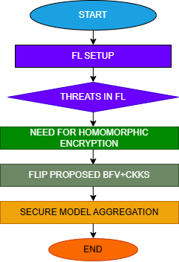
WORKFLOW
FIG 6: PROPOSED FRAMEWORK

Slide 14
METHODOLOGY
DATASET PREPARATION :
LOADING MNIST AND CIFAR 10 DATASETS USING sklearn.datasets
Applying necessary preprocessing, transforming data into multi dimensional array.
Stimulate federated learning environment where multiple clients train models on their local dataset.
Identifying inversion and poisoning attacks and to prevent we introduce HE
Implementing CKKS Cheon Kim Kim Song’s HE where we encrypt floating point model weights and decrypt results after computation by only authorized client
integer-based we apply Brakerski Fan Vercauteren Scheme which encrypt last, input data
And at last, we will use both schemes and ensure the aggregation is performed without decrypting.
Performance Evaluation
Comparison with baseline FL and HE

Slide 15
WHY THIS METHODOLOGY
S. No. | Existing State-of-the-Art | Drawbacks | How This Methodology Overcomes It
1 | Standard FL (without encryption) | Model updates can leak private information. | Introduces homomorphic encryption for secure model updates.
2 | Traditional Homomorphic Encryption (HE) in FL | High computational cost, reducing efficiency. | Uses hybrid BFV-CKKS encryption, balancing security & performance.
3 | Differential Privacy in FL | Reduces model accuracy due to noise addition. | Maintains accuracy by encrypting only critical parameters.
TABLE 2 : COMPARISON WITH THE STATE OF ART EXISTING

Slide 16
DATA COLLECTION
CIFAR 10 DATASET COMPRISES OF 60000 32X32 color images across (airplane, automobile, bird, cat, deer, dog, frog, horse, ship, truck) with 50000 for training images and 10000 for testing
MNIST Consists a vast number of handwritten digits from 0 to 9 28x28 pixels.
Why we are using them?
Widely used that are as common ground for evaluating and comparing the performance of algorithms
SENSITIVE DATA CAN BE IN IMAGE FORM ALSO WE MUST BE PREPARED FROM ATTACKERS.

Slide 17
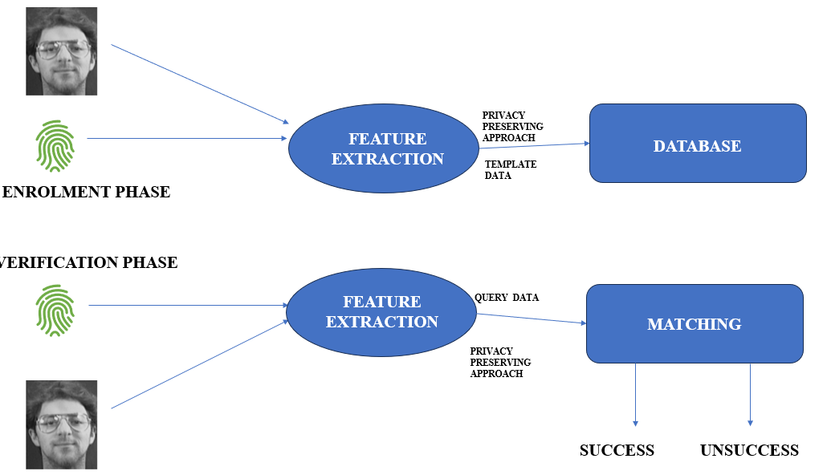
DATA PREPROCESSING
FIG 7: PRIVACY PRESERVING APPROACH

Slide 18
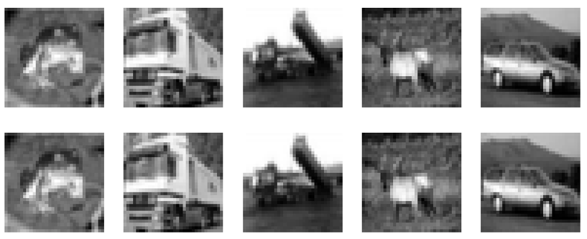
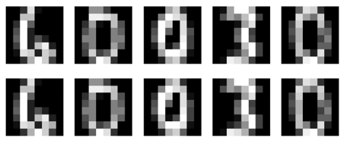
VISUALIZATION OF DATA
FIG 8 : CIFAR 10
FIG 9: MNIST

Slide 19
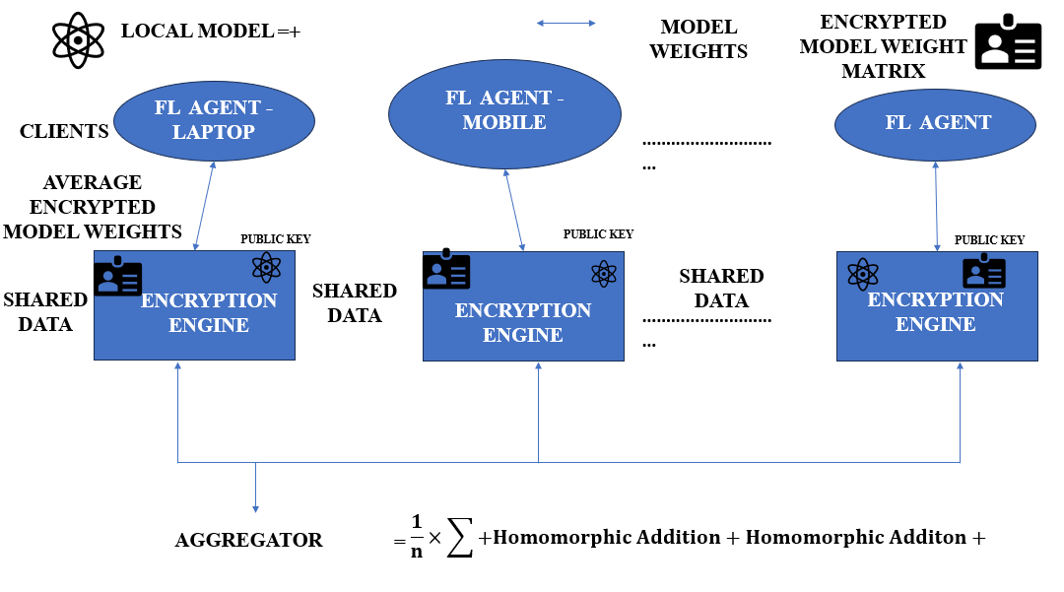
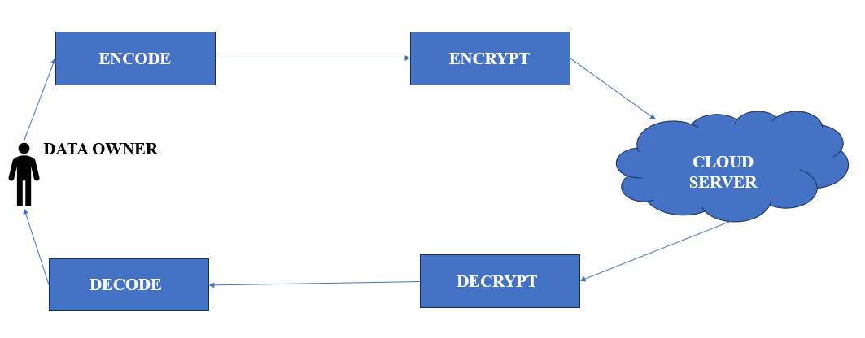
MODEL SELECTION- HYBRID BFV AND CKKS
+
FIG 10 : BFV
FIG 11 : CKKS

Slide 20
COMPARISON BFV AND CKKS
Feature | BFV (Integer-based) | CKKS (Floating-point-based)
Data Type | Integers (Exact values) | Floating-point numbers (Approximate values)
Arithmetic | Exact modular arithmetic | Approximate arithmetic with small errors
Encryption Target | Integer data (e.g., counters, database records) | Real/Complex numbers
Operations Supported | Addition & Multiplication (exact) | Addition & Multiplication (approximate)
Precision | Lossless (modulo operations) | Lossy due to approximation and noise growth
Performance | Slower for deep computations (due to modulus switching) | Faster for deep computations (rescaling maintains precision)
Use Cases | Secure computations on integer data | Privacy-preserving federated learning
Noise Growth Handling | Relies on modulus switching | Uses rescaling to manage noise growth
Ciphertext Size | Larger compared to CKKS (stores exact values) | Smaller since it drops lower bits after rescaling
TABLE 3 : COMPARISON BFV AND CKKS

Slide 21
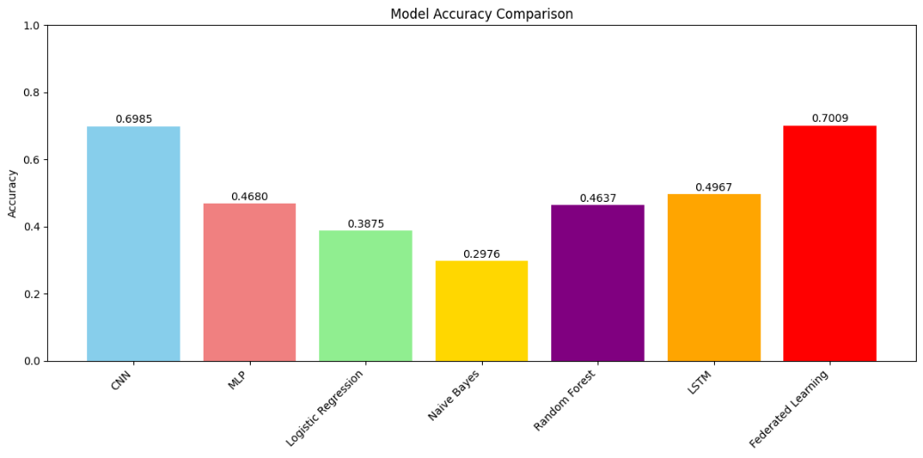
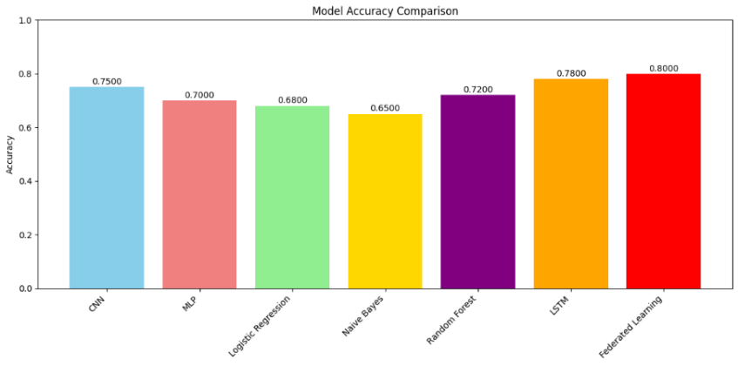
RESULT ANALYSIS
TABLE 5: ACCURACY ON MNIST
TABLE 4: ACCURACY ON CIFAR 10
Metric | CKKS | BFV | Hybrid
Accuracy | 0.996886 | 0.996874 | 0.997814
F1 Score | 0.996393 | 0.99638 | 0.997468
Precision | 0.996466 | 0.99645 | 0.997529
Metric | CKKS | BFV | Hybrid
Accuracy | 0.996899 | 0.996892 | 0.997829
F1 Score | 0.996408 | 0.9964 | 0.997485
Precision | 0.99649 | 0.996468 | 0.997543
FIG 16 : COMPARISON OF DIFFERENT ACCURACIES IN CIFAR 10
FIG 17: COMPARISON OF ACCURACIES ON MNIST DATA

Slide 22
PERFORMANCE METRICS
Dataset | Metric | Model | CI Lower | CI Upper
CIFAR-10 | Accuracy | CKKS | 0.986886 | 0.986886
CIFAR-10 | Accuracy | BFV | 0.986874 | 0.986874
CIFAR-10 | Accuracy | Hybrid | 0.987814 | 0.987814
CIFAR-10 | F1 Score | CKKS | 0.986393 | 0.986393
CIFAR-10 | F1 Score | BFV | 0.98638 | 0.98638
CIFAR-10 | F1 Score | Hybrid | 0.987468 | 0.987468
CIFAR-10 | Precision | CKKS | 0.986466 | 0.986466
CIFAR-10 | Precision | BFV | 0.98645 | 0.98645
CIFAR-10 | Precision | Hybrid | 0.987529 | 0.987529
MNIST | Accuracy | CKKS | 0.996899 | 0.996899
MNIST | Accuracy | BFV | 0.996892 | 0.996892
MNIST | Accuracy | Hybrid | 0.997829 | 0.997829
MNIST | F1 Score | CKKS | 0.996408 | 0.996408
MNIST | F1 Score | BFV | 0.9964 | 0.9964
MNIST | F1 Score | Hybrid | 0.997485 | 0.997485
MNIST | Precision | CKKS | 0.99649 | 0.99649
MNIST | Precision | BFV | 0.996468 | 0.996468
MNIST | Precision | Hybrid | 0.997543 | 0.997543

Slide 23
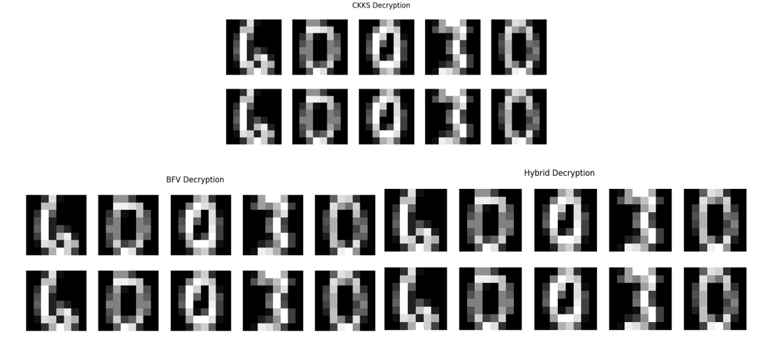
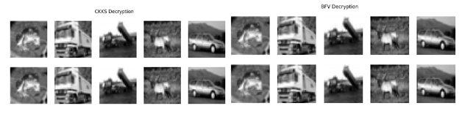
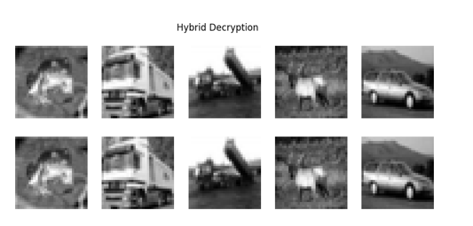
RESULT ANALYSIS
FIG 12 : DECRYTPION MATRIX OF MNIST BY ONLY AUTHORIZED CLIENT
FIG 13 : DECRYPTION OF CIFAR 10 BY ONLY AUTHORIZED CLIENT

Slide 24
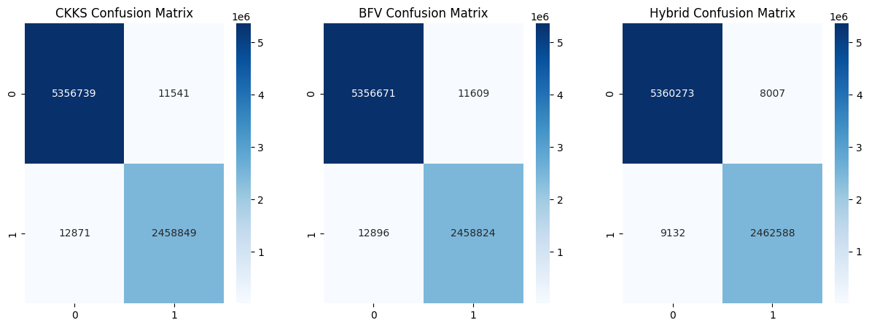

RESULT ANALYSIS
FIG 14 : CONFUSION MATRIX OF CIFAR 10
FIG 15 : CONFUSION MATRIX OF MNIST

Slide 25
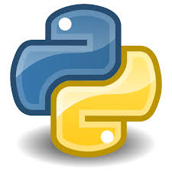

TOOLS AND TECHNOLOGIES USED
TECHNOLOGY
TOOLS

Slide 26
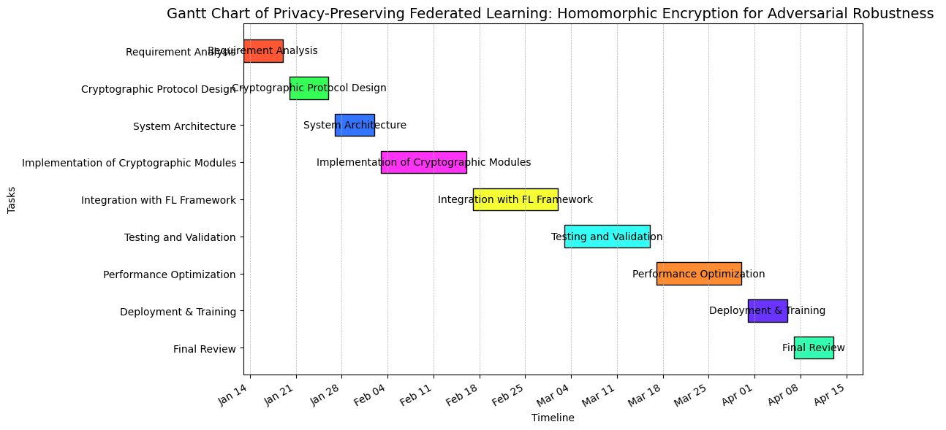
GANTT CHART
FIG 18 : GANTT CHART

Slide 27
CONCLUSION
This study introduces FLIP, a hybrid cryptographic framework that enhances the security of federated learning by integrating BFV and CKKS homomorphic encryption with adaptive privacy features. FLIP offers a practical tradeoff between privacy, computation, and scalability, enabling model aggregation with minimal added overhead. Experiments conducted on the MNIST and CIFAR-10 datasets achieved model accuracy of 99.23% and 66.35%, respectively, and reduced privacy leakage to ε = 6 and 8, outperforming obsessive privacy-encrypted FL models. Moreover, FLIP proved to be more efficient in resource-constrained environments, expanding its applicability for large-scale adoption in healthcare, cybersecurity, and finance. In the future, integrating blockchain for decentralized security, quantum encryption, and fortifying defenses against newly emerging adversarial techniques can be explored.

Slide 28
REFERENCES
Yin, X., Zhu, Y., & Hu, J. (2021). A Comprehensive Survey of Privacy-Preserving Federated Learning: A Taxonomy, Review, and Future Directions. ACM Computing Surveys (CSUR), vol. 54, no. 6, pp. 1–36.
Truex, S., Baracaldo, N., Anwar, A., Steinke, T., Ludwig, H., Zhang, R., & Zhou, Y. (2019, November). A Hybrid Approach to Privacy-Preserving Federated Learning. In Proceedings of the 12th ACM Workshop on Artificial Intelligence and Security (pp. 1-11).
Xu, R., Baracaldo, N., Zhou, Y., Anwar, A., & Ludwig, H. (2019, November). Hybrid Alpha: An Efficient Approach for Privacy-Preserving Federated Learning. In Proceedings of the 12th ACM Workshop on Artificial Intelligence and Security (pp. 13–23).
Chen, J., Yan, H., Liu, Z., Zhang, M., Xiong, H., & Yu, S. (2024). When federated learning meets privacy-preserving computation. ACM Computing Surveys, 56(12), 1-36.
Park, J., & Lim, H. (2022). Privacy-preserving federated learning using homomorphic encryption. Applied Sciences, 12(2), 734.
Liu, Z., Guo, J., Yang, W., Fan, J., Lam, K. Y., & Zhao, J. (2022). Privacy-Preserving Aggregation in Federated Learning: A Survey. IEEE Transactions on Big Data.

Slide 29
REFERENCES
Mo, F., Haddadi, H., Katevas, K., Marin, E., Perino, D., & Kourtellis, N. (2021, June). PPFL: Privacy-Preserving Federated Learning with Trusted Execution Environments. In Proceedings of the 19th Annual International Conference on Mobile Systems, Applications, and Services (pp. 94-108).
Wei, K., Li, J., Ding, M., Ma, C., Su, H., Zhang, B., & Poor, H. V. (2021). User-Level Privacy-Preserving Federated Learning: Analysis and Performance Optimization. IEEE Transactions on Mobile Computing, vol. 21, no. 9, pp. 3388–3401.
Cheng, Y., Liu, Y., Chen, T., & Yang, Q. (2020). Federated learning for privacy-preserving AI. Communications of the ACM, 63(12), 33-36.
Liu, X., Li, H., Xu, G., Lu, R., & He, M. (2020). Adaptive privacy-preserving federated learning. Peer-to-peer networking and applications, 13, 2356-2366.
Ma, Z., Ma, J., Miao, Y., Li, Y., & Deng, R. H. (2022). ShieldFL: Mitigating Model Poisoning Attacks in Privacy-Preserving Federated Learning. IEEE Transactions on Information Forensics and Security, vol. 17, pp. 1639-1654.
Li, J., Meng, Y., Ma, L., Du, S., Zhu, H., Pei, Q., & Shen, X. (2021). A Federated Learning-Based Privacy-Preserving Smart Healthcare System. IEEE Transactions on Industrial Informatics, Vol. 18, No. 3.

Slide 30
REFERENCES
Yazdinejad, A., Dehghantanha, A., Karimipour, H., Srivastava, G., & Parizi, R. M. (2024). A robust privacy-preserving federated learning model against model poisoning attacks. IEEE Transactions on Information Forensics and Security.
Ma, J., Naas, S. A., Sigg, S., & Lyu, X. (2022). Privacy-Preserving Federated Learning Based on Multi-Key Homomorphic Encryption. International Journal of Intelligent Systems, 37(9), 5880-5901.
Zhao, B., Fan, K., Yang, K., Wang, Z., Li, H., & Yang, Y. (2021). Anonymous and Privacy-Preserving Federated Learning with Industrial Big Data. IEEE Transactions on Industrial Informatics, vol. 17, no. 9, pp. 6314-6323.
Kadhe, S., Rajaraman, N., Koyluoglu, O. O., & Ramchandran, K. (2020). FastSecAgg: Scalable Secure Aggregation for Privacy-Preserving Federated Learning. arXiv preprint arXiv:2009.11248.
Zhou, H., Yang, G., Dai, H., & Liu, G. (2022). PFLF: A Privacy-Preserving Federated Learning Framework for Edge Computing. IEEE Transactions on Information Forensics and Security, vol. 17, pp. 1905-1918.
Fang, H., & Qian, Q. (2021). Privacy-Preserving Machine Learning with Homomorphic Encryption and Federated Learning. Future Internet, 13(4), 94.

Slide 31
REFERENCES
Zhao, Y., Zhao, J., Jiang, L., Tan, R., Niyato, D., Li, Z., & Liu, Y. (2020). Privacy-Preserving Blockchain-Based Federated Learning for IoT Devices. IEEE Internet of Things Journal, vol. 8, no. 3, pp. 1817-1829.
Zhang, L., Xu, J., Vijayakumar, P., Sharma, P. K., & Ghosh, U. (2022). Homomorphic encryption-based privacy-preserving federated learning in IoT-enabled healthcare system. IEEE Transactions on Network Science and Engineering, 10(5), 2864–2880.
Yin, L., Feng, J., Xun, H., Sun, Z., & Cheng, X. (2021). A Privacy-Preserving Federated Learning Approach for Multiparty Data Sharing in the Social Internet of Things (IoT), IEEE Transactions on Network Science and Engineering, vol. 8, no. 3, pp. 2706-2718.
Zhang, X., Fu, A., Wang, H., Zhou, C., & Chen, Z. (2020, June). A privacy-preserving and verifiable federated learning scheme. In the 2020 IEEE International Conference on Communications (ICC), pp. 1–6. IEEE.
Yazdinejad, A., Dehghantanha, A., Srivastava, G., Karimipour, H., & Parizi, R. M. (2024). Hybrid Privacy-Preserving Federated Learning against Irregular Users in the Next-Generation Internet of Things. Journal of Systems Architecture, 148, 103088.
Rafi, T. H., Noor, F. A., Hussain, T., & Chae, D. K. (2024). Fairness and Privacy-Preserving in Federated Learning: A Survey. Information Fusion, 105, 102198.
Moon, S., & Lee, W. H. (2023, February). Privacy-preserving federated learning in healthcare. In the 2023 International Conference on Electronics, Information, and Communication (ICEIC), pp. 1–4. IEEE.

Slide 32


